Slide 1
Water Year 2014: Colorado River Basin Conditions Review
CRFS
November 20, 2014

Slide 2
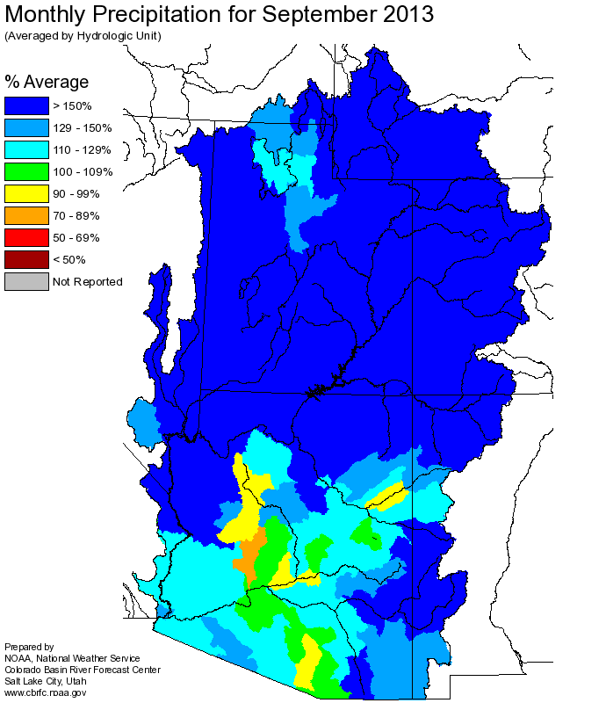
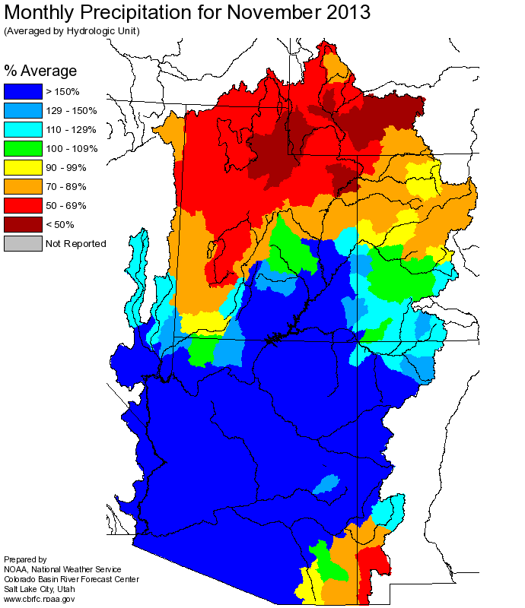
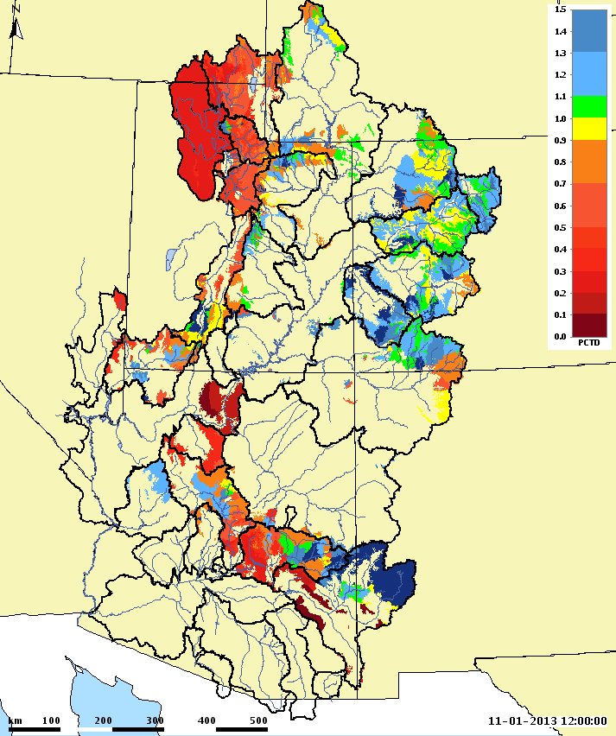
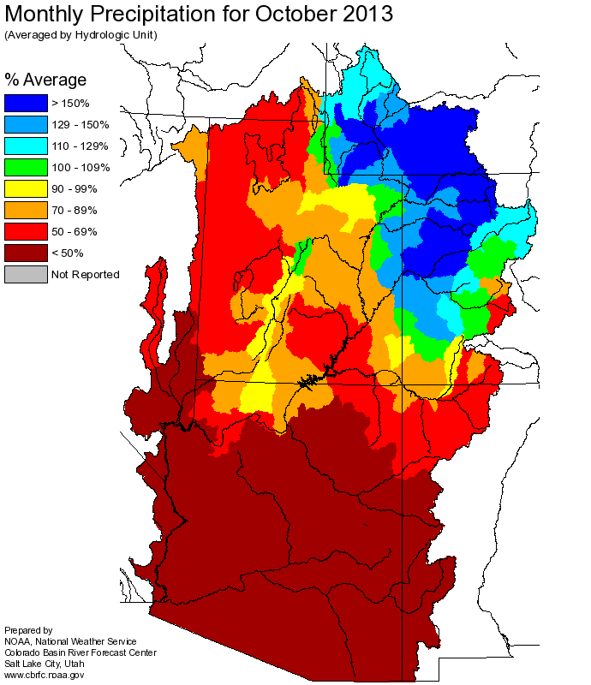
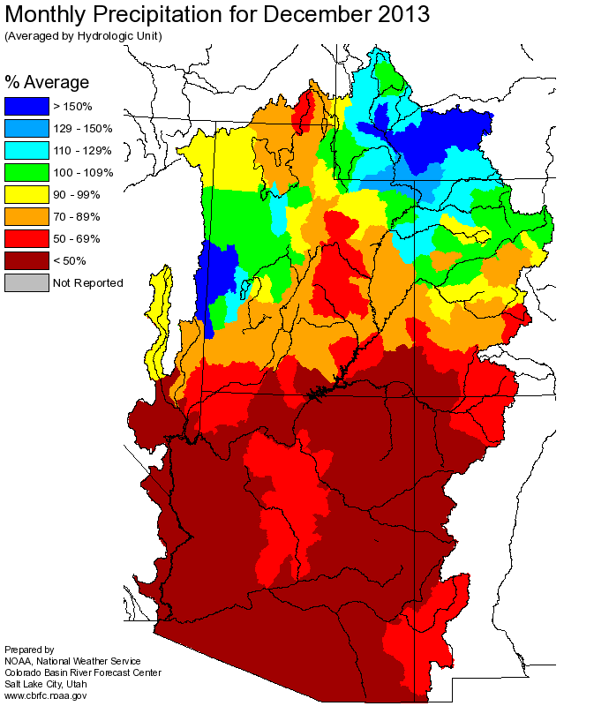
SEP-DEC PRECIPITATION
CBRFC Model Soil Moisture
November 1, 2013

Slide 3
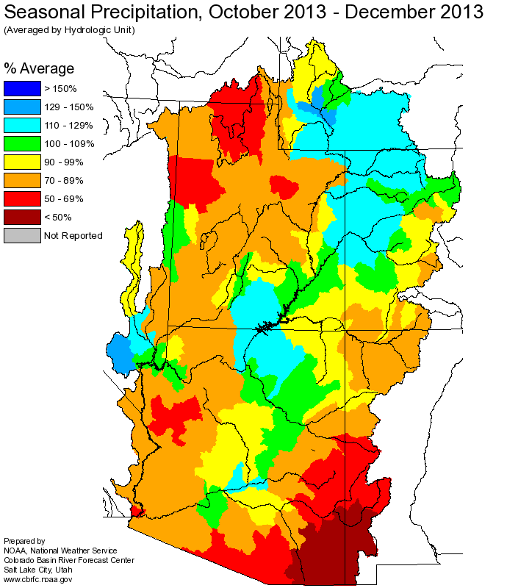
JANUARY 1 CONDITIONS

Slide 4
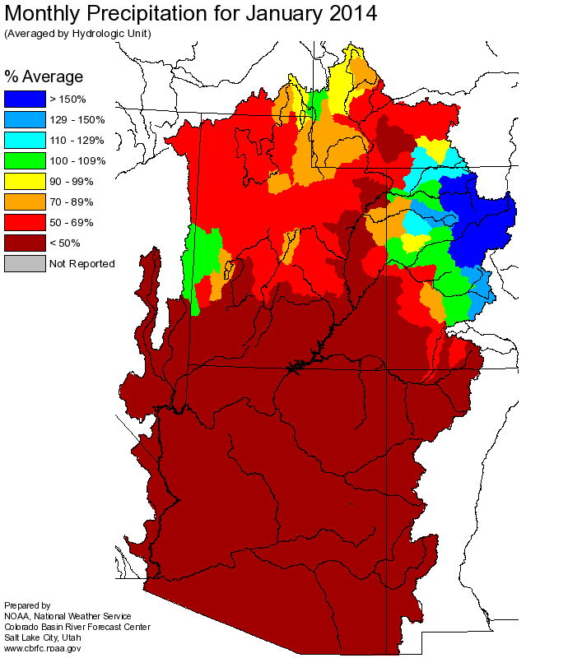
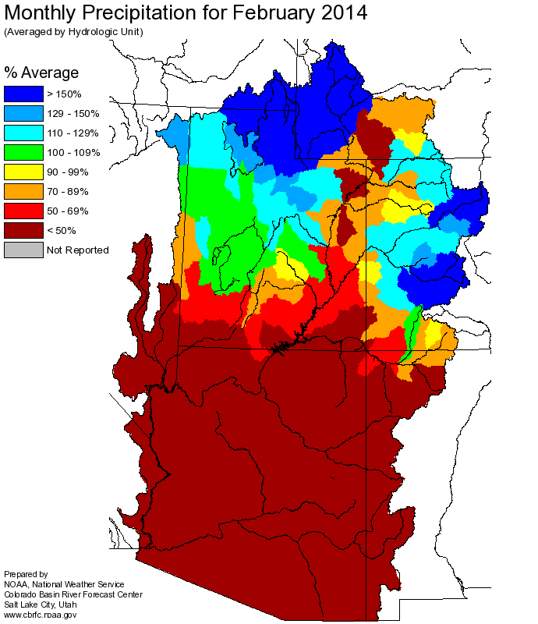
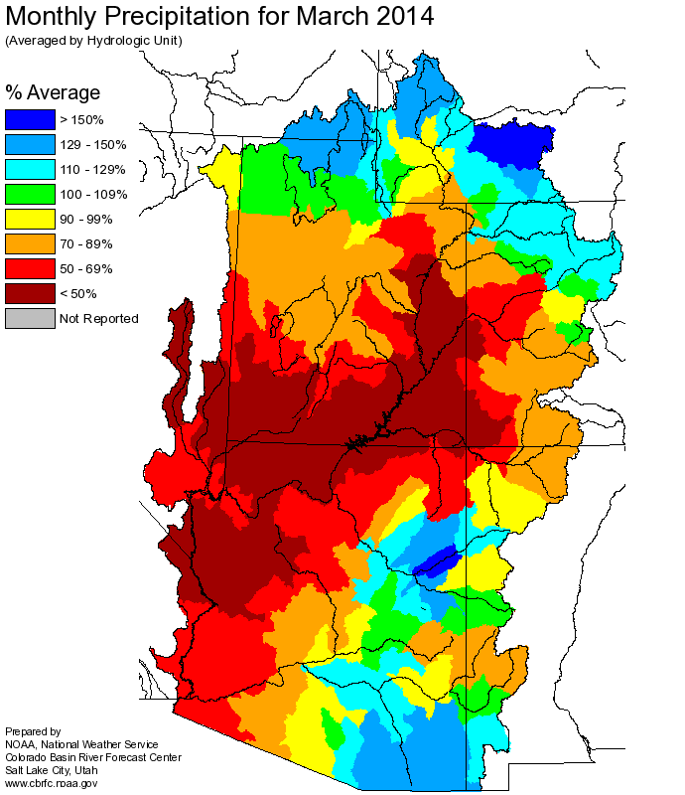
JAN-MAR PRECIPITATION
150%-200%
250%-350%
150%-200%
140%
120%

Slide 5
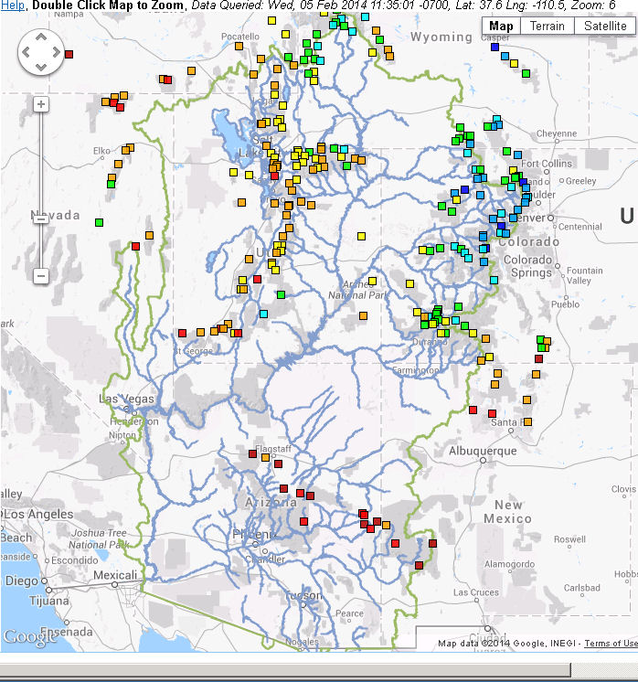
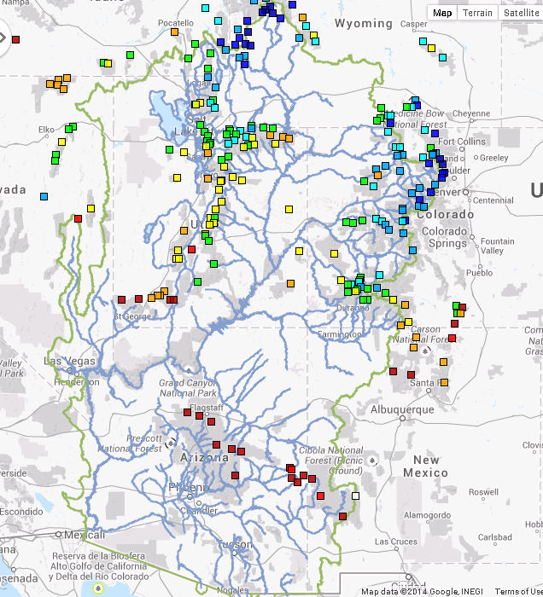
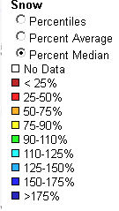
FEBRUARY SWE CHANGE
February 5th Snow
March 5th Snow

Slide 6
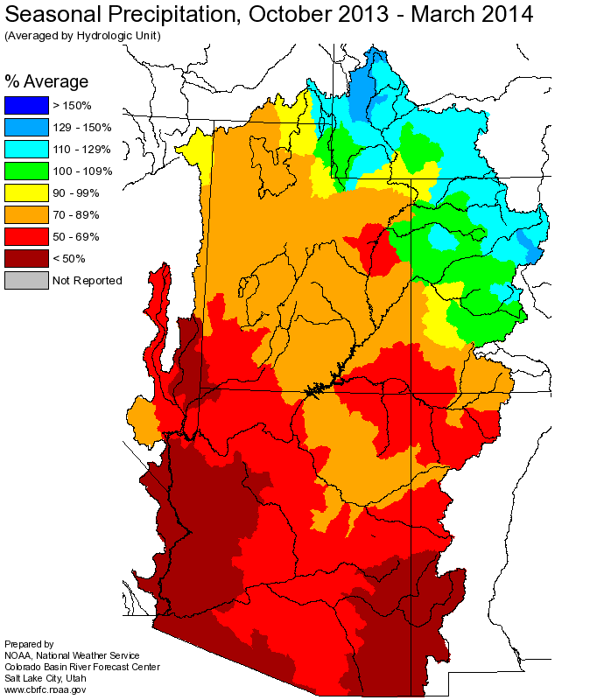
APRIL 1 CONDITIONS

Slide 7
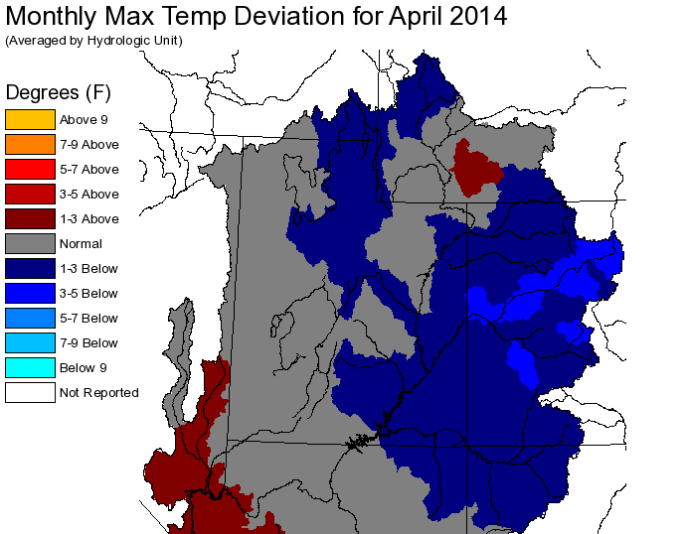
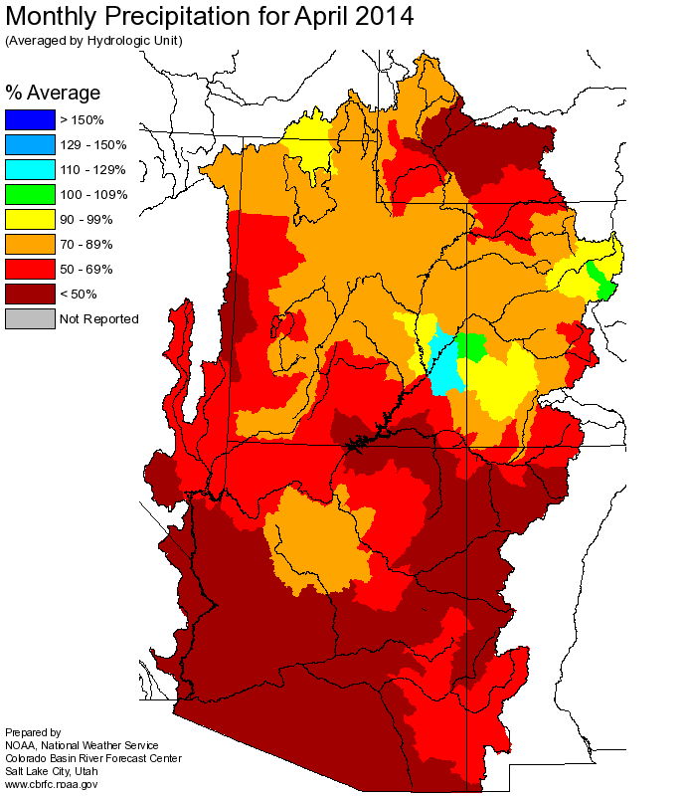
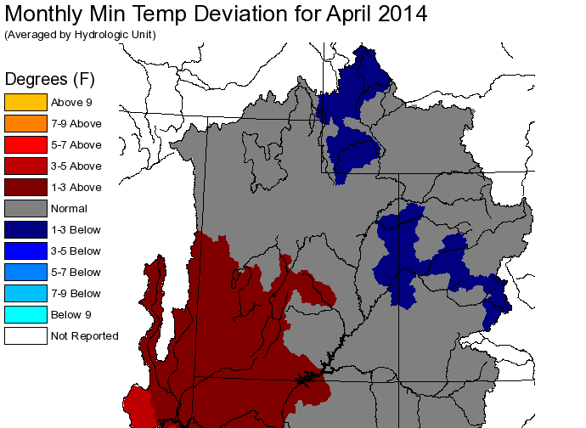
APRIL PRECIPITATION AND TEMPERATURE

Slide 8
APRIL FLOWS

Slide 9
MAY 1 CONDITIONS

Slide 10
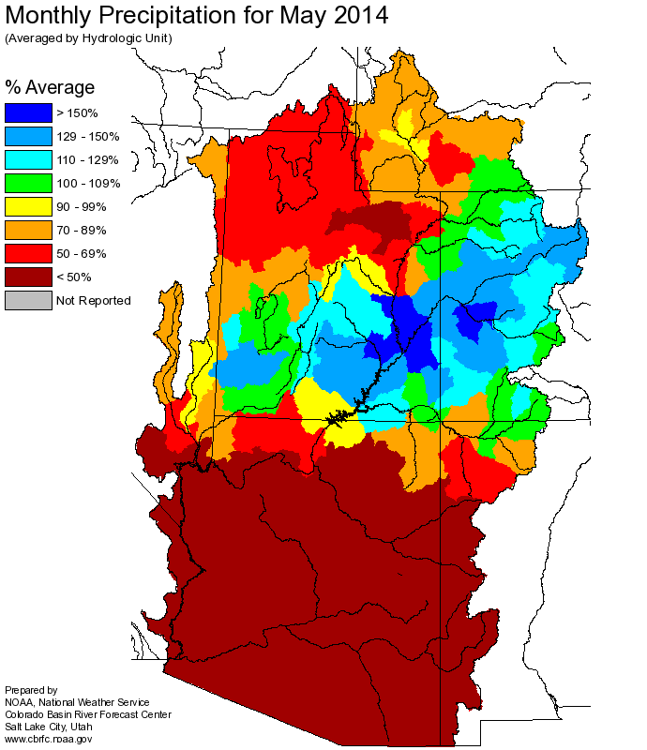
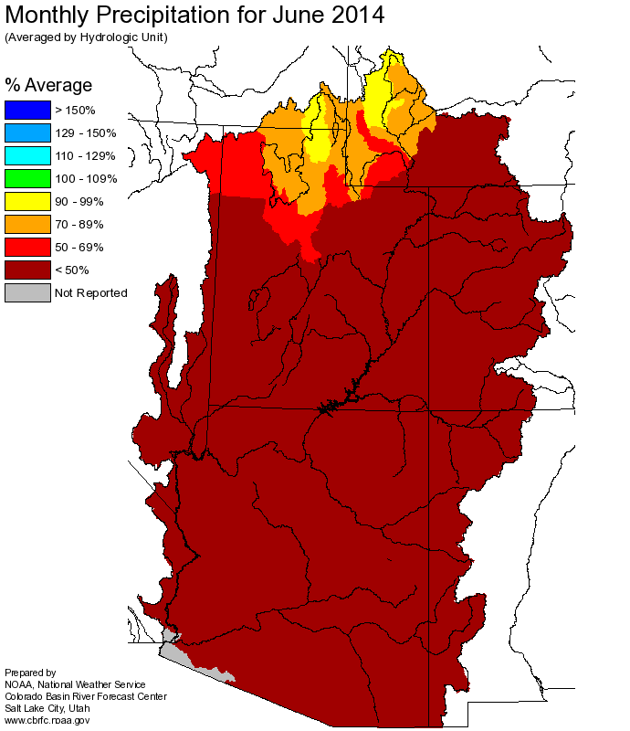
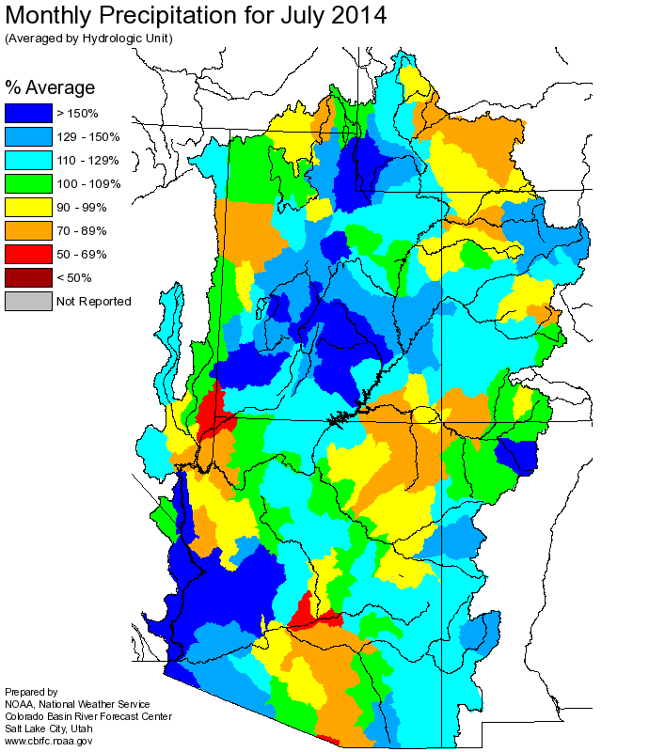
MAY-JUL PRECIPITATION

Slide 11
SUMMARY
Very wet September boosted soil moisture conditions.
November 1 modeled soil moisture in some areas of the Colorado and Gunnison River headwaters were near to above the maximum values from the calibration period (1981-2010).
February precipitation was a big game changer in much of the basin, with widespread 150+ % average.
The Upper Green especially benefitted with ~300%.
The San Juan, unfortunately, missed out.
Big April flow volumes in the Yampa, Upper Colorado, and Gunnison basins during a dry, cool month seemed to confirm the modeled wet fall soil moisture conditions.
April-June was very dry throughout most of the basin.
Except May had near to much above much average precipitation in western Colorado.

