Slide 1
Water Year 2014: Colorado River Basin Water Supply Forecasts
CRFS
November 20, 2014

Slide 2
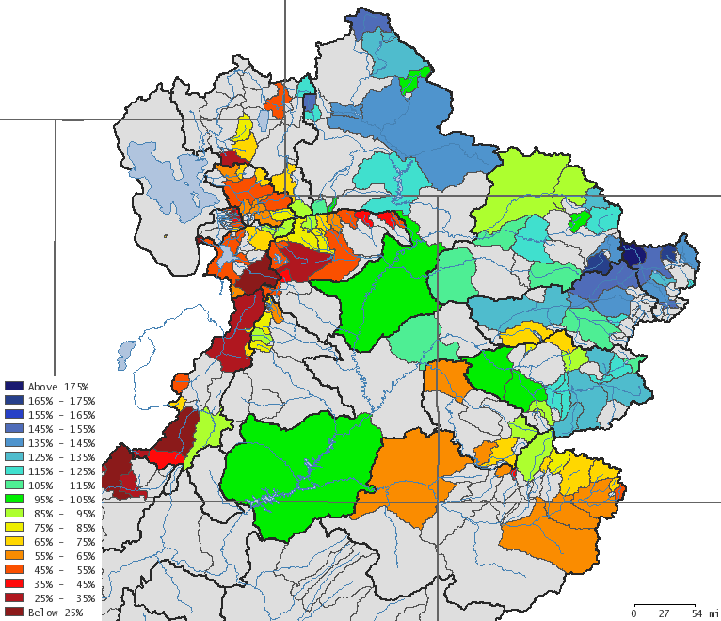
Green River Basin
April-July 2014
Observed Volume
% of 1981-2010 average
Upper Green
Near record February precipitation
Large increases in forecasts on March 1
Much above average volumes observed
Forecast error low at headwater locations, increased downstream points
Yampa
Above average volumes except for Little Snake
Not much change in forecasts over the season
Forecasts performed well on mainstem
Forecasts slightly too high in Little Snake
Duchesne
Very dry winter/spring, except February
Drying trend West -> East
Below average volumes, higher volumes in high elevations west side basins
Most forecasts were too high but within normal error

Slide 3
Green River Basin
April-July 2014
Observed Volume
% of 1981-2010 average
Upper Green
Near record February precipitation
Large increases in forecasts on March 1
Much above average volumes observed
Forecast error low at headwater locations, increased downstream points
Yampa
Above average volumes except for Little Snake
Not much change in forecasts over the season
Forecasts performed well on mainstem
Forecasts slightly too high in Little Snake
Duchesne
- Very dry winter/spring, except February
- Drying trend West -> East
- Below average volumes, higher volumes in high elevations west side basins
- Most forecasts were too high but within normal error

Slide 4
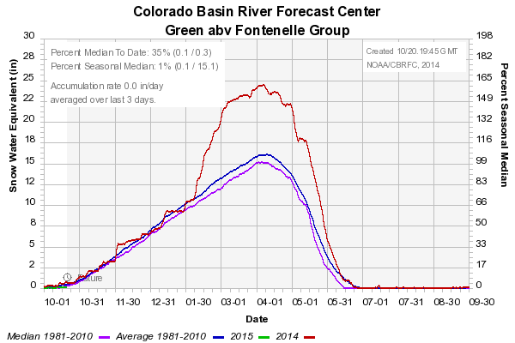
Upper Green: Basin Conditions
Feb = +9.4in SWE
February precipitation for all the SNOTELs was 2nd highest on record!

Slide 5
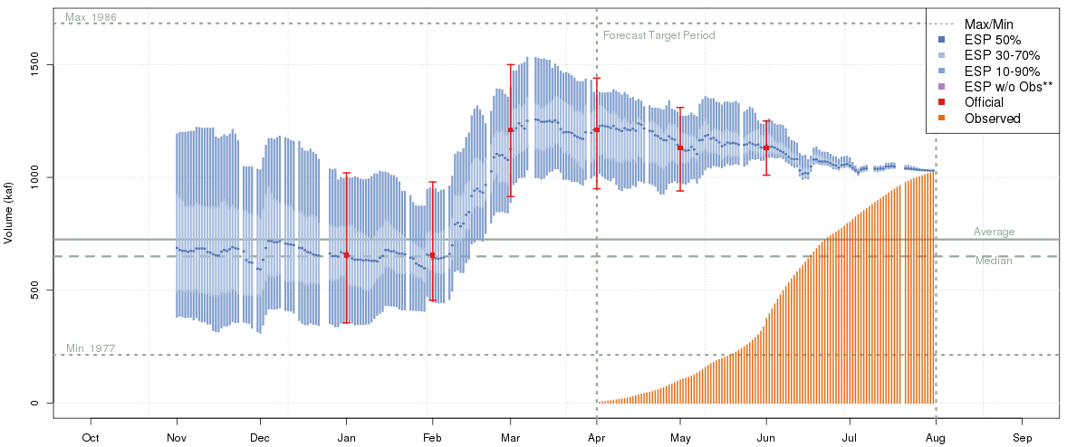
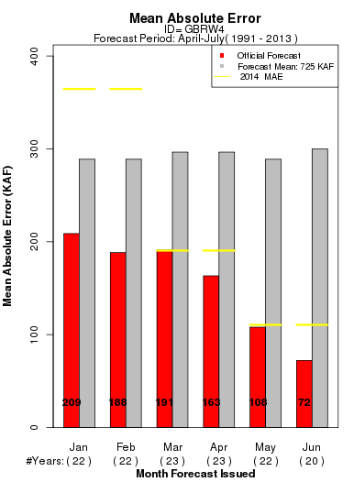
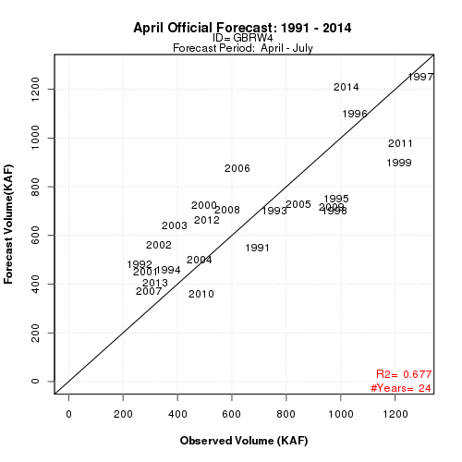
Upper Green:
Fontenelle Inflow
April-July
1020 KAF
141%
Cumulative
observed volume

Slide 6
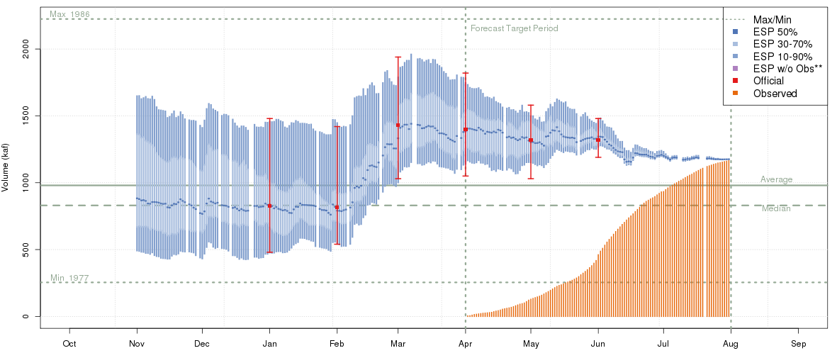
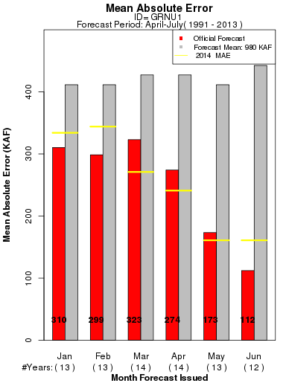
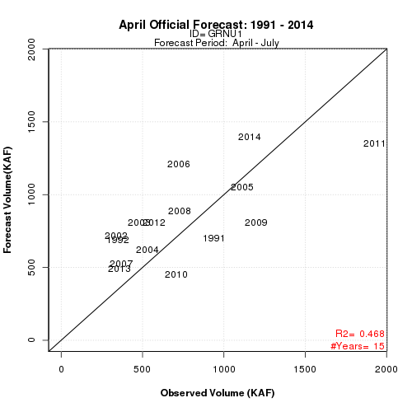
Upper Green:
Flaming Gorge Inflow
April-July
1160 KAF
118%

Slide 7
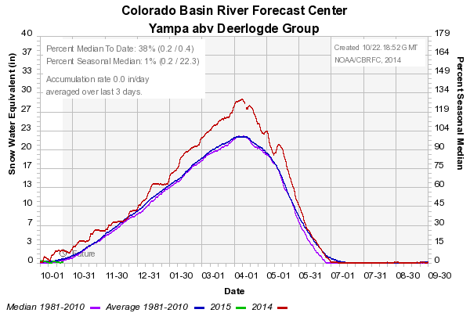
Yampa: Basin Conditions

Slide 8
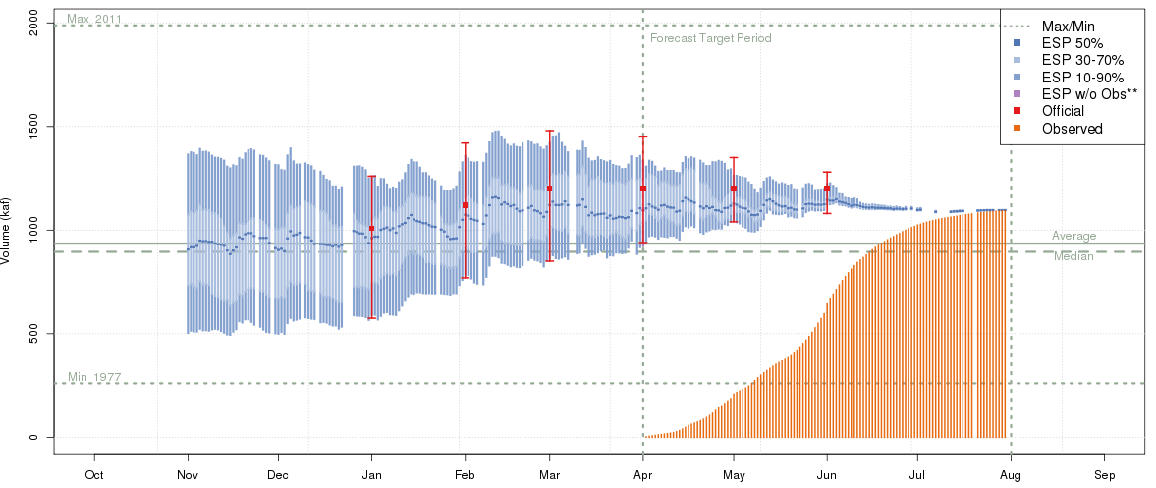
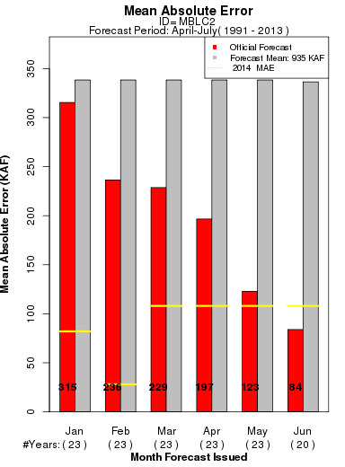
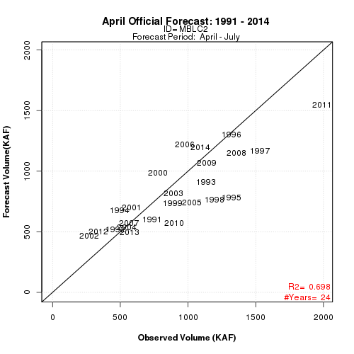
Yampa:
Yampa River near Maybell
April-July
1092 KAF
117%
Notes:
Little Snake and White River Forecasts increases in May but obs closer to April forecast

Slide 9
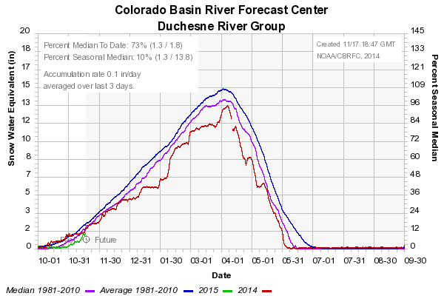
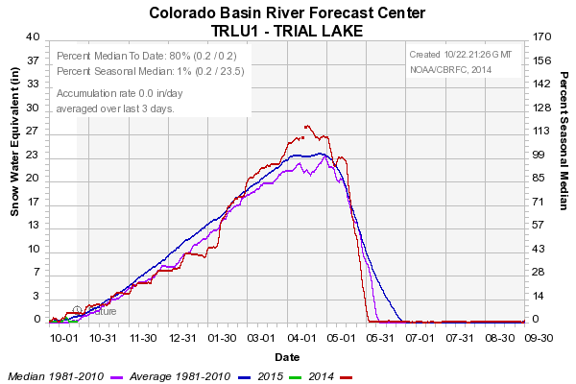
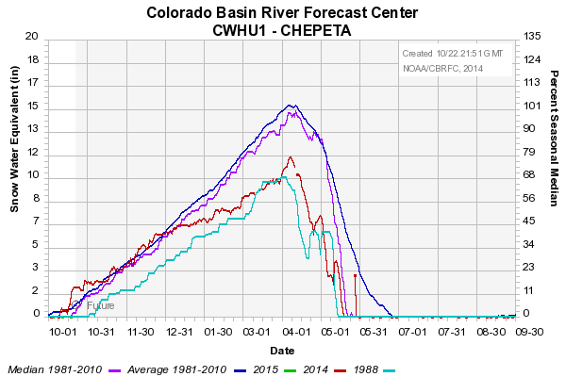
Duchesne: Basin Conditions
Drying trend West to East

Slide 10
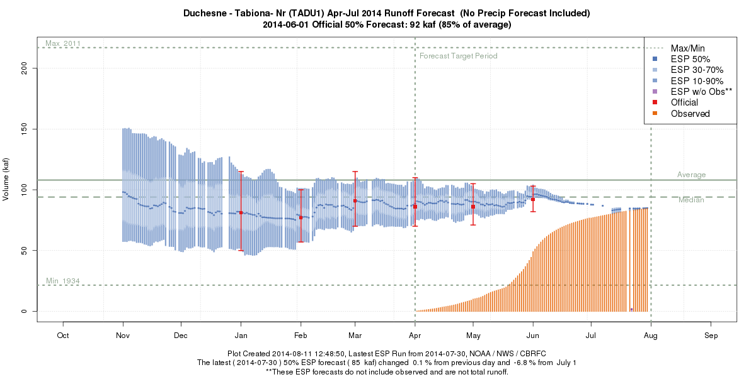
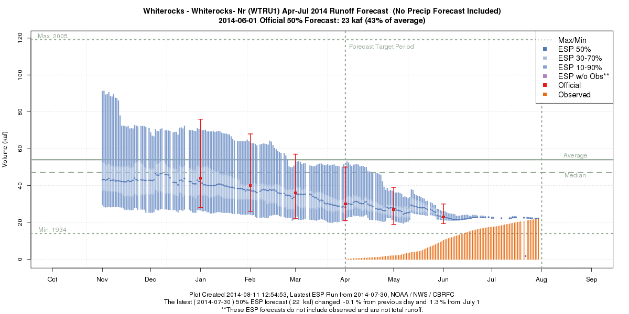
Duchesne: Duchesne – Tabiona and Whiterocks - Whiterocks
April-July
87 KAF
80%
West
April-July
22 KAF
41%
East

Slide 11
Upper Colorado Basin
April-July 2014
Observed Volume
% of 1981-2010 average
Mainstem
Good soil moisture conditions entering winter and good precipitation and snowpack throughout the season led to much above average observed volumes.
Water supply forecasts for most points were on target by March.
Gunnison
Good soil moisture conditions in upper Gunnison entering winter
Water supply forecasts fairly consistent as frequent storms occurred.
Forecasts a little too high in headwaters but came in on the mark at Blue Mesa Res.
Dolores
Forecasts missed the mark. Initial model states in error.
Dry conditions in the spring led to greater early season forecast error.

Slide 12
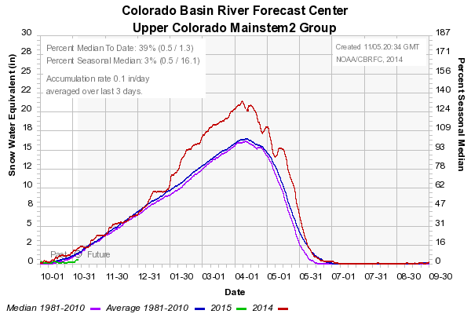
Upper Colorado Mainstem: Basin Conditions

Slide 13
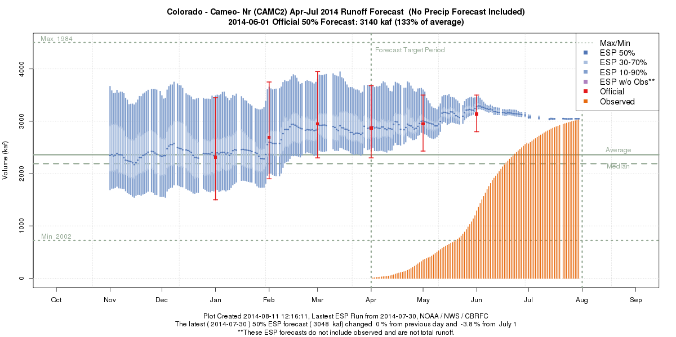
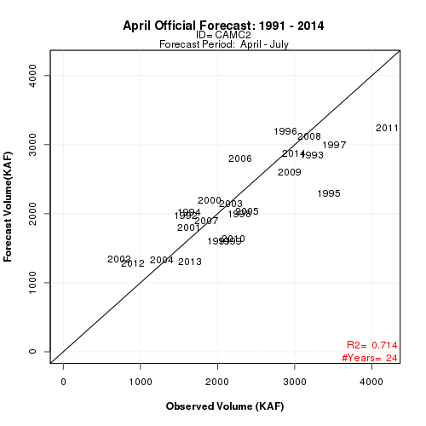
Upper Colorado: Colorado near Cameo
April-July
2993 KAF
127%

Slide 14
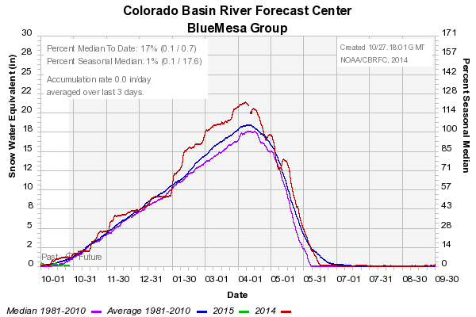
Gunnison: Basin Conditions

Slide 15
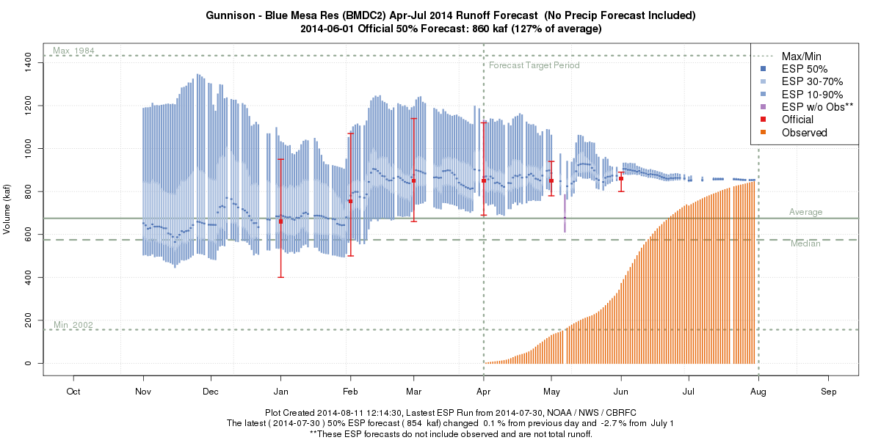
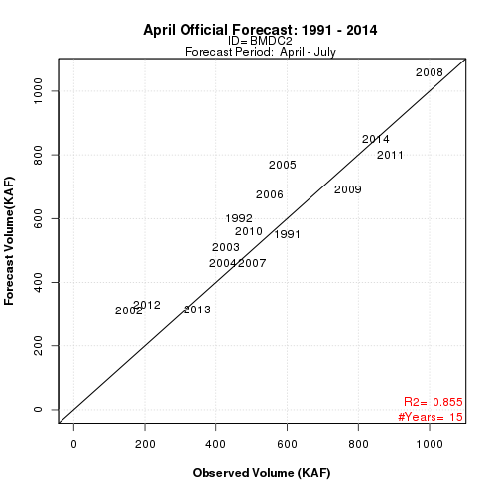
Gunnison: Blue Mesa Inflow
April-July
849 KAF
126%

Slide 16
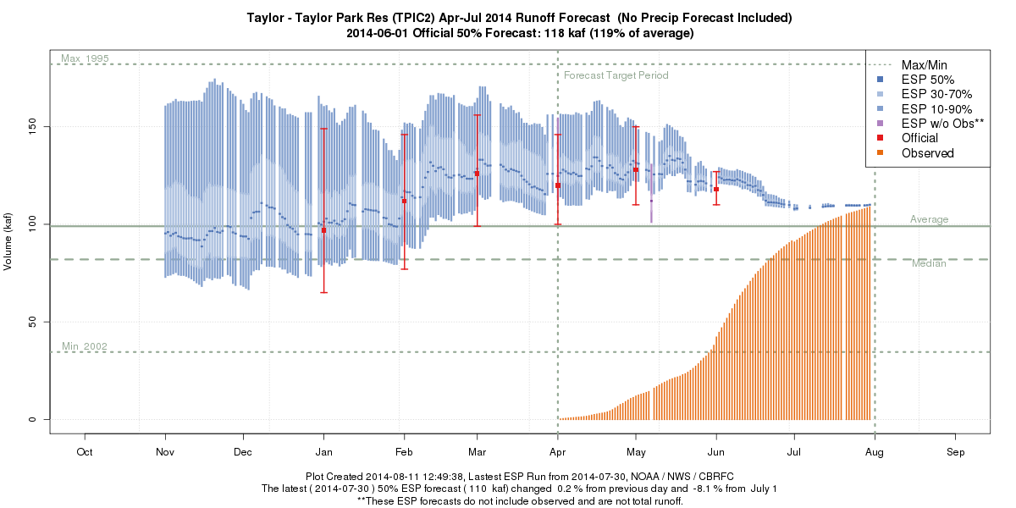
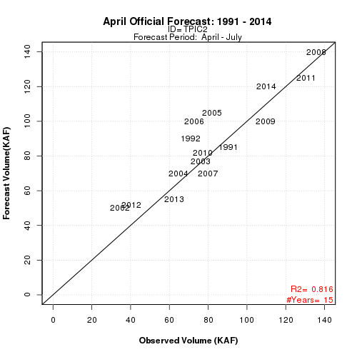
Gunnison: Taylor Park Inflow
April-July
110 KAF
111%

Slide 17
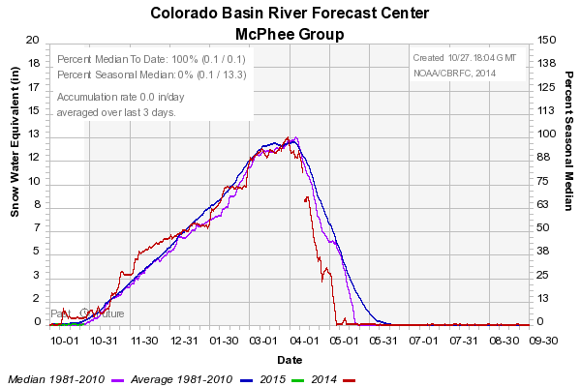
Dolores: Basin Conditions

Slide 18
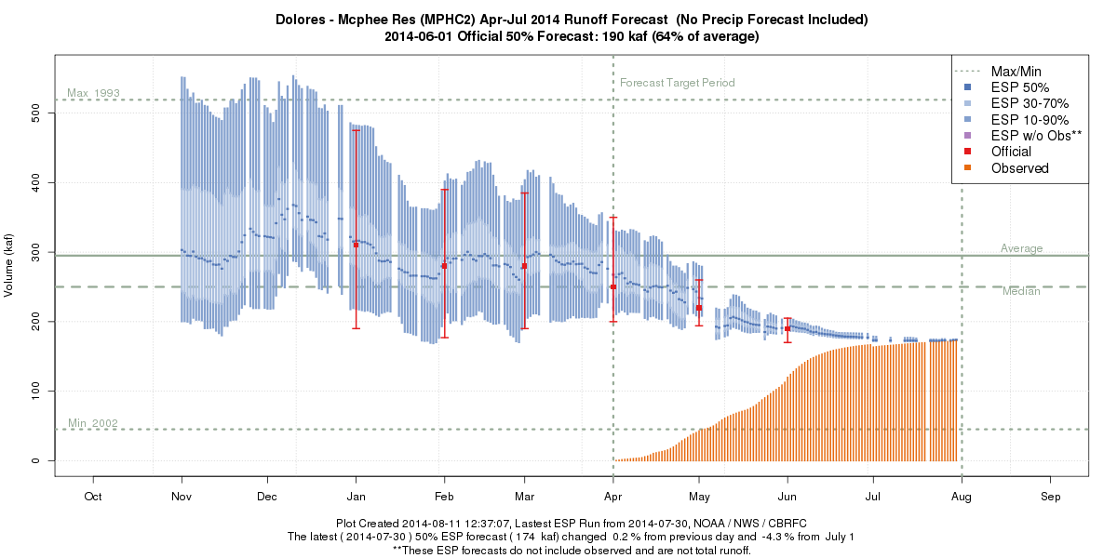
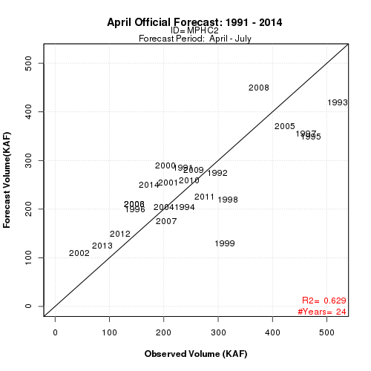
Dolores: McPhee Reservoir Inflow
April-July
173 KAF
59%

Slide 19
San Juan Basin
April-July 2014
Observed Volume
% of 1981-2010 average
San Juan
Dry spring weather and below average snow resulted in below average runoff.
This despite good soil moisture conditions in the northern part of the basin entering winter.

Slide 20
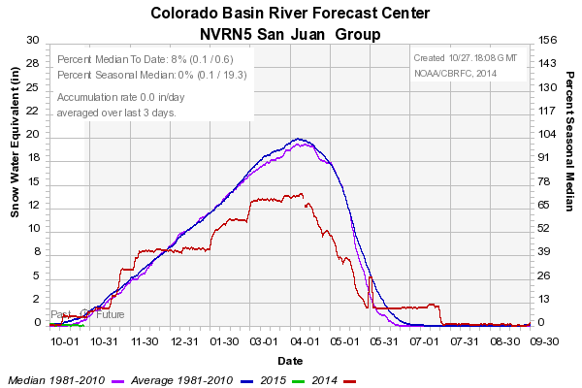
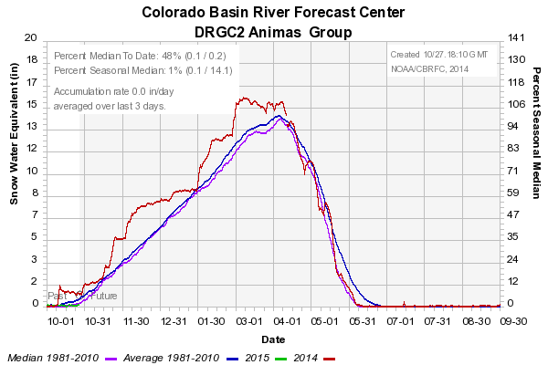
San Juan: Basin Conditions

Slide 21
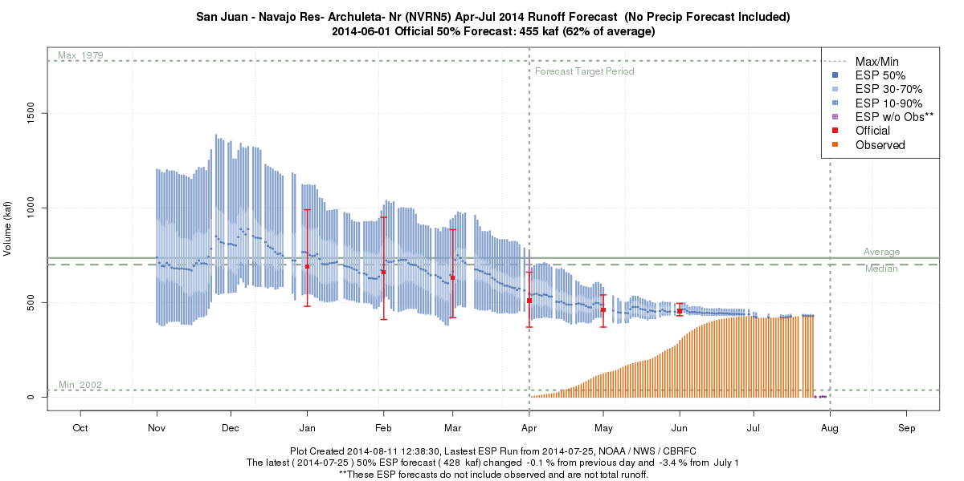
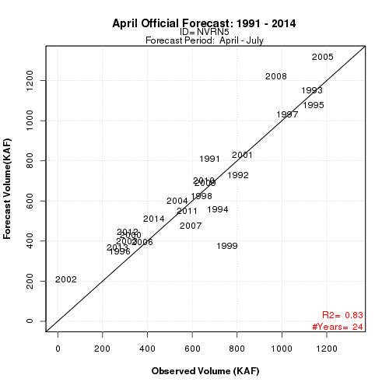
San Juan: Navajo Reservoir Inflow
April-July
428 KAF
58%

Slide 22
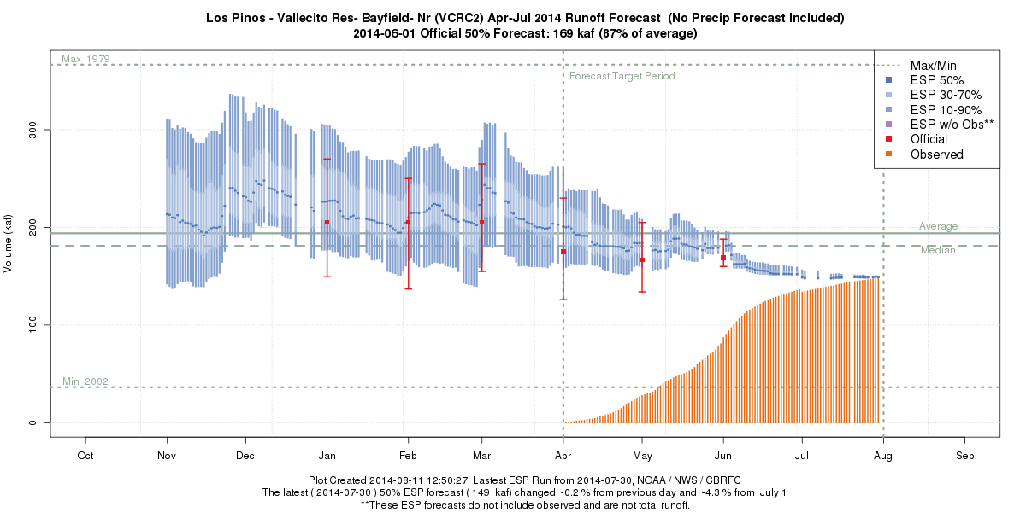
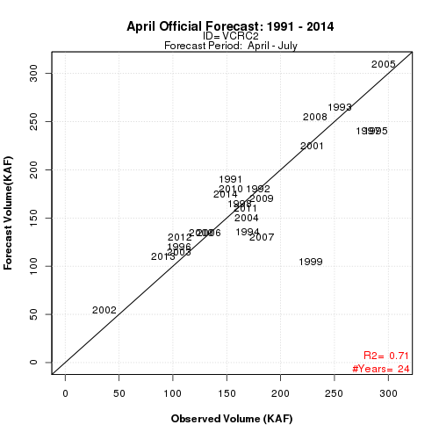
San Juan: Vallecito Reservoir Inflow
April-July
149 KAF
77%

Slide 23
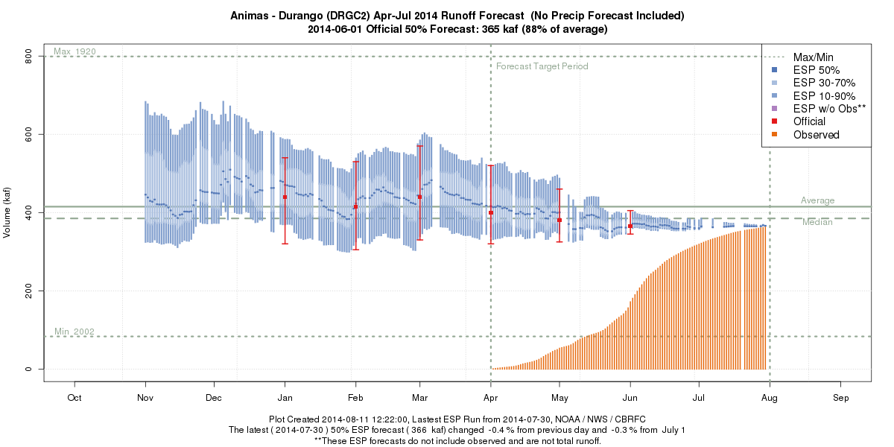
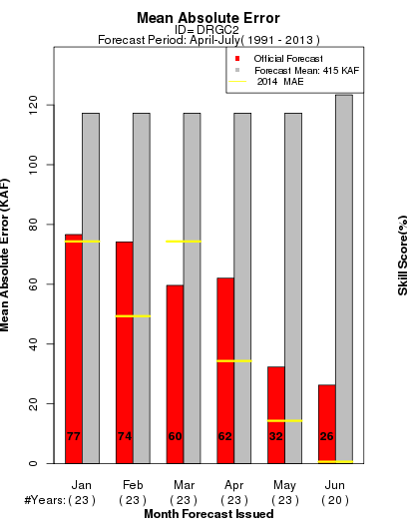
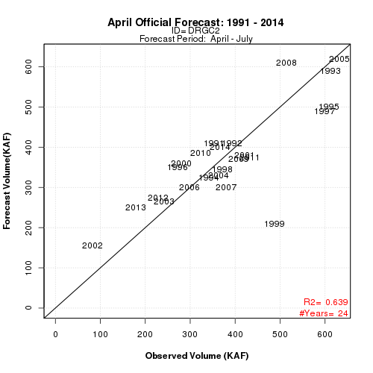
San Juan: Animas - Durango
April-July
366 KAF
88%

Slide 24
Lake Powell
April-July 2014
Observed Volume
% of 1981-2010 average
Lake Powell
Total snow water equivalent in the basin was near median most of the season.
Best water supply forecasts were in January and February!
March forecast was the highest of the season at 116% of average after wet February in northern portions of the basin.
April-July runoff was 97% of average and water year total was 96% of average.

Slide 25
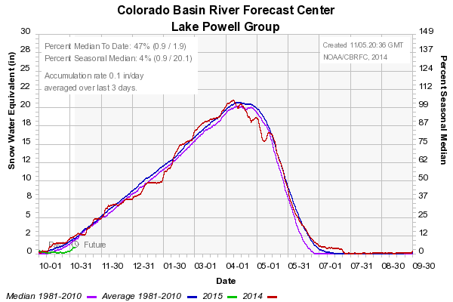
Lake Powell: Basin Conditions

Slide 26
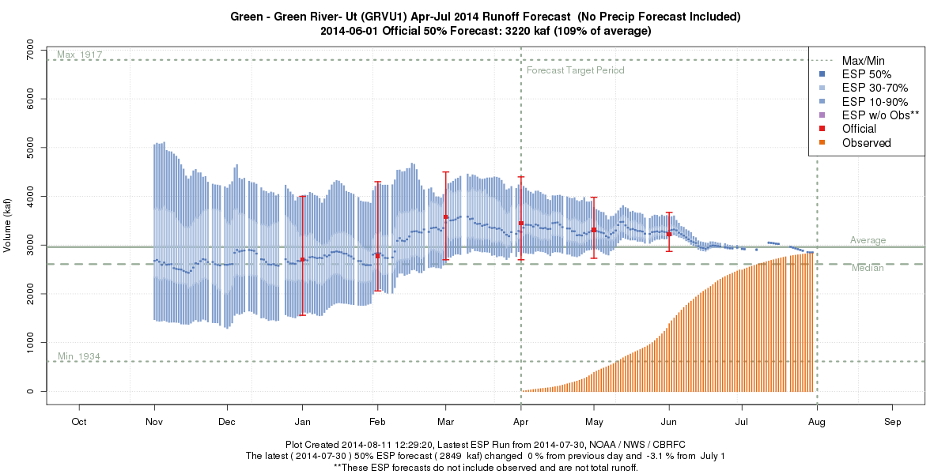
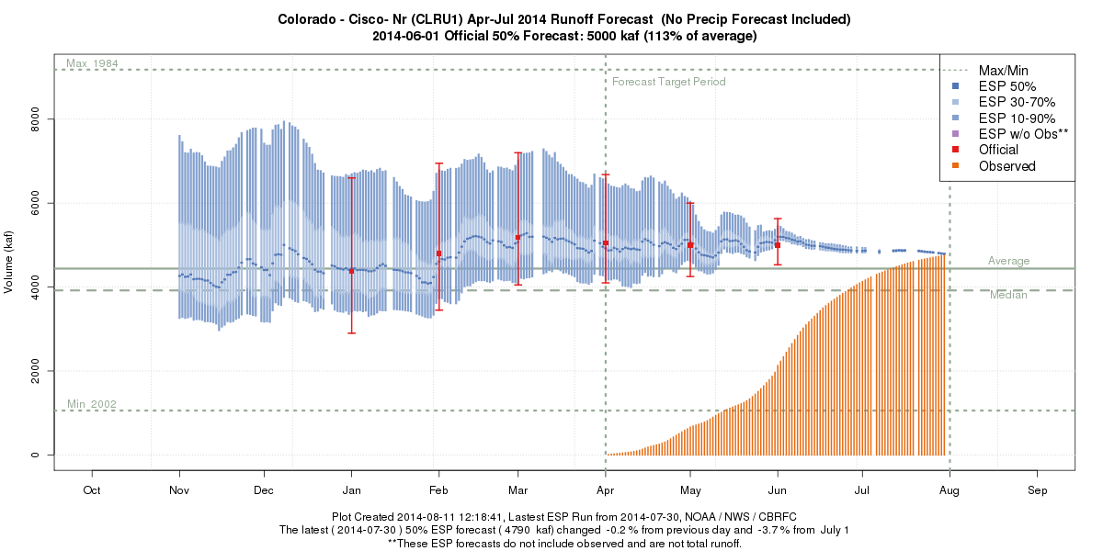
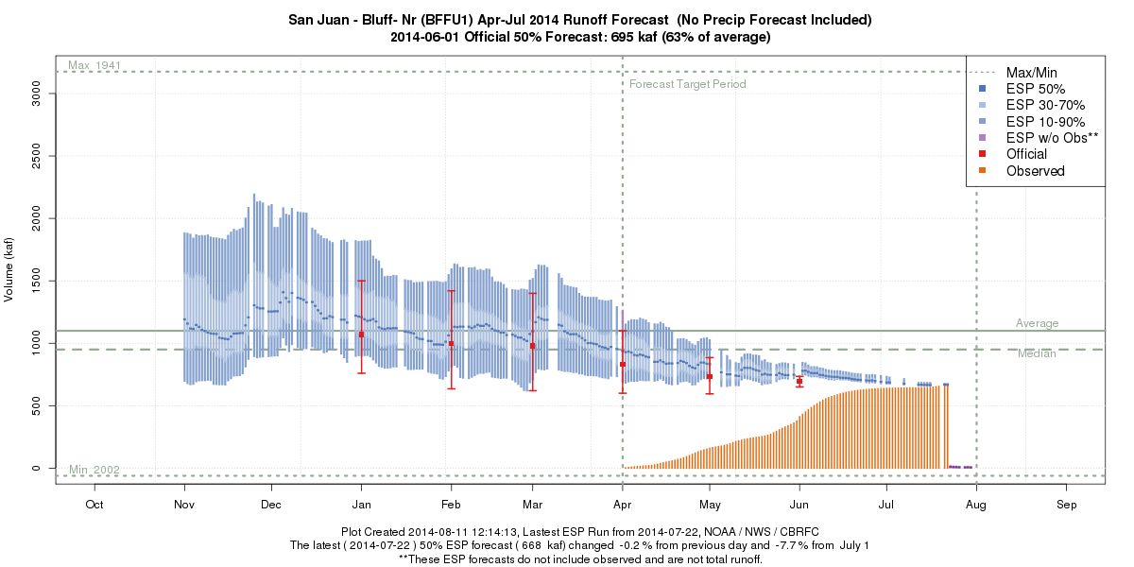
Lake Powell: Contributing Forecasts
Green – Green River, UT
April-July
2813 KAF
95%
Colorado – Cisco, nr
April-July
4718 KAF
106%
San Juan – Bluff, nr
April-July
642 KAF
58%

Slide 27
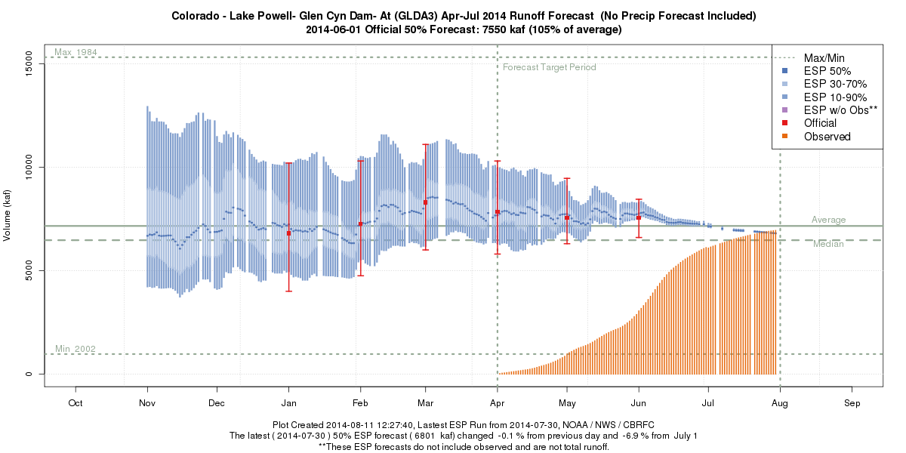
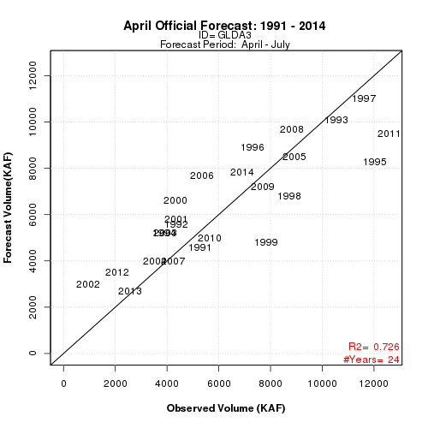
Lake Powell
April-July
6923 KAF
97%

Slide 28
Verification Maps – April
ESP Model Mean Absolute % Error
based on 30 years of re-forecasts
2014 Official Forecasts vs.
ESP Mean Absolute Error
Better where snowmelt is primary source and well documented (or no) diversions.
Worse where rain can come into play and/or incomplete diversion information.
Positive = 2014 Forecast performed BETTER
Negative = 2014 Forecasts performed WORSE
-5 to 5 = Normal

Slide 29
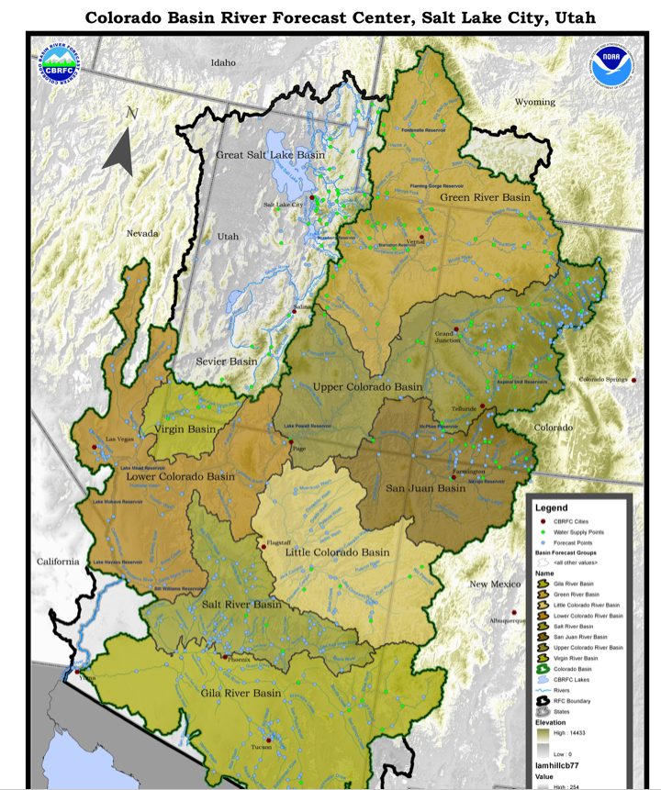
Lower Colorado Basin
All Areas
Dry soil conditions entering the season.
Generally below average precipitation Jan-Jun resulted in another dry year.
Snow amounts similar to the 2002 year.
Many forecast points 10% or lower all time for total seasonal volume.
Virgin

Slide 30
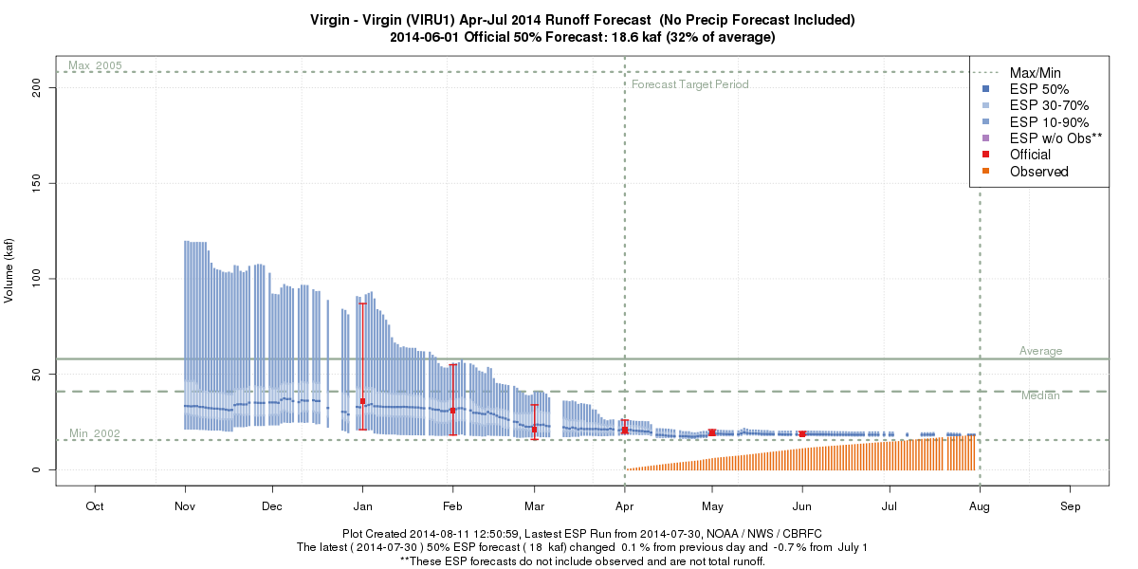
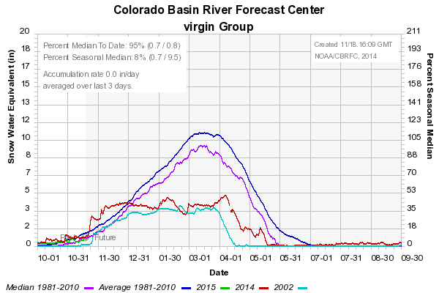
LOWER COLORADO: Virgin at Virgin
April-July
18.2 KAF
31%
2nd driest of 98 years

Slide 31
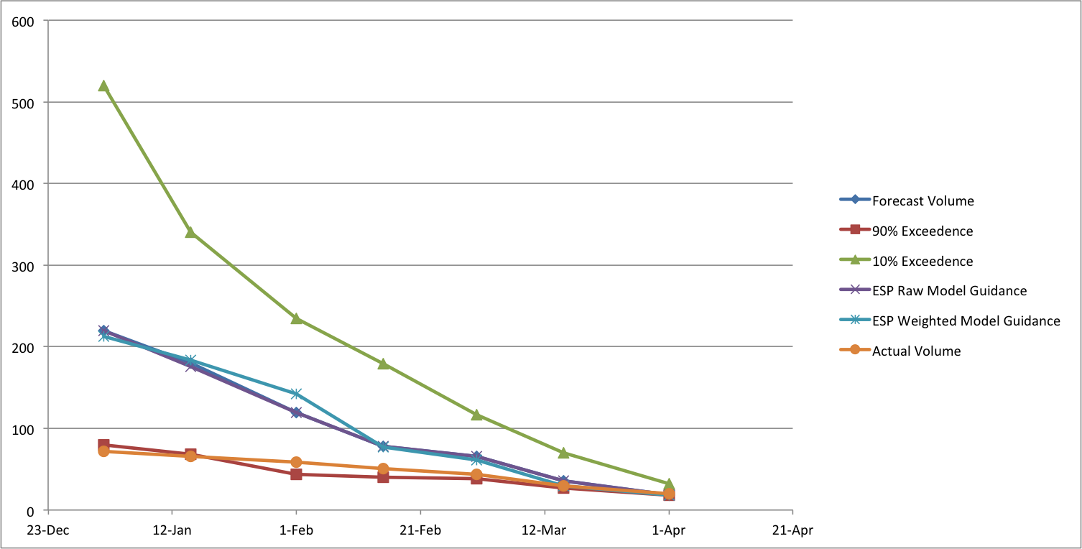
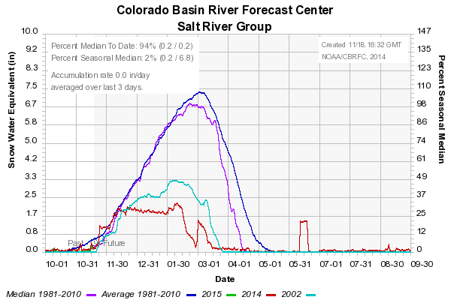
LOWER COLORADO: Salt near Roosevelt
Progressive Forecast Period (Forecast Issue Date through May)
Jan-May
72 KAF
23% median
8th driest of 101 years

