Slide 1
CRFS Technical Meeting LC Operations Update
March 27, 2014

Slide 2
Topics
LC Operations Update
Minute 319 Update

Slide 3
Lower Basin Operations Water Year 2014
Lake Mead Conditions
Current elevation: 1,103.0 feet (46% full)
Projected 2014 EOCY elevation: 1,086.0 feet
Projected decline of 22.8 feet in CY 2014
Operating under the Normal/ICS Surplus Condition
Lower Basin projected water use of 7.5 maf +/- ICS created or delivered
Mexico projected to take delivery of 1.5 maf +/- any water deferred or delivered
Environmental pulse flow taking place in Spring 2014 (105 kaf)
Restoration of the Lower Colorado reach in Mexico

Slide 4
Lower Basin Side Inflows – WY/CY 2014^{1,2} Intervening Flow from Glen Canyon to Hoover Dam
Month in WY/CY 2014 |  | 5-Year Average Intervening Flow (KAF) | Observed Intervening Flow (KAF) | Observed Intervening Flow (% of Average) | Difference From 5-Year Average (KAF)
HISTORICAL | October 2013 | 52 | 38 | 73% | -14
 | November 2013 | 52 | 116 | 221% | 64
 | December 2013 | 95 | 41 | 43% | -54
 | January 2014 | 75 | 45 | 60% | -30
 | February 2014 | 78 | 76 | 97% | -2
FUTURE | March 2014 | 68
 | April 2014 | 80
 | May 2014 | 60
 | June 2014 | 23
 | July 2014 | 64
 | August 2014 | 116
 | September 2014 | 97
 | October 2014 | 52
 | November 2014 | 52
 | December 2014 | 95
WY 2014 Totals |  | 860 | 824 | 96% | -36
CY 2014 Totals |  | 860 | 828 | 96% | -32
¹ Values were computed with the LC’s gain-loss model for the most recent 24-month study.
² Percents of average are based on the 5-year mean from 2009-2013.

Slide 5
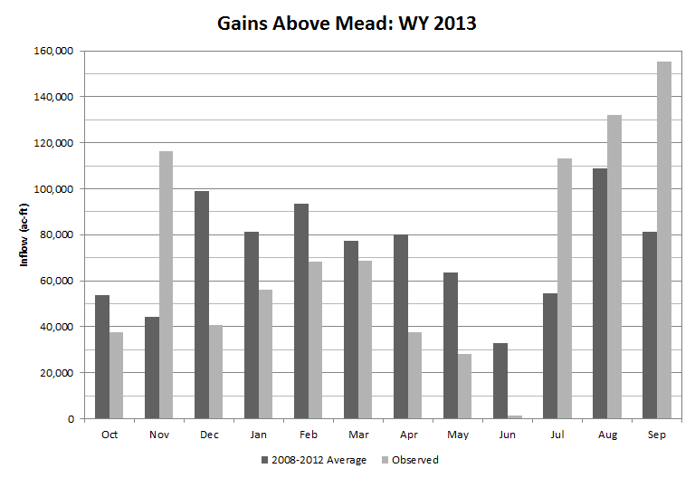
Lower Basin Side Inflows – WY/CY 2013^{1,2} Intervening Flow from Glen Canyon to Hoover Dam
¹ Values were computed with the LC’s gain-loss model for the October 2013 24-month study.
² Percents of average are based on the 5-year mean from 2008-2012.

Slide 6
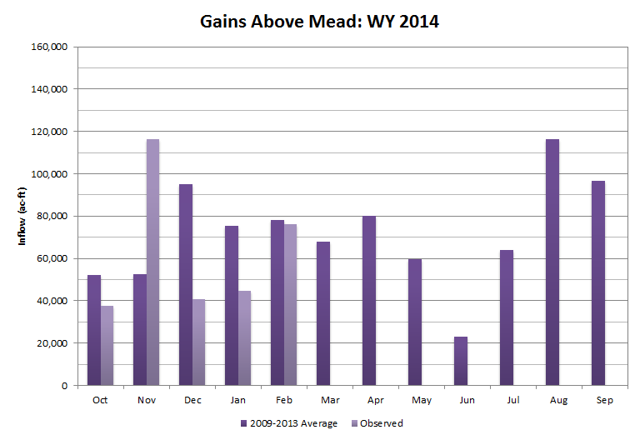
Lower Basin Side Inflows – WY/CY 2014^{1,2} Intervening Flow from Glen Canyon to Hoover Dam
¹ Values were computed with the LC’s gain-loss model for the most recent 24-month study.
² Percents of average are based on the 5-year mean from 2009-2013.

Slide 7
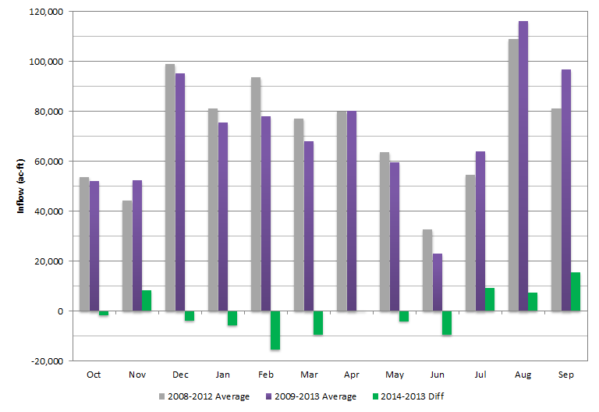
Lower Basin Side Inflows 5-year average comparison: 2013/2014

Slide 8
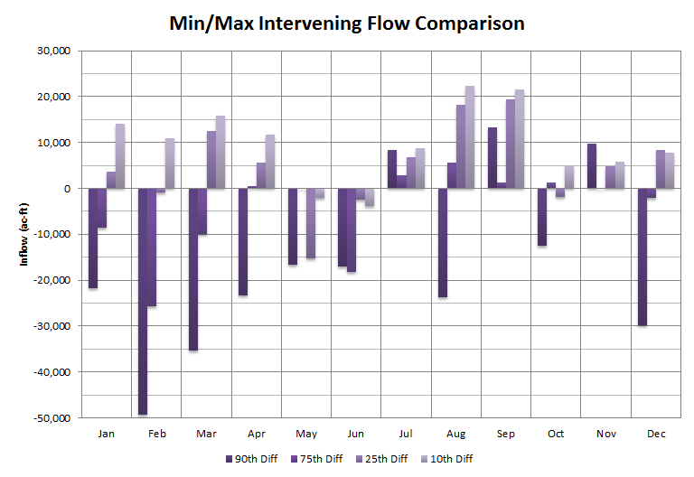
Lower Basin Side Inflows 5-year average comparison: 2013/2014

Slide 9
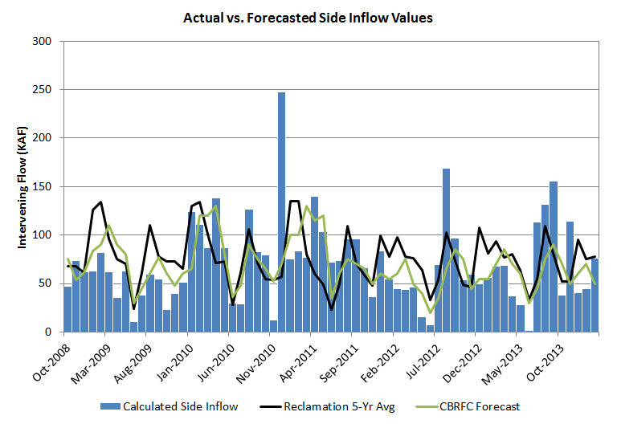
Lower Basin Side Inflows Forecast value comparison: CBRFC vs. USBR

Slide 10
End of Water Year 2014 Projections March 2014 24-Month Study Most Probable Inflow Scenario¹
Projected Unregulated Inflow into Powell = 11.80 maf (109% of average)
Lake Mead
Lake Powell
1,219.6
26.120 maf
24.322 maf
3,700
17.0 maf
3,648
1,145
16.2 maf
3,615.4 feet
13.3 maf in storage
55% of capacity
1,105
12.2 maf
3,575
1,075
1,082.8 feet
10.2 maf in storage
40% of capacity
9.6 maf
9.5 maf
5.9 maf
3,525
1,025
6.0 maf
7.48 maf
0.0 maf
3,370
895
0.0 maf
Dead Storage
1.9 maf
2.5 maf
Dead Storage
Not to Scale
¹ WY 2014 unregulated inflow into Lake Powell is based on the CBRFC outlook dated 3/4/14.

Slide 11
End of Calendar Year 2014 Projections
March 2014 24-Month Study Most Probable Inflow Scenario¹
Lake Mead
Lake Powell
1,219.6
26.120 maf
24.322 maf
3,700
17.0 maf
3,648
1,145
16.2 maf
1,105
12.2 maf
3,611.4 feet
12.9 maf in storage
53% of capacity
1,085.99 feet
10.5 maf in storage
40% of capacity
9.5 maf
3,575
1,075
9.6 maf
5.9 maf
3,525
1,025
6.0 maf
0.0 maf
3,370
895
0.0 maf
Dead Storage
1.9 maf
2.5 maf
Dead Storage
Not to Scale
¹ WY 2014 unregulated inflow into Lake Powell is based on the CBRFC outlook dated 3/4/14.

Slide 13
Percent of Traces with Event or System Condition Results from January 2014 CRSS^{1,2} (values in percent)
 | Event or System Condition | 2014³ | 2015 | 2016 | 2017 | 2018
Upper Basin – Lake Powell | Equalization Tier | 0 | 17 | 23 | 31 | 29
 | Equalization – annual release > 8.23 maf | 0 | 17 | 22 | 31 | 29
 | Equalization – annual release = 8.23 maf | 0 | <1 | 1 | <1 | <1
 | Upper Elevation Balancing Tier | 0 | 50 | 51 | 45 | 42
 | Upper Elevation Balancing – annual release > 8.23 maf | 0 | 8 | 30 | 34 | 31
 | Upper Elevation Balancing – annual release = 8.23 maf | 0 | 42 | 21 | 11 | 11
 | Upper Elevation Balancing – annual release < 8.23 maf | 0 | <1 | <1 | <1 | <1
 | Mid-Elevation Release Tier | 100 | 33 | 17 | 13 | 18
 | Mid-Elevation Release – annual release = 8.23 maf | 0 | <1 | <1 | 1 | 1
 | Mid-Elevation Release – annual release = 7.48 maf | 100 | 33 | 17 | 12 | 17
 | Lower Elevation Balancing Tier | 0 | <1 | 9 | 11 | 11
Lower Basin – Lake Mead | Shortage Condition – any amount (Mead ≤ 1,075 ft) | 0 | <1 | 44 | 54 | 53
 | Shortage – 1st level (Mead ≤ 1,075 and ≥ 1,050) | 0 | <1 | 43 | 44 | 31
 | Shortage – 2nd level (Mead < 1,050 and ≥ 1,025) | 0 | <1 | 1 | 9 | 18
 | Shortage – 3rd level (Mead < 1,025) | 0 | <1 | <1 | 1 | 4
 | Surplus Condition – any amount (Mead ≥ 1,145 ft) | 0 | <1 | 4 | 7 | 13
 | Surplus – Flood Control | 0 | <1 | <1 | 1 | 2
 | Normal or ICS Surplus Condition | 100 | >99 | 52 | 39 | 34
¹ Reservoir initial conditions based on observed levels on December 31, 2013
² Hydrologic inflow traces based on resampling of the observed natural flow
record from 1906-2010
³ Percentages shown in 2014 are reported as ‘0’ as 2014 operations were
determined by the August 2013 24-Month Study

Slide 14
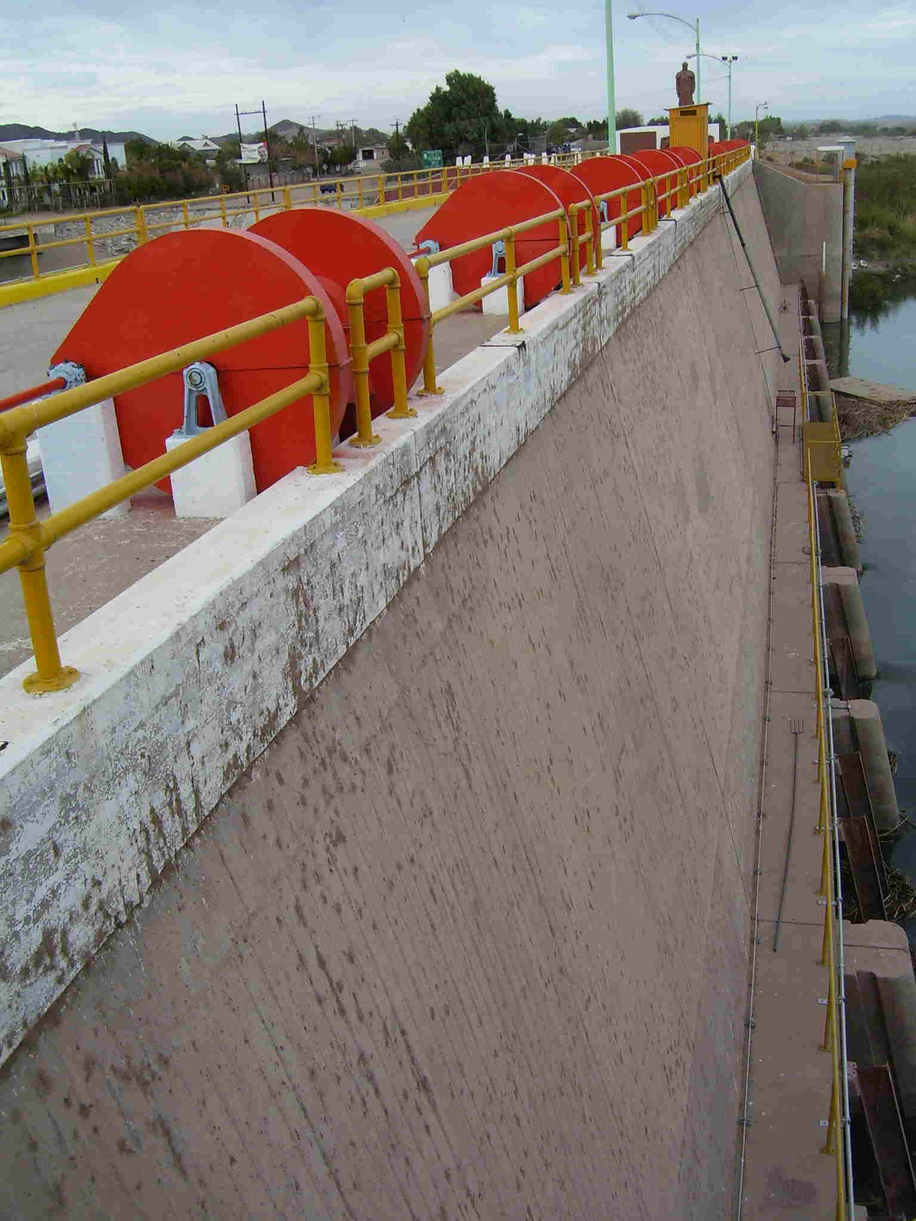
Additional Operational Data (provisional year-to-date values)
Mexico Excess Flows
3,886 acre-feet (as of 3/26/14)
Brock Reservoir Total Storage
35,800 acre-feet (as of 3/22/14)
Senator Wash Total Storage
13,800 acre-feet (as of 3/22/14)

Slide 15
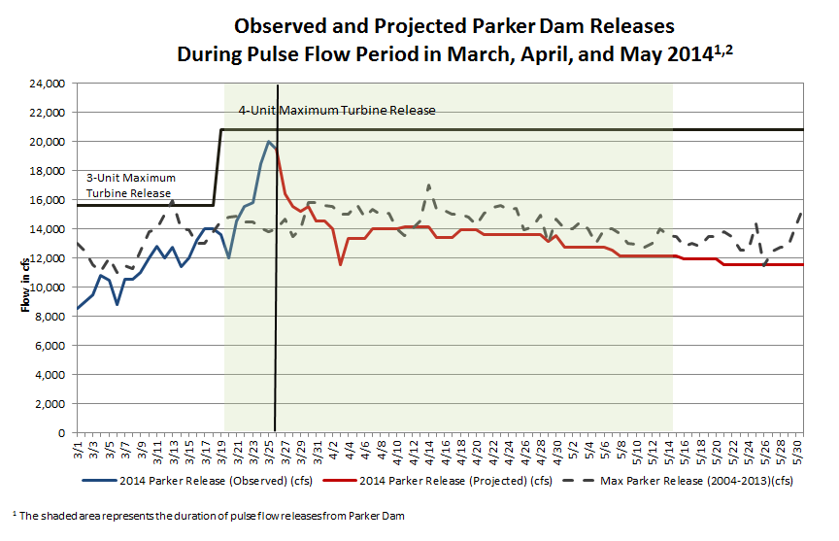
Minute 319: Pulse Flow

Slide 16
Lower Colorado River
Operations
For further information: http://www.usbr.gov/lc/region
Email at:
bcoowaterops@usbr.gov

