Slide 1
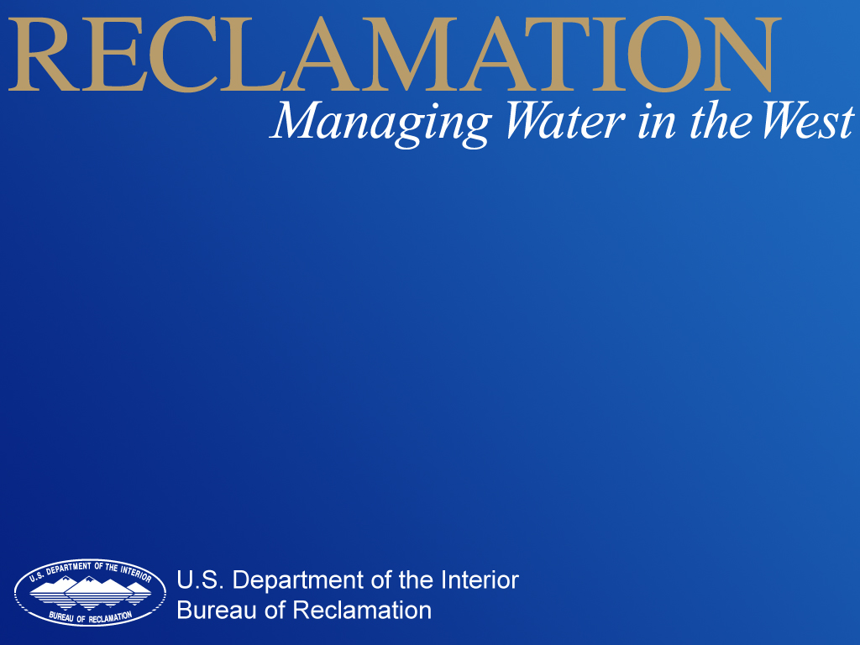
USBR Updates:
Green River
CRFS Meeting March 27, 2014

Slide 2
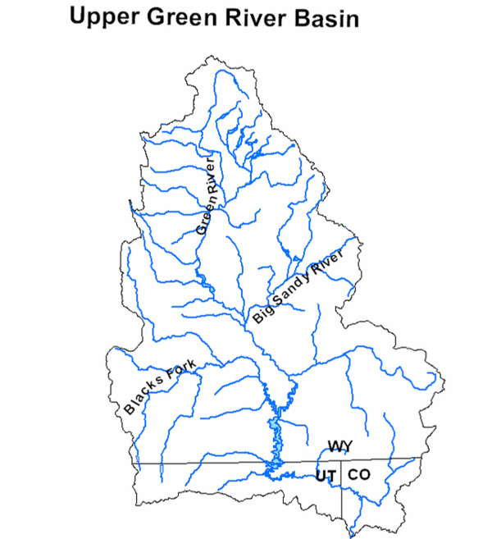
Green River Operations
Fontenelle
Flaming Gorge

Slide 3
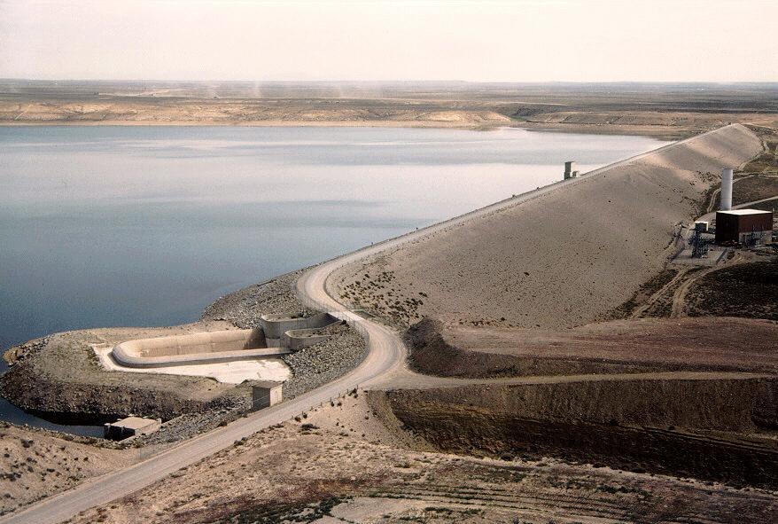
Fontenelle Operations

Slide 4
Fontenelle
Storage
Live Capacity 345,000 AF
Capacity on 3/26/14 127,317 AF
(37% full) slightly high for March
Pool Elevation
Reservoir Elev. (Min) 6506.00 feet
Elevation on 3/26/14 6472.07 feet
Elevation above (Min) 33.93 feet
Inflow and Release
Average Inflow 925 cfs
Average Release 1,430 cfs

Slide 5
Fontenelle Reservoir Elevation
Notes:
Go to P:\FontenelleOps\FontenelleDailyOps.xls to get most recent plot

Slide 6
Fontenelle Inflow and Release
Projected releases between 3,000-8,000 cfs over summer, likely longer duration of 8,000 cfs, depends on observed inflow
Apr – Jul Inflow
1,240 KAF (171%)
Notes:
Go to P:\FontenelleOps\FontenelleDailyOps.xls to get most recent plot

Slide 7
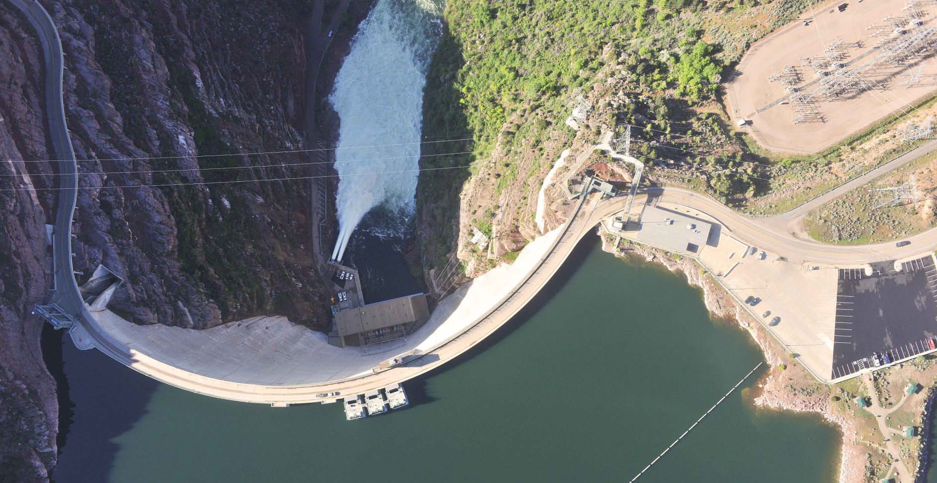
Flaming Gorge Operations

Slide 8
Flaming Gorge
Live Capacity 3.752 MAF
Capacity on 3/26/14 2.909 MAF
Available Space .843 MAF
(78% full)
Reservoir Elev. 6040.00 feet
Elevation on 3/26/14 6017.99 feet
Elevation below (Full) 22.01 feet
Average Inflow 1,750 cfs
Average Release 830 cfs

Slide 9
Spring 2014 Hydrograph
Projected peak between 4,600-8,600 cfs for 3-4 weeks during larval drift
Apr – Jul Inflow
1,430 KAF (146%)
Projected releases steady of approximately 2,000 cfs over summer and winter

Slide 10
Upper Green Classifications

Slide 11
Yampa River Classifications

Slide 12
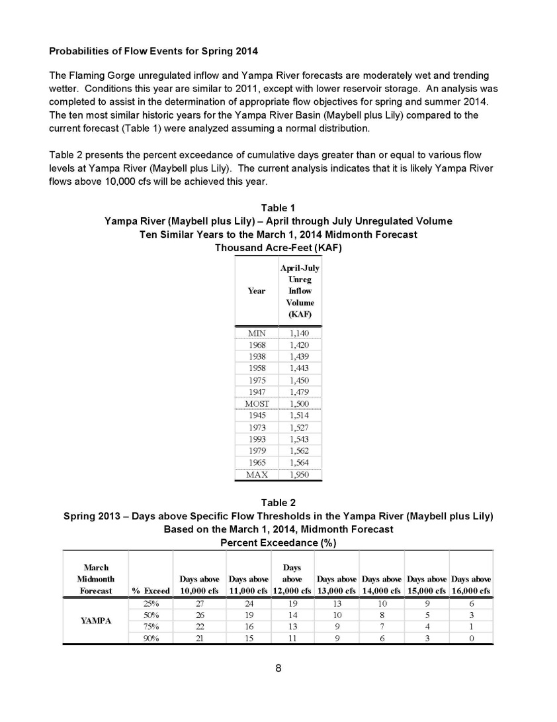

Slide 13
Green WY 2014
Fontenelle releases expected to be higher this summer and the reservoir is expected to fill.
Flaming Gorge peak release timed with larval trigger. Runoff conditions may require releases prior to larval presence. Maximum summer releases vary between 3,000 cfs, 4,600 cfs and 8,600 cfs. Current base flow releases calculated at 1,975 cfs.

