Slide 1
CBRFC/NRCS
DISCUSSION
CRFS
March 27, 2014

Slide 2
WY 2014 Precipitation and snowpack CONDITIONS

Slide 3
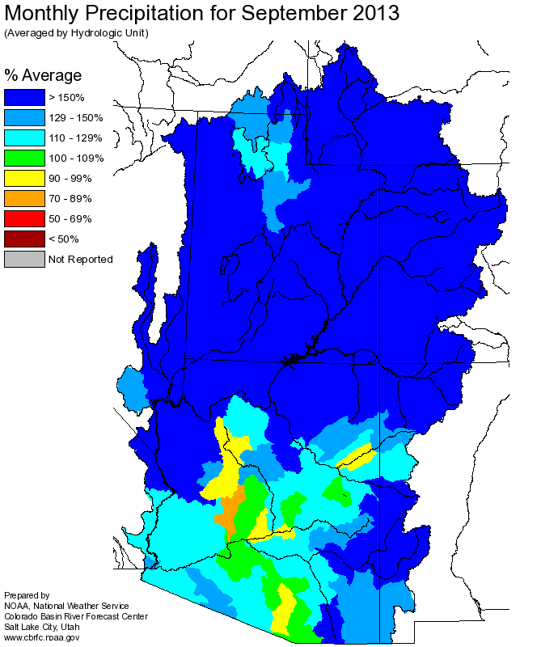
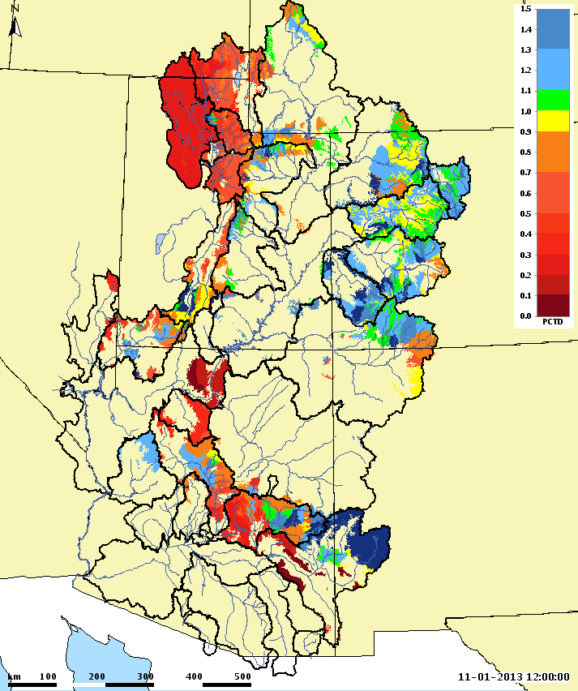
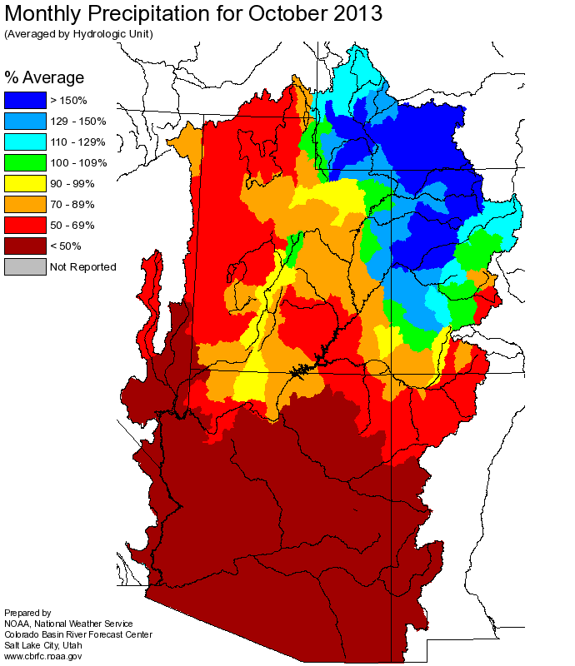
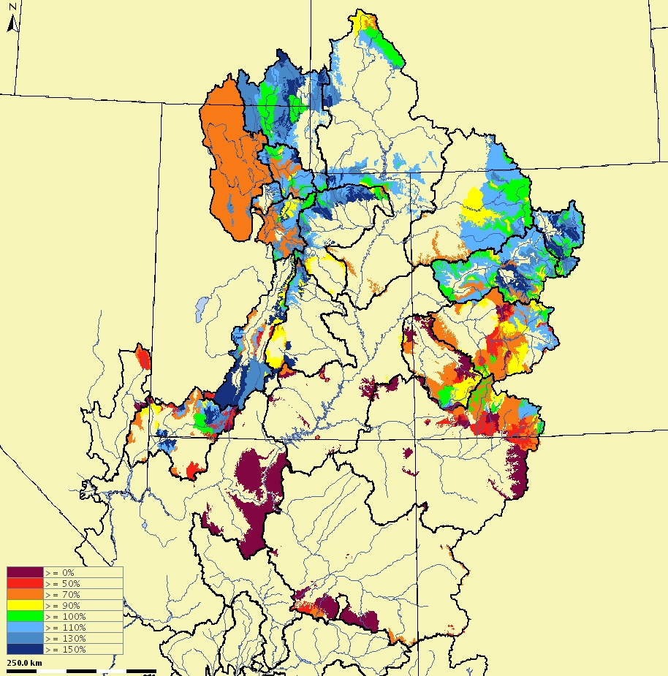
FALL CONDITIONS
CBRFC Model Soil Moisture
November 1, 2013

Slide 4
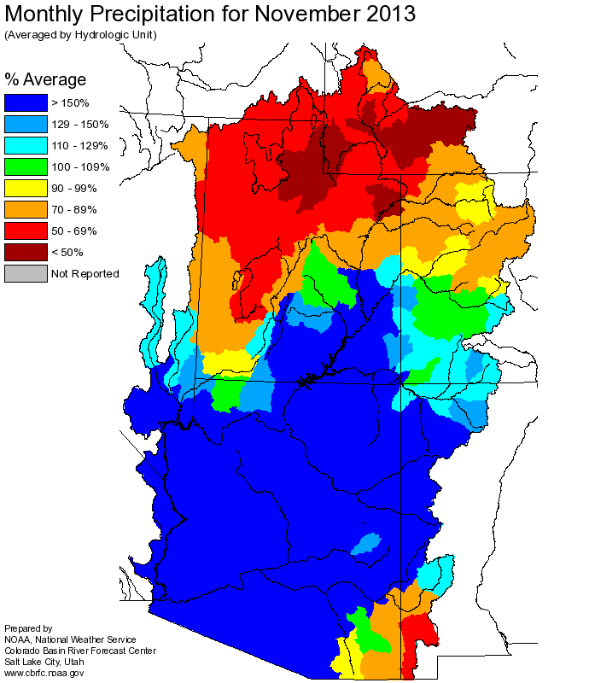
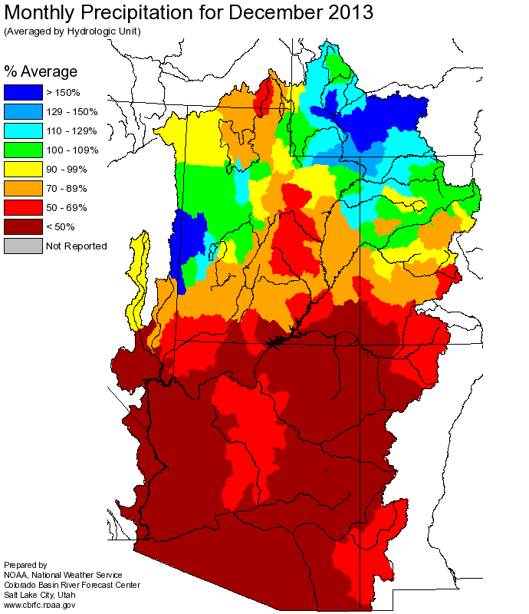
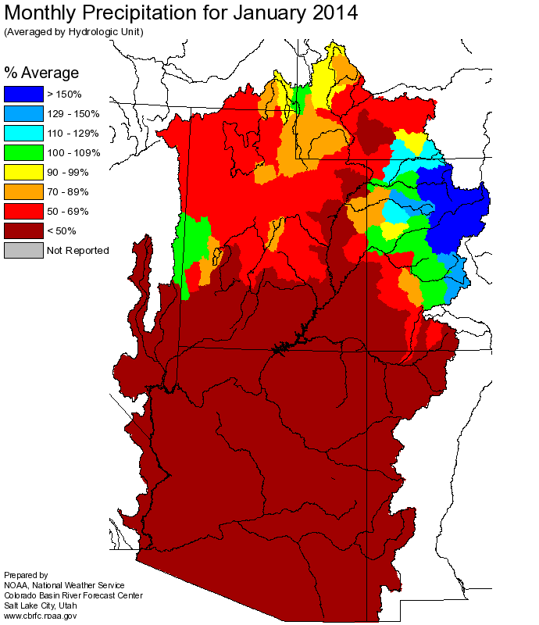
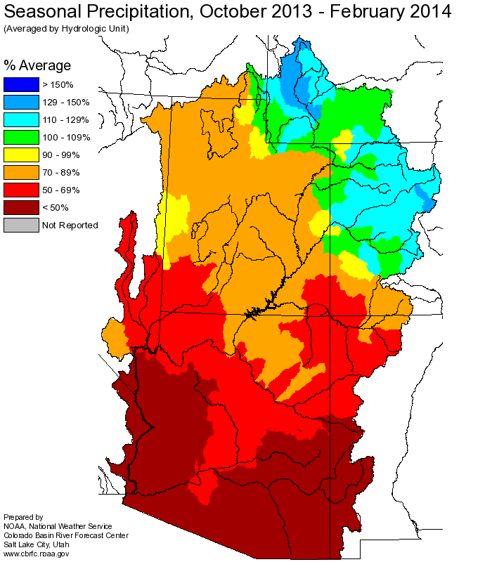
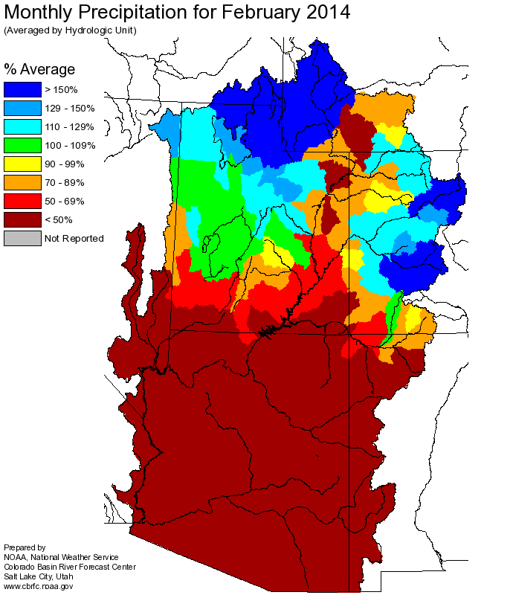
WINTER PRECIPITATION
150%-200%
250%-350%
150%-200%

Slide 5
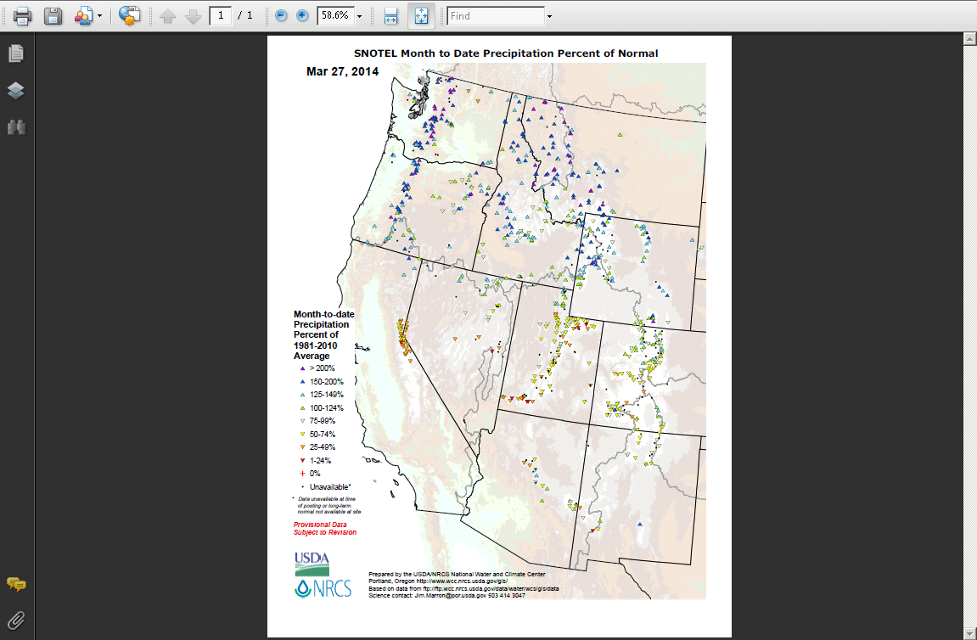
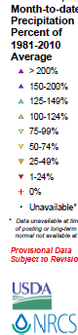
MARCH PRECIPITATION TO DATE
Near to
Above Average
Below to
Much Below
Average

Slide 6
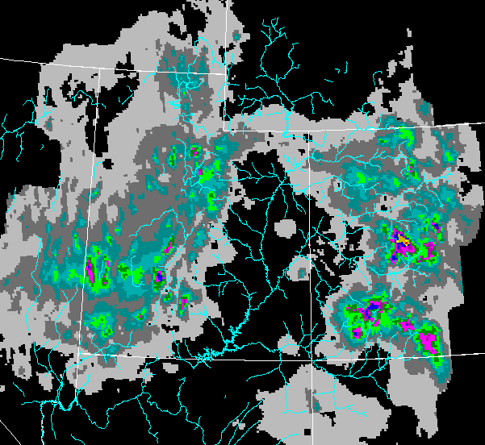

Observed 24 hr Precipitation
Ending 3/27/14 12z

Slide 7
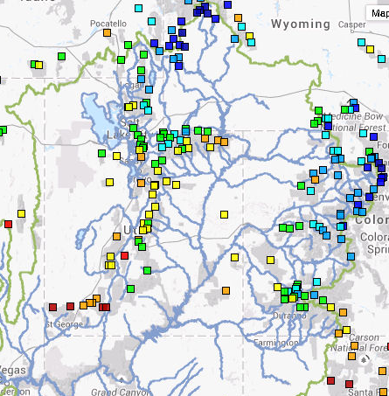
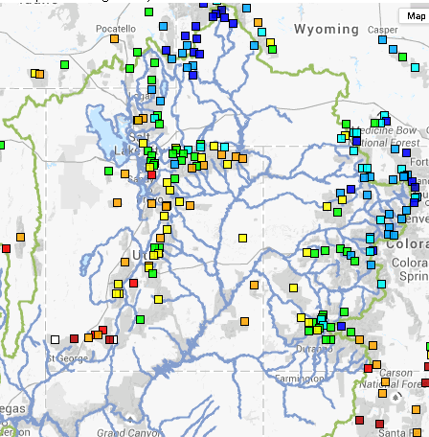
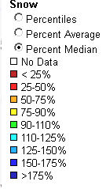
SNOW WATER EQUIVALENT
March 5, 2014
March 24, 2014

Slide 8
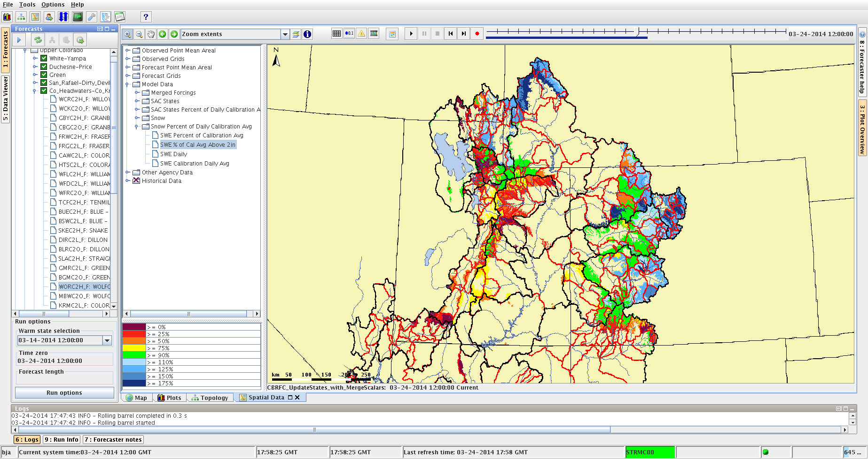
MODEL SWE
MARCH 24, 2014
% CALIBRATION AVERAGE
(> 2”)

Slide 9
WY 2014
WEATHER AND CLIMATE FORECASTS

Slide 10
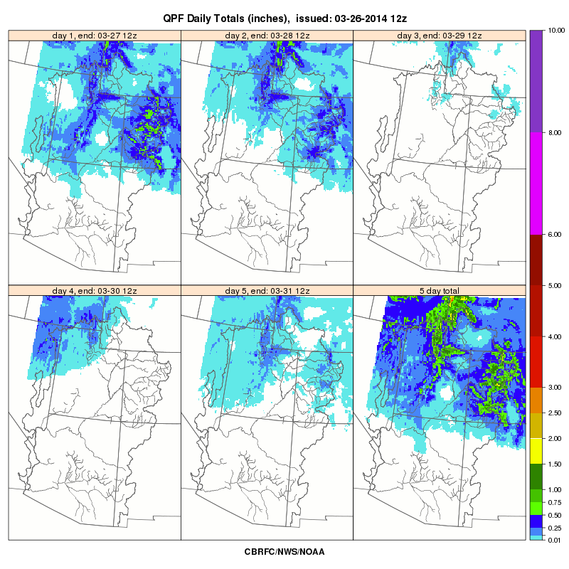
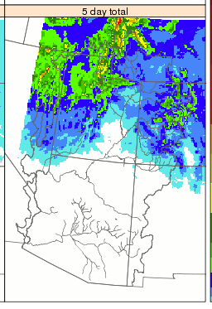
SHORT RANGE FORECASTS
5 Day Total QPF
Issued 3/27/14

Slide 11
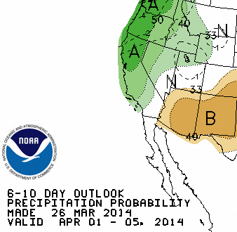
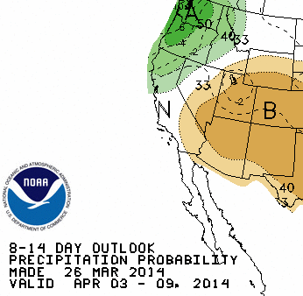
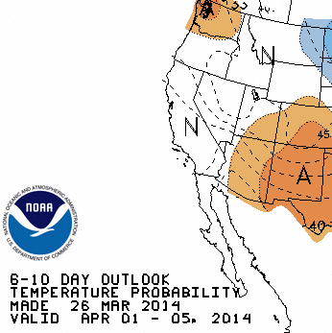
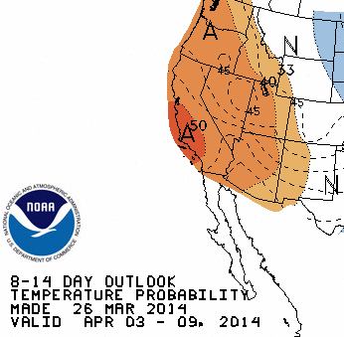
MEDIUM RANGE FORECASTS

Slide 12
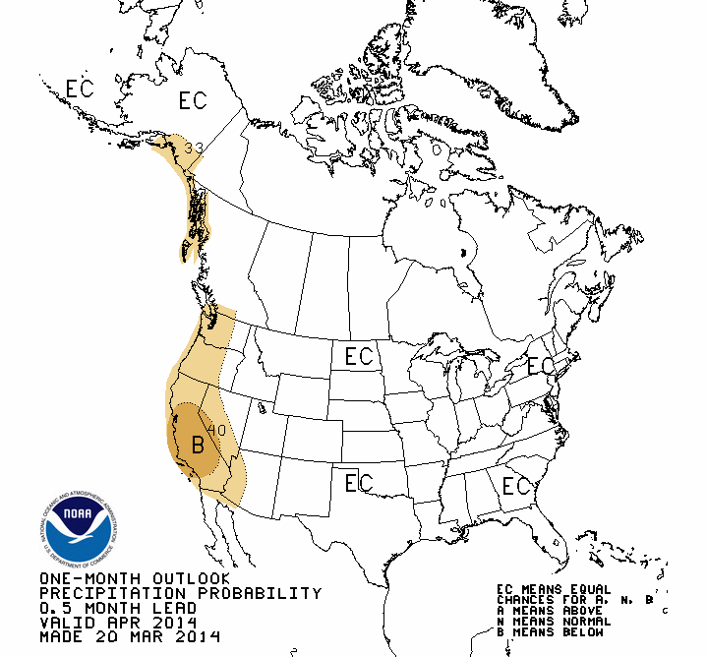
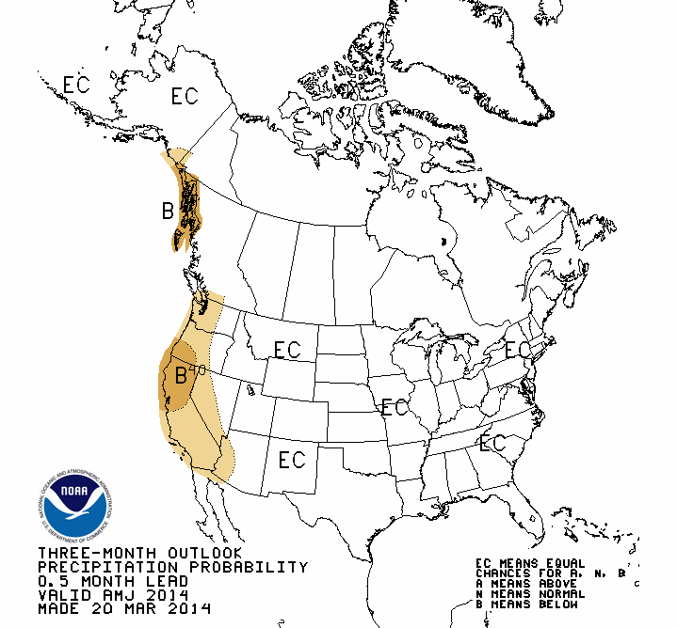
CLIMATE OUTLOOKS - PRECIPITATION
APRIL 2014
APRIL-MAY-JUNE 2014

Slide 13
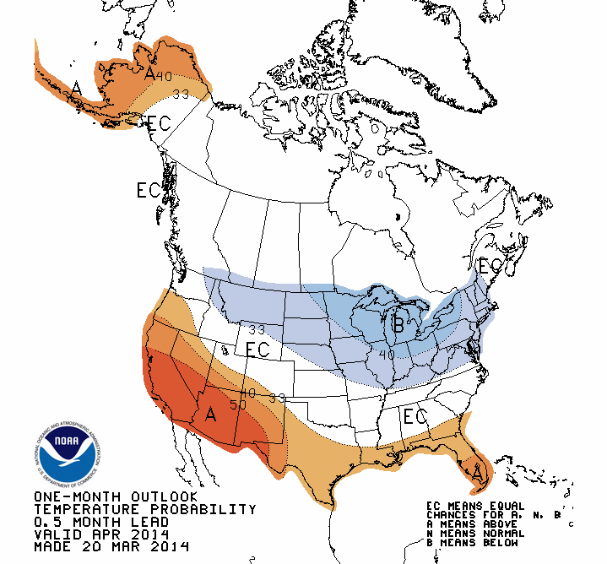
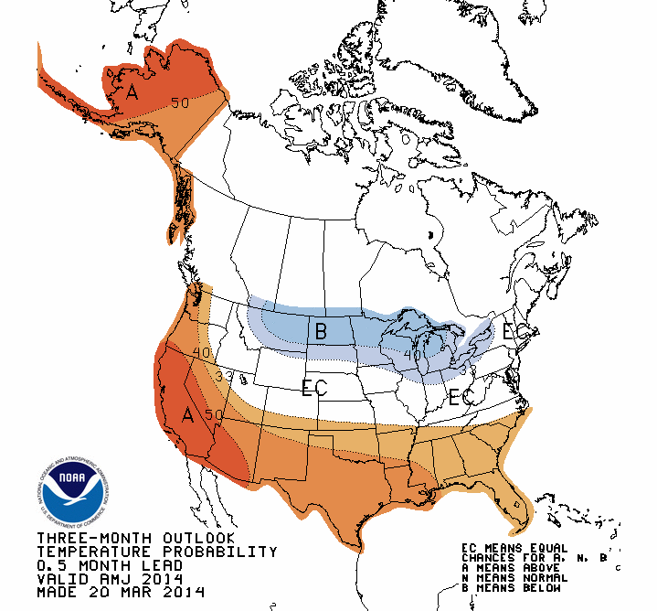
CLIMATE OUTLOOKS - TEMPERATURE
APRIL 2014
APRIL-MAY-JUNE 2014

Slide 14
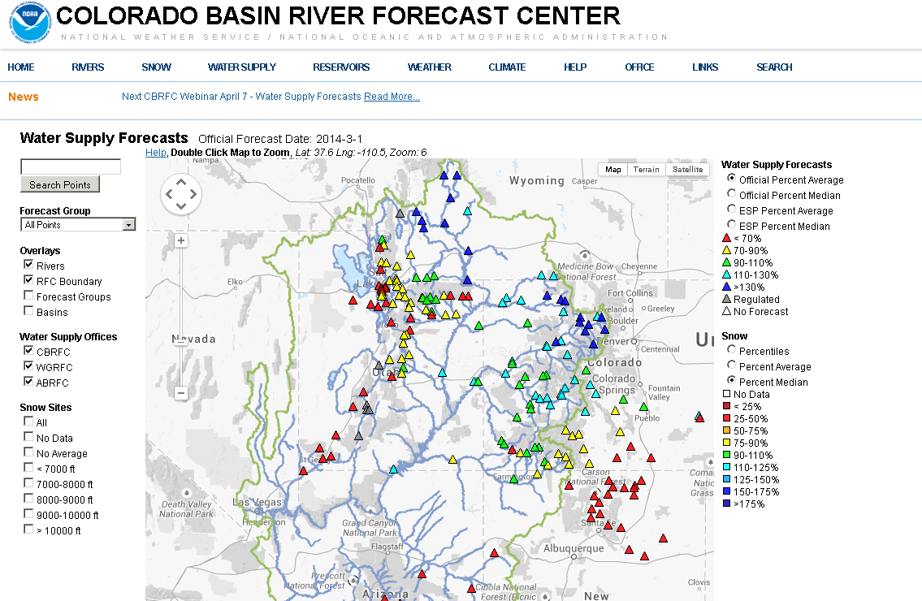
WY 2014
WATER SUPPLY FORECASTS
MARCH 1, 2014 CBRFC
OFFICIAL WATER SUPPLY FORECASTS

Slide 15
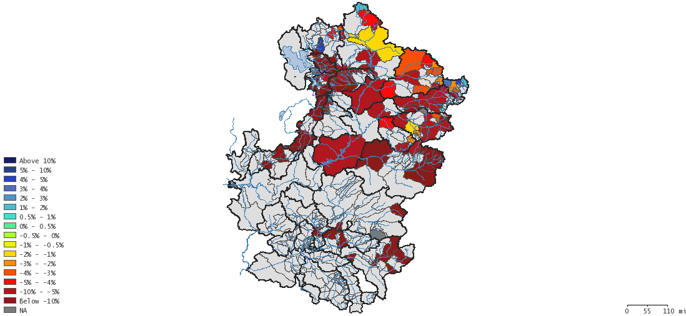
ESP MARCH 2 VS. MARCH 24
%CHANGE IN VOLUME
0 Day QPF
Fontenelle: -2%
Flaming Gorge: -5%
Yampa – Deerlodge: -9%
Green – Green River, UT: -7%
Colorado – Cameo: -5%
Blue Mesa: -9%
Colorado – Cisco: -6%
Navajo: -20%
San Juan – Bluff: -17%
Lake Powell: -10%

Slide 16
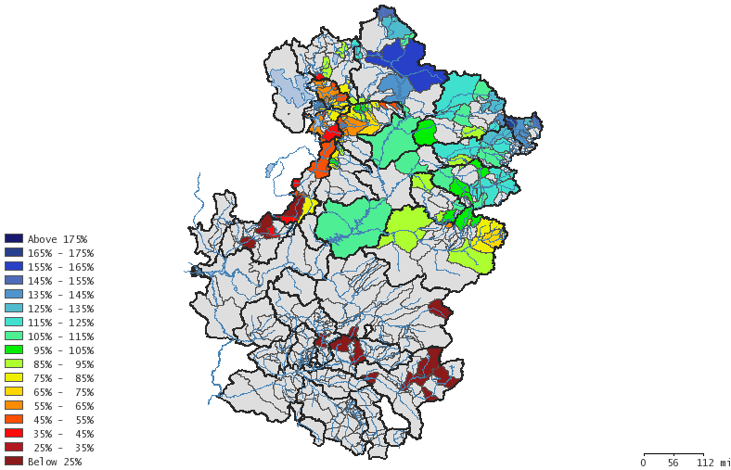
ESP MARCH 24
%AVERAGE
0 Day QPF

Slide 17
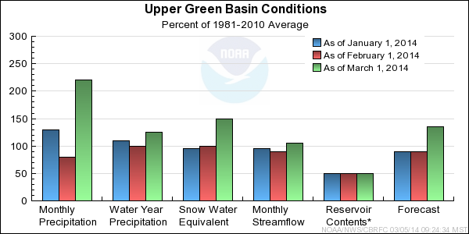
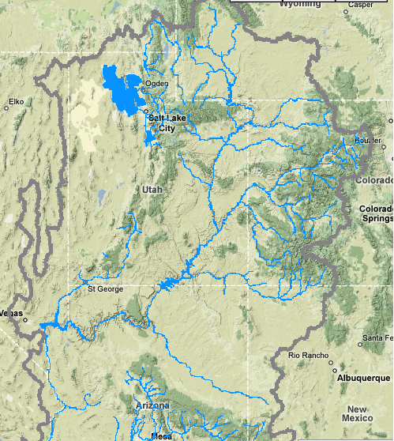
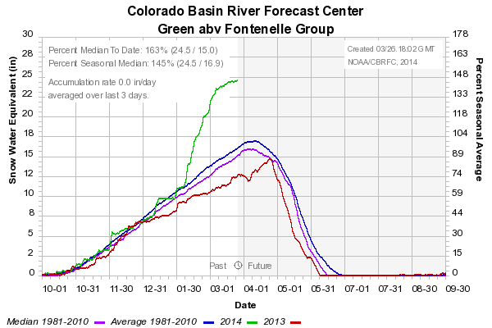
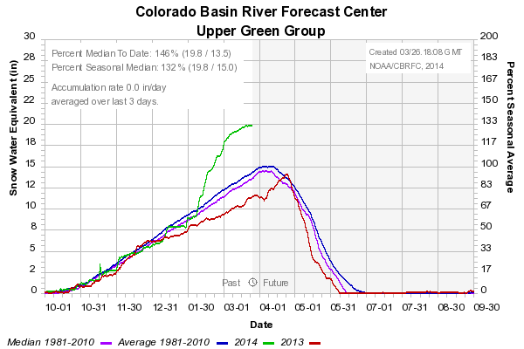
163%
146%

Slide 18
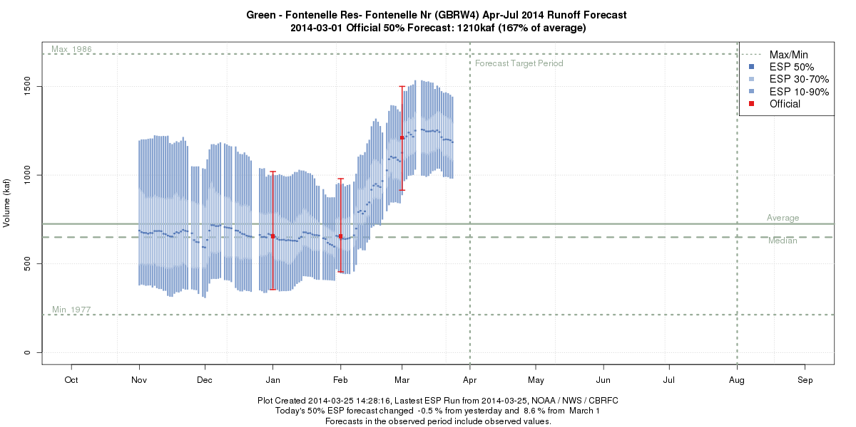
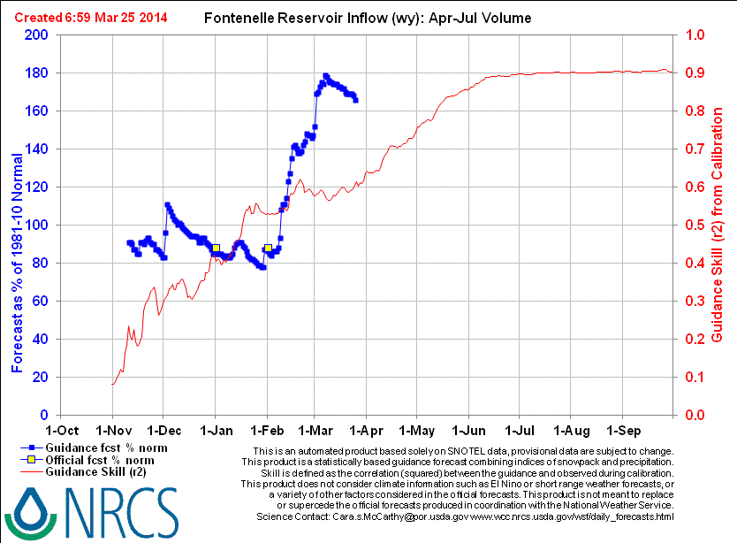
 | Mar 1 | Mar 17 | Mar 26
CBRFC-SWS | 1183
CBRFC-ESP (QPF 0) | 1207 | 1247 | 1175
CBRFC-ESP (QPF 5) | 1247 | 1272 | 1238
CBRFC FINAL | 1210/ 167% | 1240/ 171%
175 / 51%
 | Mar 1 | Mar 25
NRCS- Daily | 1099 | 1201
NRCS-Statistical | 995/1030R | 1050
NRCS FINAL | 1030/142%

Slide 19
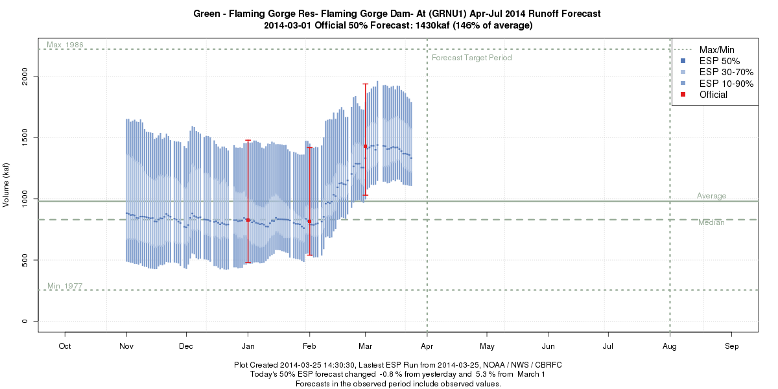
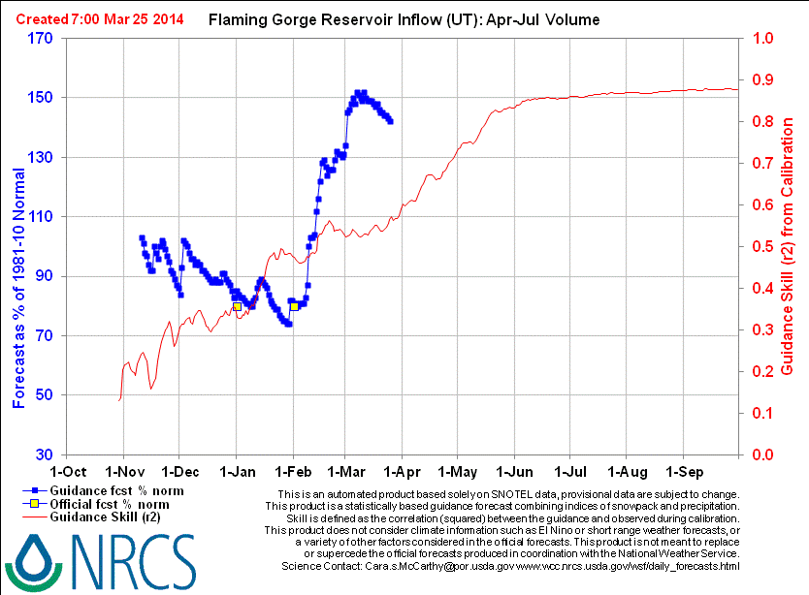
 | Mar 1 | Mar 17 | Mar 26
CBRFC-SWS | 1660
CBRFC-ESP (QPF 0) | 1411 | 1420 | 1315
CBRFC-ESP (QPF 5) | 1445 | 1440 | 1385
CBRFC FINAL | 1430/ 146% | 1430/ 146%
 | Mar 1 | Mar 25
NRCS- Daily | 1312 | 1395
NRCS-Statistical | 1240/1310R | 1330
NRCS FINAL | 1310 / 134%

Slide 20
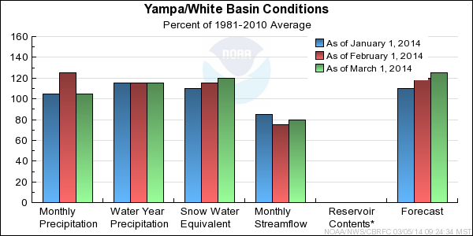
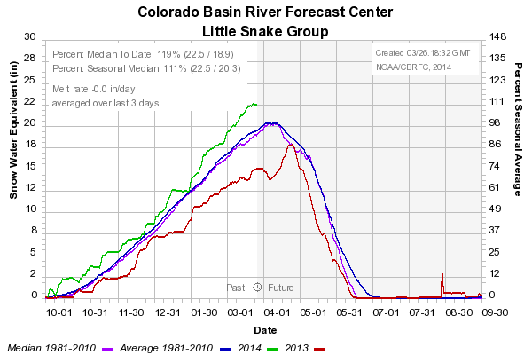
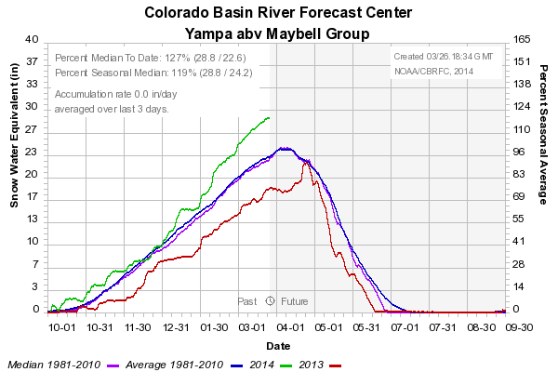
119%
127%

Slide 21
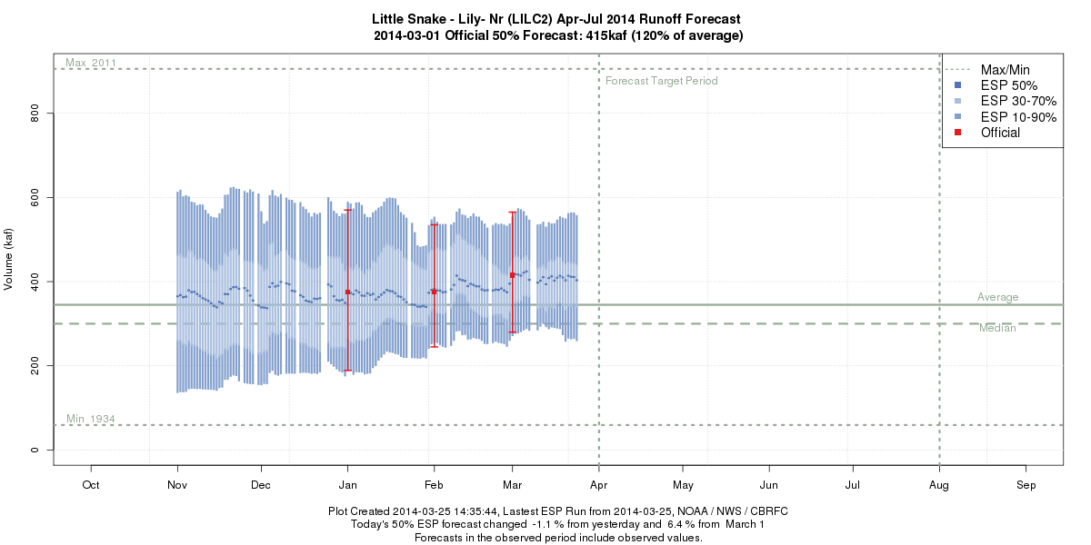
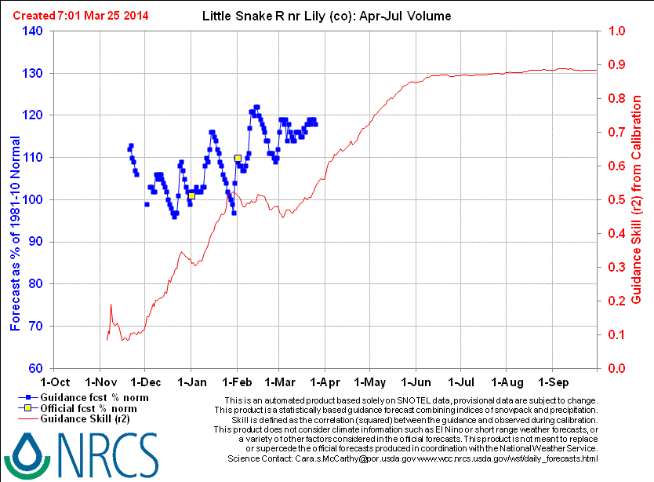
 | Mar 1 | Mar 26
CBRFC-SWS | 416
CBRFC-ESP (QPF 0) | 404 | 395
CBRFC-ESP (QPF 5) | 418 | 394
CBRFC FINAL | 415/ 120%
Mar 1: 420 / 122%
Mar 25: 390 / 113

Slide 22
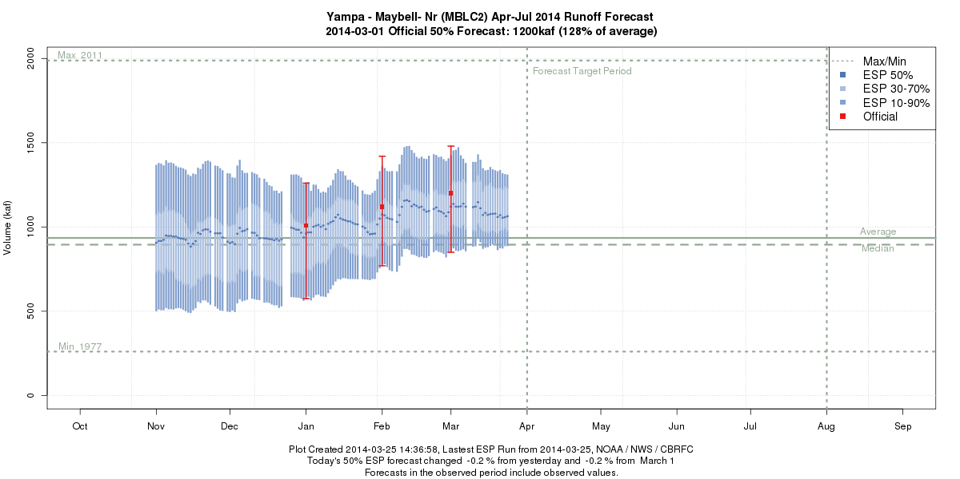
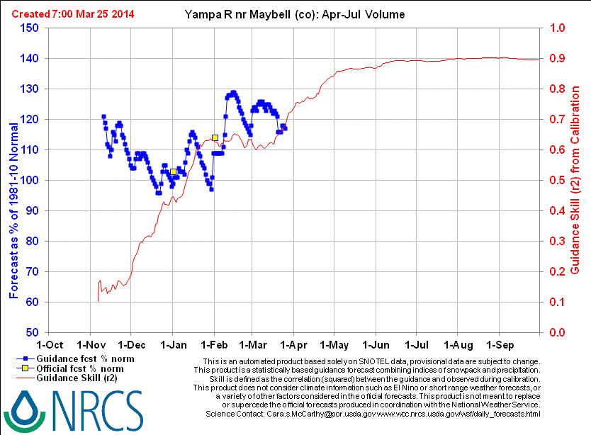
 | Mar 1 | Mar 26
CBRFC-SWS | 1325
CBRFC-ESP (QPF 0) | 1138 | 1060
CBRFC-ESP (QPF 5) | 1117 | 1085
CBRFC FINAL | 1200/ 128%
Mar 1: 1240 / 133%
Mar 25: 1290 / 138%

Slide 23
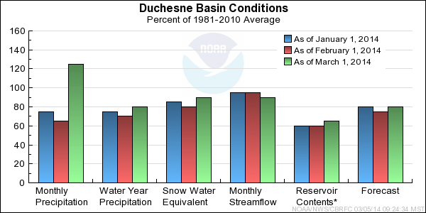
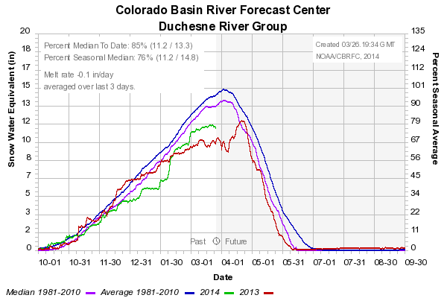
85%

Slide 24
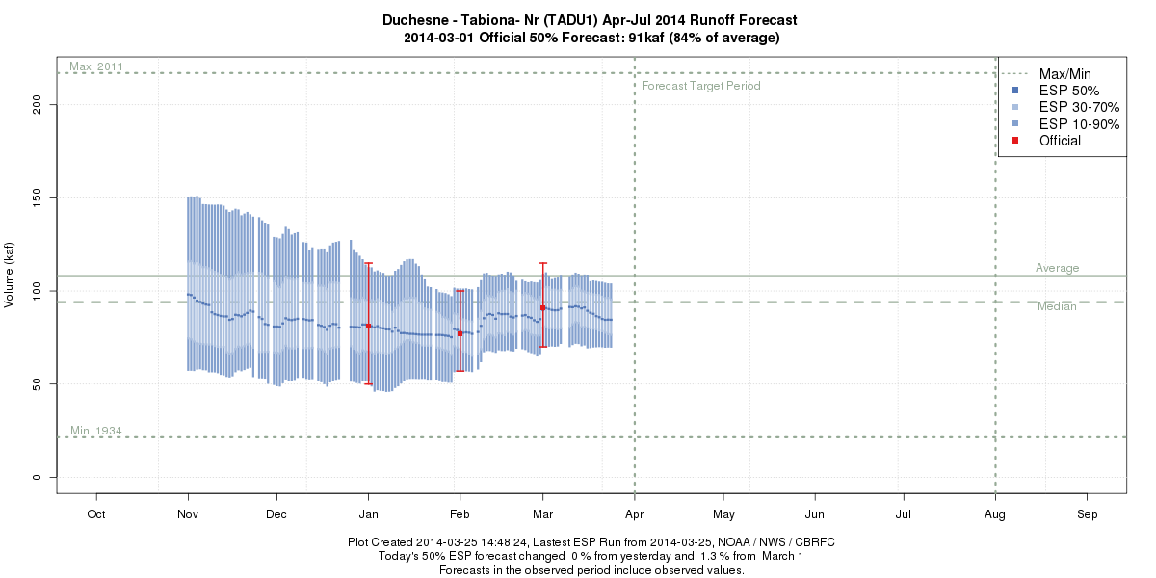
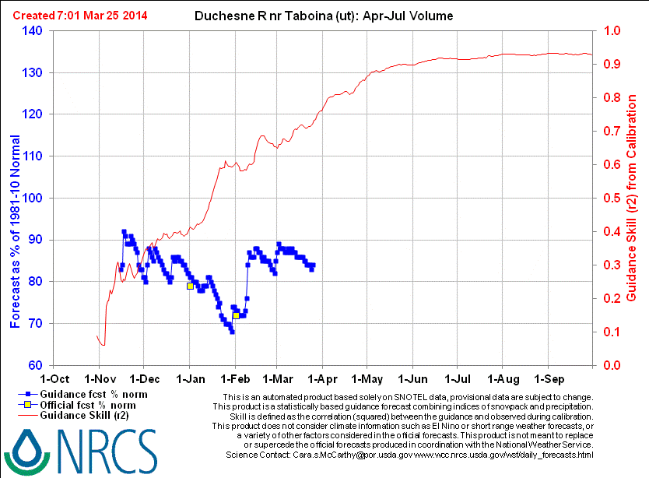
 | Mar 1 | Mar 26
CBRFC-SWS | 88
CBRFC-ESP (QPF 0) | 91 | 86
CBRFC-ESP (QPF 5) | 92 | 84
CBRFC FINAL | 91/84%
Mar 1: 93 / 86%
Mar 25: 88 / 81%
69 / 64%

Slide 25
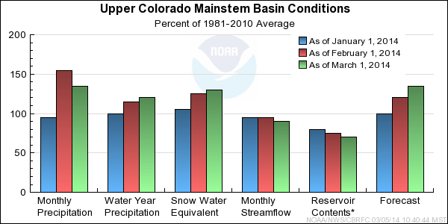
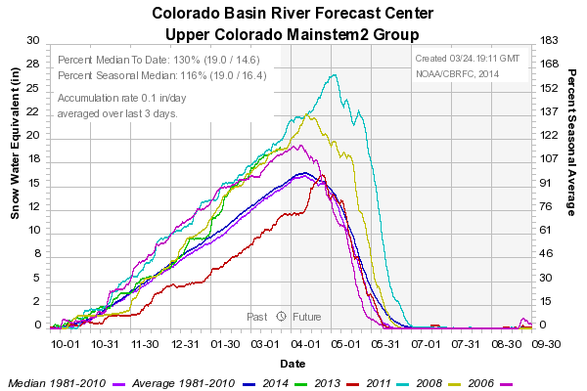
130%
COLORADO - CAMEO | APRIL – JULY VOLUME
2014 (FCST 3/1) | 2950 KAF / 125%
2014 (ESP 3/25) | 2764 KAF / 117%
2006 | 2274 KAF / 96%
2008 | 3171 KAF / 134%
2011 | 4200 KAF / 178%

Slide 26


 | Mar 1 | Mar 25
CBRFC-SWS | 3100
CBRFC-ESP (QPF 0) | 2924 | 2764
CBRFC-ESP (QPF 5) | 2916 | 2802
CBRFC FINAL | 2950 / 125%
 | Mar 1 | Mar 25
NRCS- Daily | 2753 | 2774
NRCS-Statistical | 2890R | 2880
NRCS FINAL | 2890/ 123%

Slide 27


122%

Slide 28


 | Mar 1 | Mar 17 | Mar 24
CBRFC-SWS | 840
CBRFC-ESP (No QPF) | 878 | 898 | 821
CBRFC-ESP (QPF) | 875 | 858 | 814
CBRFC FINAL | 850 / 126% | 850 / 126%
 | Mar 1 | Mar 25
NRCS- Daily | 785 | 752
NRCS-Statistical | 770/785R | 750
NRCS FINAL | 785 / 116%

Slide 29



CBRFC: 120 / 121%
CBRFC: 97 / 96%
NRCS: 115 / 116%
NRCS: 94 / 93%
Mid Month Forecast Values
CBRFC: 265 / 90%
NRCS: 235 / 80%

Slide 30


74%

Slide 31


 | Mar 1 | Mar 17 | Mar 24
CBRFC-SWS | 606
CBRFC-ESP (No QPF) | 685 | 630 | 583
CBRFC-ESP (QPF) | 671 | 622 | 563
CBRFC FINAL | 630 / 85% | 590 / 80%
 | Mar 1 | Mar 25
NRCS- Daily | 542 | 478
NRCS-Statistical | 580R | 470
NRCS FINAL | 580 / 79%

Slide 32




Mid-Month CBRFC: 48 / 87%
Mid-Month CBRFC: 190 / 98%
Mid-Month NRCS: 43 / 78%
Mid-Month NRCS: 156 / 80%
Mar 1: 49 / 89%
Mar 25: 40 / 73%
Mar 1: 165 / 85%
Mar 25: 150 / 77%

Slide 33

March precip to date: ~85%
110%

Slide 34




Green – Green River, UT
 | Mar 1 | Mar 17 | Mar 25
CBRFC-SWS | 8281
CBRFC-ESP (QPF 0) | 8505 | 8218 | 7591
CBRFC-ESP (QPF 5) | 8349 | 7871 | 7538
CBRFC FINAL | 8300/ 116% | 8000 / 112%
CBRFC: 3580 / 121%
NRCS: 3210/ 108%
Colorado – Lake Powell Inflow
Colorado – Cisco, nr
CBRFC: 5180/ 117%
NRCS: 4840/ 113%
San Juan – Bluff, nr
CBRFC: 980/ 89%
 | Mar 1 | Mar 16 | Mar 25
NRCS- Daily
NRCS-Statistical | 7710-7790R | 7390-7480R | 7290-7390R
NRCS FINAL | 7800/ 109% | 7500 / 105%
NRCS: 935/ 85%

Slide 35


Virgin and Lower Colorado

Slide 36



Lake Mead Intervening Flow
Forecast issued 3/17/2014
March: 80 KAF / 73%
April: 50 KAF / 48%
May: 50 KAF / 66%
April - July: 175 KAF / 63%
43%
Mar1: 21 kaf/ 36% avg
Mar25: 20 kaf
Mar1: 23 / 40%
Mar25: 17.9 / 31%

Slide 37


Jan-May forecast: 220 kaf / 71 % med
Mar-May forecast: 66 kaf / 28 % med
Jan-Feb obs: 29 kaf
Mar obs to date: ~20 kaf

