Slide 1

CRFS Technical Committee
Fall Meeting
LC Operations Update
December 8, 2015

Slide 2
Topics
LC Current Conditions Update
LC Operations Update
SECURE Reservoir Operations Pilot Update

Slide 3
Current Conditions

Slide 4
Colorado River Basin Storage
(as of December 4, 2015)
Reservoir | Percent Full | Storage (maf) | Elevation (feet)
Lake Powell | 50% | 12.22 | 3,604.9
Lake Mead | 38% | 9.88 | 1,078.4
Lake Mohave | 84% | 1.53 | 636.6
Lake Havasu | 92% | 0.57 | 447.4
Total System Storage* | 50% | 29.87 | NA
*Total system storage was 29.72 maf or 50% this time last year
Notes:
4
In handout, include conditions this time at the beginning of year

Slide 5
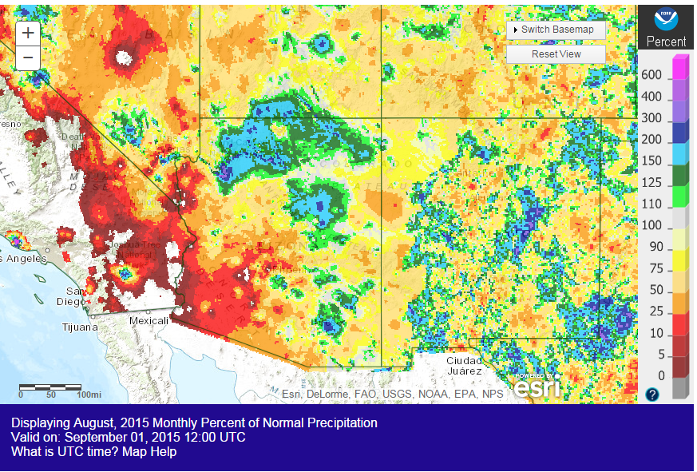
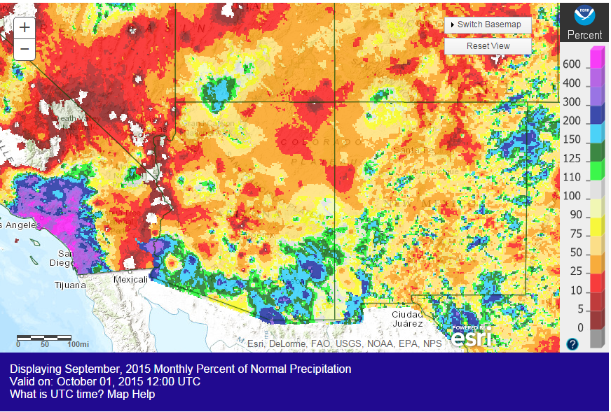
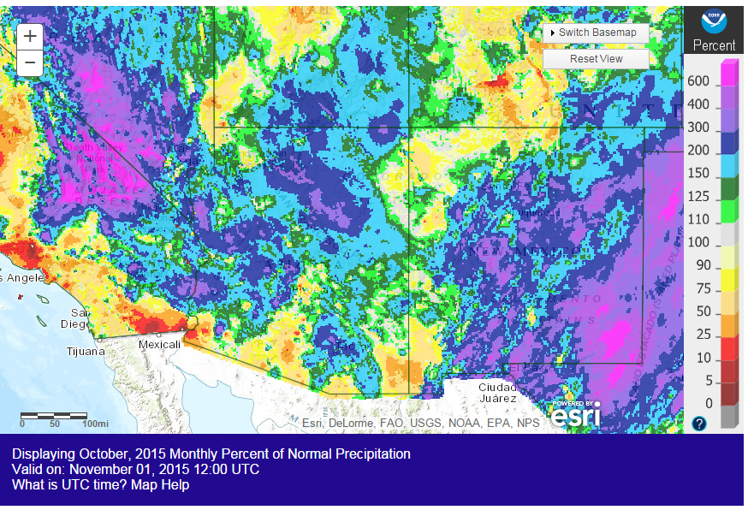
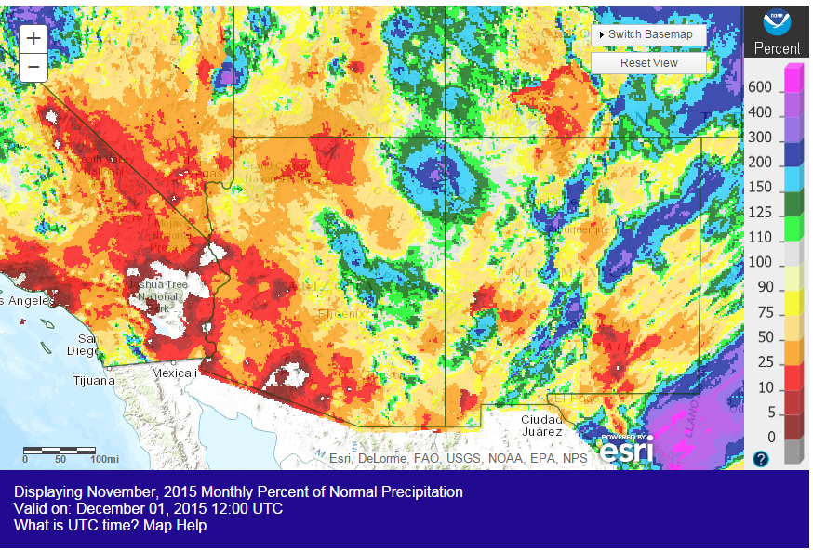
Observed Precipitation
Source: http://water.weather.gov/precip/
Notes:
-Discuss dry summer conditions and wet October.

Slide 6
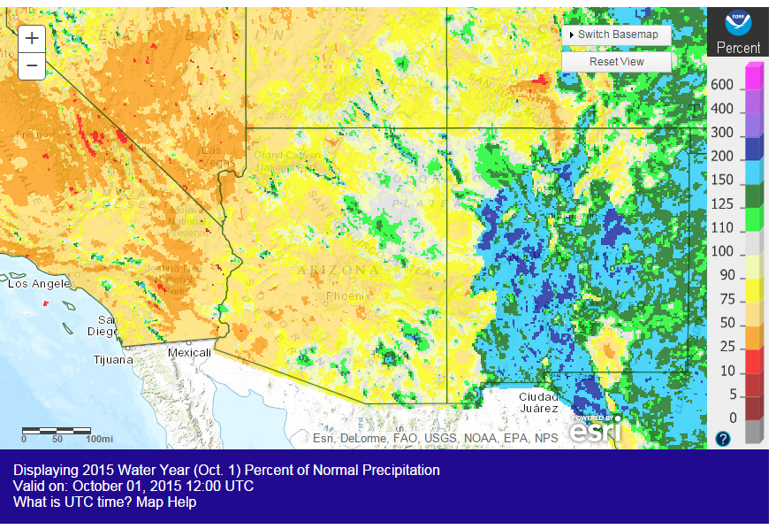
WY 2015 Observed Precipitation
Source: http://water.weather.gov/precip/
Notes:
-Overall, a dry Water Year 2015 with near normal precip in Arizona.

Slide 7
Lower Basin Side Inflows – WY/CY 2015^{1,2}
Intervening Flow from Glen Canyon to Hoover Dam
Month in WY/CY 2015 |  | 5-Year Average Intervening Flow (KAF) | Observed Intervening Flow (KAF) | Observed Intervening Flow (% of Average) | Difference From 5-Year Average (KAF)
OBSERVED | October 2014 | 61 | 68 | 111% | 7
 | November 2014 | 50 | 44 | 88% | -6
 | December 2014 | 96 | 56 | 58% | -40
 | January 2015 | 72 | 73 | 101% | 1
 | February 2015 | 77 | 90 | 117% | 13
 | March 2015 | 61 | 57 | 94% | -4
 | April 2015 | 76 | 26 | 34% | -50
 | May 2015 | 49 | 25 | 51% | -24
 | June 2015 | 23 | 16 | 71% | -7
 | July 2015 | 67 | 80 | 119% | 13
 | August 2015 | 127 | 115 | 91% | -12
 | September 2015 | 114 | 73 | 64% | -41
 | October 2015 | 61 | 119 | 195% | 58
 | November 2015 | 50 | 18 | 35% | -33
PROJ | December 2015 | 96
 | WY 2015 Totals | 874 | 724 | 83% | -150
 | CY 2015 Totals | 874 | 789 | 90% | -85
¹ Values were computed with the LC’s gain-loss model for the most recent 24-month study.
² Percents of average are based on the 5-year mean from 2010-2014.
Notes:
-Another below normal year for intervening flows

Slide 8
Parker Dam Releases
Notes:
-Despite dry conditions in the basin, Parker Dam releases were lower than the past 15 year average beginning in April and continued through October. (drought conservation?)

Slide 9
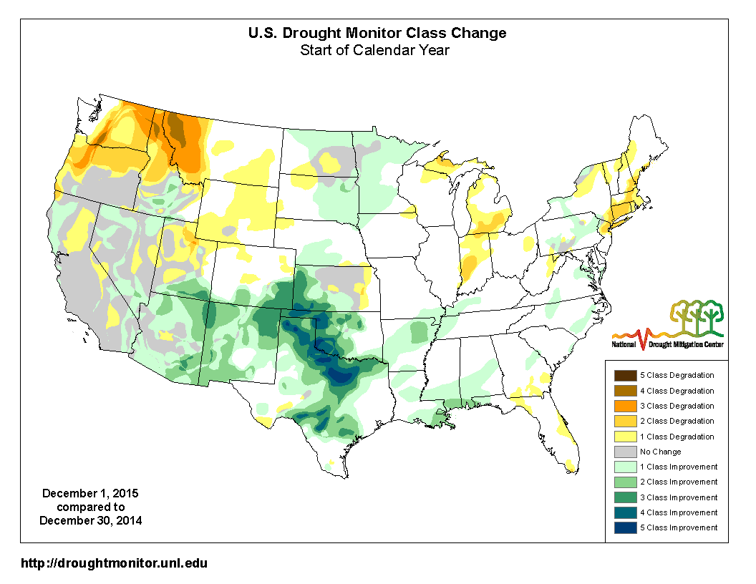
Drought Conditions
Notes:
-Reinforces that there hasn’t been much change in drought conditions in CA since beginning of year. Slight improvement in AZ

Slide 10
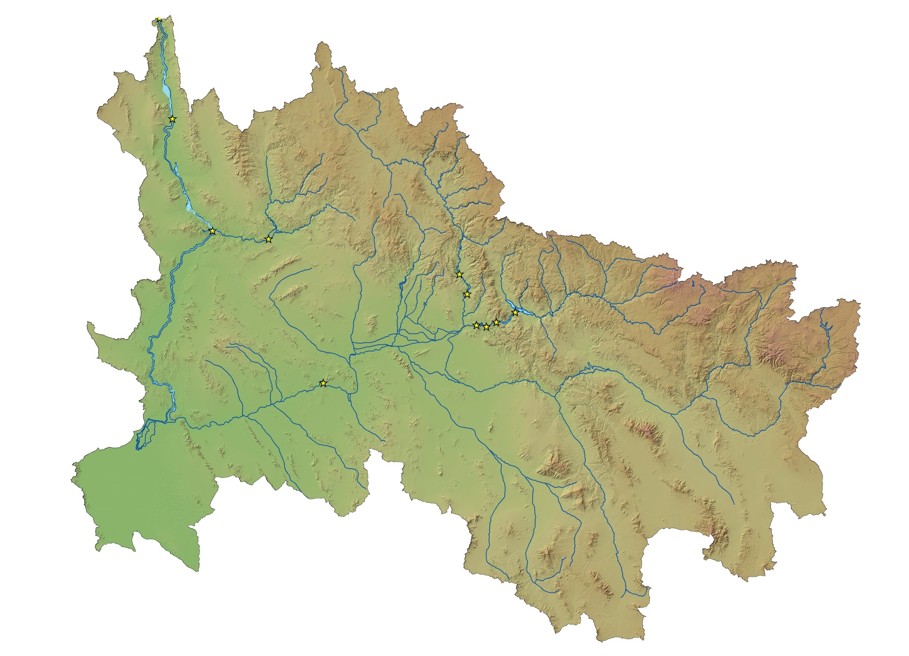

Hoover Dam
STATUS OF OTHER LOWER BASIN RESERVOIRS
as of December 5, 2015
Alamo Dam
Elevation: 1,087.9 feet
Capacity: 5%
Content: 52 kaf
Inflow: 2 cfs
Outflow: 10 cfs
Davis Dam
Salt River Project
Capacity: 50%
Content: 1.14 maf
Alamo Dam
Bill Williams
River
Agua Fria River
Verde River
Parker Dam
Horseshoe Dam
Bartlett Dam
Salt River
Colorado River
Roosevelt Dam
Painted Rock Dam
Stewart Mtn. Dam
Gila River
Mormon Flat Dam
Horse Mesa Dam
Santa Cruz River
San Pedro River
Painted Rock Dam
Elevation: 535.0 feet
Capacity: 0%
Inflow: 0 cfs
Outflow: 0 cfs

Slide 11
Lower Basin Operations
Calendar Year 2015/2016
Lake Mead Operating Conditions
Operating under the Normal/ICS Surplus Condition
  Lower Basin projected water use of 7.5 maf +/- ICS created or delivered
  Mexico projected to take delivery of 1.5 maf +/- any water deferred or delivered

Slide 12
End of Calendar Year 2015 Projections
November 2015 24-Month Study Most Probable Inflow Scenario¹
Based on a 9.00 maf release pattern from Lake Powell in Water Year 2016
Lake Mead
Lake Powell
1,219.6
26.120 maf
24.322 maf
3,700
17.3 maf
3,651
1,145
16.2 maf
1,105
12.2 maf
9.5 maf
3,600.6 feet
11.80 maf in storage
49% of capacity
3,575
1,075
9.6 maf
1,083.1 feet
10.27 maf in storage
39% of capacity
5.9 maf
3,525
1,025
6.0 maf
0.0 maf
3,370
895
0.0 maf
Dead Storage
1.9 maf
2.5 maf
Dead Storage
Not to Scale
¹ WY 2016 unregulated inflow into Lake Powell is based on the CBRFC outlook dated 11/2/15.

Slide 13
End of Water Year 2016 Projections
November 2015 24-Month Study Most Probable Inflow Scenario¹
Projected Unregulated Inflow into Powell¹ = 8.39 maf (77% of average)
Lake Mead
Lake Powell
1,219.6
26.120 maf
24.322 maf
3,700
17.3 maf
3,651
1,145
16.2 maf
1,105
12.2 maf
9.5 maf
3,598.1 feet
11.57 maf in storage
48% of capacity
3,575
1,075
9.6 maf
1,074.1 feet
9.52 maf in storage
36% of capacity
5.9 maf
3,525
1,025
6.0 maf
9.00 maf
0.0 maf
3,370
895
0.0 maf
Dead Storage
1.9 maf
2.5 maf
Dead Storage
Not to Scale
¹ WY 2016 unregulated inflow into Lake Powell is based on the CBRFC outlook dated 11/2/15.
Notes:
Total WY15 Unregulated Inflow into Powell = 10.174 MAF, 94% of average
Sept Final Forecast Upper Basin 300 kaf, but we observed 276 kaf,
Sep 24-MS Powell Elev EOWY15 = 3606.53, about a half foot lower than the projection
Side inflow to Mead was 76 kaf (41 kaf less than the avg side inflow, which was used in Sep 24-MS)
Mead Elev EOWY15 = 1078.21, but Mead did not drop 0.4 ft due to lower demand than projected

Slide 14
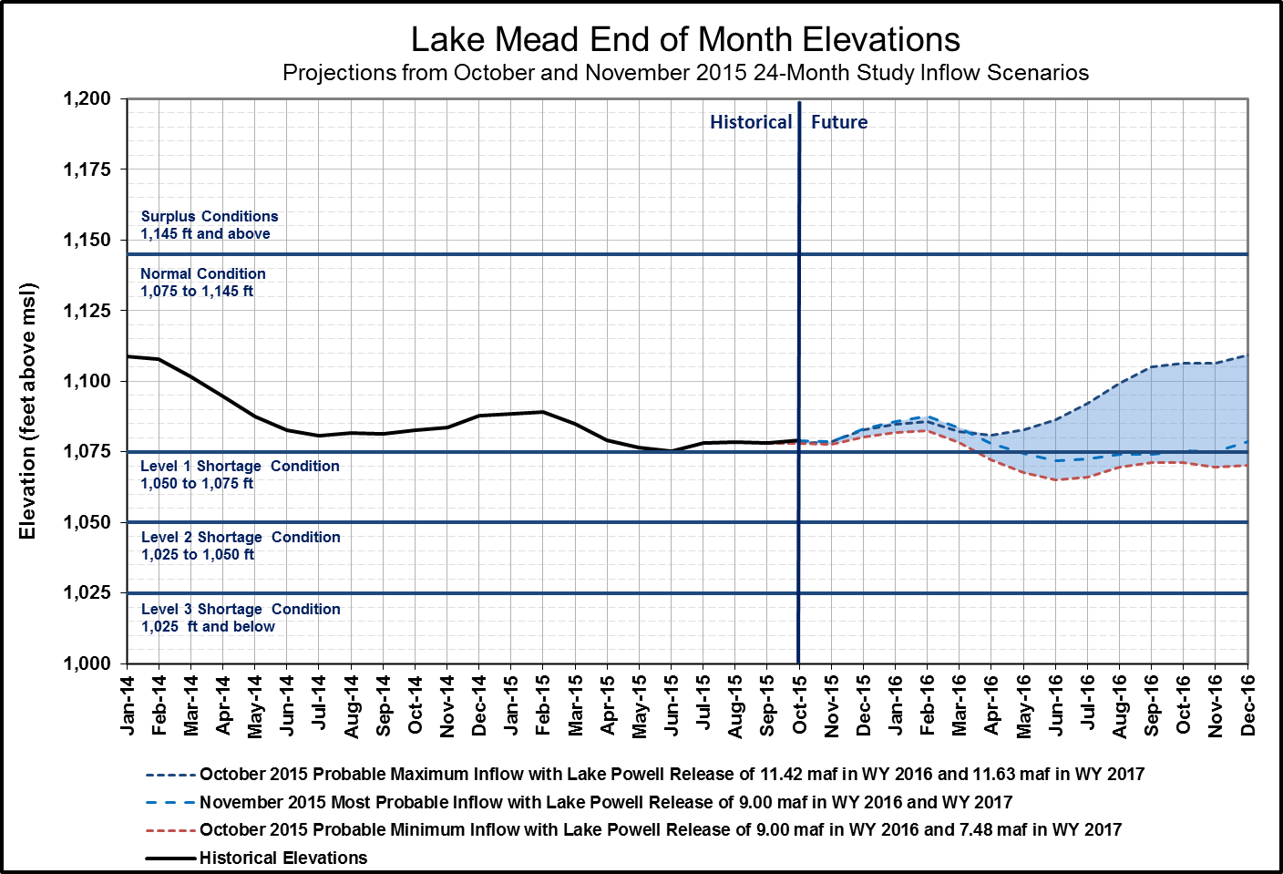
End of CY 2015 Projection:
1,083.1 feet
End of CY 2016 Projection:
1,078.7 feet
(Range 1,070 to 1,109 feet)

Slide 15
Percent of Traces with Event or System Condition
Results from August 2015 CRSS^{1,2,3} (values in percent)
 | Event or System Condition | 2016 | 2017 | 2018 | 2019 | 2020
Upper Basin – Lake Powell | Equalization Tier | 8 | 24 | 23 | 27 | 29
 | Equalization – annual release > 8.23 maf | 8 | 23 | 23 | 27 | 28
 | Equalization – annual release = 8.23 maf | 0 | 0 | 0 | 0 | 1
 | Upper Elevation Balancing Tier | 92 | 52 | 55 | 54 | 47
 | Upper Elevation Balancing – annual release > 8.23 maf | 82 | 39 | 43 | 42 | 36
 | Upper Elevation Balancing – annual release = 8.23 maf | 10 | 13 | 11 | 10 | 11
 | Upper Elevation Balancing – annual release < 8.23 maf | 0 | 0 | 1 | 2 | 0
 | Mid-Elevation Release Tier | 0 | 24 | 19 | 10 | 17
 | Mid-Elevation Release – annual release = 8.23 maf | 0 | 0 | 0 | 1 | 1
 | Mid-Elevation Release – annual release = 7.48 maf | 0 | 24 | 19 | 9 | 16
 | Lower Elevation Balancing Tier | 0 | 0 | 3 | 9 | 7
Lower Basin – Lake Mead | Shortage Condition – any amount (Mead ≤ 1,075 ft) | 0 | 18 | 52 | 65 | 59
 | Shortage – 1st level (Mead ≤ 1,075 and ≥ 1,050) | 0 | 18 | 42 | 47 | 35
 | Shortage – 2nd level (Mead < 1,050 and ≥ 1,025) | 0 | 0 | 10 | 14 | 18
 | Shortage – 3rd level (Mead < 1,025) | 0 | 0 | 0 | 4 | 7
 | Surplus Condition – any amount (Mead ≥ 1,145 ft) | 0 | 0 | 6 | 7 | 15
 | Surplus – Flood Control | 0 | 0 | 0 | 2 | 2
 | Normal or ICS Surplus Condition | 100 | 82 | 42 | 28 | 26
¹ Reservoir initial conditions based on December 31, 2015 conditions using projections from the most probable August 2015 24-Month Study.
² Results are based on 107 hydrologic inflow sequences based on resampling of the observed natural flow record from 1906-2012.
³ Percentages shown may not be representative of the full range of future
possibilities that could occur with different modeling assumptions.

Slide 16
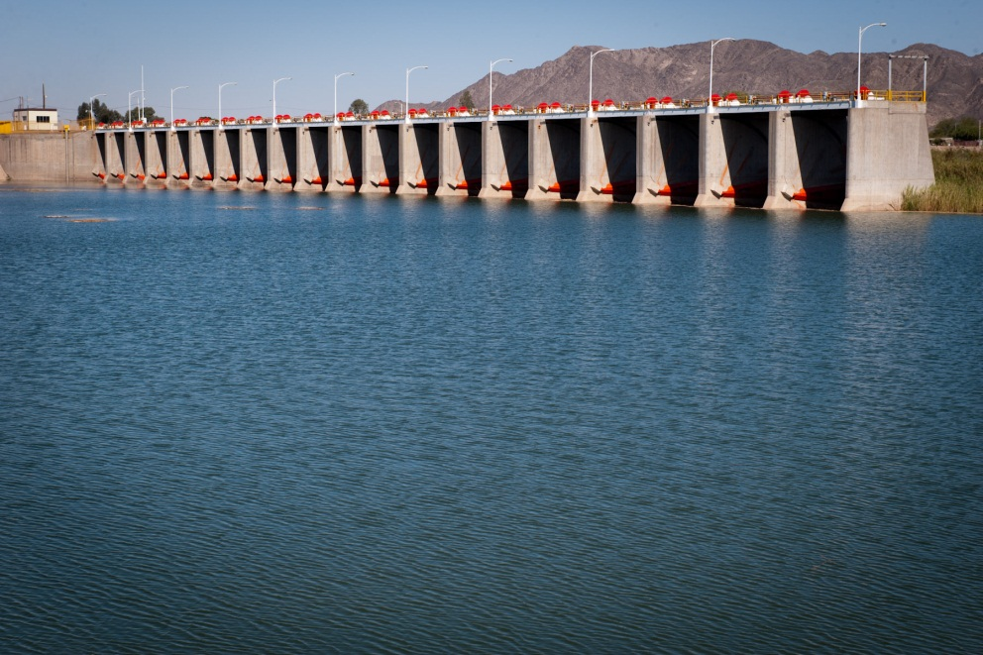
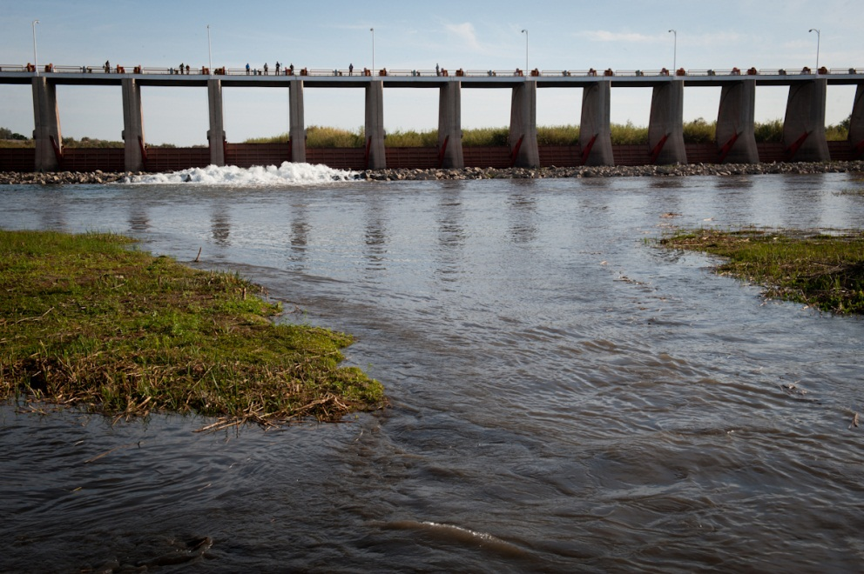
Additional Operational Data
(provisional year-to-date values)
Mexico Excess Flows (af) | Brock Reservoir Stored (af) | Senator Wash Stored (af)
14,341 | 131,977 | 104,319
Through 12/3/15 | Through 11/27/15 | Through 11/27/15
Morelos Dam Pictured Above – April 2014
Alexander Stephens (USBR)

Slide 17
SECURE Reservoir Operations: LC Pilot Study

Slide 18
SECURE Reservoir Operations Pilot Initiative
On June 26, 2015 the office of Policy and Administration distributed a memorandum requesting recommendations for pilot studies under the Reservoir Operations Pilot Initiative.
The Reservoir Operations Pilot is identified in the Bureau of Reclamation’s Climate Change Adaptation Strategy as a high priority action to achieve the goal of increasing water management flexibility.
The purpose of the pilot initiative is to develop and test guidance for increasing the flexibility of reservoir operations as an adaptation strategy to climate change impacts.
  No actual changes to operations will be performed during the pilot study.

Slide 19
SECURE Reservoir Operations Pilot Initiative
Reclamation’s Phoenix Area Office (PXAO) worked with the Salt River Project (SRP) office to develop a pilot nomination letter for the entire SRP reservoir system.
On August 17th and 18th, the SECURE Reservoir Operations (SRO) team met in Denver to review all of the submitted pilot nominations from each Reclamation region.
PXAO’s submission was well received and included the following objectives
  Identify and evaluate projected changes to surface water availability.
  Identify which changes are projected to occur due to climate change impacts or if projected changes are within normal variability.
  Use climate change data to understand impacts and potential changes to the probable maximum precipitation and probable maximum flood events.
  Incorporate extreme weather forecasting, including projected climate data, into the forecast models used by the SRP.
  Understand climate change impacts to supply volume, runoff timing, water quality, and reservoir sedimentation.

Slide 20
SECURE Reservoir Operations Pilot Initiative
Next Steps
  Clarification
    Intellectual property concerns
  Plan of study
    PXAO and SRP are expanding the objectives stated in the nomination letter to create a detailed plan of study
    Will be submitted to SRO team for review by Friday, December 11th.
    Pilot studies to officially begin in early CY 2016.

Slide 21

Lower Colorado River
Operations
For further information: http://www.usbr.gov/lc/region
Email at:
bcoowaterops@usbr.gov

