Slide 1
COLORADO RIVER FORECASTING SERVICE Technical Committee Fall 2015 Meeting
Van Crisostomo, PE
Chief, Reservoir Regulation Section
Amanda Waller Walsh, PE
Hydraulic Engineer, Reservoir Regulation Section
Los Angeles District
08 December 2015

Slide 3
Alamo Dam

Slide 4
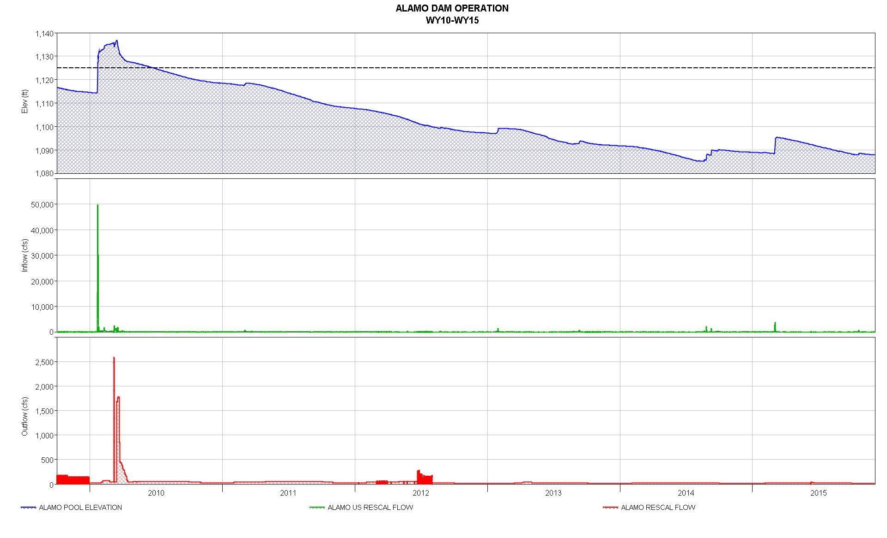
Optimal Pool 1125’ (161,000 ac-ft)
Currently 1,087.8’
(52,062 ac-ft)

Slide 5
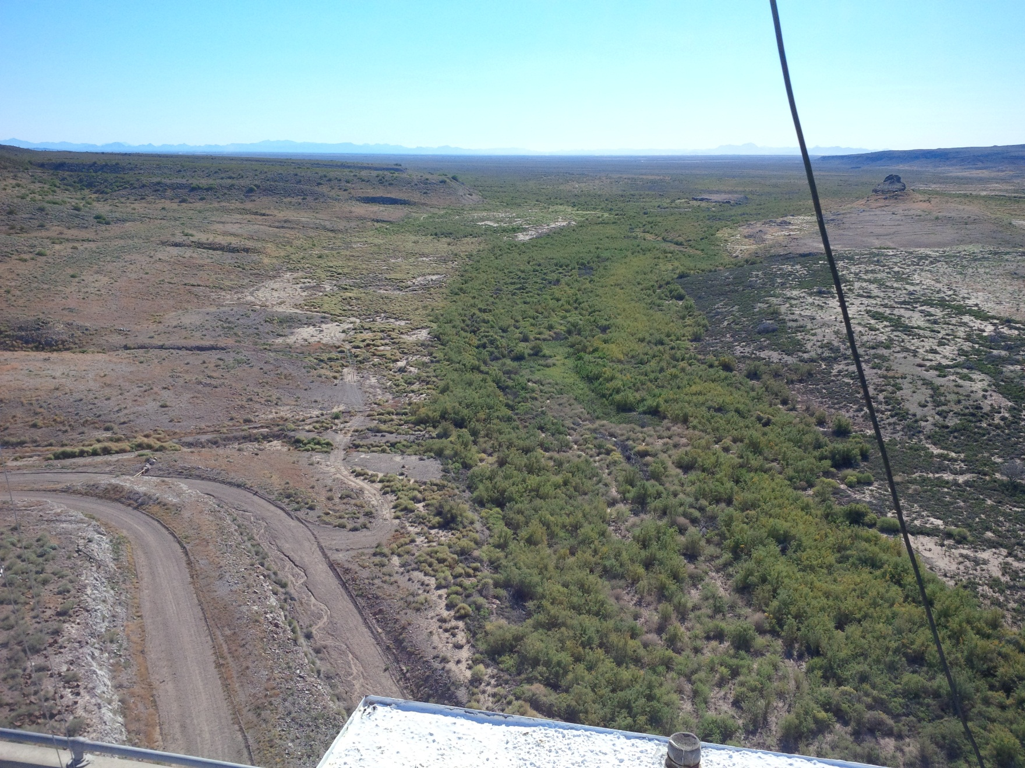
Painted Rock Dam

Slide 6
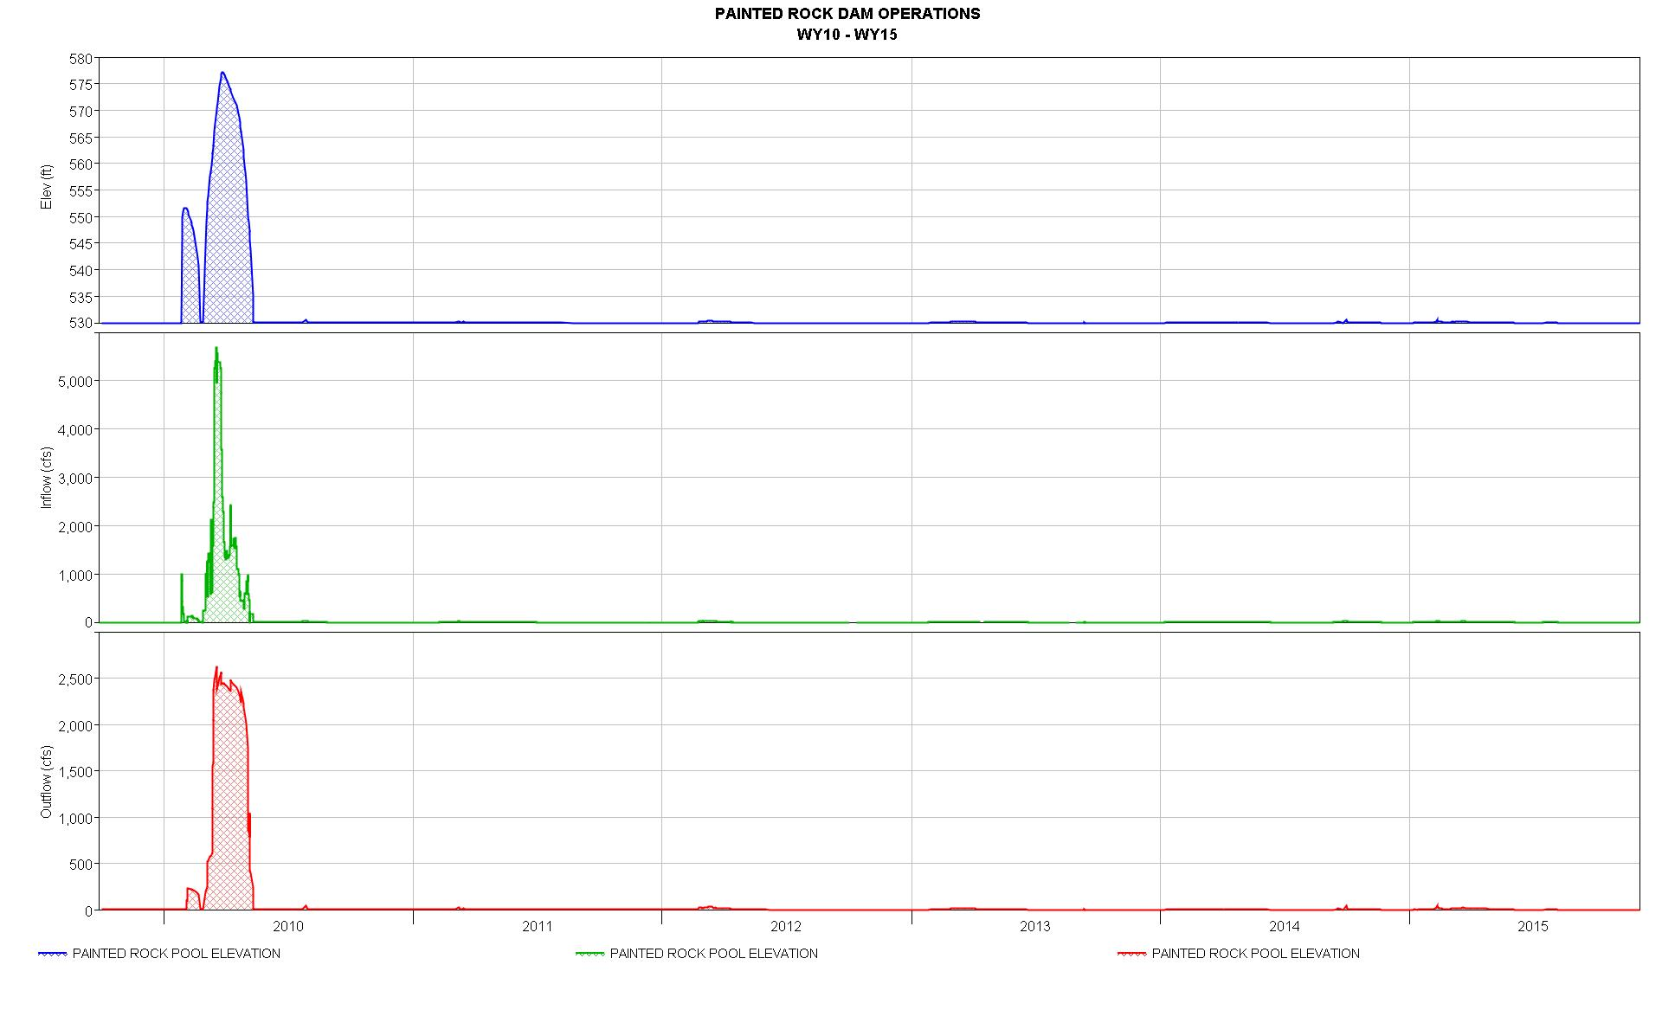
Dry since 2010

Slide 7
Other Items
Water Control Manual Update
Painted Rock Dam
Corps Water Management System (CWMS) Modeling
Bill Williams Basin Model: FY16 Completion
Gila River Basin Model: FY17 Completion
RFC Inflow Forecasts
Alamo
Gila River Basin

Slide 8
Questions?

