Slide 1
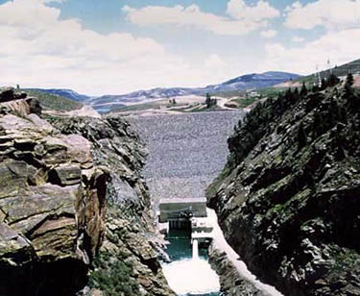
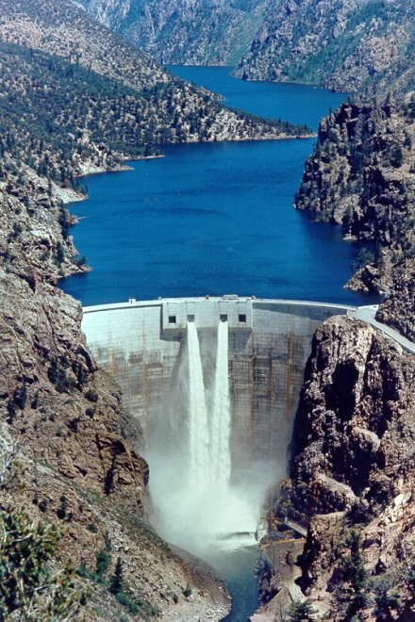
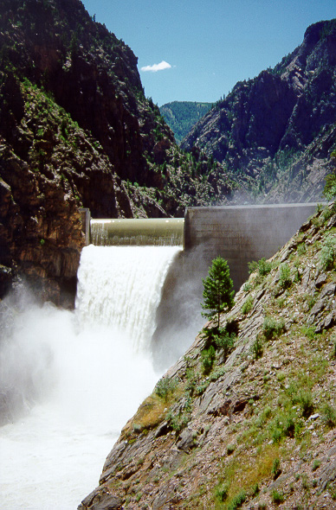
Aspinall Unit Reservoir Operations
2015

Slide 2
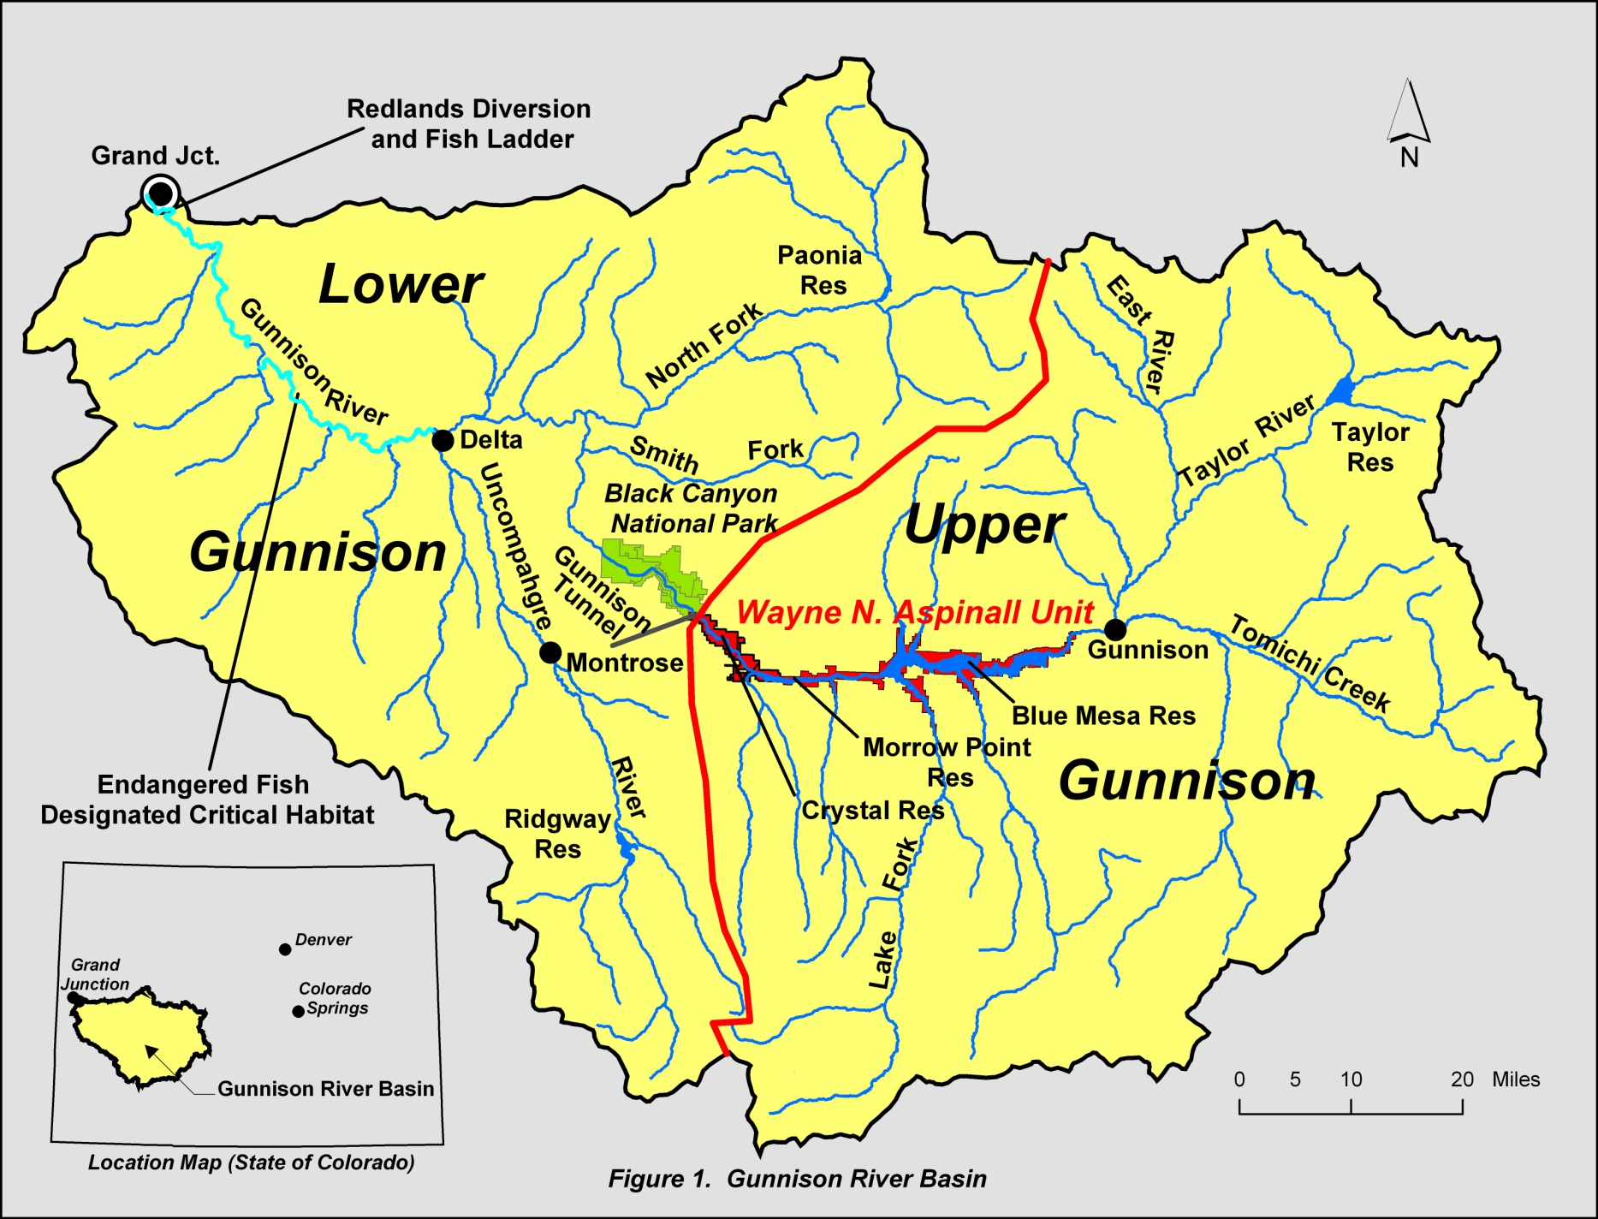

Slide 3
Operational Considerations
Aspinall Unit Purposes
Water storage / Compact Development
Power Production
Flood Control
Downstream Flow Requirements - including Senior Water Rights, timing side-inflows
Target Elevations
Meeting the ROD flow targets at Whitewater
Others - Including Recreation and Safety

Slide 5
2015 May 1st Forecasted Runoff Volume
(440,000 Acre-Feet, 83% exceedance)

Slide 6
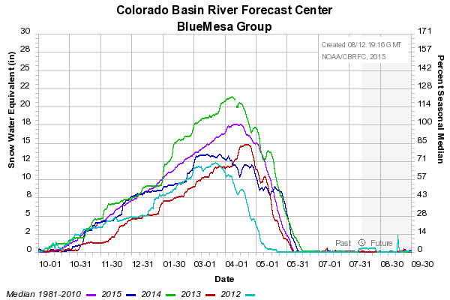
73% of seasonal peak

Slide 7
2015

Slide 9
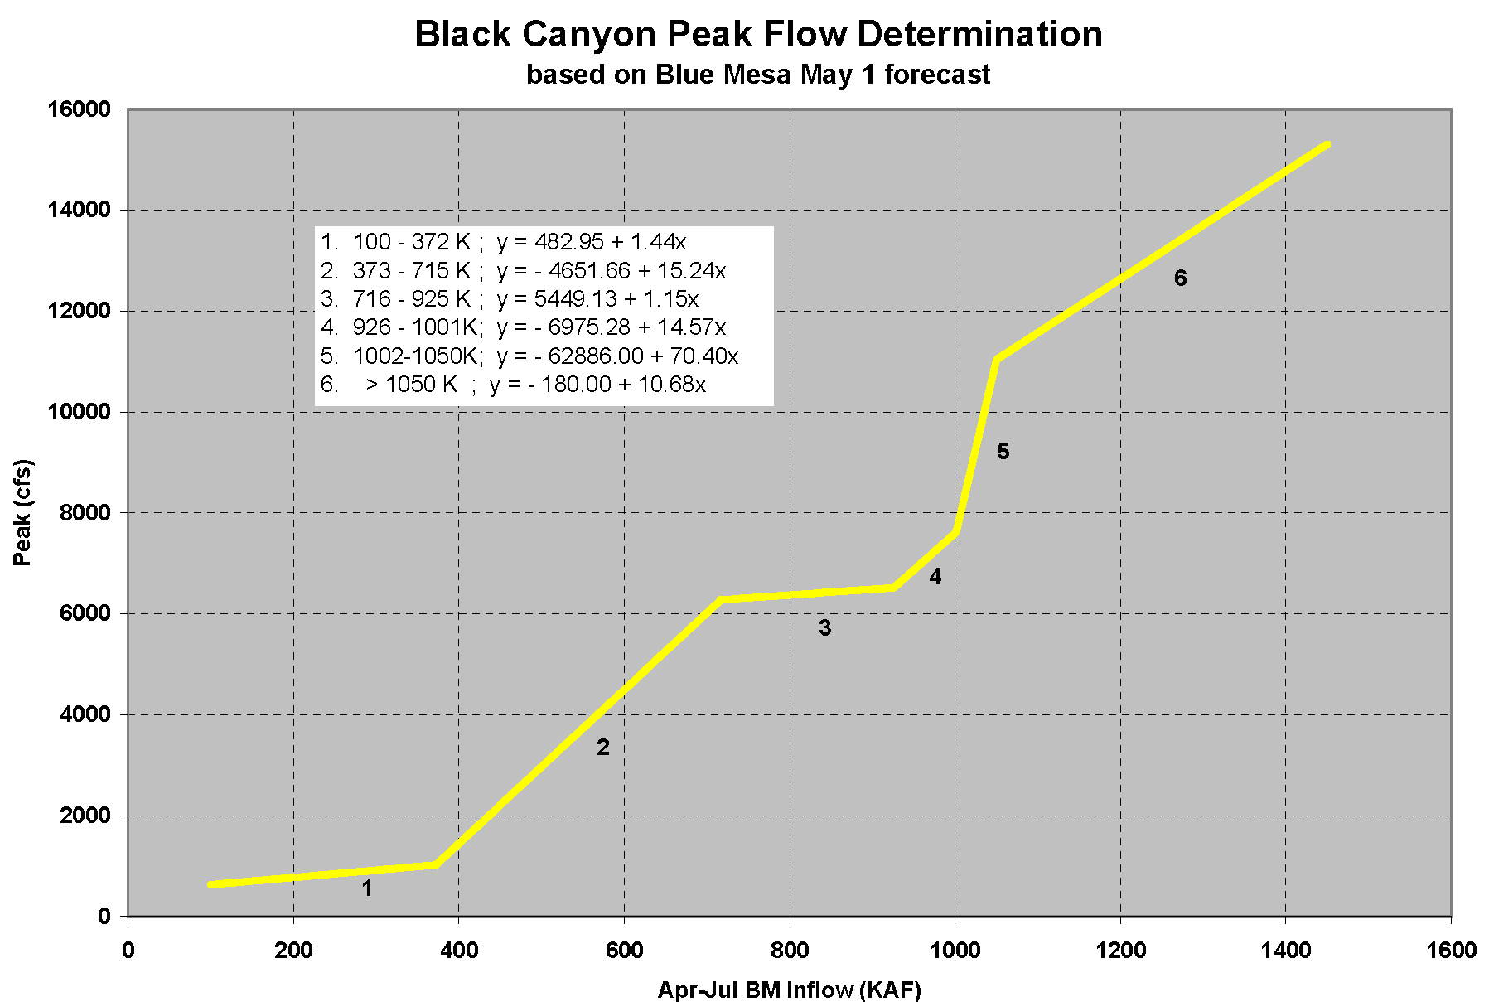
May 1 Forecast
440 KAF
2054 cfs
May 9 - 24 Hr Peak
2120 cfs
June 23 - 24 Hr Peak
7180 cfs

Slide 10
5,300 cfs May 7

Slide 11
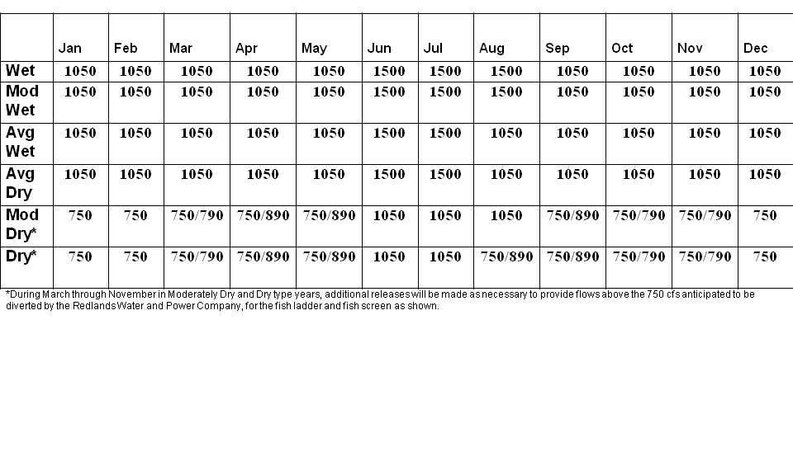
2015 Baseflow Targets

Slide 12
2015 Spring Operational Goals
Black Canyon Water Right
One Day Peak Target 2,054 cfs
ROD Peak Flow at Whitewater
4991 cfs (Instantaneous)
<14,000 cfs at Delta, CO
Safe Ramping Rates
Fill Blue Mesa

Slide 13
Whitewater flow was meet starting on May 7th
Black Canyon Water Right was meet starting on May 9th

Slide 17
~ 67 feet
Blue Mesa reservoir elevation 7452.42 feet, or 39.3% full.

Slide 18
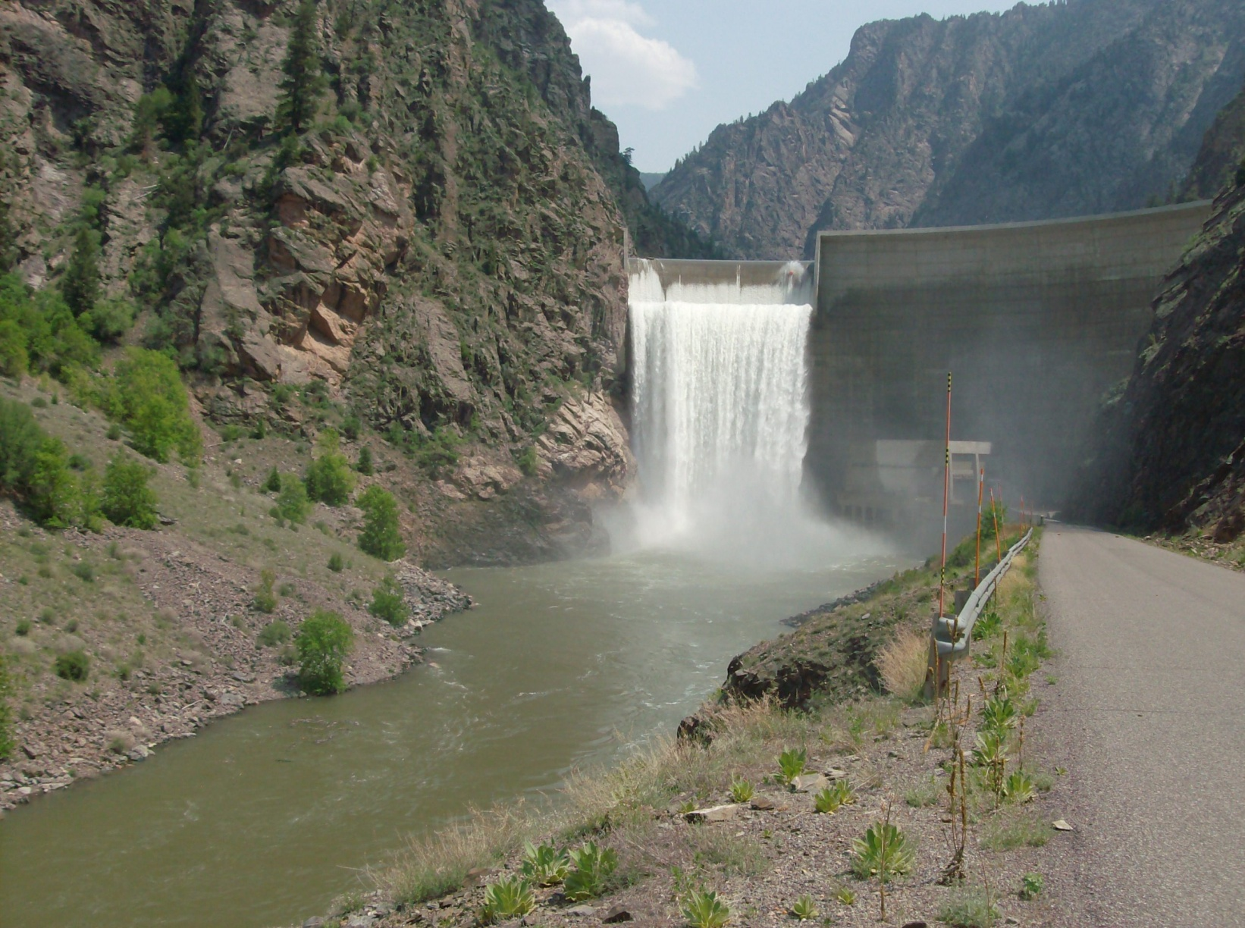
http://www.usbr.gov/uc/wcao/water/rsvrs/mtgs/amcurrnt.html

