Slide 1
USBR Updates:
Green River
CRFS Meeting December 8, 2015

Slide 2
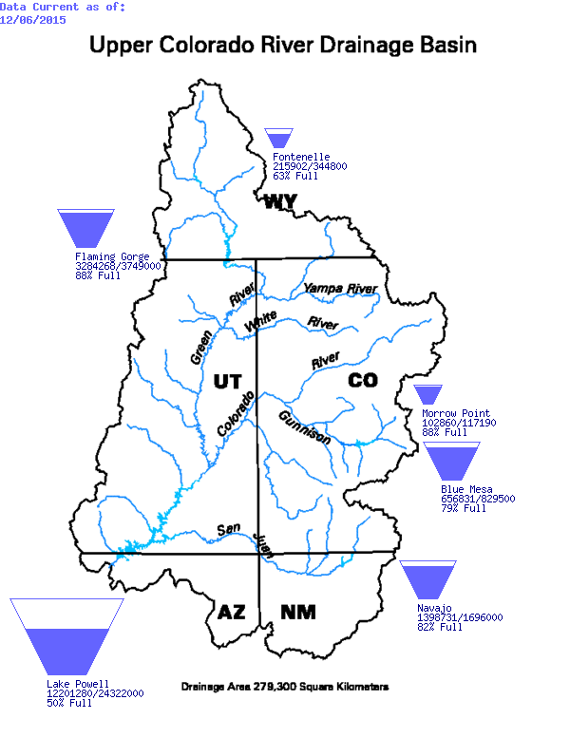
CRSP System Storage 2015
Observed April-July Inflow Percent of Average Volume
Fontenelle – 106%
Flaming Gorge – 106%
Blue Mesa – 105%
Navajo – 84%
Glen Canyon – 94%

Slide 3
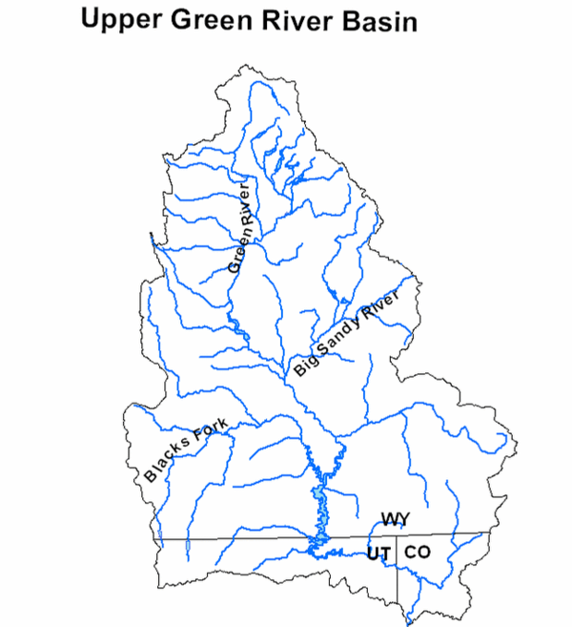
Green River Operations
Fontenelle
Flaming Gorge

Slide 4
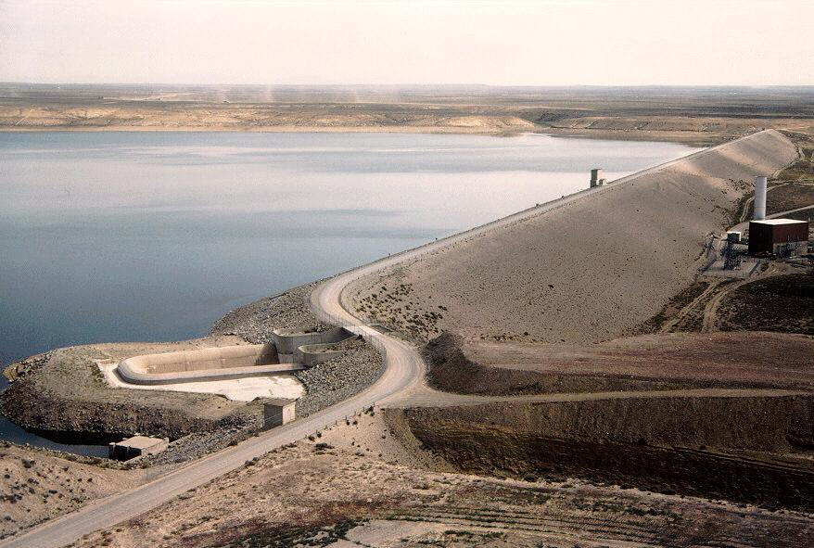
Fontenelle Operations

Slide 5
2015 Operations Summary (the good)
Reservoir filled
Peak elevation: 6505.5 ft (June 18)
Avoided spill (mostly)
Spring peak
Peak release: 7,030 cfs (June 13)
Peak inflow: 7,520 cfs (June 13)
Sufficient carry-over storage winter 2016
Baseflows set at 950 cfs

Slide 6
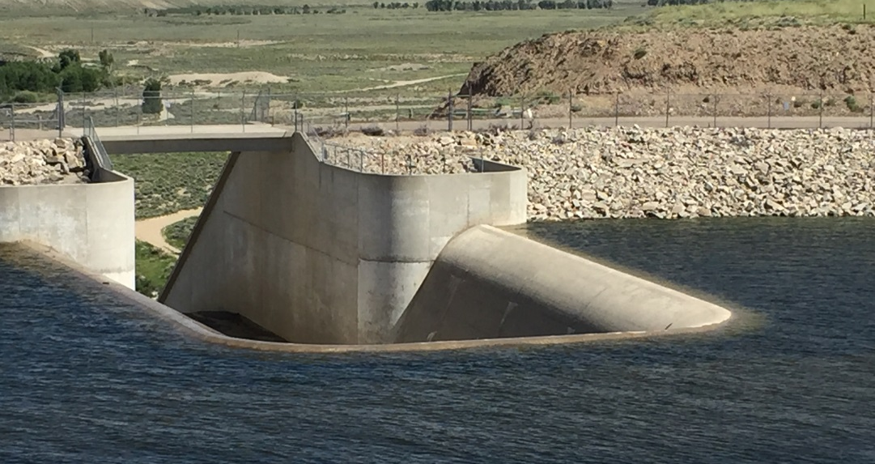
2015 Operations Summary (the not so good)
Underestimated A-J inflow volume
Entered May anticipating “dry year operation”
Filled reservoir by early June
High carry-over storage + May rainfall
Limited flexibility during June melt
Fontenelle Reservoir
“not spilling”, June 16, 2015

Slide 8
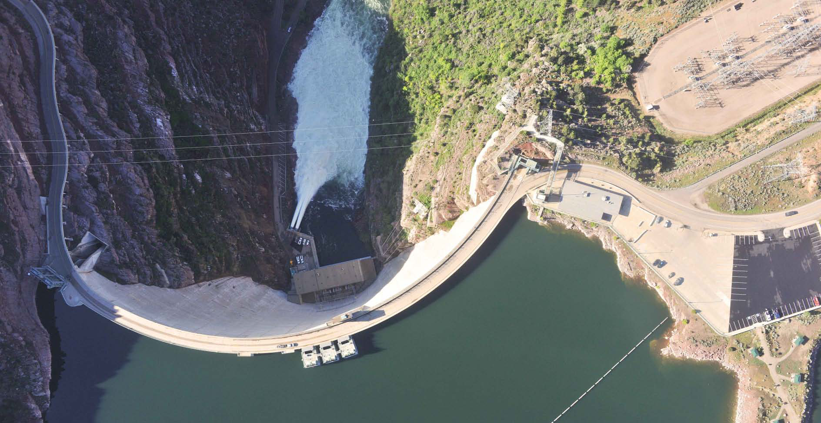
Flaming Gorge Operations

Slide 9
Larval Trigger Study Plan
Time Reach 1 flows with the initial appearance of larval suckers
Design Matrix
Three years of flows < 18,600 cfs
Three years of flows > 18,600 cfs
Connecting flows of at least seven days duration

Slide 10
Research Requests
LTSP
Research results to date – Wildly Successful!
Spillway

Slide 11
Research Requests
Support spring research
Bestgen draft backwater synthesis report
Reach 2 request
Reach 3 request
Clarification email

Slide 12
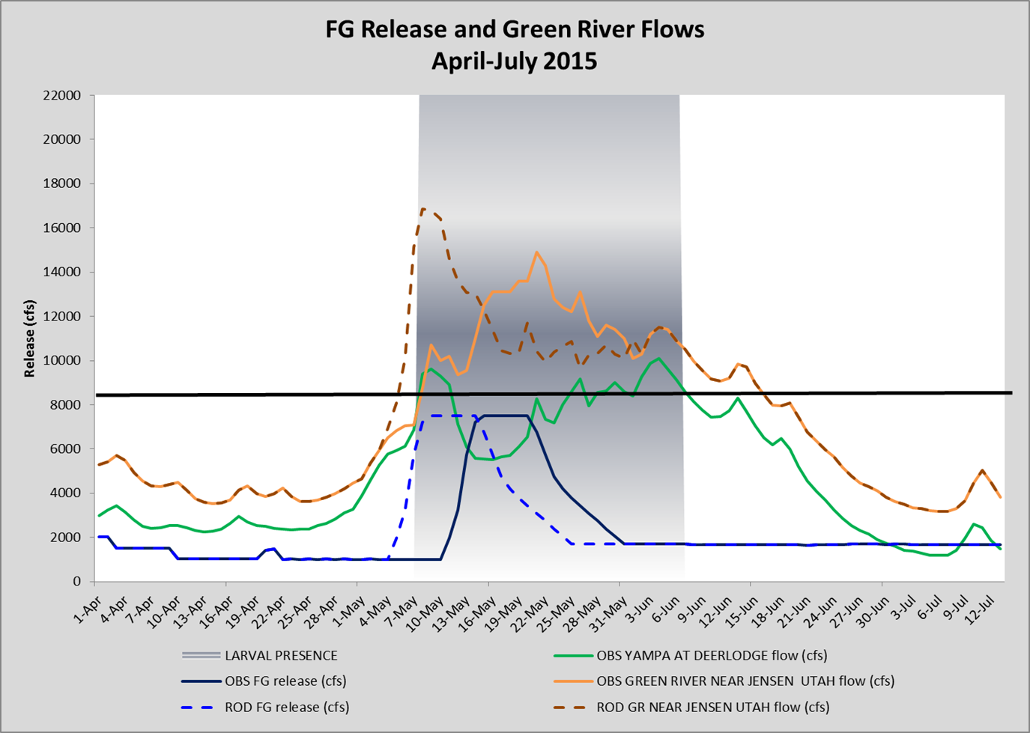
Flaming Gorge Spring Operations
ROD Days ≥ 8,300 cfs = 40
LTSP Days ≥ 8,300 cfs = 30
ROD Peak – 16,850 cfs
LTSP Peak – 14,900 cfs
Obs PP = 3 Days
Obs Bypss = 9 Days
Obs Total = 278 kaf
Mod PP = 11 Days
Mod Bypass = 6 Days
Obs Total = 293 kaf

Slide 13
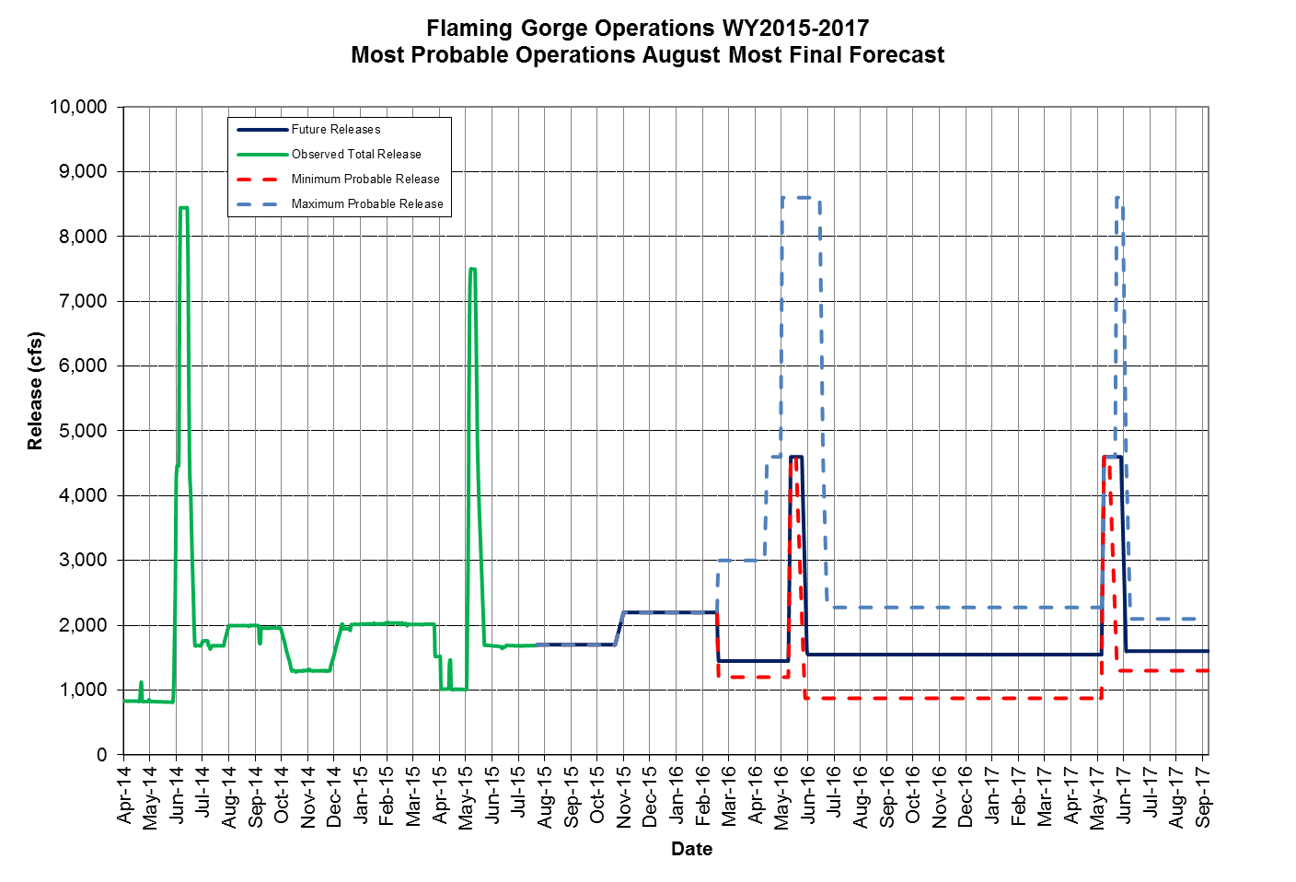
Release Scenarios
Winter Release 2,200 cfs

Slide 14
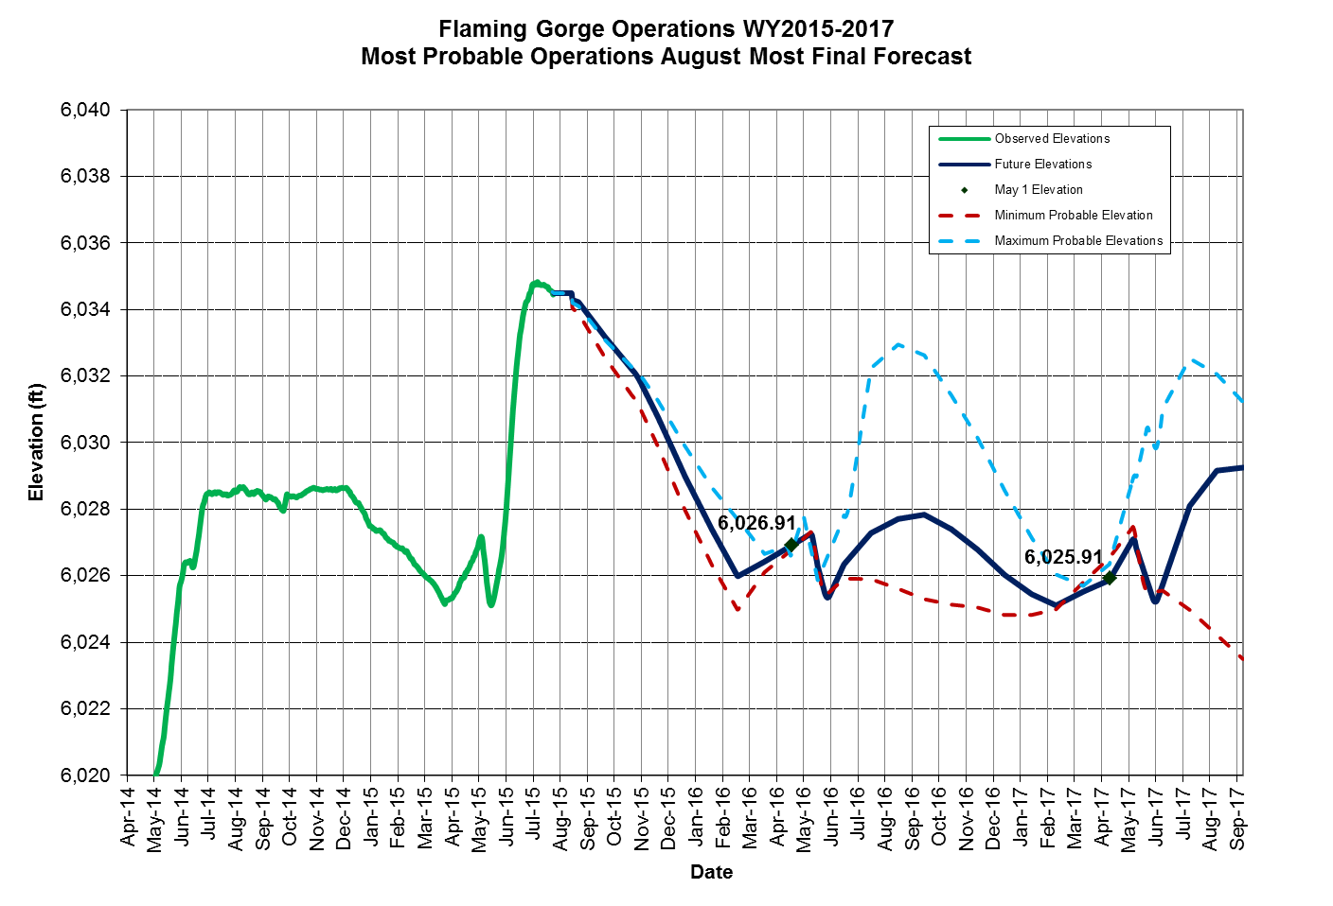
Release Scenarios
USFWS Request

