Slide 1
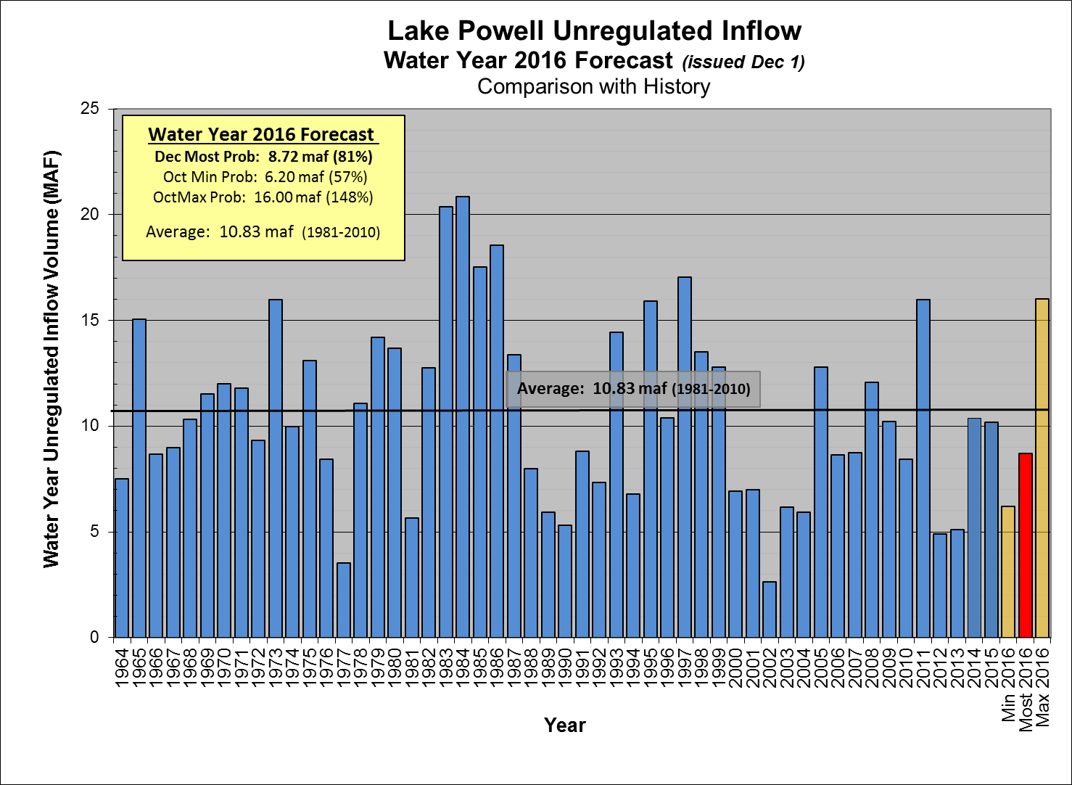

Slide 2
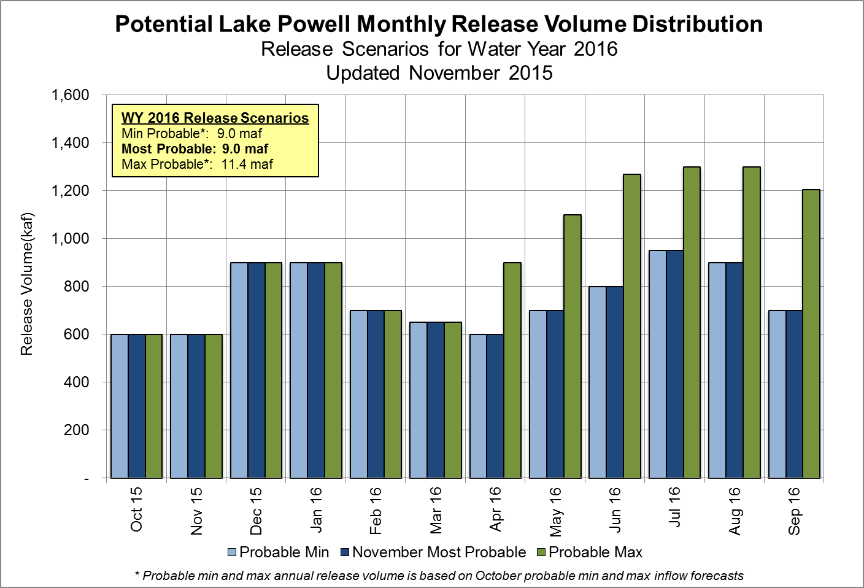

Slide 3
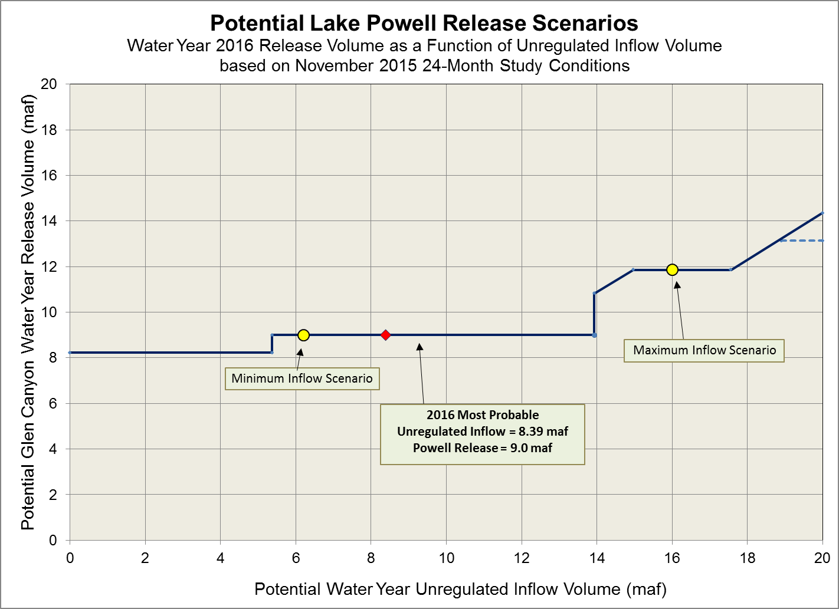

Slide 4
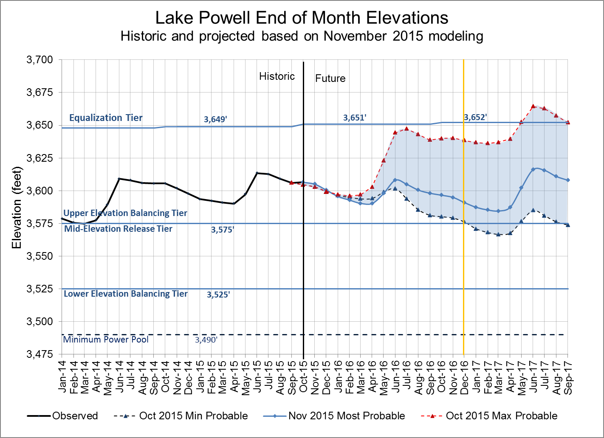
Water Year 2015 projections
Most: 9.0 maf release
Max: 11.4 maf release
Min: 9.0 maf release
Notes:
Excel file: U:\1_Powell Ops\5_Spreadsheets\24 Month Study Data\Powell_Projected_Ele_Nov2012.xlsx

Slide 5
Glen Canyon Power Plant Provisional Unit Outage Schedule for Water Year 2016
Unit Number | Oct 2015 | Nov 2015 | Dec 2015 | Jan 2016 | Feb 2016 | Mar 2016 | Apr 2016 | May 2016 | Jun 2016 | Jul 2016 | Aug 2016 | Sep 2016
1
2
3
4
5
6
7
8
Units Available | 6 | 7 | 6 | 7 | 5 | 5 | 7 | 6 | 7 | 7 | 7 | 5
Capacity (cfs) | 18,400 | 18,100 | 18,100 | 21,500 | 14,800 | 14,800 | 21,500 | 17,900 | 21,400 | 21,400 | 21,400 | 14,300
Capacity (kaf/month) | 1,150 | 1,130 | 1,160 | 1,270 | 900 | 960 | 1,280 | 1,100 | 1,290 | 1,270 | 1,400 | 900
Max (kaf) ¹ | 600 | 600 | 900 | 900 | 700 | 650 | 900 | 1,100 | 1,270 | 1,300 | 1,300 | 1,206
Most (kaf) ² | 600 | 600 | 900 | 900 | 700 | 650 | 600 | 700 | 800 | 950 | 900 | 700
Min (kaf) ¹ | 600 | 600 | 900 | 900 | 700 | 650 | 600 | 700 | 800 | 950 | 900 | 700
11.4
9.0
9.0
Projected release, based on October 2015 Min and Max Probable Inflow Projections and 24-Month Study model runs
Projected release, based on November 2015 Most Probable Inflow Projections and 24-Month Study model runs
(updated 11-16-2015)
Notes:
Annuals 2014
Annual 5-6 start 10/14/2013 finish 11/01/2013
Annual 7-8 start 02/03/2014 finish 02/21/2014 Includes Digital Governor Replacement
Annual 3-4 start 02/24/2014 finish 03/14/2014 Includes Digital Governor Replacement
Annual 4 start 04/28/2014 finish 05/15/2014 Fixed Wheel Gate 8 Year
Annual 1-2 start 09/01/2014 finish 09/19/2014 Includes Digital Governor Replacement
Annual 5-6 start 09/22/2013 finish 10/10/2013 Includes Digital Governor Replacement
Replacements 2014
Unit 3 start 09/23/2013 finish 06/27/2014 Turbine Runner Replacement
Unit 6 start 04/01/2014 finish 04/03/2015 Generator Rebuild
Unit 2 start 07/01/2014 finish 04/06/2015 Turbine Runner Replacement

Slide 6
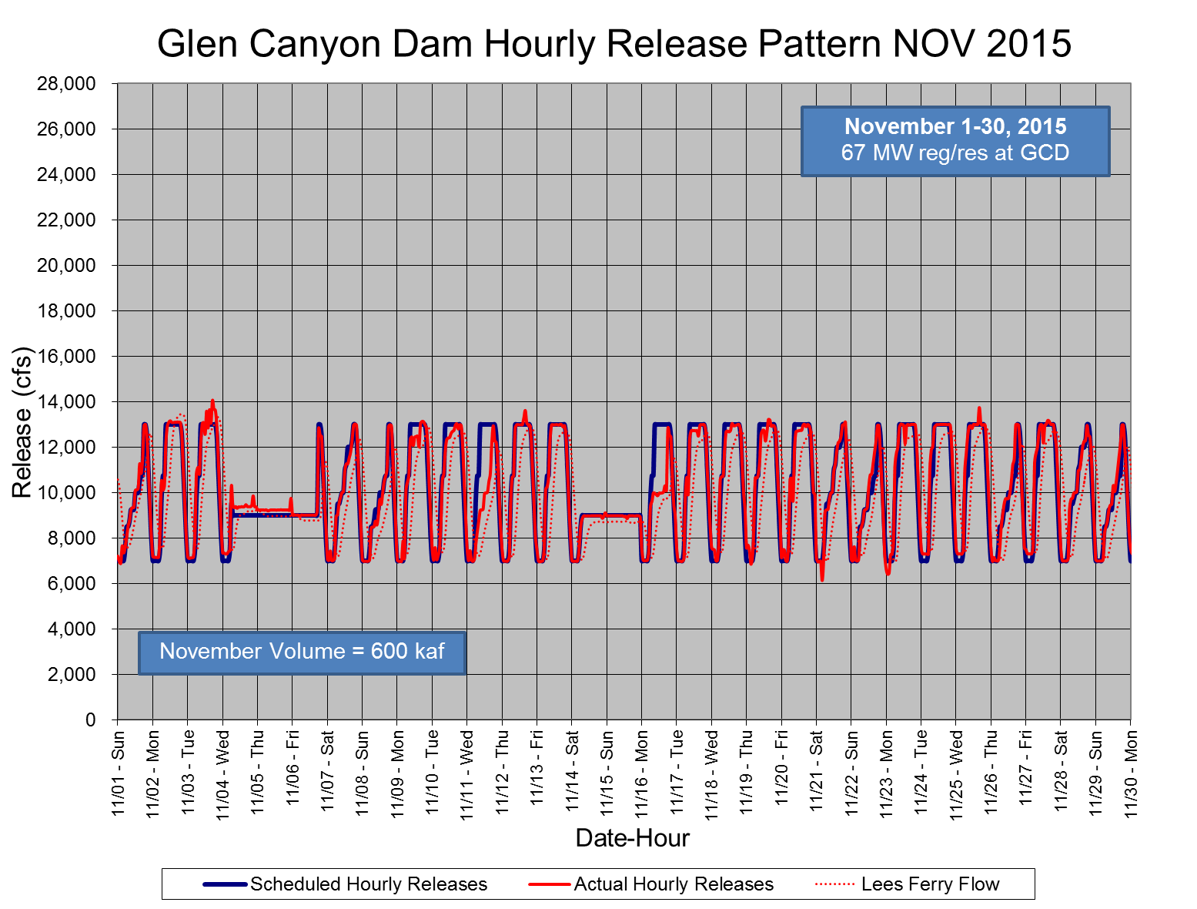
Nov
Low-steady flows for Green Sunfish treatment

Slide 7
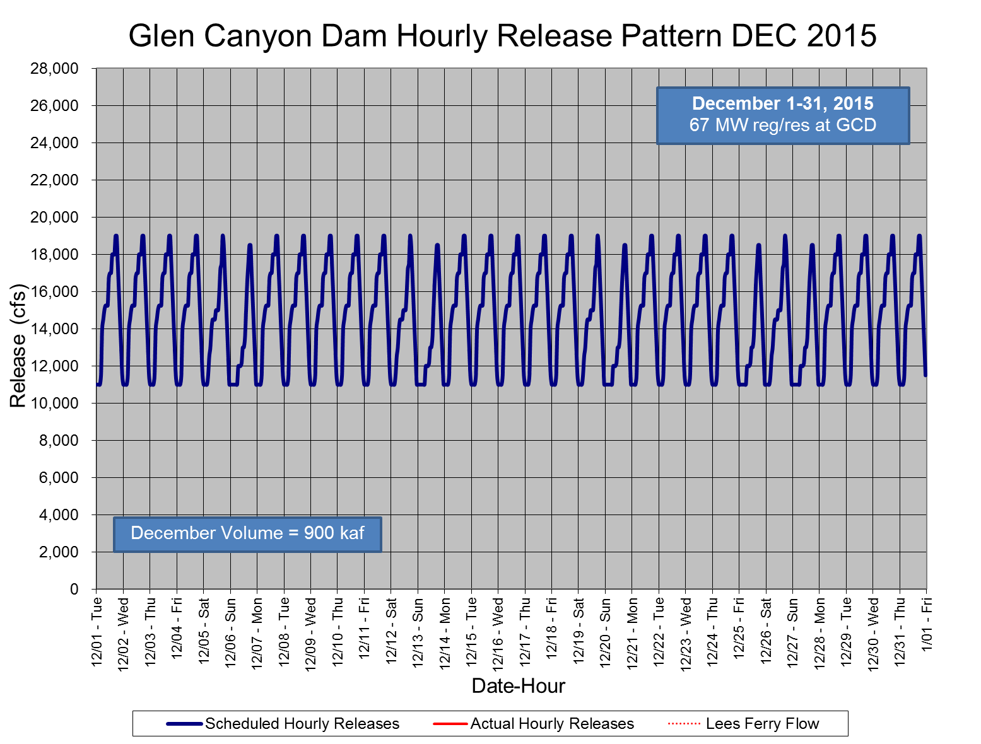
Dec

