Slide 1
CBRFC UPDATE
CRFS
December 8, 2015

Slide 2
Overview
HEFS
Web page changes
Monthly precipitation maps
New front page map overlays
Seasonal Weather
Soil Moisture
Upper Colorado Situational Awareness page
ESP baseflow verification

Slide 3
HEFS Hydrologic Ensemble Forecast System
LEGACY ESP
HEFS ESP
Precipitation
0 or 5 days QPF
climatology from calibration
Temperature (max/min)
10 days max/min QTF
climatology from calibration
Post-processing
Schaake – monthly timestep
Lower Basin – trace weighting based on ENSO condition
Precipitation
15 days from GEFS ensemble mean
270 days from CFS ensemble mean
climatology
Temperature (max/min)
15 days from GEFS ensemble mean
270 days from CFS ensemble mean
climatology
Pre-processor
converts single trace mean forecasts from GEFS and CFS back into ensembles based on historical relationship between hindcasts and calibration data
Post-processing
EnsPost – daily time step

Slide 4
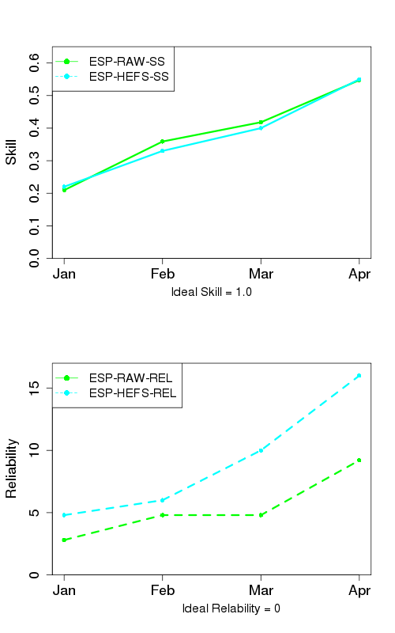
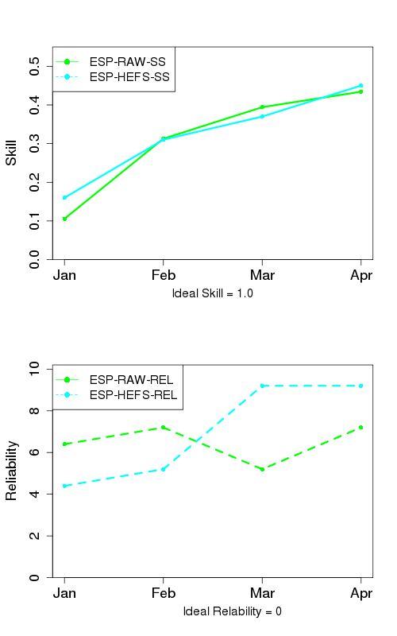
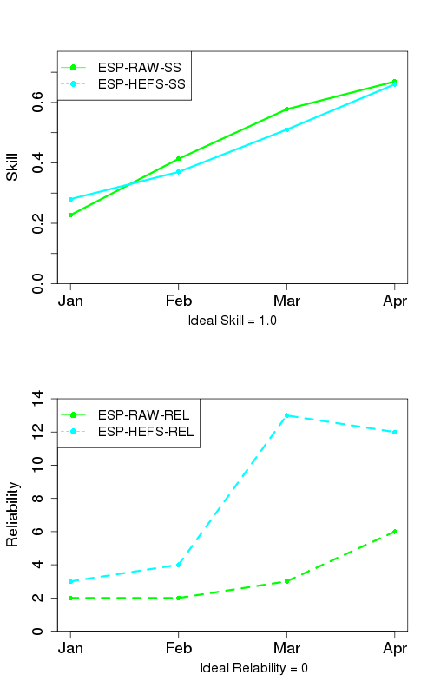
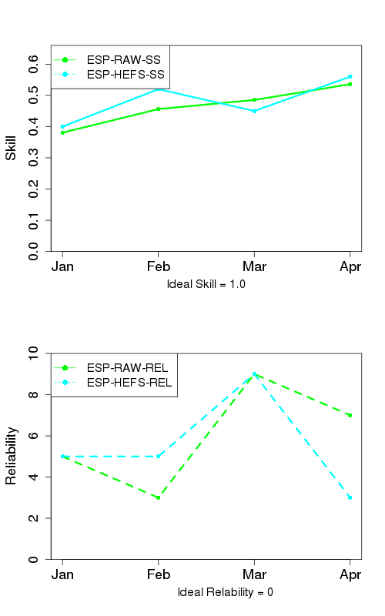
HEFS Initial Verification Results Upper Basin
Green – Warren Bridge
Elk - Milner
East - Almont
Animas - Durango

Slide 5
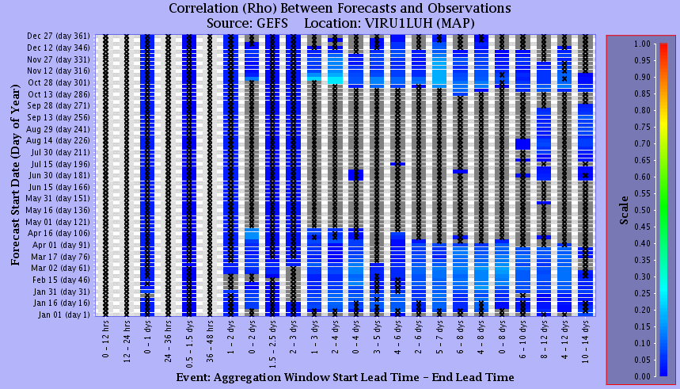
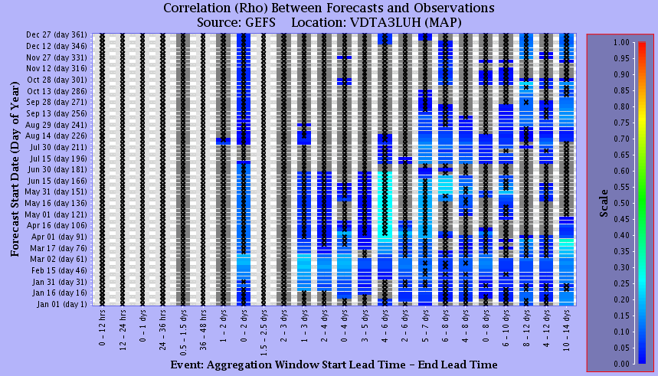
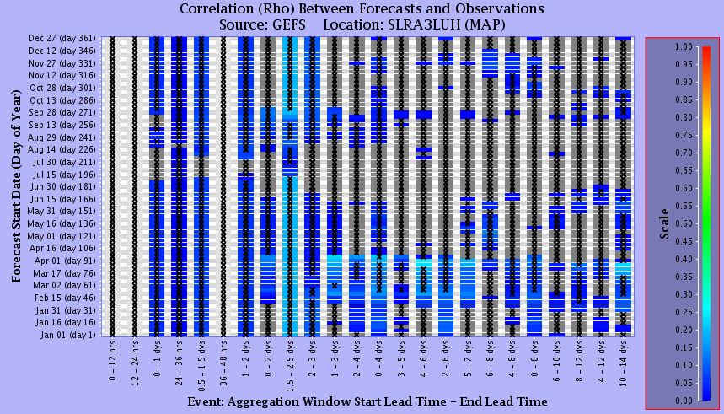
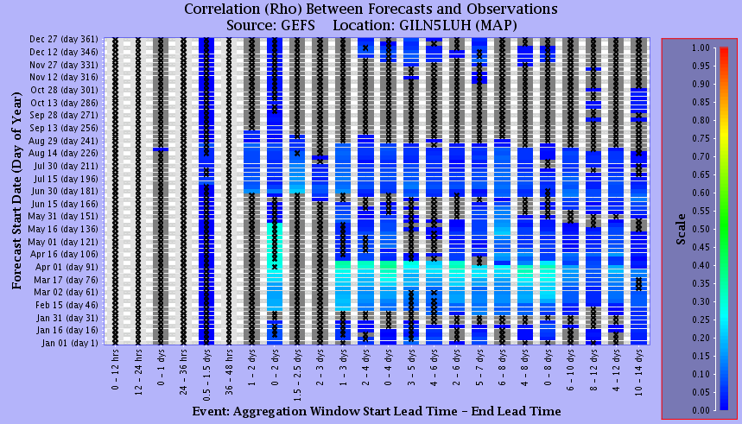
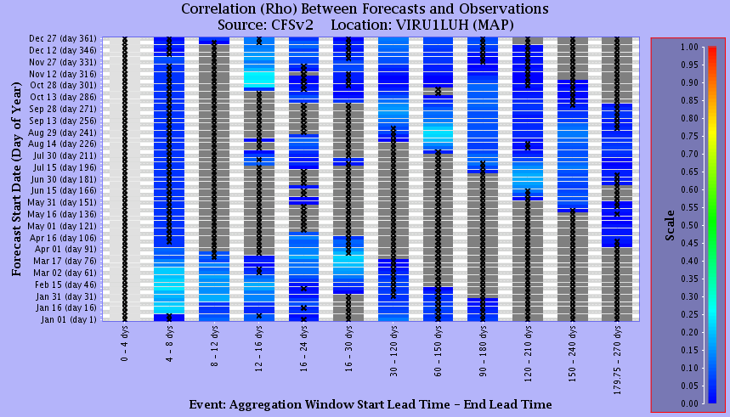
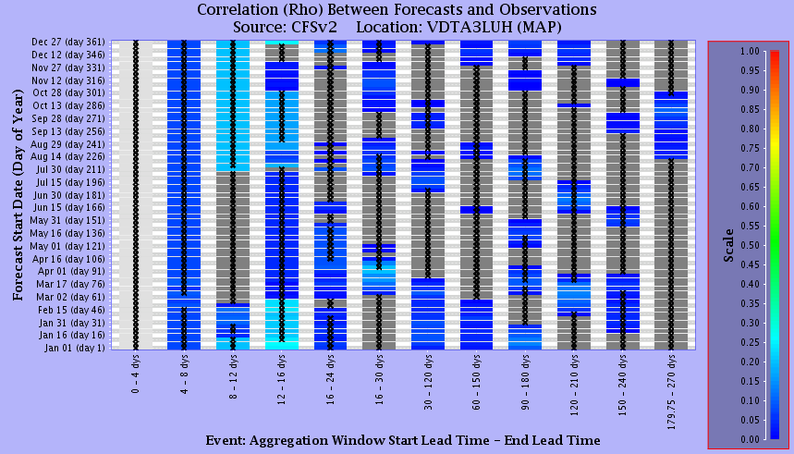
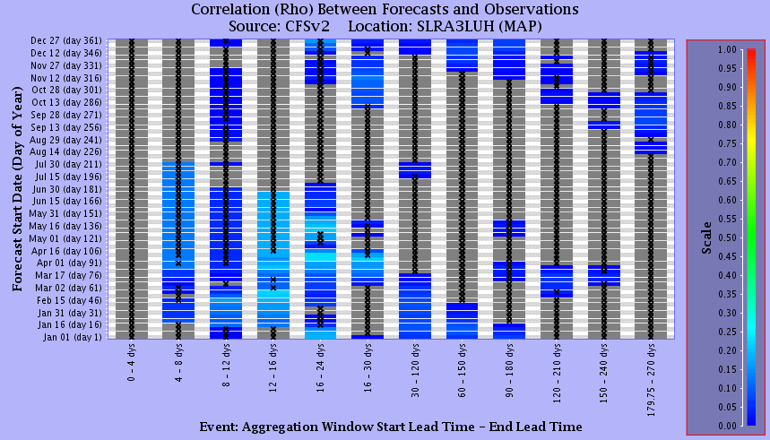
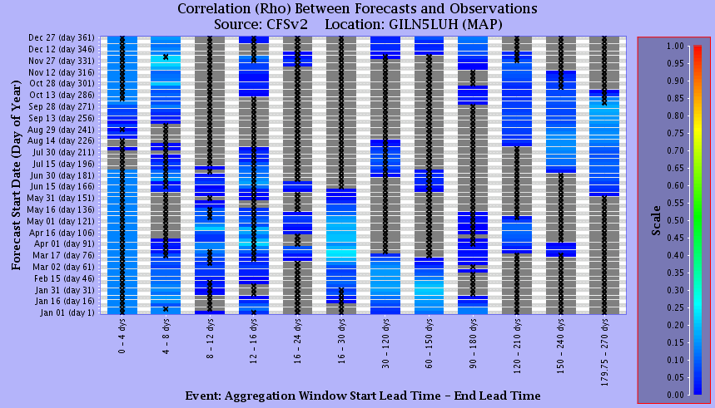
GEFS/CFSv2 Precipitation Skill Lower Basin
Virgin – Virgin
Verde – Horseshoe
Salt – Roosevelt
Gila – Gila
GEFS
CFSv2

Slide 6
HEFS Initial Verification Conclusions
Little, if any, skill added with GEFS/CFS forecast in Upper Basin
not unexpected given not much skill in CFSv2 precip forecasts
need to do more analysis on a monthly scale
Does adding GEFS/CFS improve forecasts in Lower Basin?
have begun running real time this year
will run reforecasts and analyze results in the next few months
How does CFS forecast fare when looking at ENSO signal?
limited sample size so it will be difficult to draw any conclusions
Full presentations from October 2015 Stakeholder meeting:
http://www.cbrfc.noaa.gov/present/2015/forum/GEFSCFS.pdf
http://www.cbrfc.noaa.gov/present/2015/forum/postadjust.pdf

Slide 7
WEB PAGE Monthly/Seasonal Precipitation Maps
Lumped areas based on CBRFC model defined sub-areas vs. HUC
Can be ‘trimmed’ to display most important areas for runoff contribution
more representative of how water supply conditions have been affected
these trimmed areas can then be used to compute the monthly %average precipitation
Added additional increments to %average scale for better resolution of extreme events
Available as an overlay on front page map

Slide 8
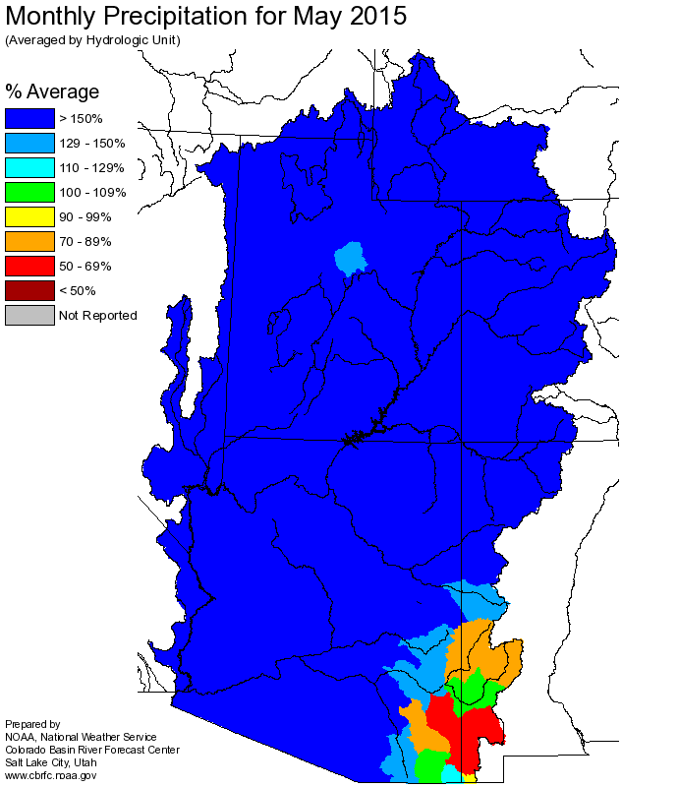
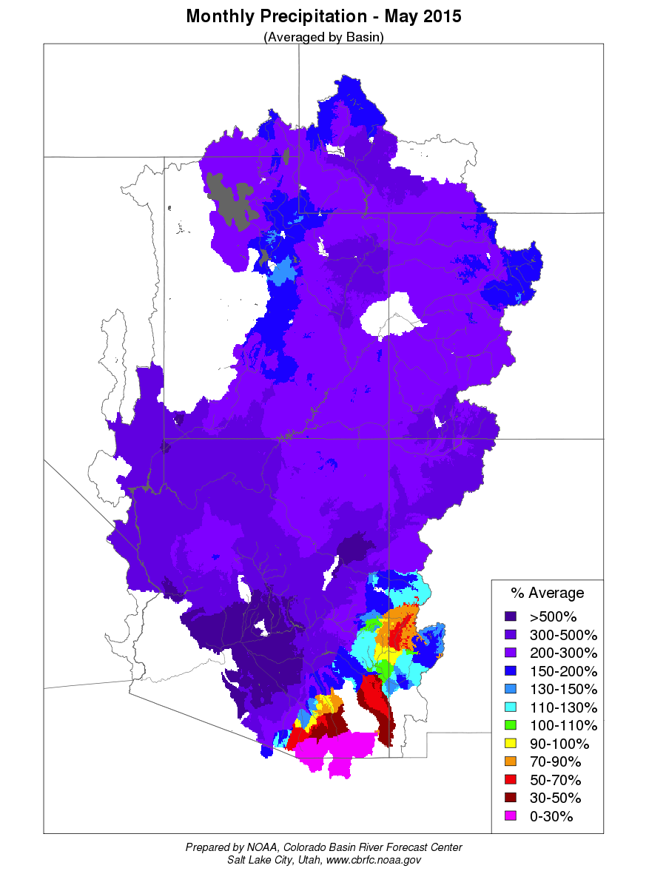
LEGACY
NEW

Slide 9
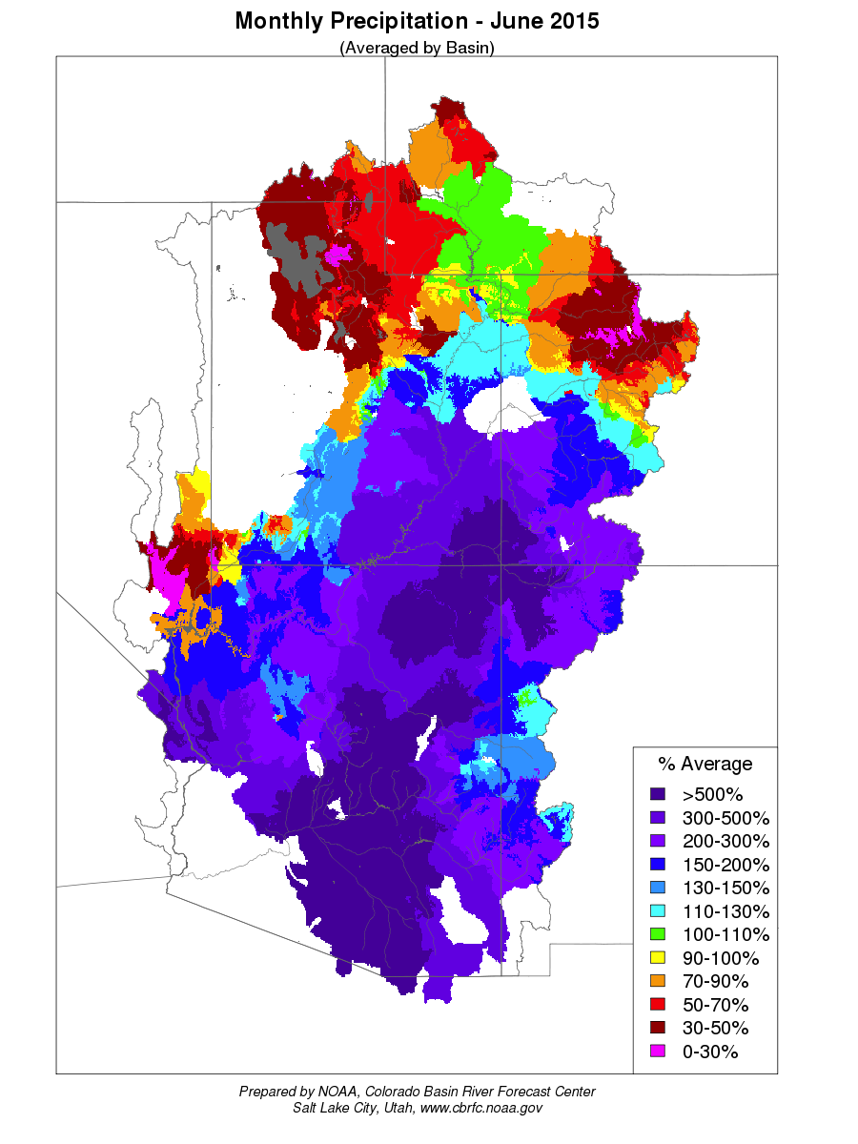
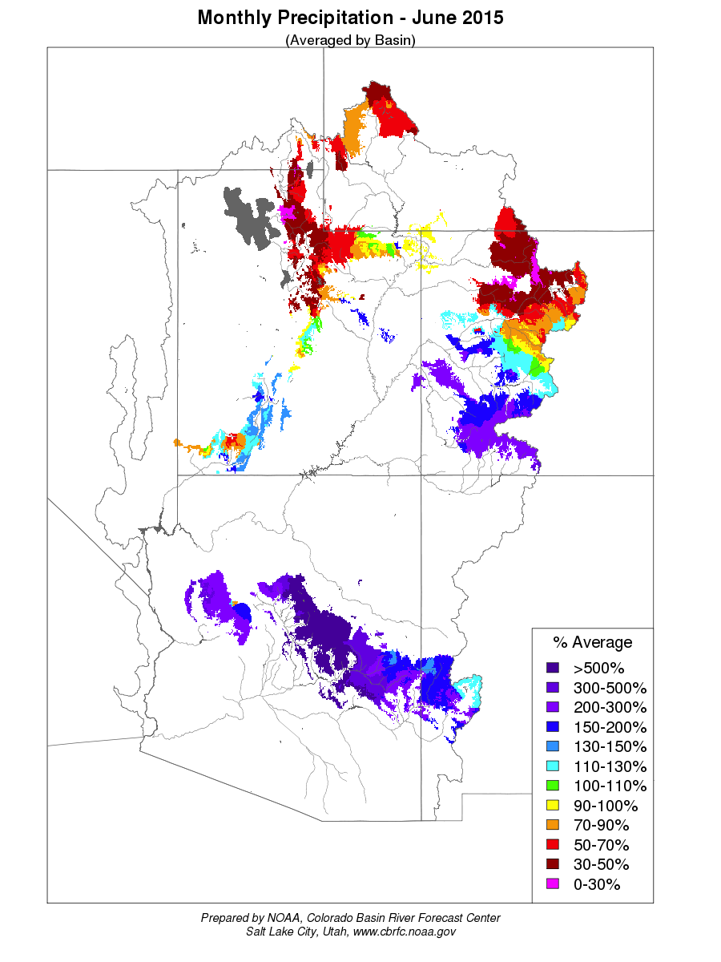
Water Year 2015
Monthly %AVG
Precipitation above
Lake Powell
 | OCT | NOV | DEC | JAN | FEB | MAR | APR | MAY | JUN | JUL | AUG | SEP | WYR TOT
HUC | 44 | 96 | 122 | 64 | 82 | 61 | 85 | 254 | 143 | 155 | 92 | 61 | 102
TRIMMED BASIN | 51 | 113 | 113 | 44 | 75 | 55 | 70 | 218 | 100 | 139 | 83 | 58 | 91
NRCS | 48 | 114 | 111 | 46 | 74 | 58 | 65 | 227 | 101 | 138 | 81 | 64 | 90

Slide 10
WEB PAGE New Front Map Overlays
Seasonal Precipitation (Water Year)
Monthly Precipitation
Month To Date
Full and trimmed versions
Fall Model Soil Moisture
Current Model Soil Moisture
Current Model ‘Inches to Saturation’
Full and trimmed versions

Slide 11
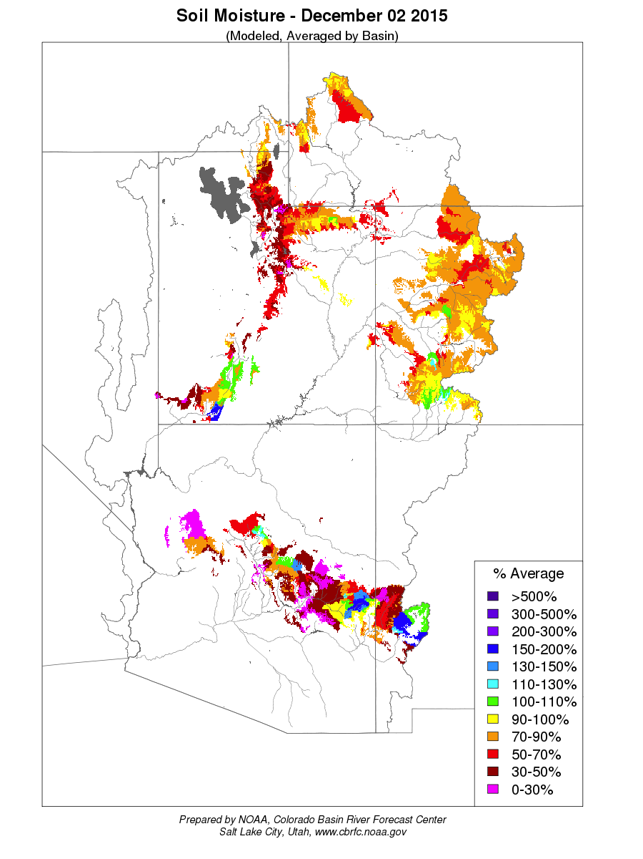
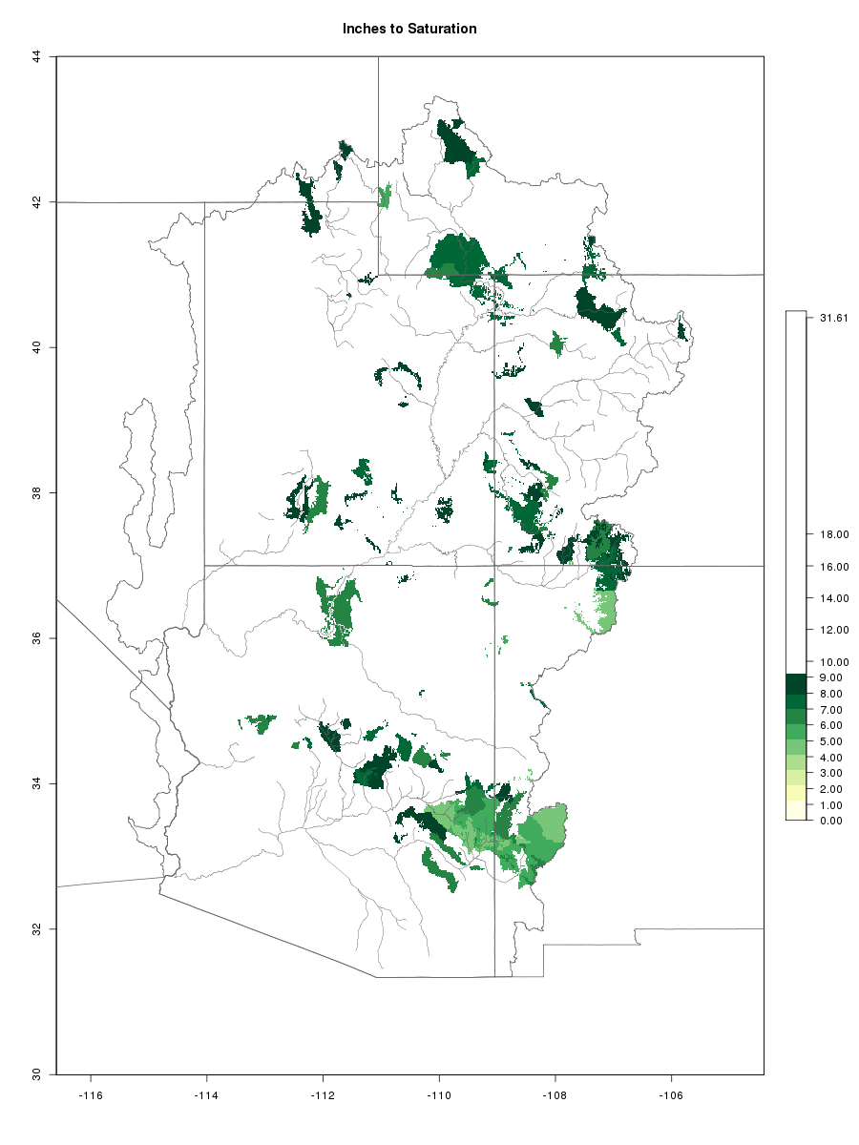
WEB PAGE Model Soil Moisture

Slide 12
WEB PAGE

