Slide 1
Water Year 2016 Initial Conditions
CRFS
December 8, 2015

Slide 2
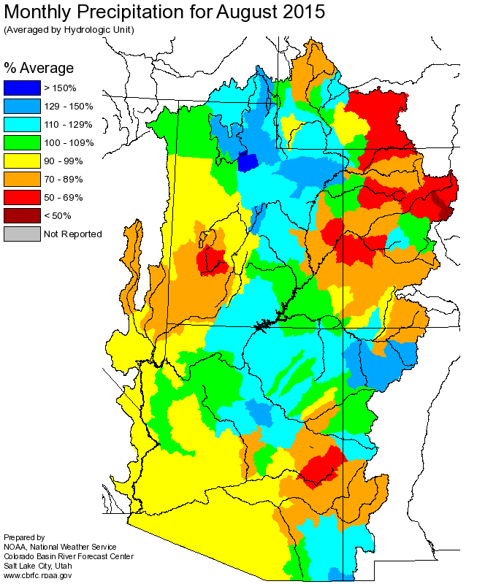
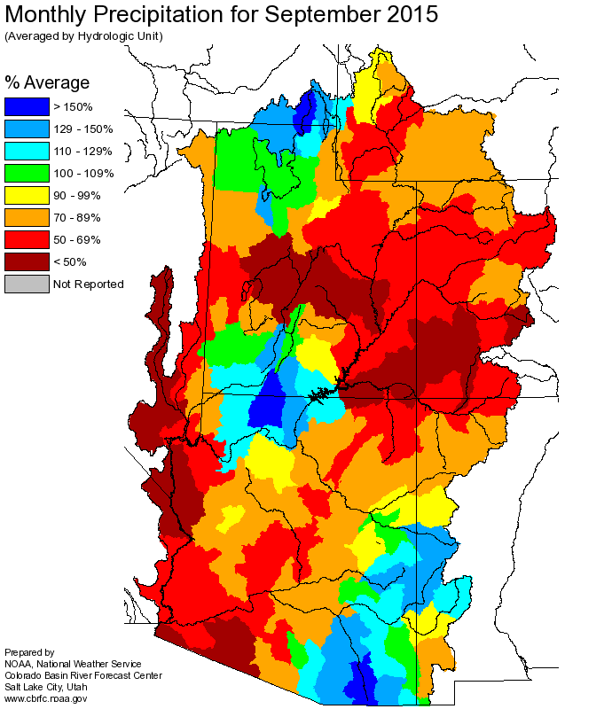
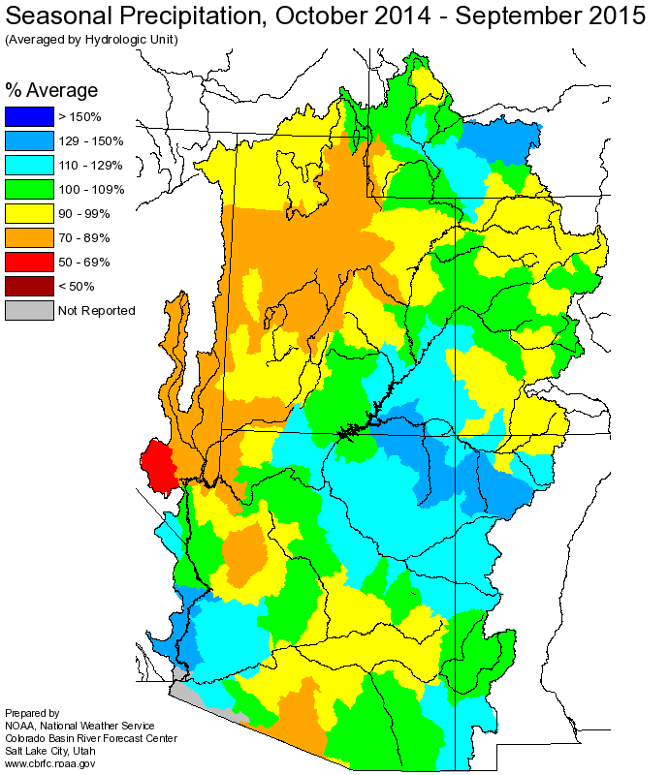
WATER YEAR 2015 PRECIPITATION
Aug-Sep:
WYR 2015 Total: Near average across much of basin

Slide 3
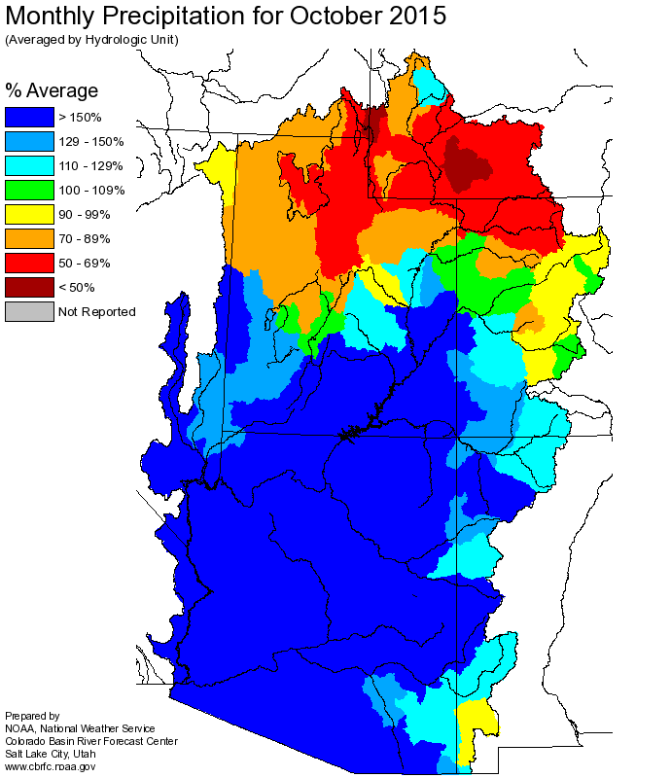
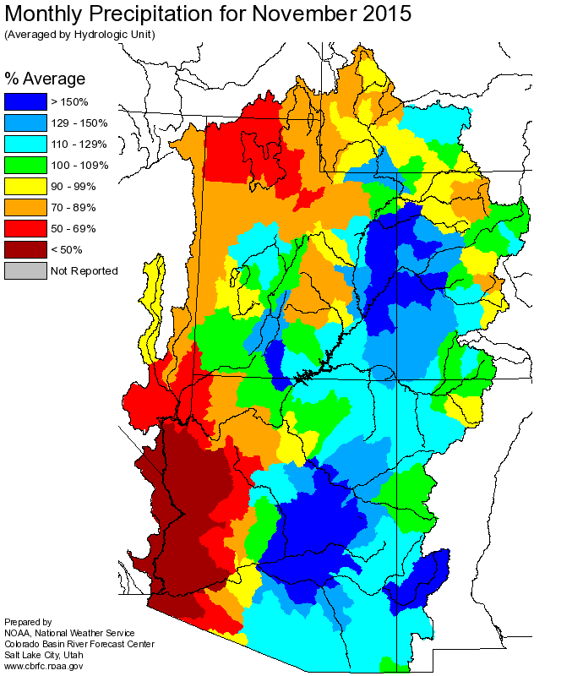
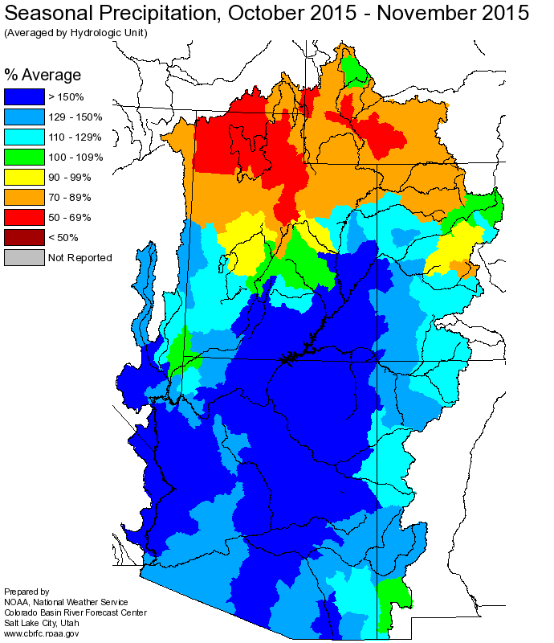
WATER YEAR 2016 PRECIPITATION
Oct-Nov:
WYR 2016 to date: Dry north, wet south
Near normal overall above Powell

Slide 4
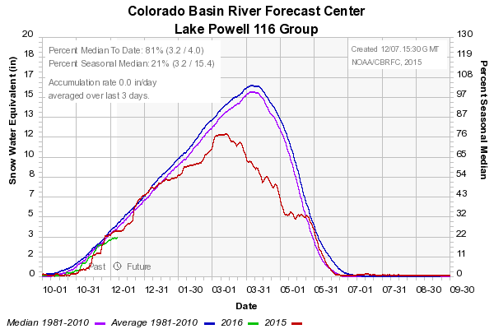
CURRENT SWE
SNOTEL and Model SWE
as of 12/7
81% Median to Date
21% Median Seasonal

Slide 5
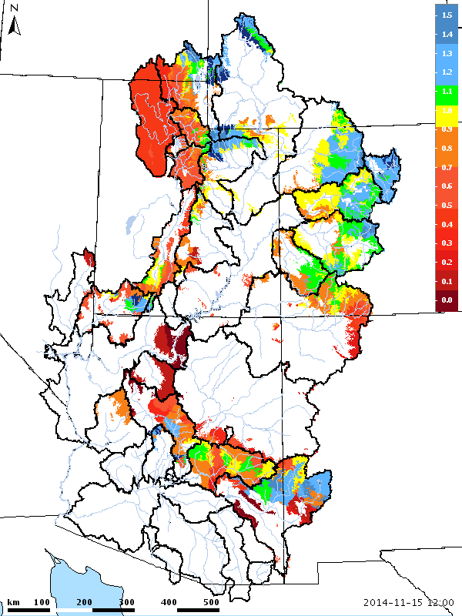
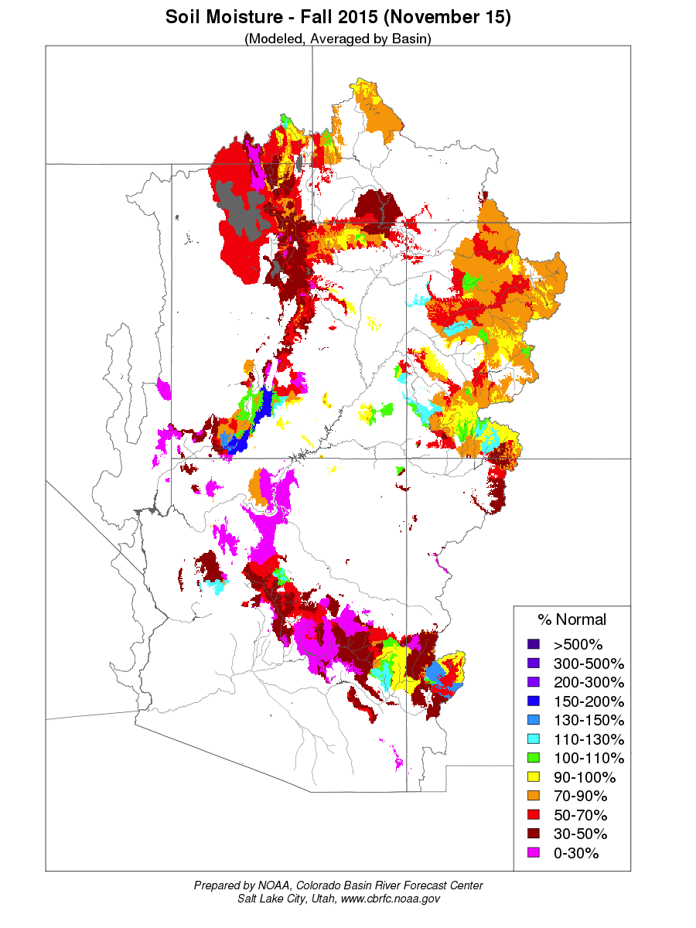
SOIL MOISTURE
CBRFC Model Soil Moisture
November 15, 2014
CBRFC Model Soil Moisture
November 15, 2015

Slide 6
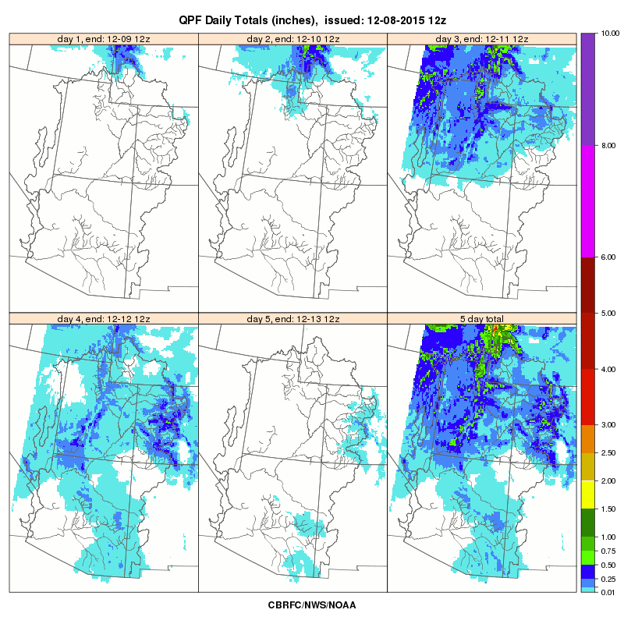
SHORT RANGE FORECASTS
WPC 7 DAY QPF
VALID 12/8 – 12/15

Slide 7
MEDIUM RANGE FORECASTS

Slide 8
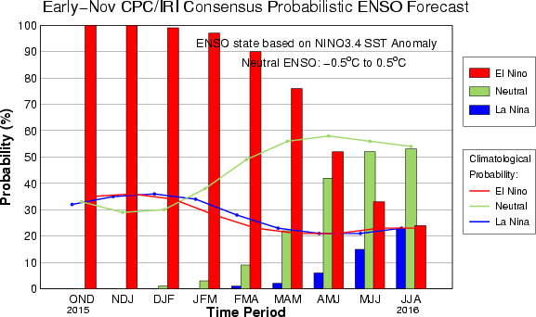
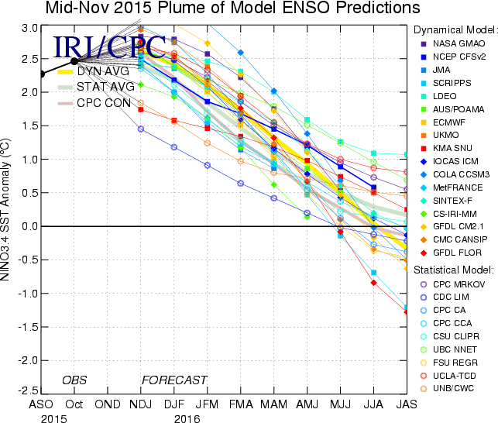
ENSO CONDITIONS
CPC/NCEP Summary (as of 12/7/15)
ENSO Alert System Status: El Niño Advisory
El Niño conditions are present.
Positive equatorial sea surface temperature (SST) anomalies continue across most of the Pacific Ocean.
El Niño will likely peak during the Northern Hemisphere winter 2015-16, with a transition to ENSO-neutral anticipated during the late spring or early summer 2016.
The chance of El Niño gradually decreases into the spring and ENSO-neutral is favored by MJJ 2016.
El Niño: characterized by a positive ONI greater than or equal to +0.5ºC.
Most models indicate Niño 3.4 will remain strong into early 2016. It is predicted to weaken through Spring 2016.
Most recent ONI value (Sep – Nov 2015): 2.0ºC

Slide 9
ENSO IMPACTS
CPC Strong Events:
1957-1958* (pre-Powell)
1965-1966 (below avg)
1972-1973 (above avg)
1982-1983 (above avg)
1991-1992 (below avg)
1997-1998 (near avg)
*Based on Reclamation Natural Flow, this was an above average year

Slide 10
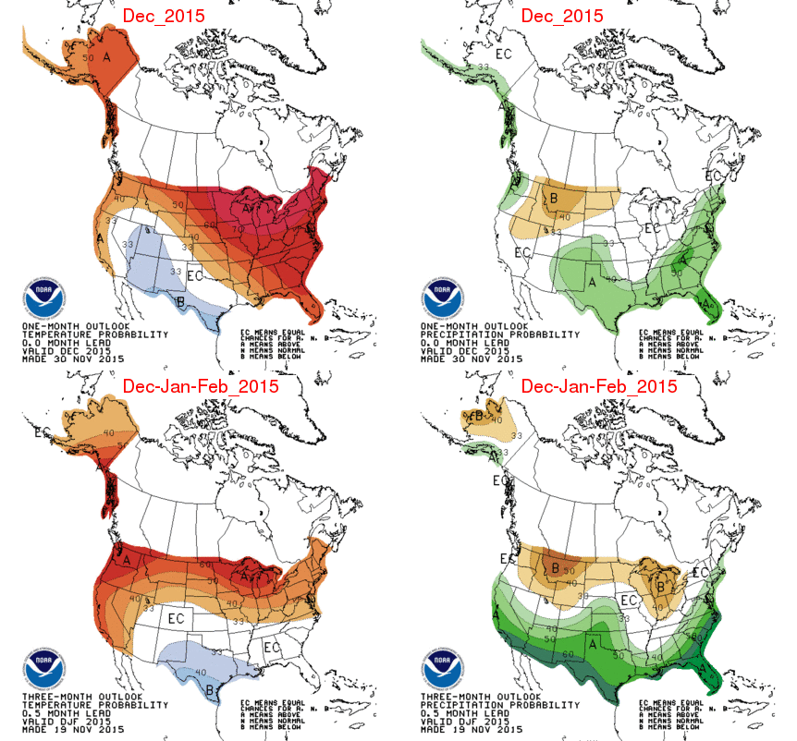
CLIMATE FORECASTS

Slide 11
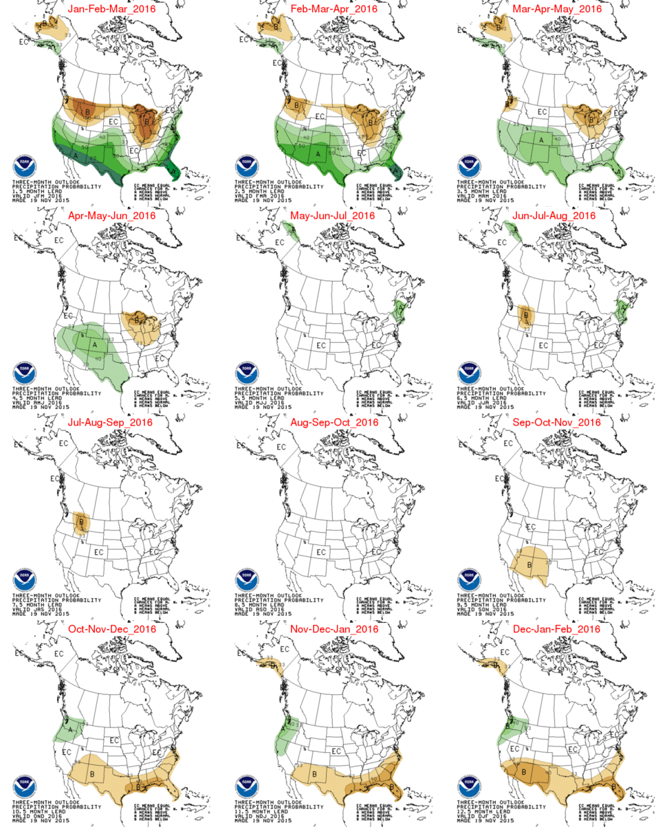
PRECIPITATION OUTLOOKS

Slide 12
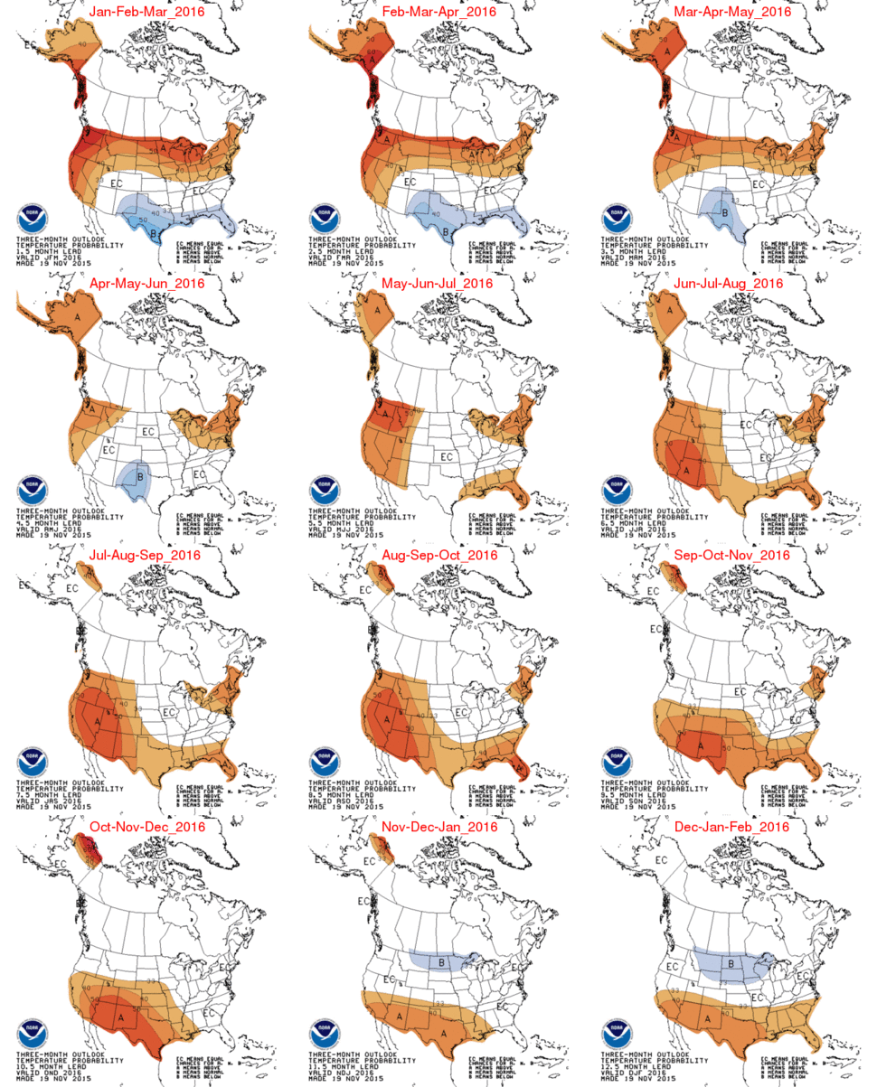
TEMPERATURE
OUTLOOKS

Slide 13
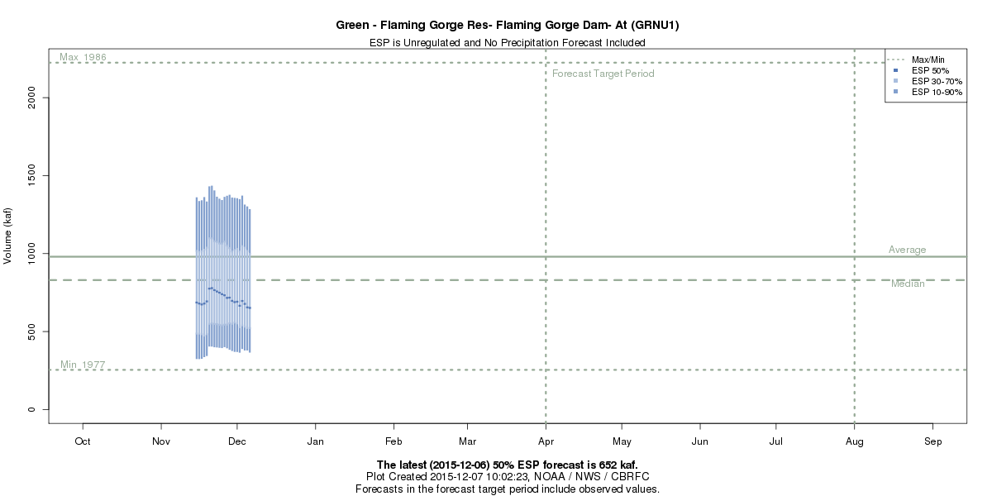
WATER YEAR 2016 OUTLOOKS
April-July 2016 Daily ESP
(as of 12/6/15)
652 KAF / 66% avg

Slide 14
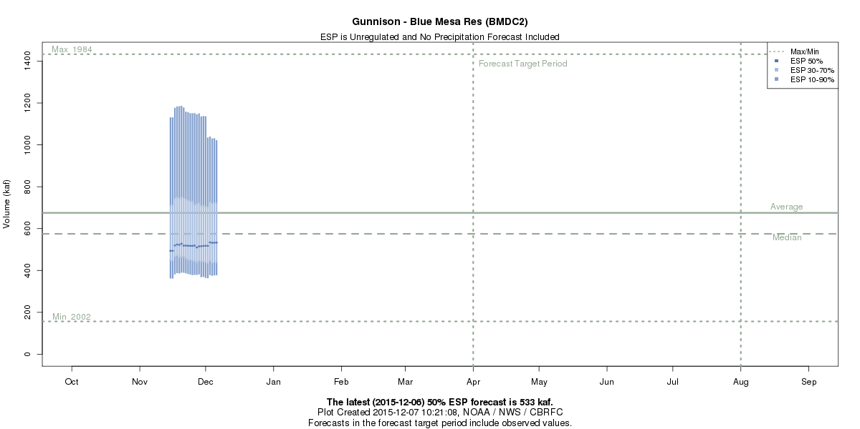
WATER YEAR 2016 OUTLOOKS
April-July 2016 Daily ESP
(as of 12/6/15)
533 KAF / 79% avg

Slide 15
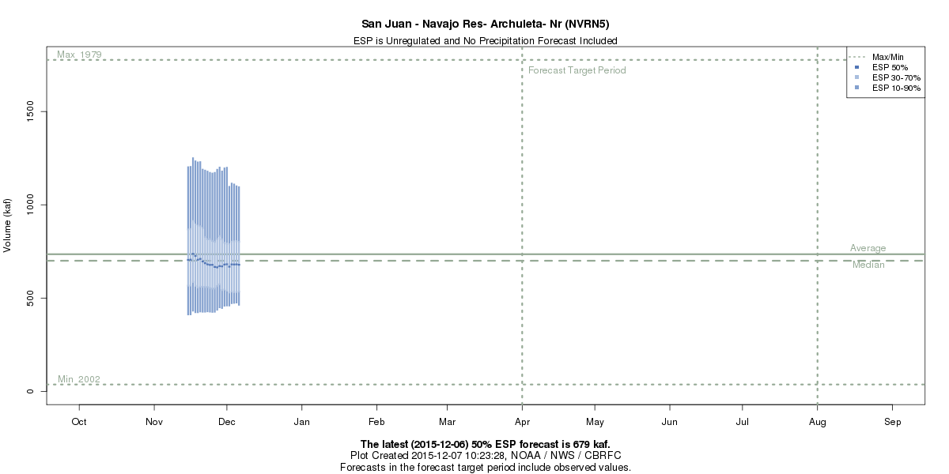
WATER YEAR 2016 OUTLOOKS
April-July 2016 Daily ESP
(as of 12/6/15)
679 KAF / 85% avg

Slide 16
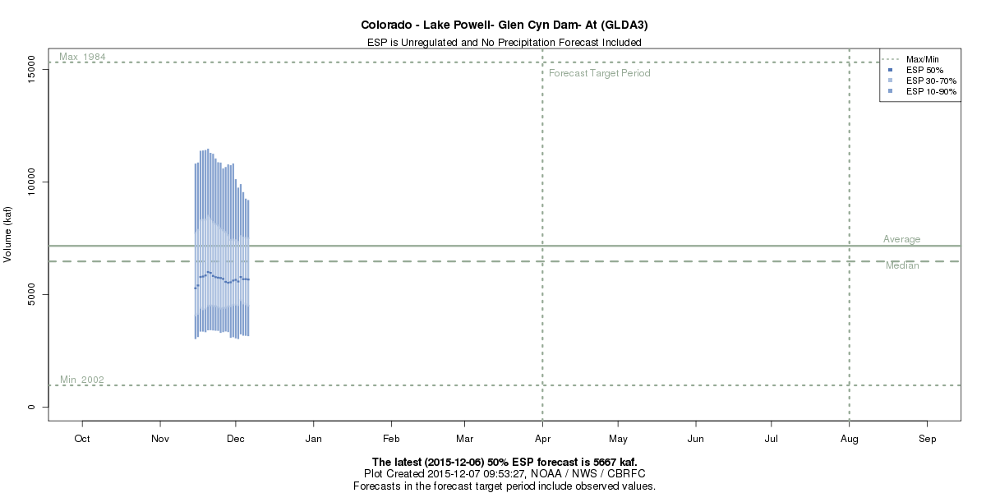
WATER YEAR 2016 OUTLOOKS
April-July 2016 Daily ESP
(as of 12/6/15)
5667 KAF / 77% avg
OBS
8721 KAF
80% avg
5600 KAF
78% avg
8721 KAF
80% avg

