Slide 1
Water Year 2015 Review
CRFS
December 8, 2015

Slide 2
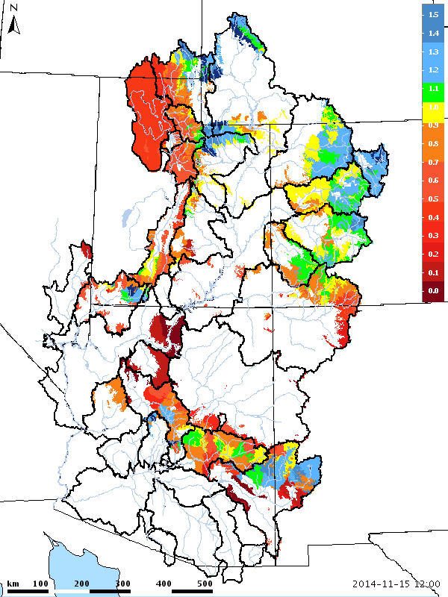
Soil Moisture – Entering The 2014/2015 Winter

Slide 3
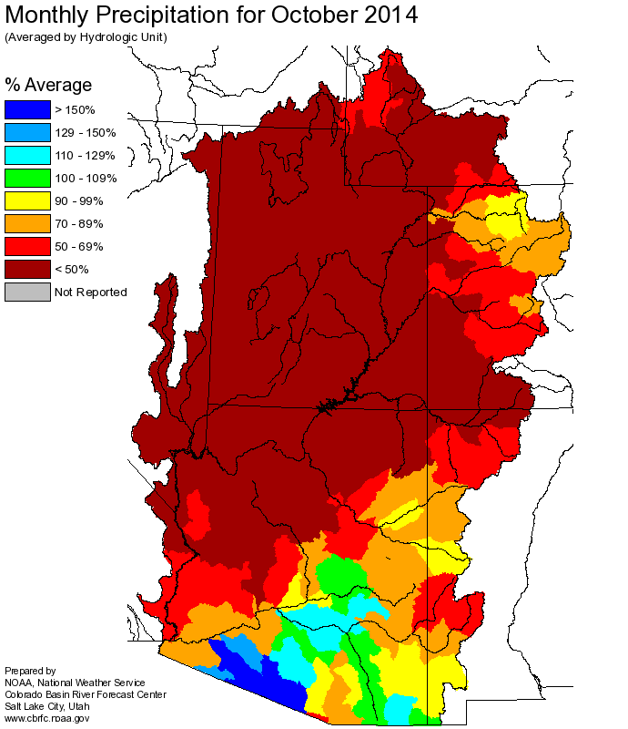
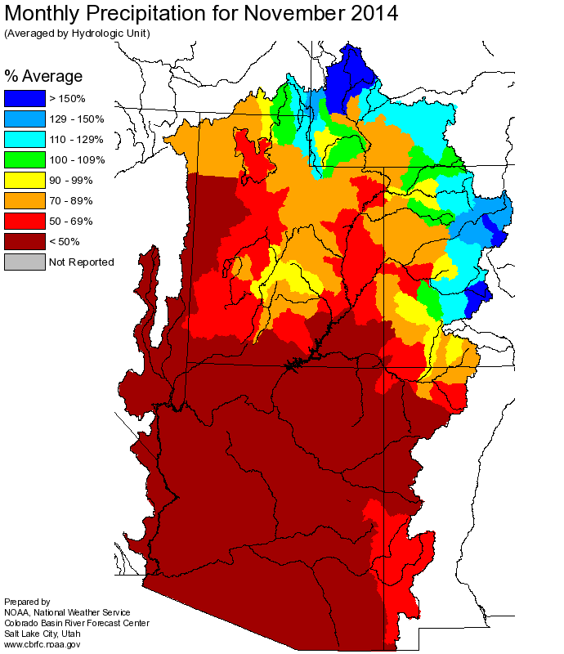
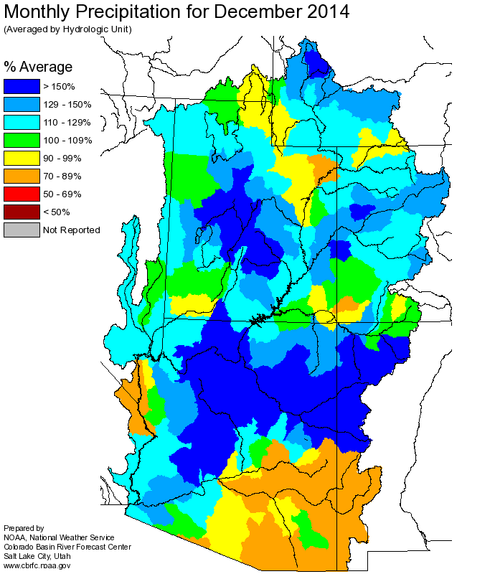
Fall Weather: Mostly warm and dry

Slide 4
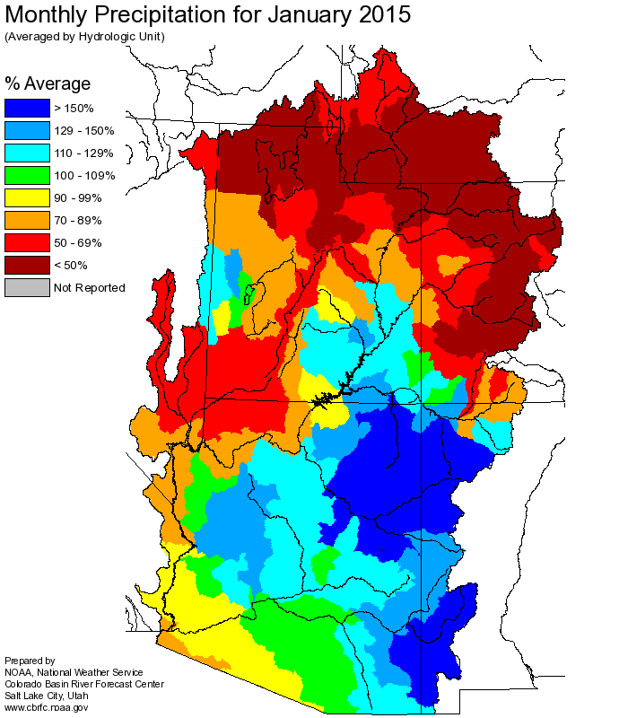
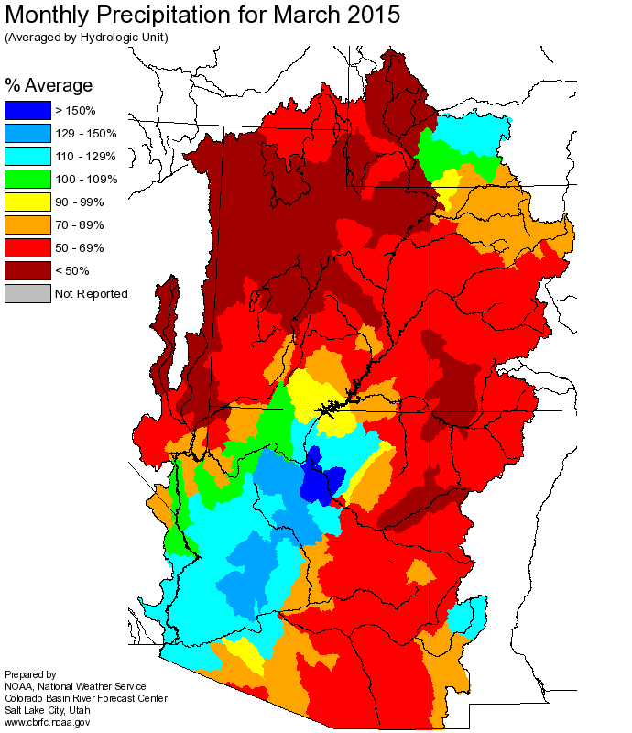
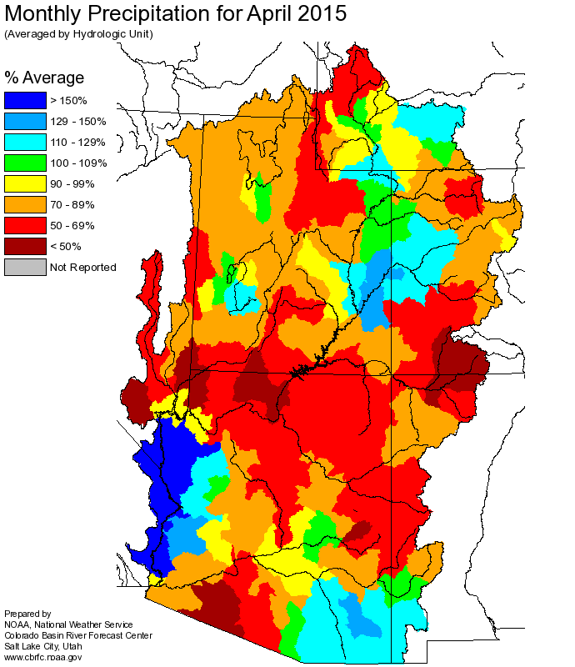
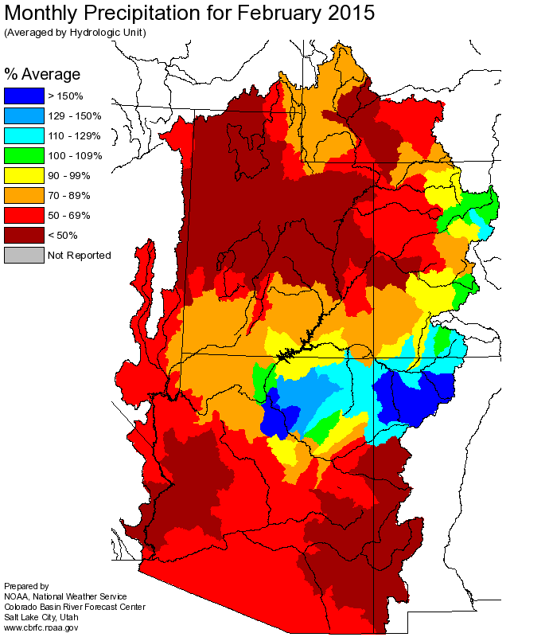
Winter/Early Spring:
Dominated by dry/warm pattern

Slide 5
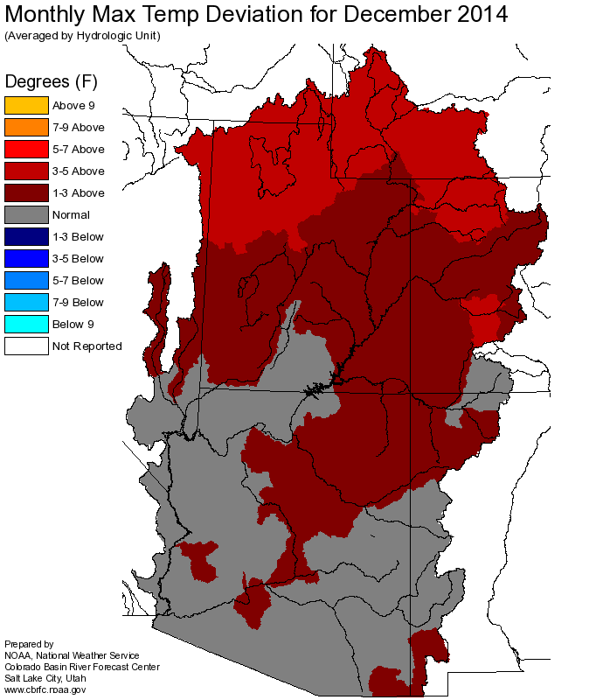
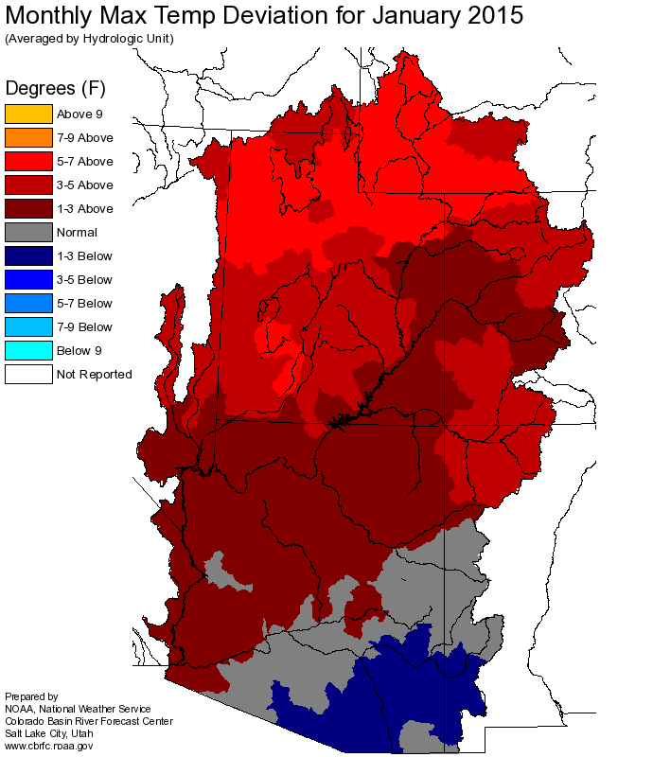
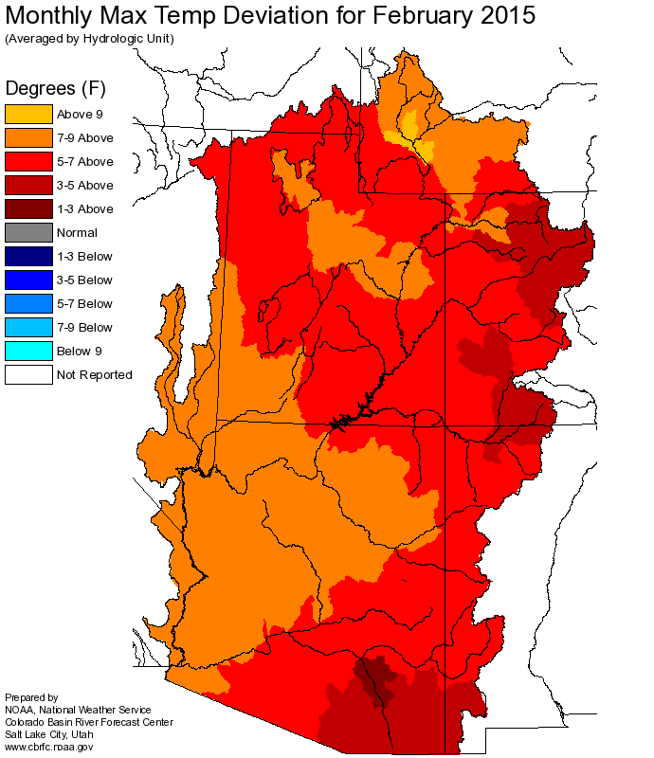
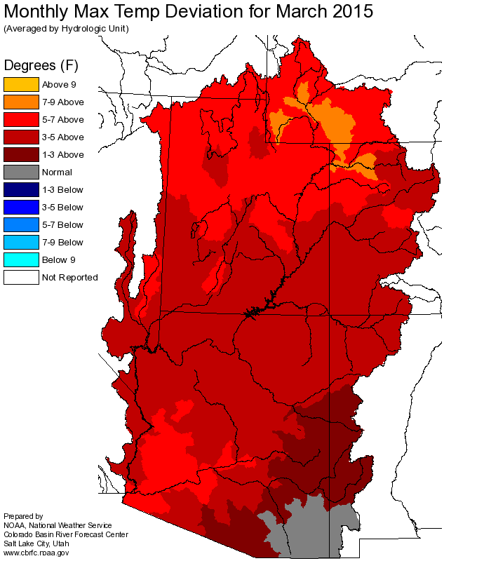
Winter Temperatures: Record heat
Impacts:
Highly variable snowpack - (Rain falling during typical snow periods)
Winter snow melt – especially lower / middle elevations
Early depletion of the snowpack – lead to record low SWE in early April / May

Slide 6
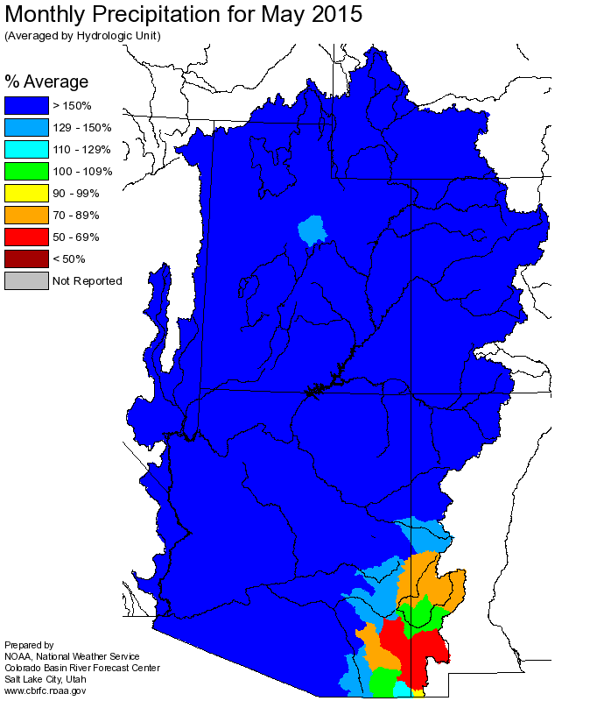
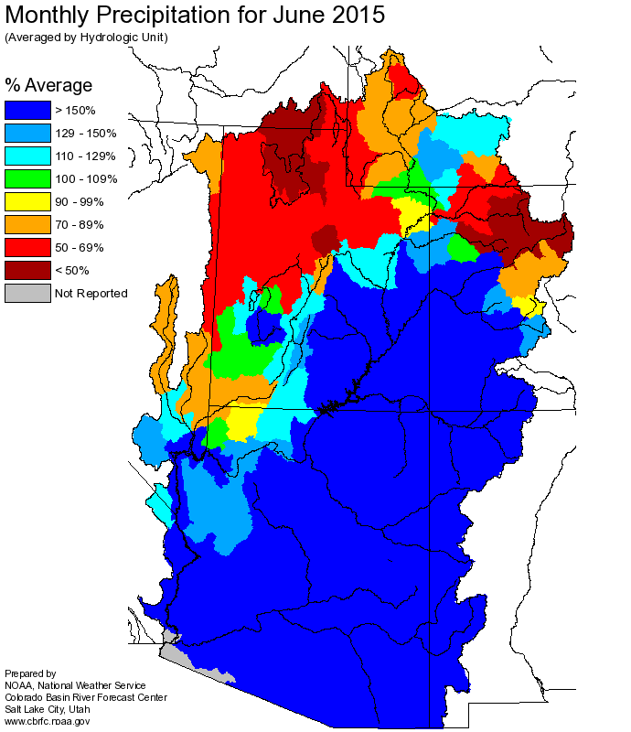
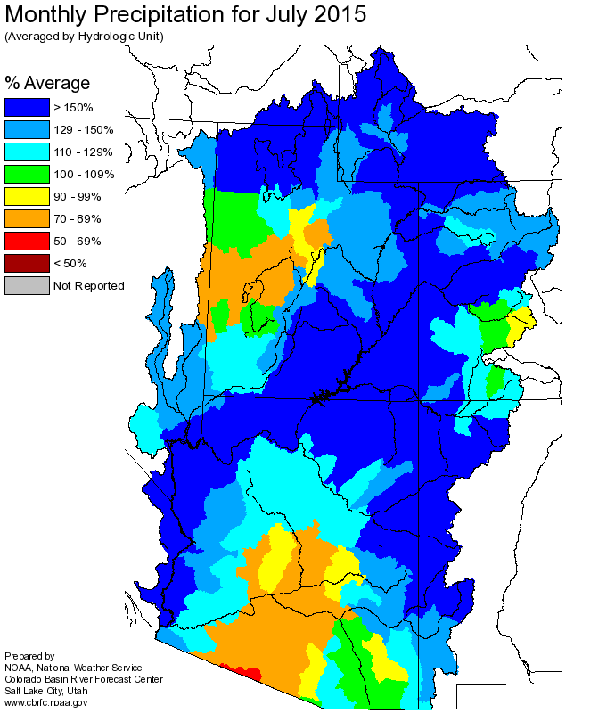
A big change in the weather:
Frequent moist storm systems (tropical moisture source)
Much below average temperatures May into early June
May:
Widespread heavy rain with some areas receiving 200 to more than 400 percent of average.
San Juan 6-11 inches of precipitation
June:
Significant precipitation continues for Gunnison basin and south
July:
Above average precipitation widespread

Slide 7
Colorado River above Lake Powell: SNOTEL Precipitation Rankings
January through April 2015
May through July 2015
Many sites driest 1-2 on record
Many sites wettest 1-3 on record

Slide 8
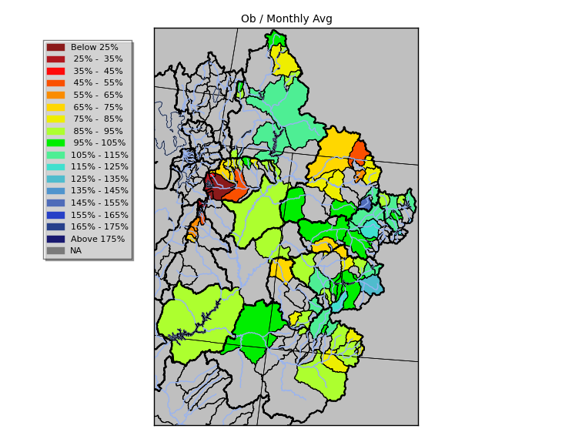
Green River Basin
April-July 2015
Observed Volume
% of 1981-2010 avg
Upper Green
- Below average snow
- Early melt in March/April due to warm temperatures
- Wet May, snow accumulation/retention at high elevation
Yampa
- Near record low snow conditions
- Extremely wet May
- Rain was a larger contribution to seasonal volumes than snow at some points
Duchesne
- Record low snow conditions
- Wet May (rain at low elevations, snow at high elevations)
- April-July observed were double May 1st forecasts at some points

Slide 9
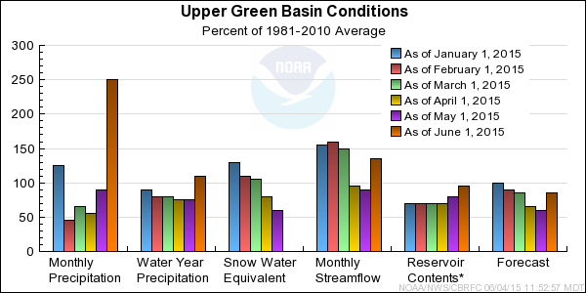
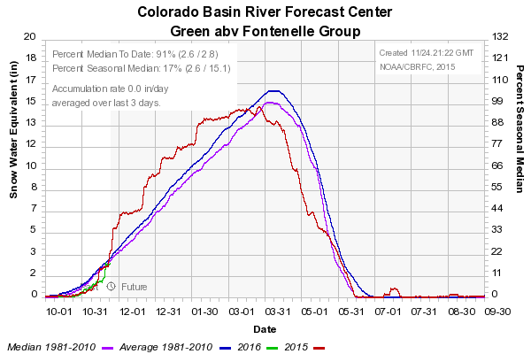
Upper Green: Basin Conditions
% of 1981-2010 avg

Slide 10
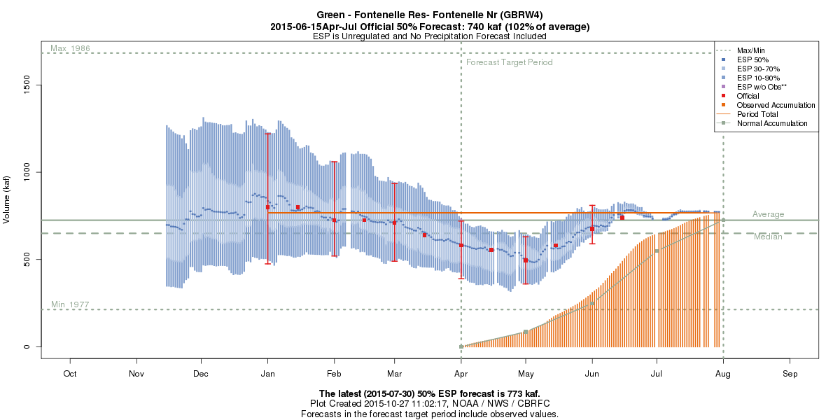
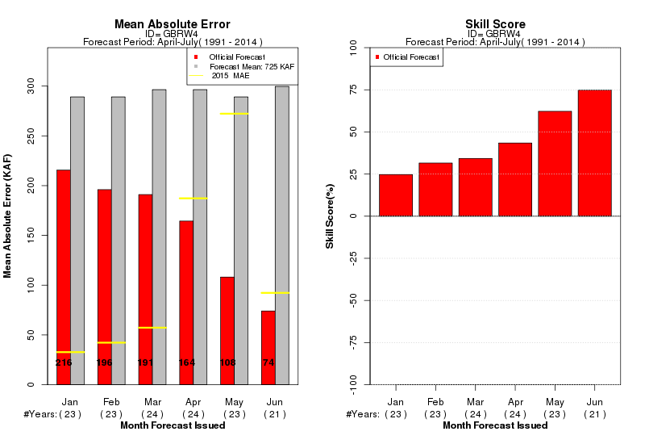
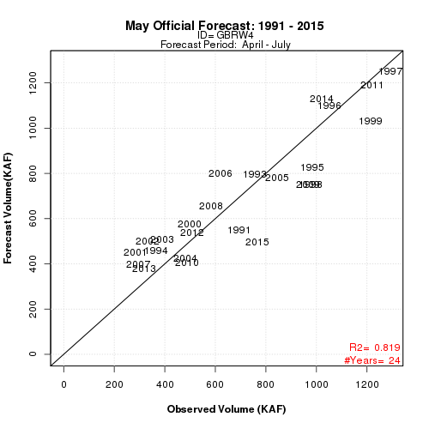
767 KAF
106% avg

Slide 11
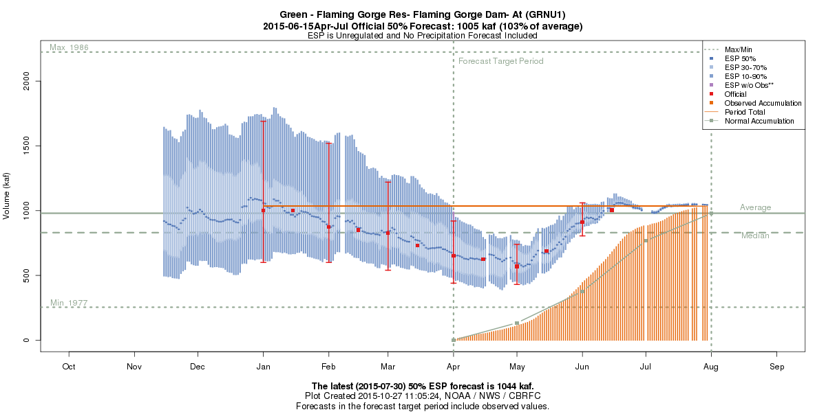
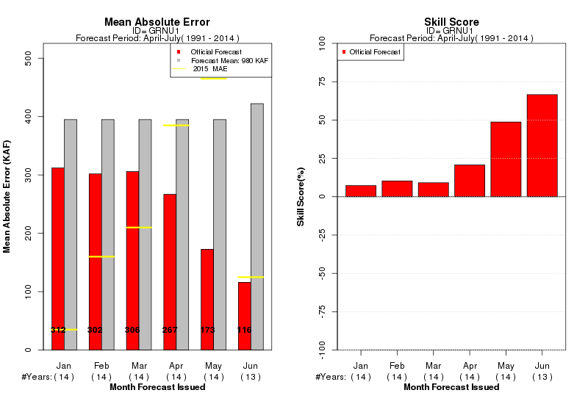
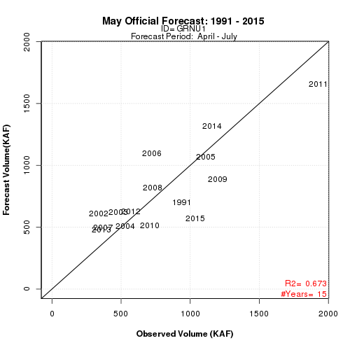
1035 KAF
106% avg

Slide 12
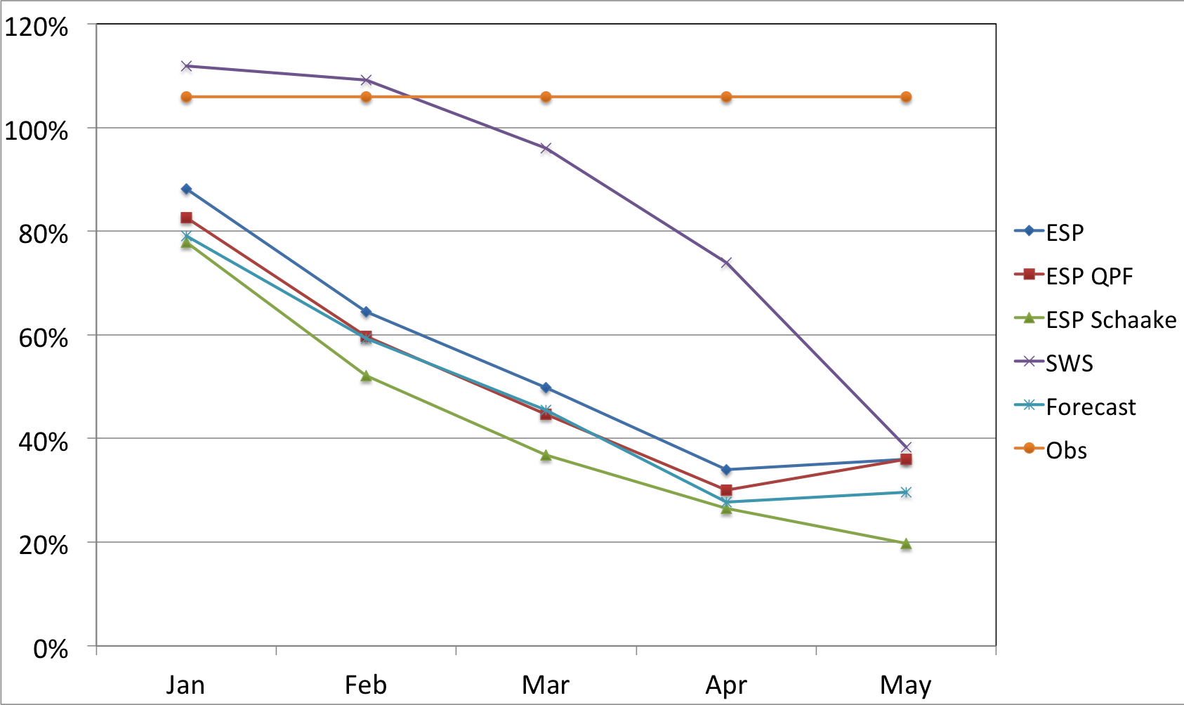
Upper Green: Flaming Gorge Local
Model guidance was not great
Always a source of uncertainty
Local = Flaming Gorge Inflow - Fontenelle Inflow
Regulated Flow from Viva Naughton, Meeks Cabin, Stateline, and Big Sandy Reservoirs

Slide 13




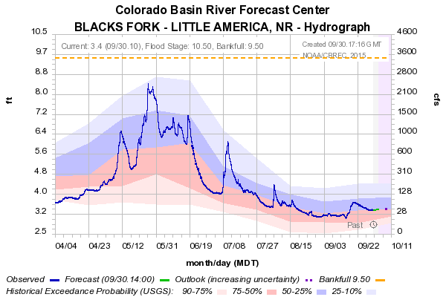
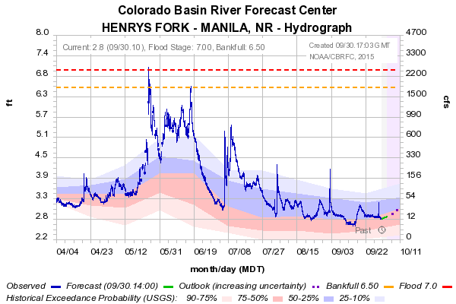
Upper Green: Flaming Gorge Local
April
May
June
July
 | Blacks Fork-Little America |  | Henry's Fork
 | ESP | OBS | ESP | OBS
Jan | 125 | 124 | 26 | 67
Feb | 81 | 124 | 24 | 67
Mar | 83 | 124 | 21.5 | 67
Apr | 38 | 124 | 13.1 | 67
May | 35 | 124 | 20 | 67
Above average precip for four months
Reservoirs spilled due to high/under predicted inflows
Reduced demand/use
Late snow accumulation and retention

Slide 14
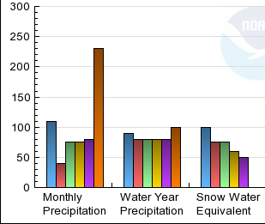
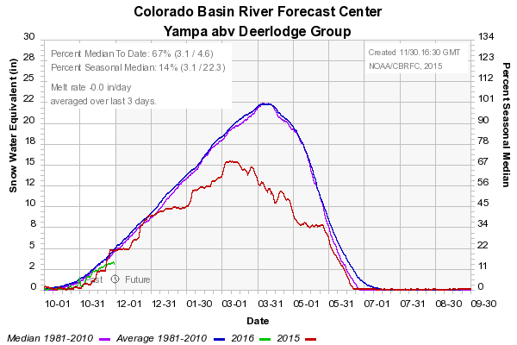
Yampa: Basin Conditions
% of 1981-2010 avg

Slide 15
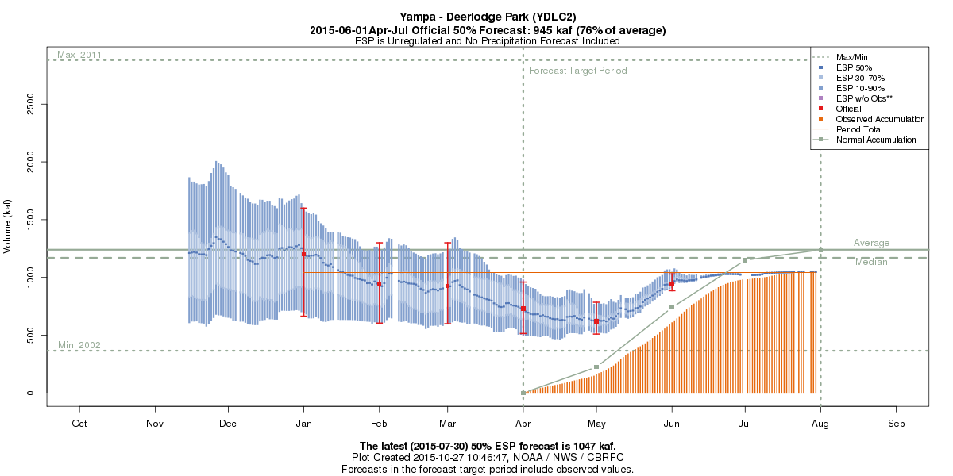
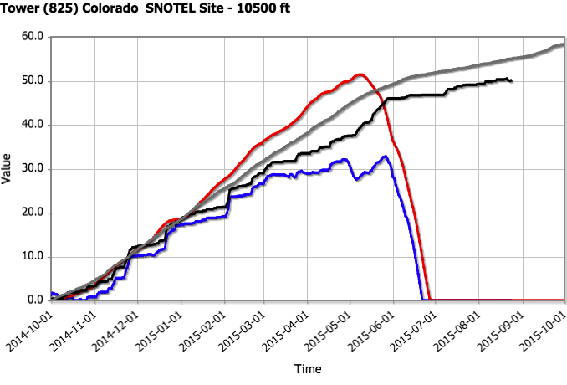
1042 KAF
84% avg
2015
Snow= 65% of Seasonal Precipitation
Normal
Snow= 95 % of Seasonal Precipitation

Slide 16
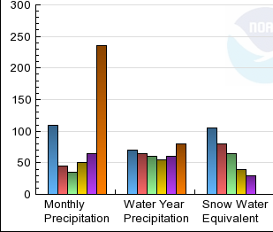
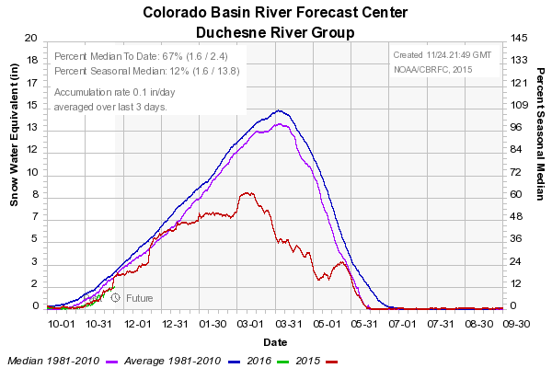
Duchesne: Basin Conditions
% of 1981-2010 avg

Slide 17
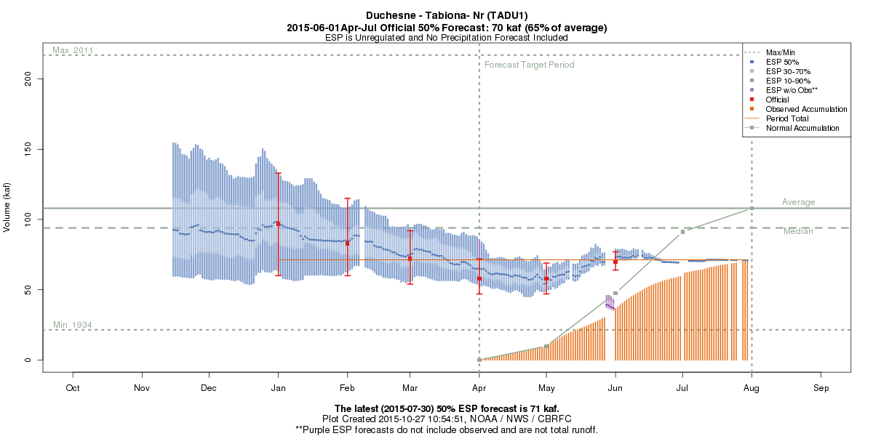
71 KAF
66% avg

Slide 18
Upper Colorado Basin
April-July 2015
Observed Volume
% of 1981-2010 avg
Mainstem
- Coming off a very good 2014 runoff season
- Above to much above average winter base flows
- Headwaters fared better precip-wise during the winter than much of the Upper Basin
- Total transmountain diversions were ~50% of average during WY2015
Gunnison/Dolores
- Large forecast errors, but model performed as expected

Slide 19
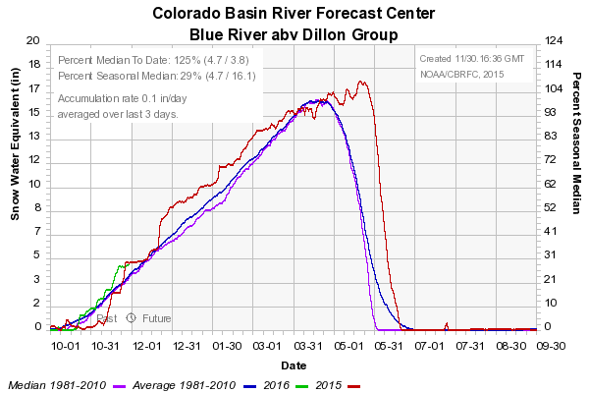
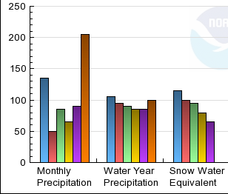
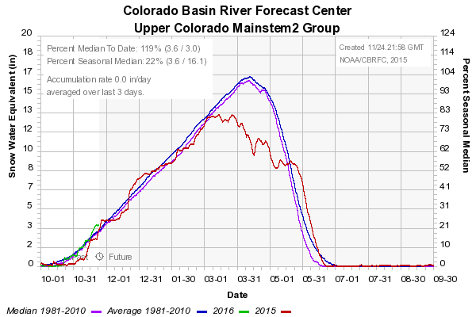
Upper Colorado Mainstem: Basin Conditions
% of 1981-2010 avg

Slide 20
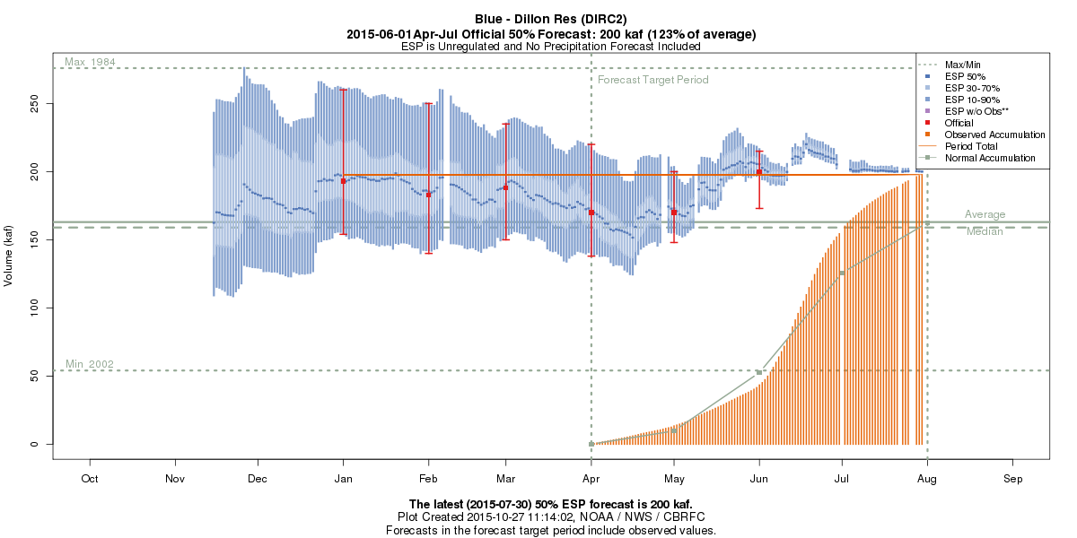
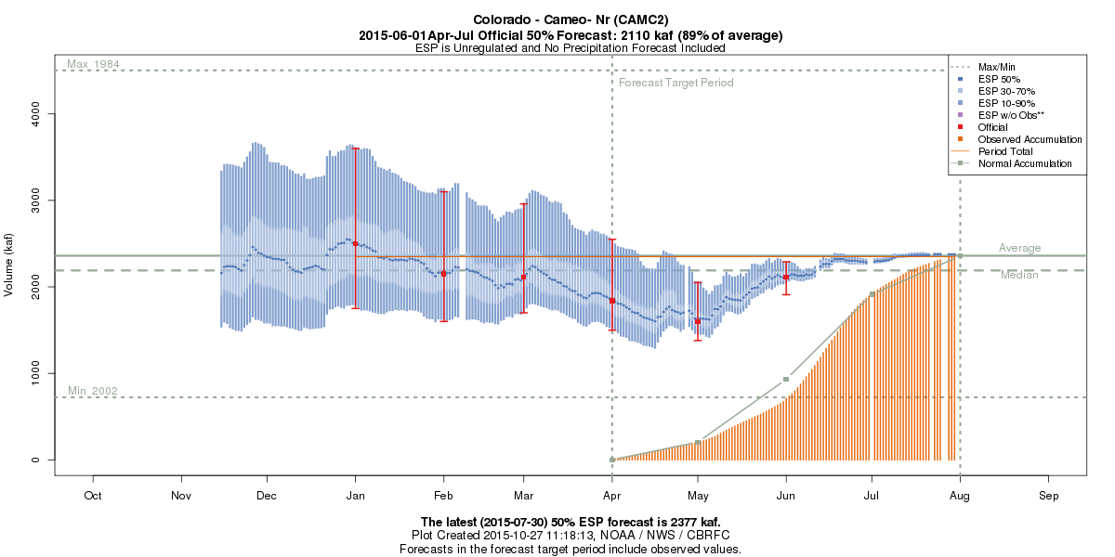
198 KAF
121% avg
2348 KAF
99% avg

Slide 21
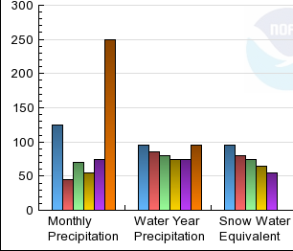
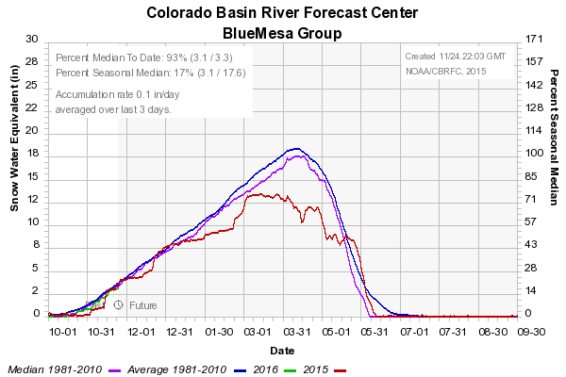
Gunnison: Basin Conditions
% of 1981-2010 avg

Slide 22
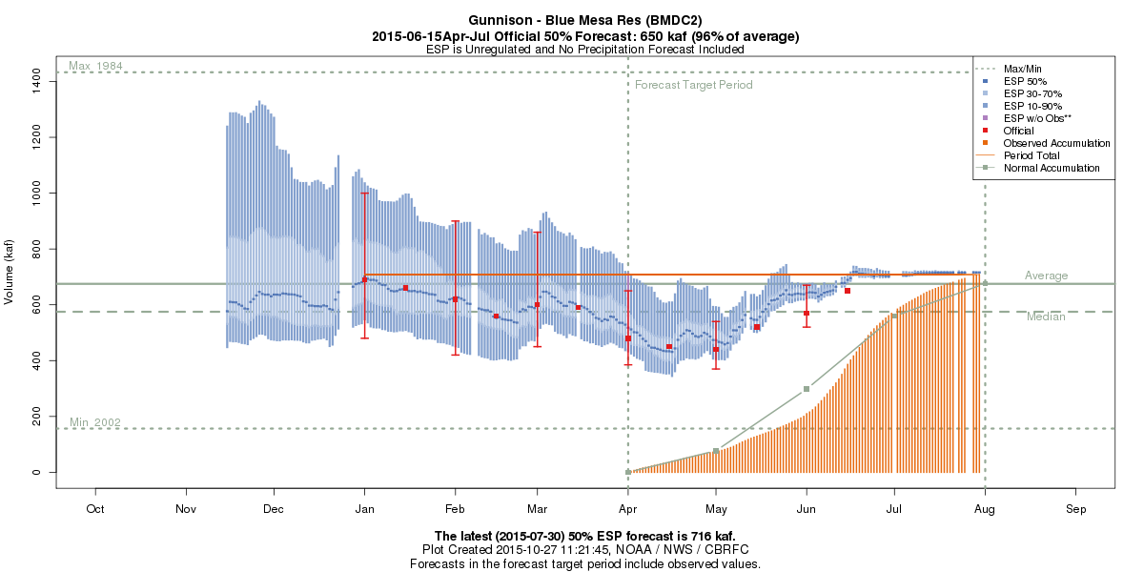
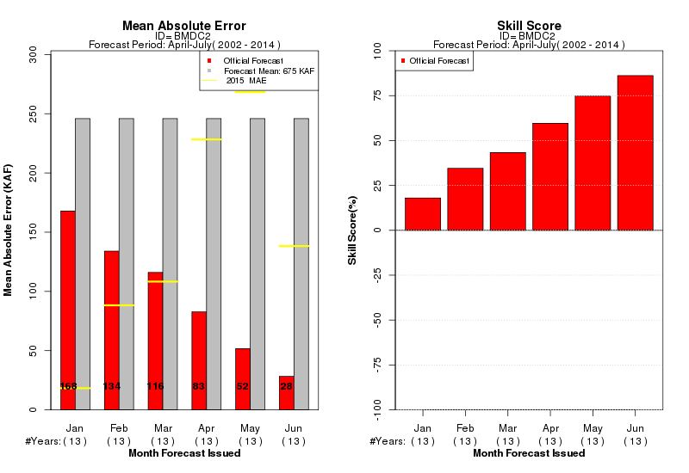
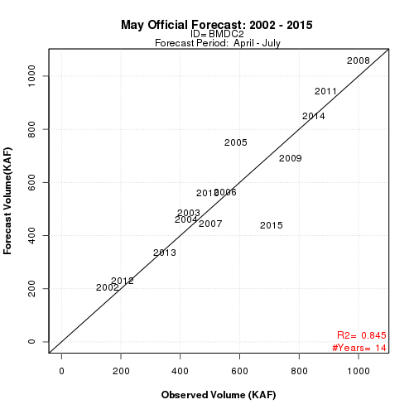
708 KAF
105% avg

Slide 23
Model / Forecast Performance & Uncertainty
Blue Mesa Reservoir Inflow Forecast Progression 2015
1st of month Forecasts
Jan: 690 KAF (102%)
Feb: 620 KAF (92%)
Mar: 600 KAF (89%)
Apr: 480 KAF (71%)
May: 440 KAF (65%)
June: 570 KAF (84%)
July: 700 KAF (104%)
10 % Chance of Exceeding : 540 KAF
50% Chance of Exceeding: 440 KAF
April-July Observed
708 KAF (105%)
90 % Chance of Exceeding: 370 KAF
Highest Forecast Trace on May 1 was 741 KAF: (3% exceedance probability)
Second Highest Forecast Trace on May 1 was 604 KAF: (7% exceedance probability)
May-July precipitation at SNOTEL sites was in the top 3-6% of the historical record.

Slide 24
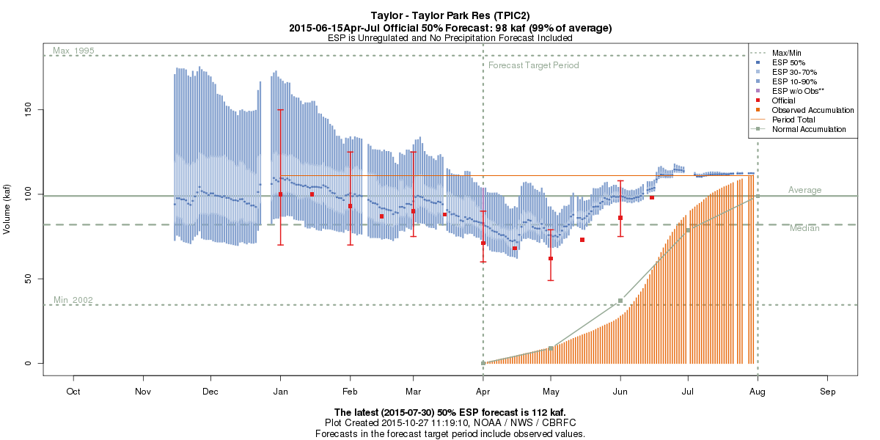
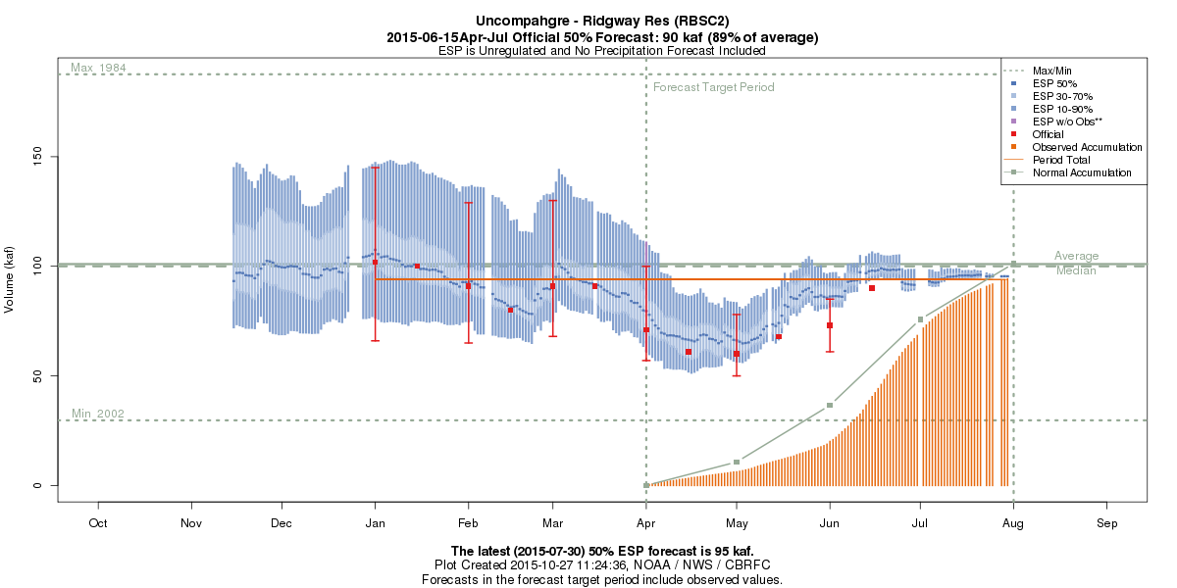
111 KAF
112% avg
94 KAF
93% avg

Slide 25
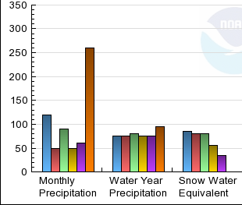
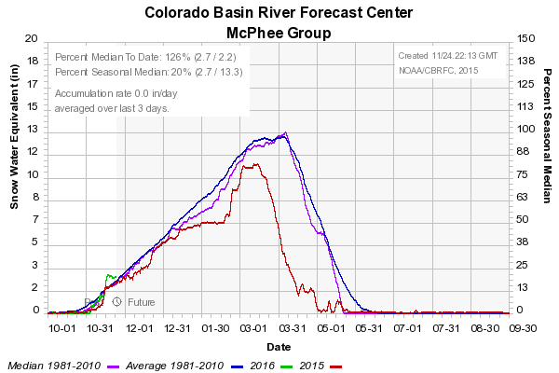
Dolores: Basin Conditions
% of 1981-2010 avg

Slide 26
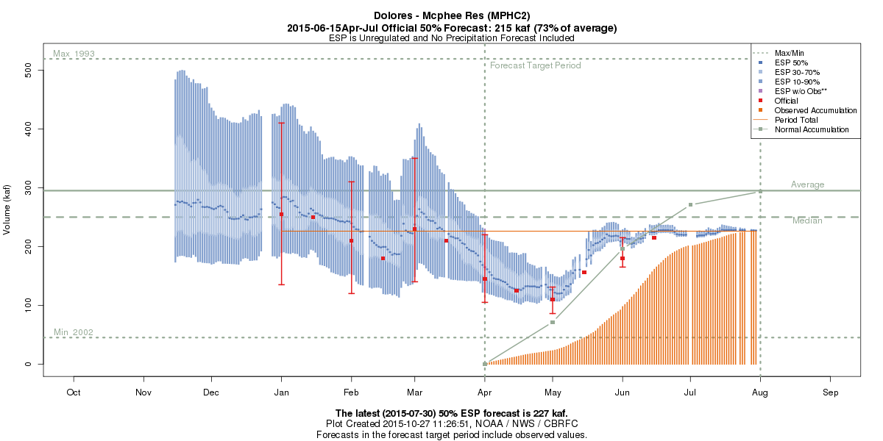
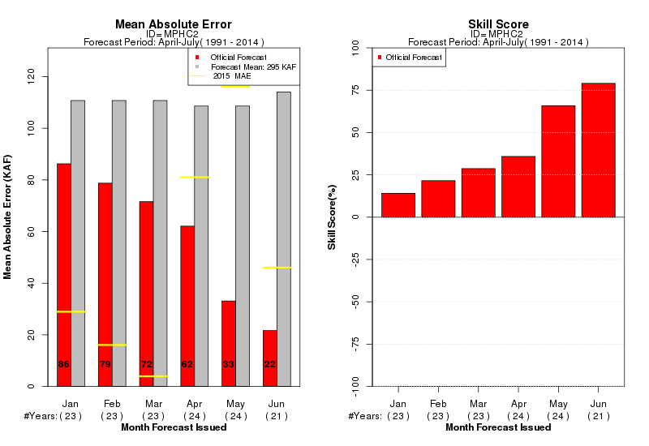

226 KAF
77% avg

Slide 27
San Juan Basin
April-July 2015
Observed Volume
% of 1981-2010 avg
San Juan
- Record (300% to more than 400% average) precipitation across the basin during May
- Much above average precipitation (200%-300%) continued into June

Slide 28



San Juan: Basin Conditions
% of 1981-2010 avg

Slide 29



619 KAF
84% avg

Slide 30


205 KAF
106% avg
54 KAF
97% avg

Slide 31

439 KAF
106% avg

Slide 32
Lake Powell
April-July 2015
Observed Volume
% of 1981-2010 avg
Lake Powell
- Largest May-June forecast change:
→ +2000 kaf (67% volume change)
- Largest May forecast vs. observed difference:
→ 3700 kaf (124% volume difference)

Slide 33

Lake Powell: Basin Conditions
% of 1981-2010 avg

Slide 34



Green – Green River, UT
2520 KAF
85% avg
Colorado – Cisco, nr
4113 KAF
93% avg
San Juan – Bluff, nr
1049 KAF
95% avg

Slide 35



6712 KAF
94% avg
3000 KAF
42% avg

Slide 36
Lake Powell: Contributing Flows
April – July Unregulated Inflow
January %Avg Forecasts
Green – 95%
Colorado – 98%
San Juan – 65%
Powell – 91%
April %Avg Forecasts
Green – 54%
Colorado– 68%
San Juan – 40%
Powell – 52%
May %Avg Forecasts
Green – 48%
Colorado– 58%
San Juan – 27%
Powell – 42%
2015 %Avg Observed
Green – 85%
Colorado– 93%
San Juan – 95%
Powell – 94%

Slide 37

Lower Colorado Basin
Lower Basin
- Neutral ENSO conditions
- The wet spring did not improve conditions in Arizona; only slight improvement in Virgin Basin
- Virgin River at Virgin 3rd driest on record this year (after 2nd driest last year)
Virgin

Slide 38


21 KAF
36% avg

Slide 39






Verde – Tangle Ck, blo, Horseshoe Dam, abv
159 KAF
102% med
Salt – Roosevelt, nr
146 KAF
47% med
Gila – Solomon, nr, Head of Safford Vly
137 KAF
100% med

Slide 40
What can we take-away from 2015?
Forecast/Model errors exist - Calibration Data, Observed Data, Future Weather
Model in general performed as expected in many areas with large April and May
forecast errors. The extreme conditions were caught within the full forecast
distribution even though we weren’t focusing on that type of scenario developing.
The ability to catch such future weather extremes in water supply forecasts is very
limited. It depends upon if these events exist in the calibration period used. Also
requires improved and quantifiable longer-term seasonal climate forecasts.
The spring rain coming when it did, following lower elevation melt that increased
soil moisture conditions, resulted in more efficient runoff.
Late season high elevation snow carries a lot of uncertainty. There is limited to no
ground truth and the use satellite data this past spring was limited due to extended
and extensive cloud cover.
Unmeasured depletions from the river systems were lower than typical due to
reduced demands. This extra water showed up in the final observed volumes at
many sites.

