Slide 1
Baseflow (Aug-Dec)
Monthly Forecast Verification
CRFS
December 8, 2015
Notes:
1

Slide 2
Objectives
Analyze performance of ESP monthly volume forecasts
  Baseflow period (August-December)
  1981-2010 ESP reforecasts; not official forecasts
  BOR MTOM Points
  Forecast lead times:
    August 1st
    September 1st
    October 1st
    November 1st
Answer key questions
  Does ESP perform better than climatology (average)?
  What impacts the performance of the monthly forecasts?
  Are there specific monthly volume or lead time issues?
Notes:
2

Slide 3
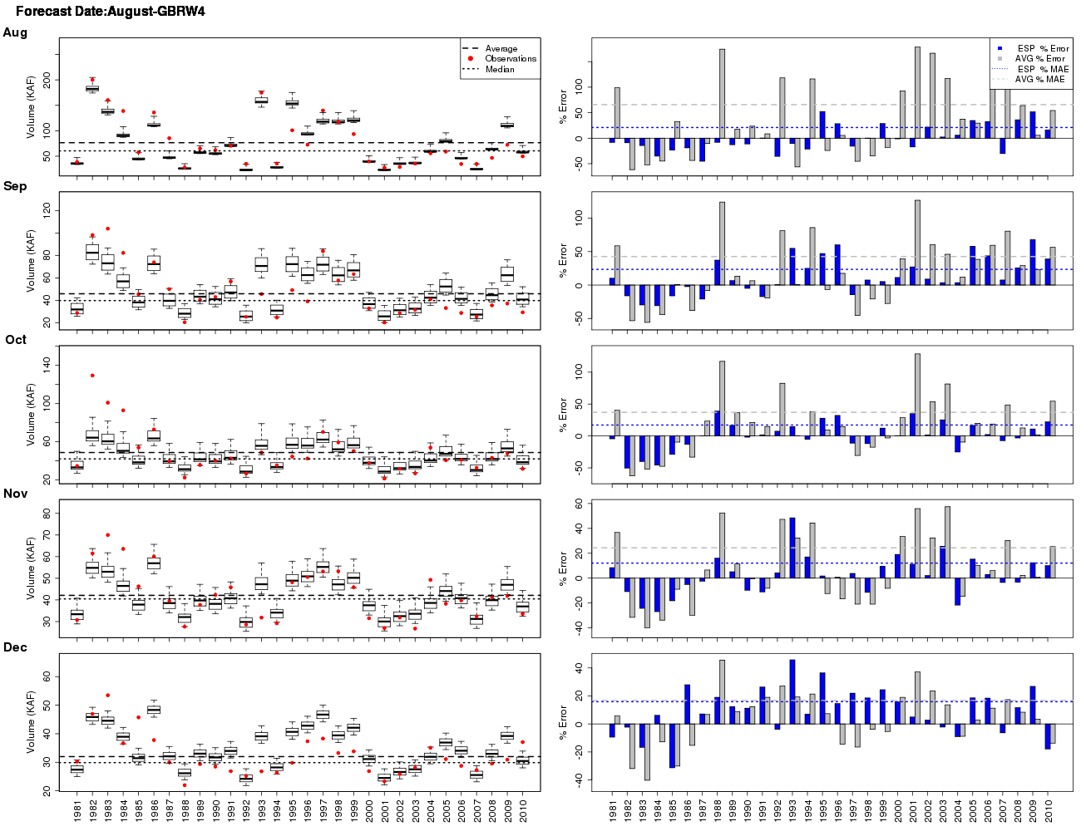
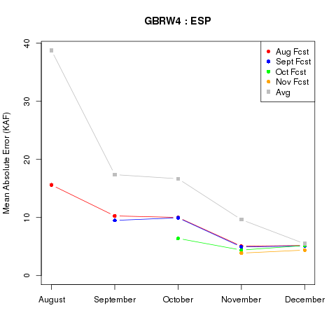
Question 1:
  Does ESP perform better than climatology ?
10%
50%
90%
Fontenelle
Notes:
3

Slide 4
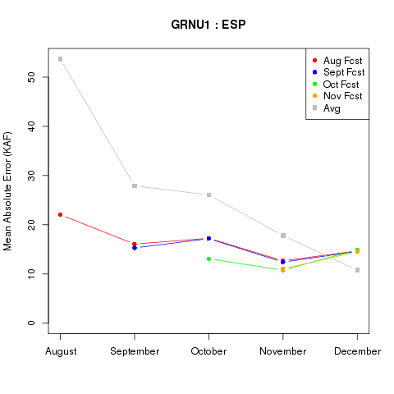
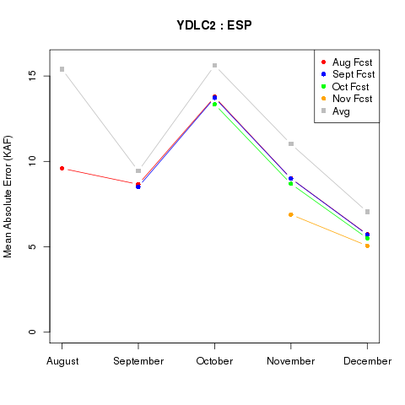
Question 1:
  Does ESP perform better than climatology ?
Green River Basin
Fontenelle
Flaming Gorge
Yampa-Deerlodge
Notes:
4

Slide 5
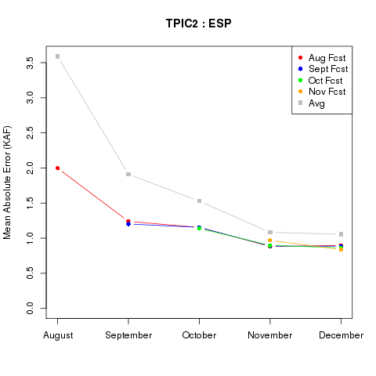
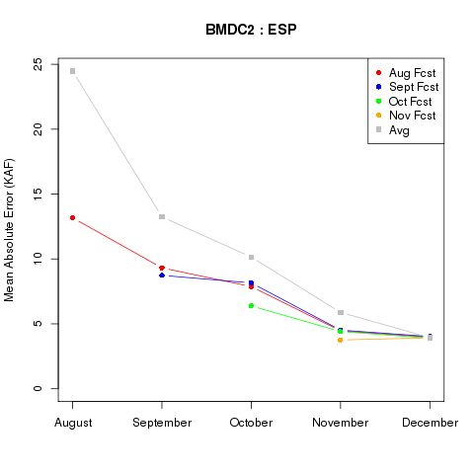
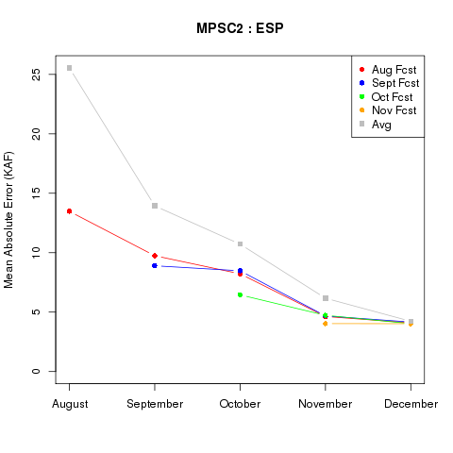
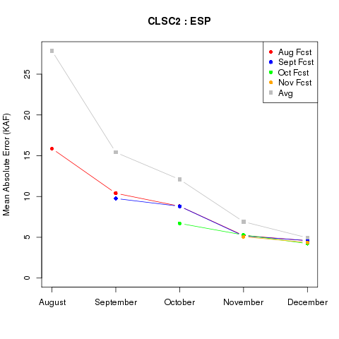
Question 1:
  Does ESP perform better than climatology ?
Gunnison
Taylor Park
Blue Mesa
Morrow Point
Crystal
Notes:
5

Slide 6
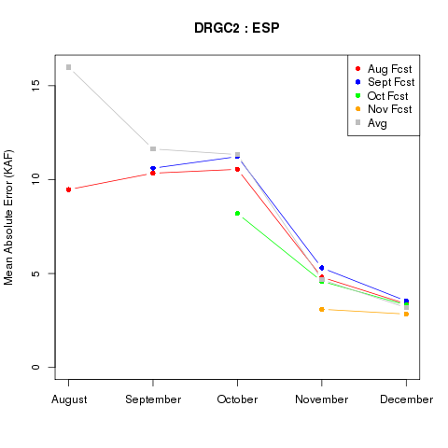
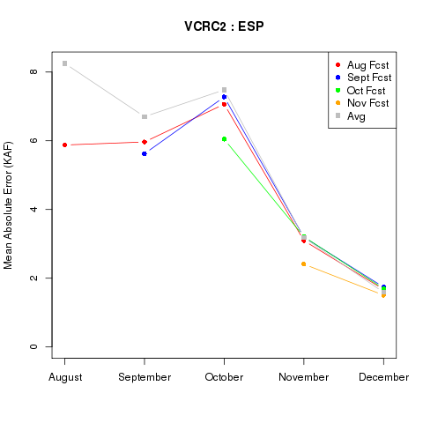
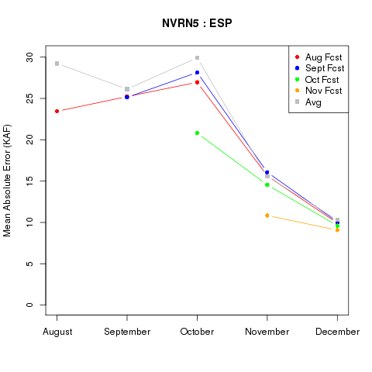
Question 1:
  Does ESP perform better than climatology ?
San Juan
Animas-Durango
Blue Mesa
Vallecito
Crystal
Navajo
Notes:
6

Slide 7
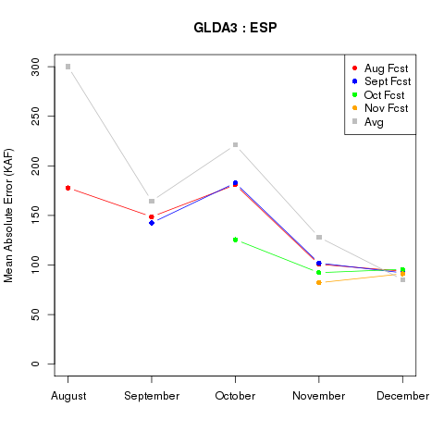
Question 1:
  Does ESP perform better than climatology ?
Lake Powell
Lake Powell
Sum of Average Errors
August Forecast | 700 KAF
October Forecast | 300 KAF
Notes:
7

Slide 8
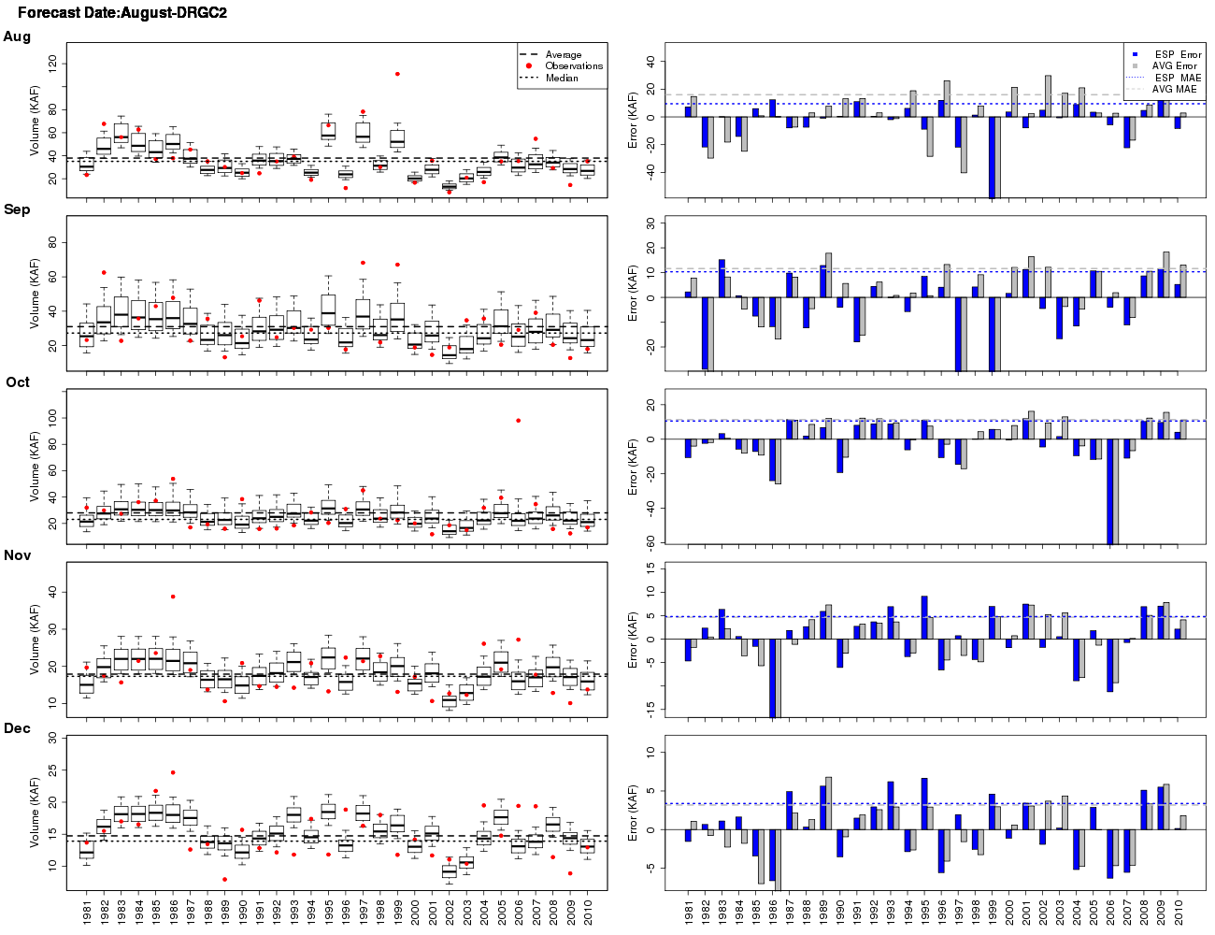
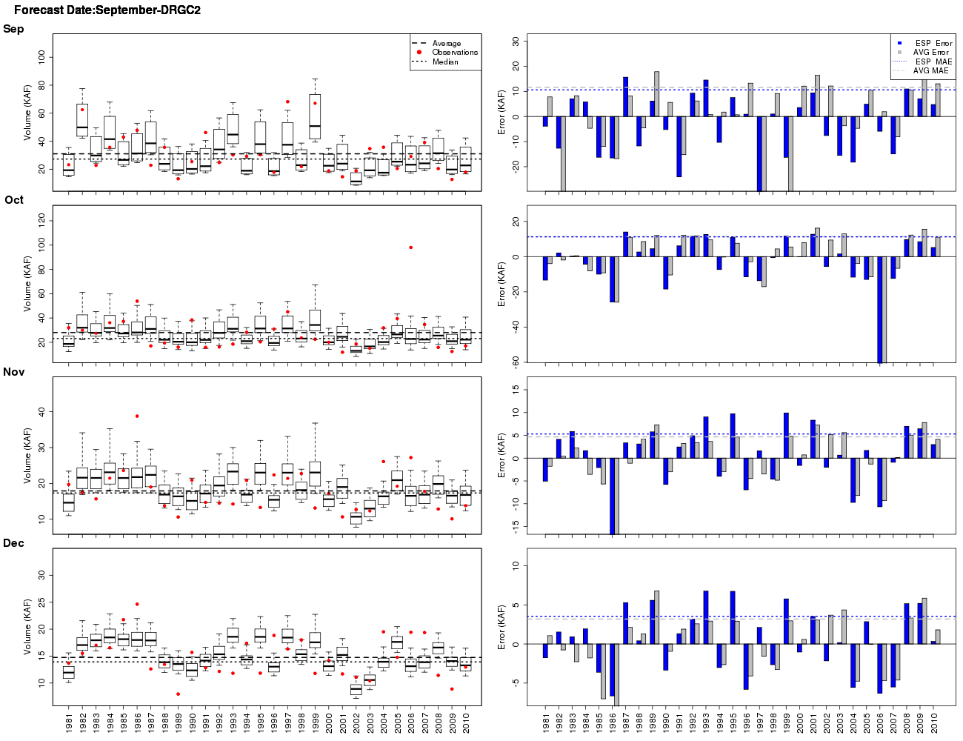
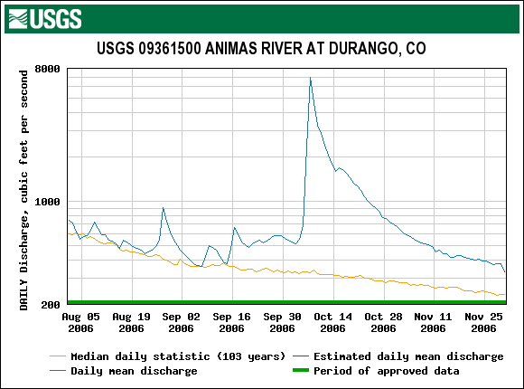
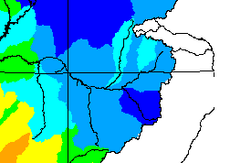
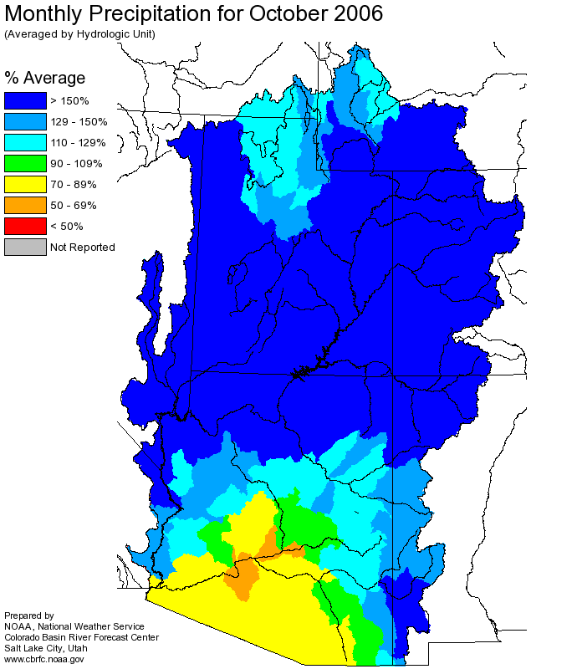
Question 2:
  What impacts the performance of the forecast?
Fall rain events result in larger forecast errors
Animas-Durango
September 2006
October 2006
Notes:
8

Slide 9
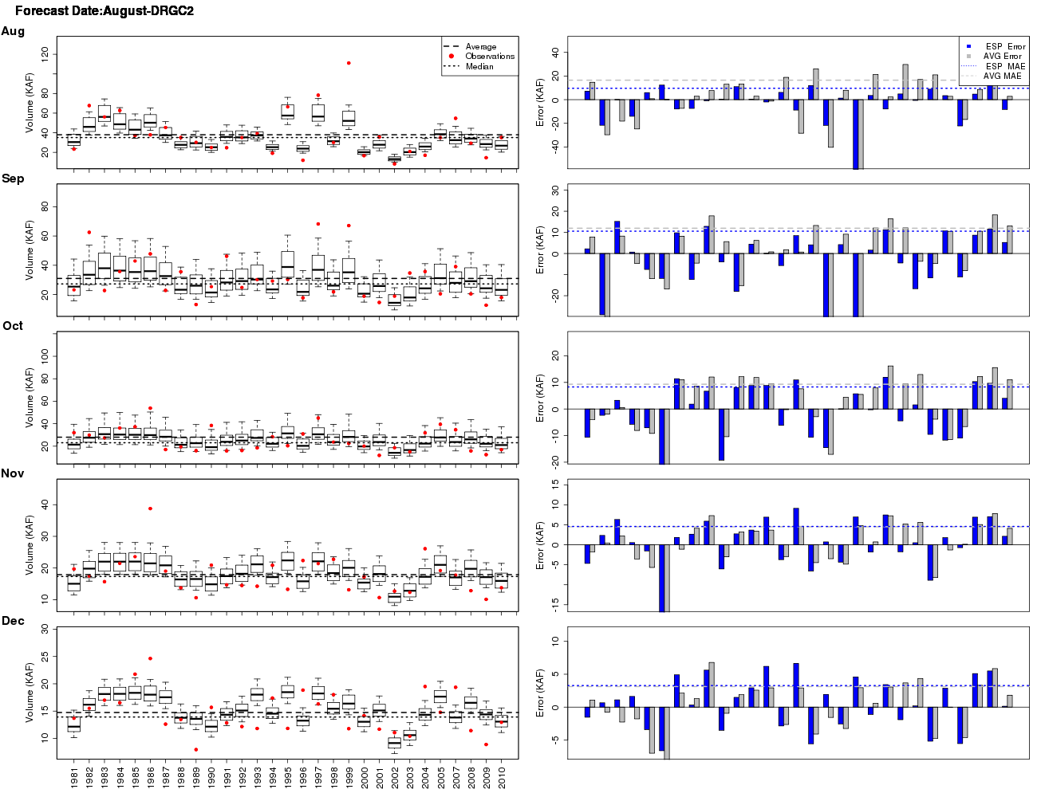
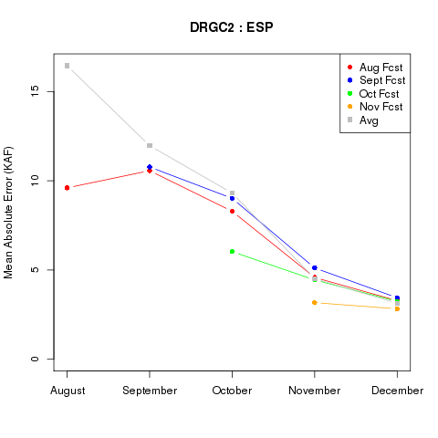
Question 2:
  What impacts the performance of the forecast?
Fall precipitation events result in larger forecast errors
Animas-Durango
Remove 2006 from error analysis
Animas-Durango
 | Oct MAE (KAF) w/2006 | Oct MAE (KAF) No 2006 | % Change in Error
Aug Fcst | 10.6 | 8.0 | - 25%
Sep Fcst | 11.2 | 9.0 | -20%
Notes:
9

Slide 10
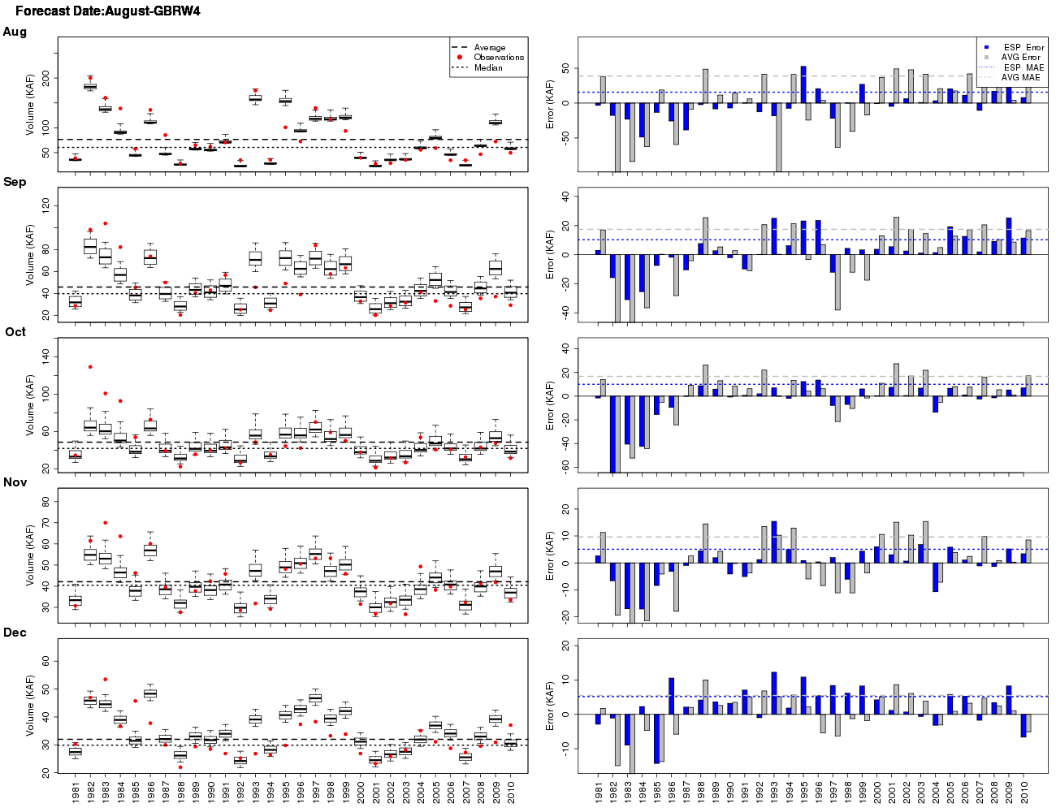
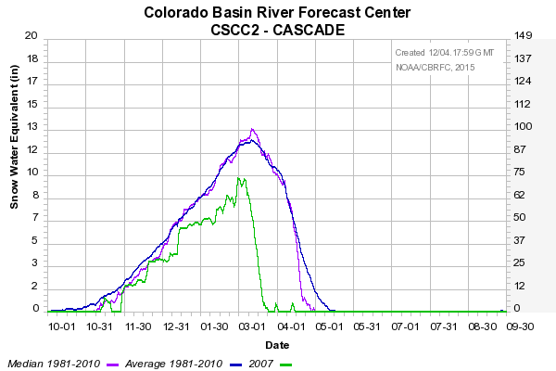
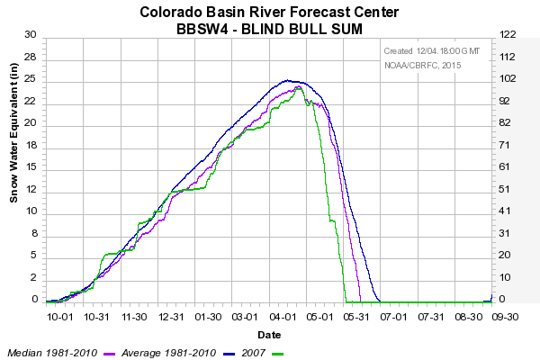
Question 2:
  What impacts the performance of the forecast?
Elevation and rain versus snow also impacts the forecast errors
Animas
Fontenelle
~8600 ft
~8800 ft
Rain versus snow
Notes:
10

Slide 11
Question 3:
  Are there specific monthly volumes or lead time issues?
Yes. Forecasts of December volumes have errors more similar to climatology than other months.
Flaming Gorge
What is going on in December?
  Transition in hydrology (ice)
  Decline in quality of observed data
  Calibration error increases
  Less variability in flows of winter months
Variability in Observed Monthly Flows
 | Flaming Gorge |  | Vallecito
 | Oct | Dec | Oct | Dec
Max (KAF) | 166 | 91 | 55 | 10.4
Min (KAF) | 16.7 | 17 | 3.2 | 2.7
Vallecito
Notes:
11

Slide 12
Summary
ESP monthly forecasts for the months of Aug-Nov have less error than climatology (average) for all forecast lead times
Large fall precipitation events increase monthly forecast errors
Elevation and rain versus snow impacts monthly forecast errors
December forecast errors may be higher than climatology due the transition in hydrology, lower quality observed data, and less variation in winter flows
Notes:
12

