Slide 1

CRFS Technical Committee
Spring Meeting
LC Operations Update
March 26, 2015

Slide 2
Topics
LC Current Conditions Update
LC Operations Update
Pilot System Conservation Program

Slide 3
Current Conditions

Slide 4
Colorado River Basin Storage
(as of March 22, 2015)
Current Storage | Percent Full | Storage (maf) | Elevation (feet)
Lake Powell | 45% | 10.94 | 3,591.3
Lake Mead | 40% | 10.52 | 1,086.1
Lake Mohave | 95% | 1.72 | 643.9
Lake Havasu | 95% | 0.59 | 448.4
Total System Storage* | 49% | 28.97 | NA
*Total system storage was 28.43 maf or 48% this time last year
Notes:
4

Slide 5
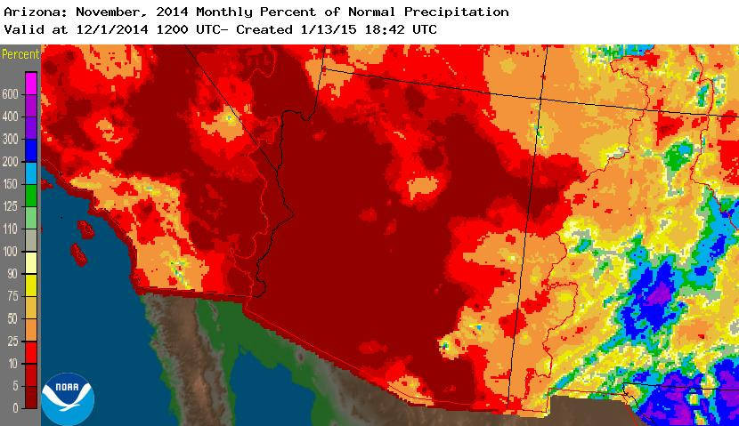
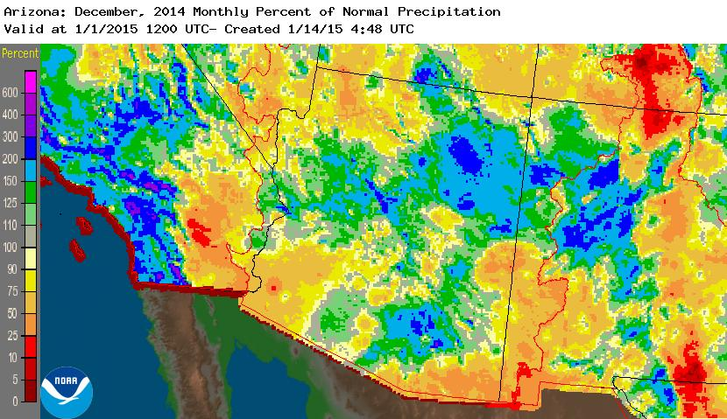
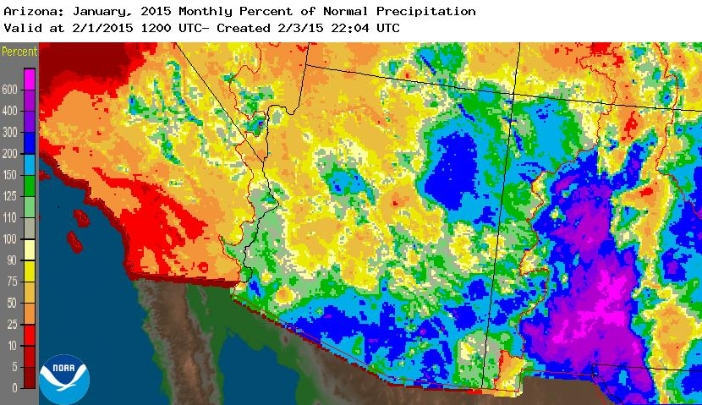
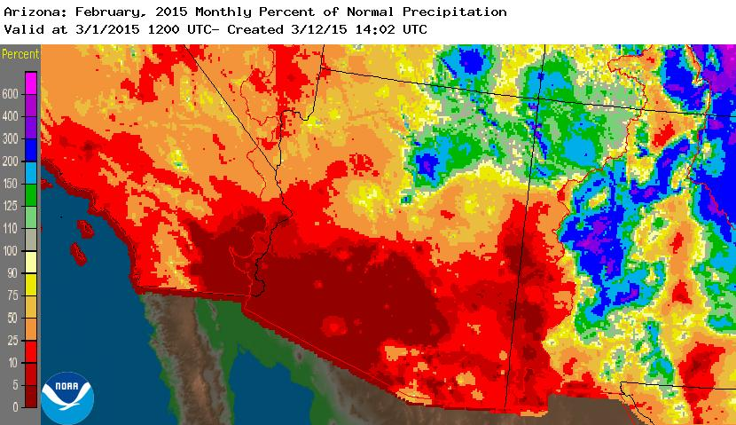
Observed Precipitation
Source: http://water.weather.gov/precip/

Slide 6
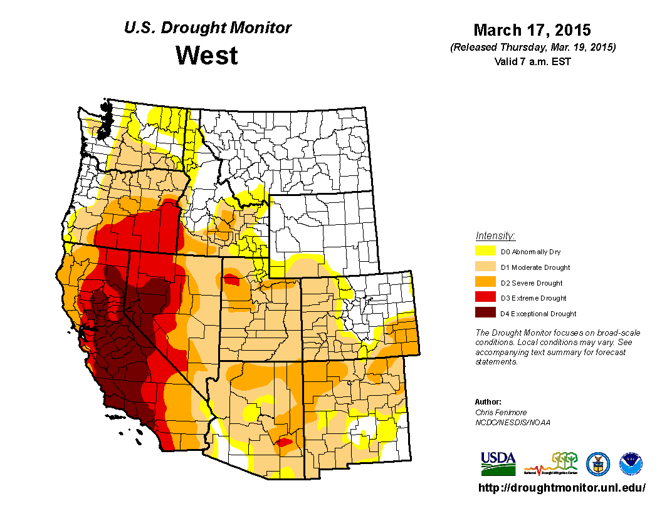
Drought Conditions

Slide 7
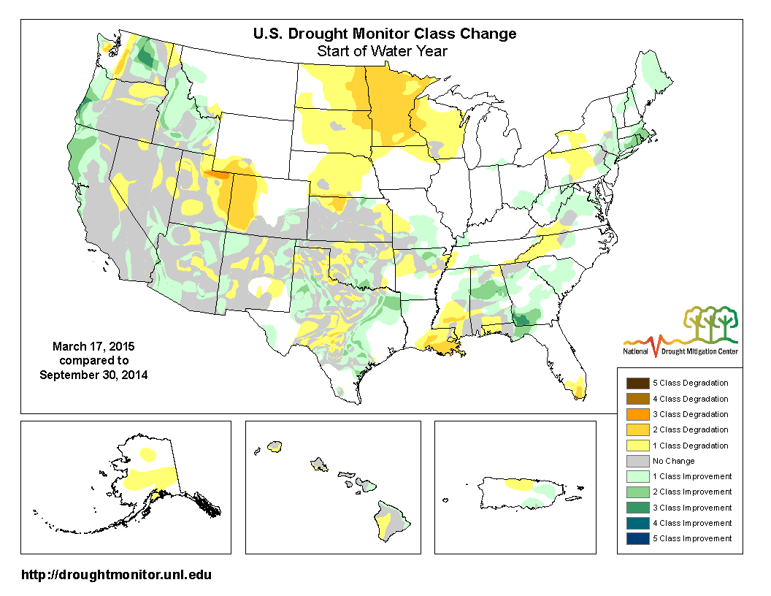
Drought Conditions

Slide 8
Lower Basin Side Inflows – WY/CY 2014^{1,2}
Intervening Flow from Glen Canyon to Hoover Dam
Month in WY/CY 2014 |  | 5-Year Average Intervening Flow (KAF) | Observed Intervening Flow (KAF) | Observed Intervening Flow (% of Average) | Difference From 5-Year Average (KAF)
HISTORICAL | October 2013 | 52 | 38 | 73% | -14
 | November 2013 | 52 | 101 | 194% | 49
 | December 2013 | 95 | 43 | 45% | -52
 | January 2014 | 75 | 45 | 60% | -30
 | February 2014 | 78 | 76 | 97% | -2
 | March 2014 | 68 | 29 | 43% | -39
 | April 2014 | 80 | 17 | 21% | -63
 | May 2014 | 60 | 13 | 22% | -47
 | June 2014 | 23 | 10 | 43% | -13
 | July 2014 | 64 | 54 | 84% | -10
 | August 2014 | 116 | 113 | 97% | -3
 | September 2014 | 97 | 140 | 144% | 43
 | October 2014 | 52 | 68 | 131% | 16
 | November 2014 | 52 | 43 | 83% | -9
 | December 2014 | 95 | 67 | 71% | -28
 | WY 2014 Totals | 860 | 678 | 79% | -182
 | CY 2014 Totals | 860 | 674 | 78% | -186
¹ Values were computed with the LC’s gain-loss model for the most recent 24-month study.
² Percents of average are based on the 5-year mean from 2009-2013.

Slide 9
Lower Basin Side Inflows – WY/CY 2015^{1,2}
Intervening Flow from Glen Canyon to Hoover Dam
Month in WY/CY 2015 |  | 5-Year Average Intervening Flow (KAF) | Observed Intervening Flow (KAF) | Observed Intervening Flow (% of Average) | Difference From 5-Year Average (KAF)
OBSERVED | October 2014 | 61 | 68 | 111% | 7
 | November 2014 | 50 | 44 | 88% | -6
 | December 2014 | 96 | 56 | 58% | -40
 | January 2015 | 72 | 72 | 100% | 0
 | February 2015 | 77 | 89 | 116% | 13
PROJECTED | March 2015 | 61
 | April 2015 | 76
 | May 2015 | 49
 | June 2015 | 23
 | July 2015 | 67
 | August 2015 | 127
 | September 2015 | 114
 | October 2015 | 61
 | November 2015 | 50
 | December 2015 | 96
 | WY 2015 Totals | 874 | 847 | 97% | -27
 | CY 2015 Totals | 874 | 887 | 101% | 13
¹ Values were computed with the LC’s gain-loss model for the most recent 24-month study.
² Percents of average are based on the 5-year mean from 2010-2014.

Slide 10
Lower Basin Side Inflows
Intervening Flow from Glen Canyon to Hoover Dam

Slide 11
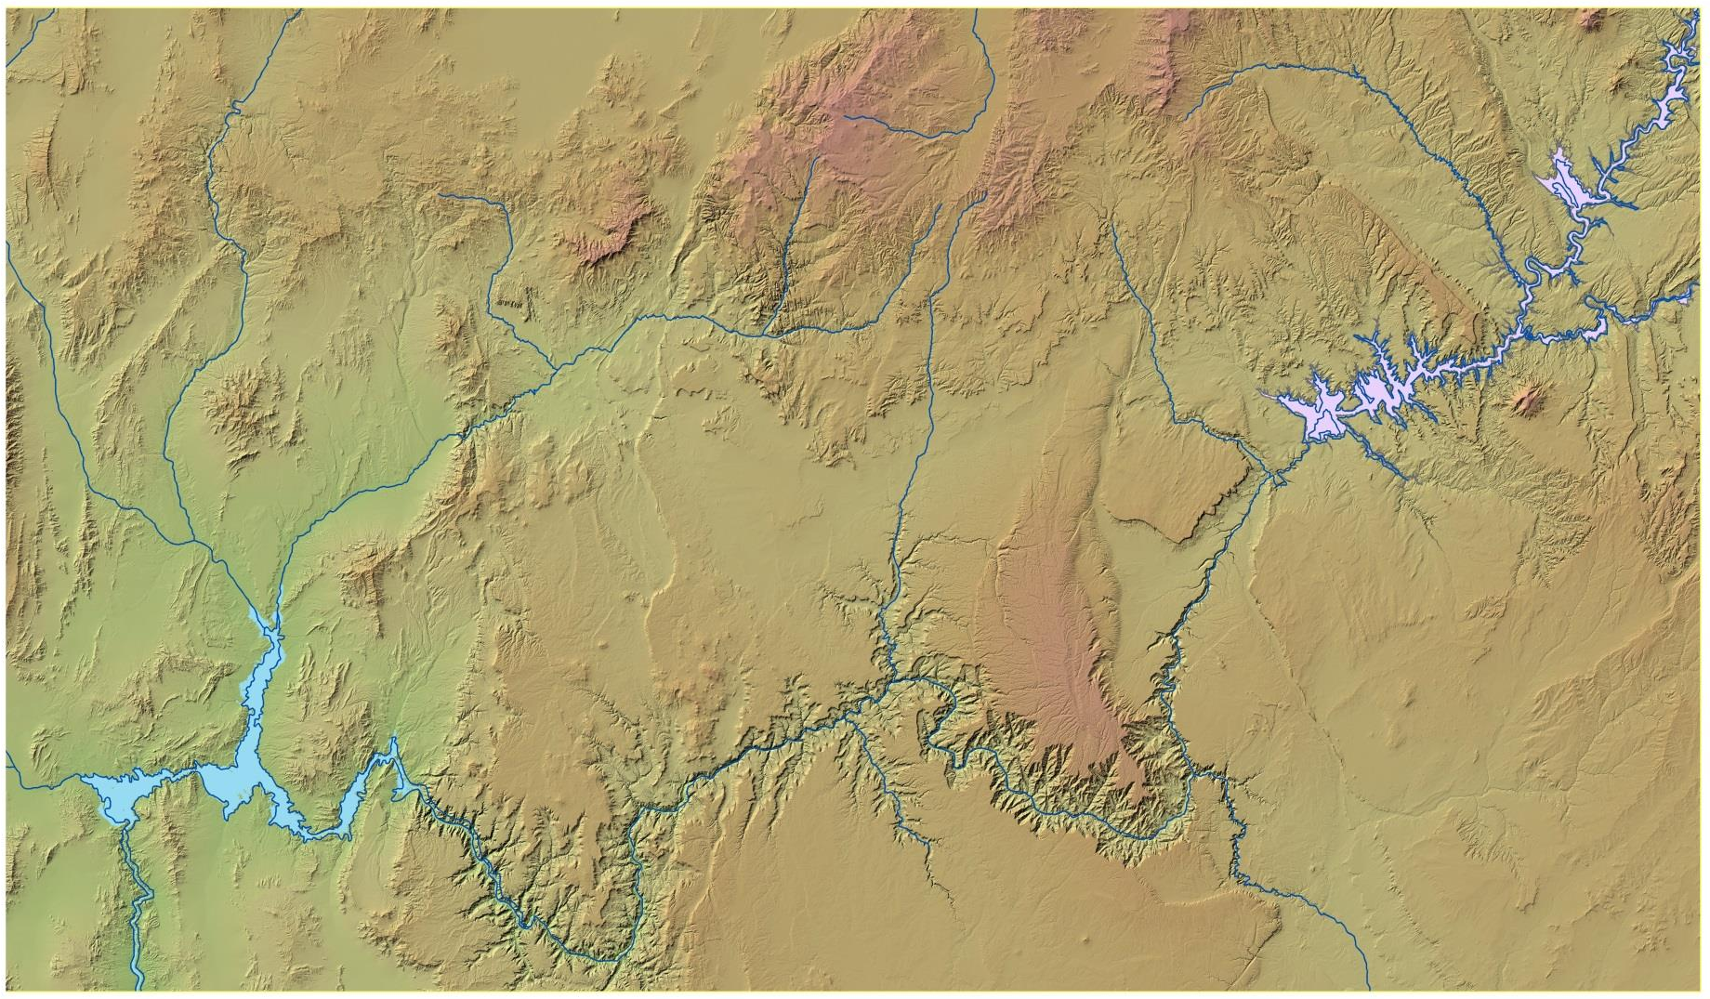

Lake Mead Intervening Flow Forecast – March 2015
Based on CBRFC Forecast Dated March 16, 2015
Total Intervening Flow¹: 80 kaf (73%)
24-Month Study Intervening Flow²: 61 kaf
Paria River
3.0 kaf (135% / 184%)
Paria River
Lake Powell
Virgin River
Muddy River
Virgin River
10.0 kaf (43% / 68%)
Little Colorado River
12.9 kaf (43% / 63%)
Lake Mead
Las Vegas
Wash
Little Colorado River
(% of Average / % of Median)
¹Percent of average based on period of record from 1981-2010
²This value is based on the 5-year average from 2010-2014.
The 24-month study uses a 5-year average to model intervening
flows between Glen Canyon Dam and Lake Mead.

Slide 12
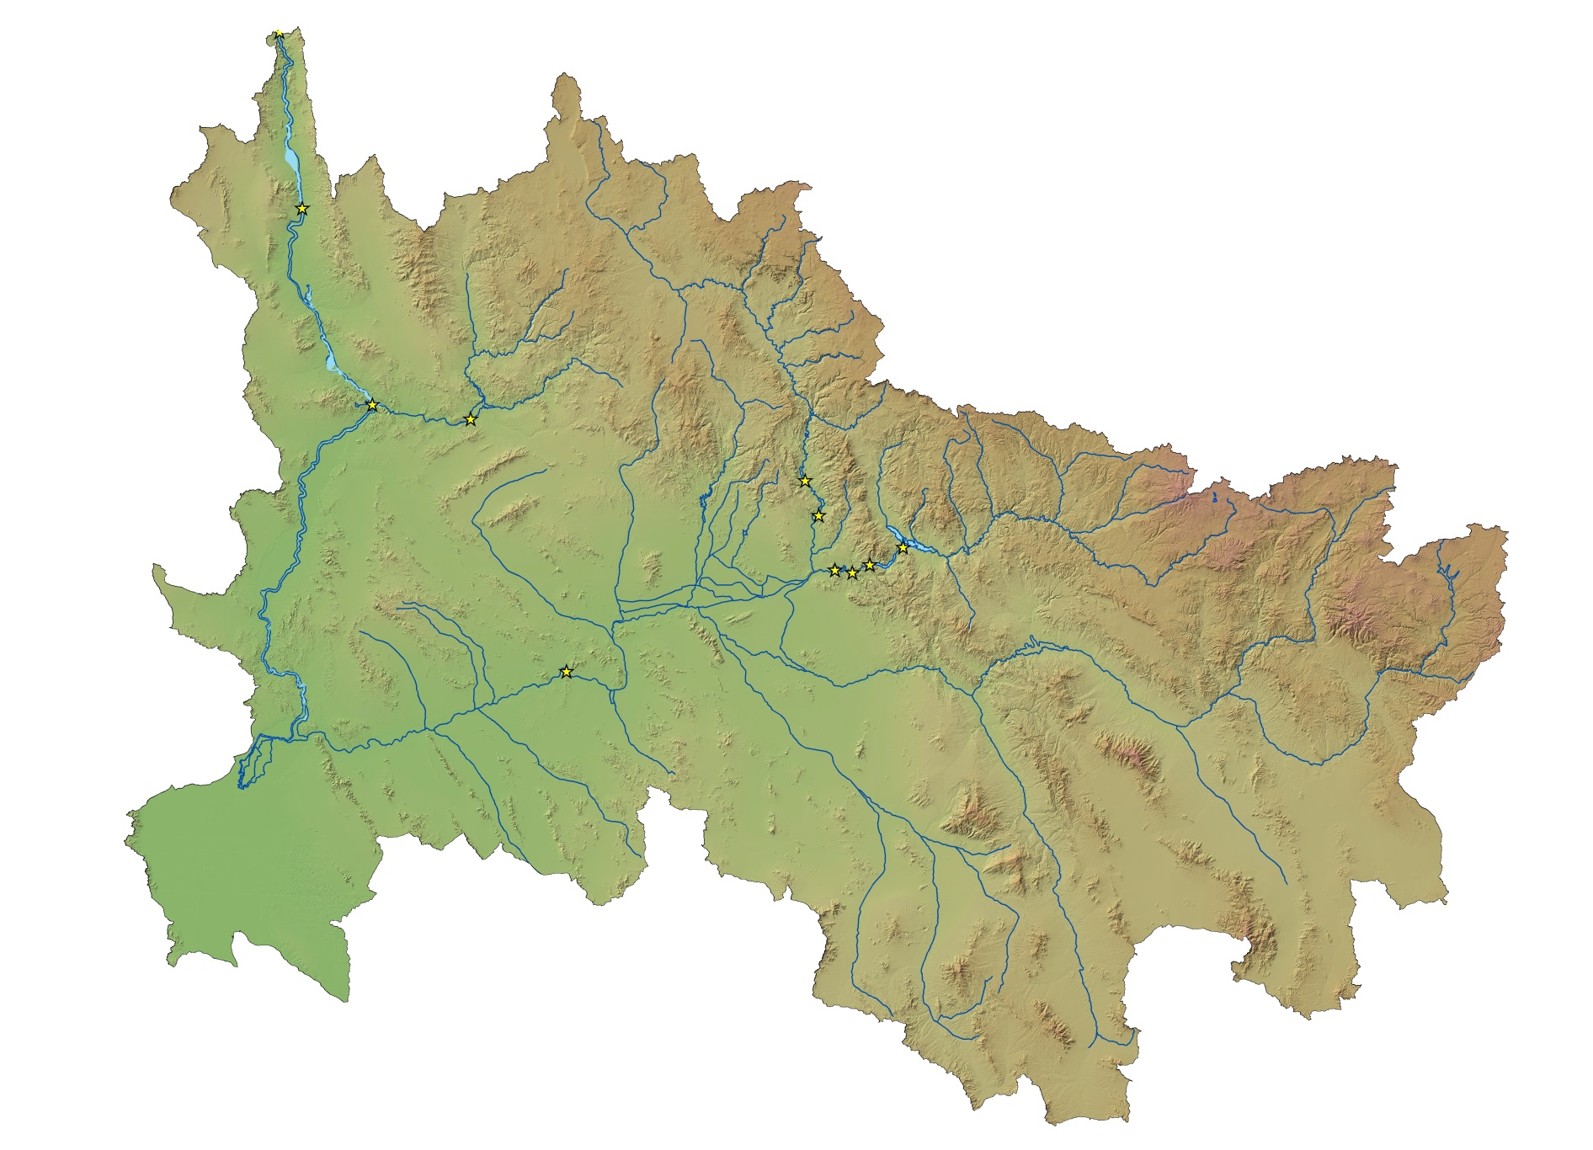
Hoover Dam
STATUS OF OTHER LOWER BASIN RESERVOIRS
as of March 23, 2015
Alamo Dam
Elevation: 1,095.02 feet
Capacity: 7%
Content: 68 kaf
Inflow: 0 cfs
Outflow: 25 cfs
Davis Dam
Salt River Project
Capacity: 58%
Content: 1.33 maf
Alamo Dam
Bill Williams
River
Agua Fria River
Verde River
Parker Dam
Horseshoe Dam
Bartlett Dam
Salt River
Colorado River
Roosevelt Dam
Painted Rock Dam
Stewart Mtn. Dam
Gila River
Mormon Flat Dam
Horse Mesa Dam
Santa Cruz River
San Pedro River
Painted Rock Dam
Elevation: 535.0 feet
Capacity: 0%
Inflow: 0 cfs
Outflow: 0 cfs

Slide 13
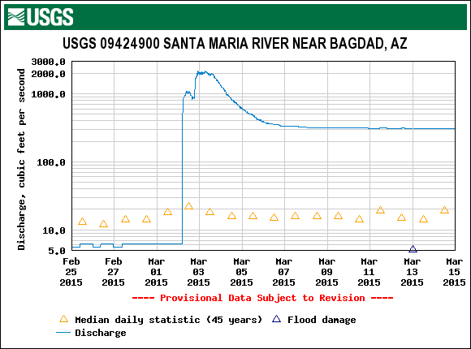

Slide 14
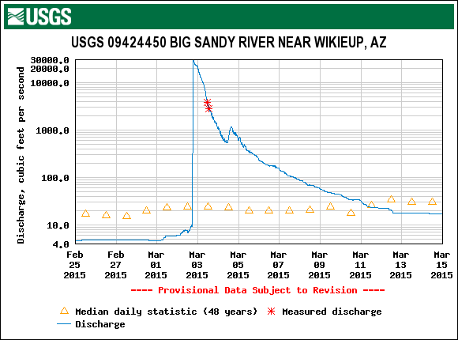

Slide 15
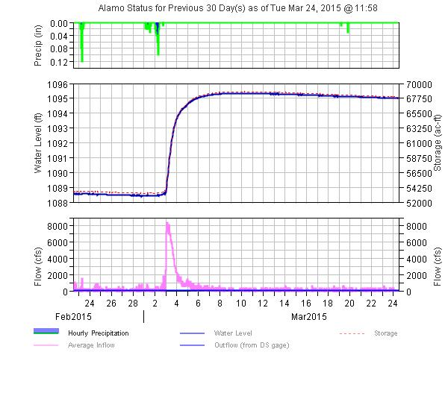

Slide 16
Lower Basin Operations
Calendar Year 2015
Lake Mead Operating Conditions
Operating under the Normal/ICS Surplus Condition
  Lower Basin projected water use of 7.5 maf +/- ICS created or delivered
  Mexico projected to take delivery of 1.5 maf +/- any water deferred or delivered

Slide 17
End of Water Year 2015 Projections
March 2015 24-Month Study Most Probable Inflow Scenario¹
Projected Unregulated Inflow into Powell¹ = 8.61 maf (79% of average)
Lake Mead
Lake Powell
1,219.6
26.120 maf
24.322 maf
3,700
17.1 maf
3,649
1,145
16.2 maf
1,105
12.2 maf
3,596.0 feet
11.38 maf in storage
47% of capacity
9.5 maf
3,575
1,075
9.6 maf
1,075.7 feet
9.66 maf in storage
37% of capacity
5.9 maf
3,525
1,025
6.0 maf
9.00 maf
0.0 maf
3,370
895
0.0 maf
Dead Storage
1.9 maf
2.5 maf
Dead Storage
Not to Scale
¹ WY 2015 unregulated inflow into Lake Powell is based on the CBRFC outlook dated 3/3/15.

Slide 18
End of Calendar Year 2015 Projections
March 2015 24-Month Study Most Probable Inflow Scenario¹
Based on a 9.00 maf release pattern from Lake Powell in Water Year 2016
Lake Mead
Lake Powell
1,219.6
26.120 maf
24.322 maf
3,700
17.3 maf
3,651
1,145
16.2 maf
1,105
12.2 maf
3,589.2 feet
10.75 maf in storage
44% of capacity
3,575
1,075
1,081.1 feet
10.11 maf in storage
39% of capacity
9.6 maf
9.5 maf
5.9 maf
3,525
1,025
6.0 maf
0.0 maf
3,370
895
0.0 maf
Dead Storage
1.9 maf
2.5 maf
Dead Storage
Not to Scale
¹ WY 2015 unregulated inflow into Lake Powell is based on the CBRFC outlook dated 3/3/15.

Slide 19
Most Probable Scenario:
EOCY Elev: 1,081.14 ft
CY15 Decline: 6.7 ft
Most Probable Scenario:
EOWY Elev: 1,073.13 ft

Slide 20
Percent of Traces with Event or System Condition
Results from January 2015 CRSS^{1,2,3} (values in percent)
 | Event or System Condition | 2015 | 2016 | 2017 | 2018 | 2019
Upper Basin – Lake Powell | Equalization Tier | 7 | 23 | 23 | 26 | 30
 | Equalization – annual release > 8.23 maf | 7 | 23 | 23 | 26 | 29
 | Equalization – annual release = 8.23 maf | 0 | 0 | 0 | 0 | 1
 | Upper Elevation Balancing Tier | 93 | 50 | 53 | 52 | 44
 | Upper Elevation Balancing – annual release > 8.23 maf | 85 | 42 | 42 | 41 | 32
 | Upper Elevation Balancing – annual release = 8.23 maf | 8 | 8 | 10 | 11 | 12
 | Upper Elevation Balancing – annual release < 8.23 maf | 0 | 0 | 1 | 0 | 0
 | Mid-Elevation Release Tier | 0 | 27 | 20 | 13 | 17
 | Mid-Elevation Release – annual release = 8.23 maf | 0 | 0 | 0 | 1 | 1
 | Mid-Elevation Release – annual release = 7.48 maf | 0 | 27 | 20 | 12 | 16
 | Lower Elevation Balancing Tier | 0 | 0 | 4 | 9 | 9
Lower Basin – Lake Mead | Shortage Condition – any amount (Mead ≤ 1,075 ft) | 0 | 21 | 54 | 62 | 59
 | Shortage – 1st level (Mead ≤ 1,075 and ≥ 1,050) | 0 | 21 | 45 | 40 | 33
 | Shortage – 2nd level (Mead < 1,050 and ≥ 1,025) | 0 | 0 | 9 | 19 | 19
 | Shortage – 3rd level (Mead < 1,025) | 0 | 0 | 0 | 3 | 7
 | Surplus Condition – any amount (Mead ≥ 1,145 ft) | 0 | 0 | 5 | 8 | 14
 | Surplus – Flood Control | 0 | 0 | 0 | 1 | 2
 | Normal or ICS Surplus Condition | 100 | 79 | 41 | 30 | 27
¹ Reservoir initial conditions based on the observed levels on December 31, 2014.
² Hydrologic inflow traces based on resampling of the observed natural flow
record from 1906-2010.
³ Percentages shown may not be representative of the full range of future
possibilities that could occur with different modeling assumptions.

Slide 21
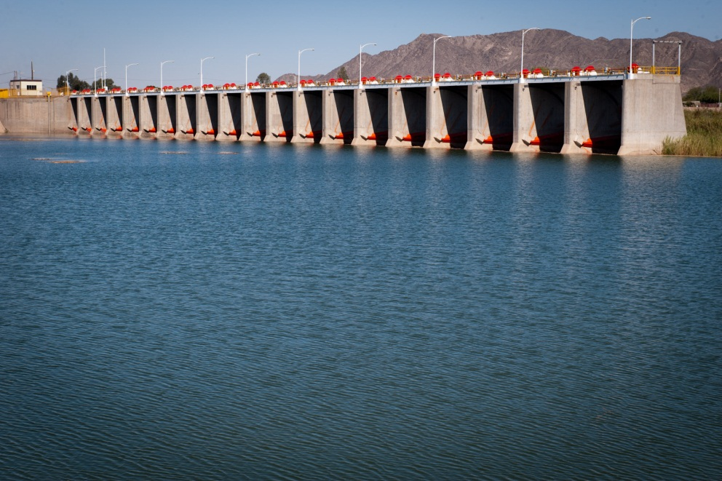
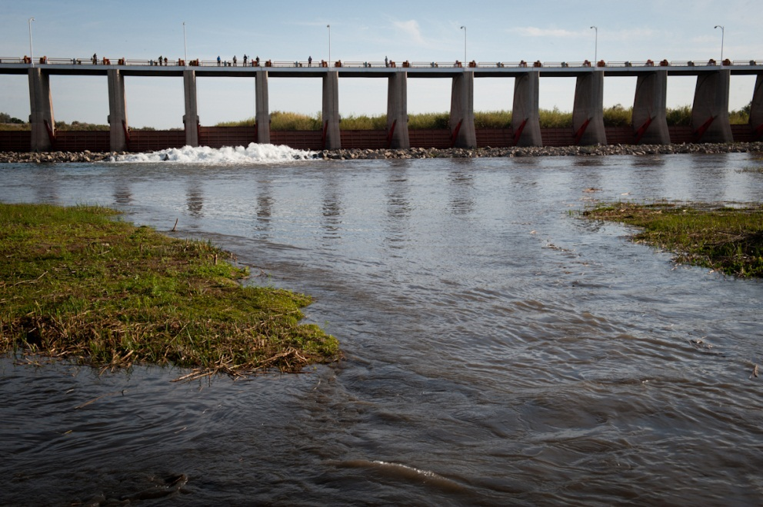
Additional Operational Data
(provisional year-to-date values)
Mexico Excess Flows (af) | Brock Reservoir Stored (af) | Senator Wash Stored (af)
1,674 | 37,730 | 24,640
Through 3/22/15 | Through 3/20/15 | Through 3/22/15
Morelos Dam Pictured Above – April 2014
Alexander Stephens (USBR)

Slide 22
Pilot System Conservation Program

Slide 23
System Conservation Pilot Program
On July 30, 2014, Reclamation and four municipal entities entered into an agreement to jointly fund $11 million for the Pilot System Conservation Program to conserve water to remain in Lake Powell and Lake Mead to benefit the Colorado River system. Reclamation will contribute $3 million for the Pilot Program and the other 4 funding partners $2 million each.
  The five funding partners are MWD, SNWA, CAWCD, Denver Water, and Reclamation.
Under the Funding Agreement, $8.25 million is allocated for use in the Lower Basin and $2.75 million is allocated for use in the Upper Basin.
  The Funding Agreement is available on Reclamation’s website at: www.usbr.gov//newsroom/docs/2014-07-30-Executed-Pilot-SCP-Funding-Agreement.pdf

Slide 24
System Conservation Pilot Program
The purpose of the Funding Agreement is to initiate a Pilot Program for System Conservation to determine whether System Conservation is a sufficiently cost-effective, robust, and feasible method to partially mitigate the impacts of ongoing drought on the Colorado River System by managing water elevation levels in Lakes Mead and Powell above critically low elevations as a first priority, with the ancillary benefit of enhancing flows in areas upstream of storage reservoirs.
  The Pilot Program seeks to develop short-term pilot projects that keep water in Lakes Powell and Mead through temporary, voluntary, and compensated conservation mechanisms
  Another aim of the program is to explore our ability to develop a suite of projects with geographic and methodological diversity and diverse water use sectors including agricultural, municipal and industrial entities.

Slide 25
System Conservation Pilot Program
Proposed conservation measures include:
  Efficiency improvements, land fallowing, water reuse, landscape conversions
17 pre-proposals were received by Reclamation – estimated combined reduction in consumptive use in excess of 60 kaf
  Still requires additional information and investigation before demand reduction is known
  Proposed costs/af range from less than $100 /af to more than $1,000/af; proposed conservation value ranges from 100 af/year to more than 10 kaf/year
Following submittal, evaluation, and approval of proposals – Reclamation will enter into implementation agreements with successful applicants
  First round of implementation agreements will be completed by summer 2015

Slide 26
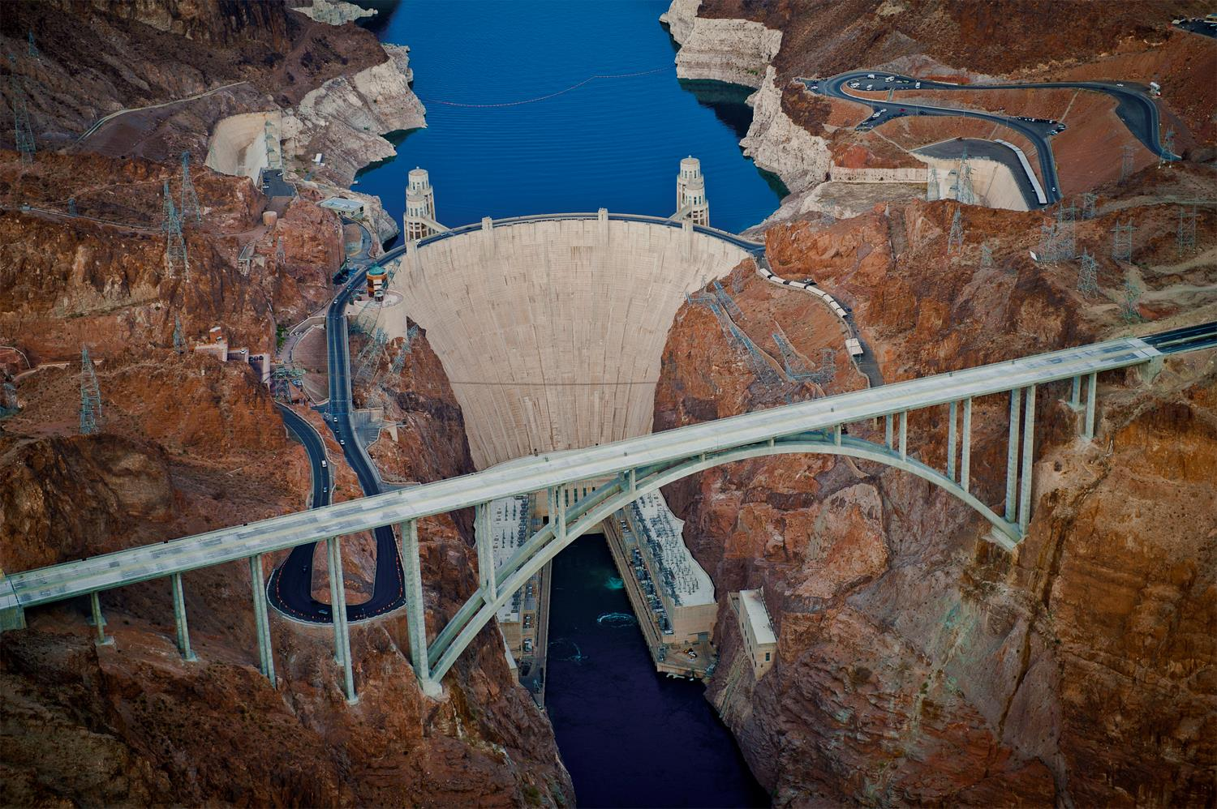
Lower Colorado River
Operations
For further information: http://www.usbr.gov/lc/region
Email at:
bcoowaterops@usbr.gov

