Slide 1
Navajo New Operations 2015
No more decision tree
Available Water for Spring Peak Release uses End of Water Year Storage Target (EWYST) of 6063 ft (with 6050 option)
Navajo will be operated to meet EWYST by the end of each water year (with all users and TBF met).
In dry years, reservoir may come short of EWYST.
Risk of shortage is greatly reduced in modeling.

Slide 2
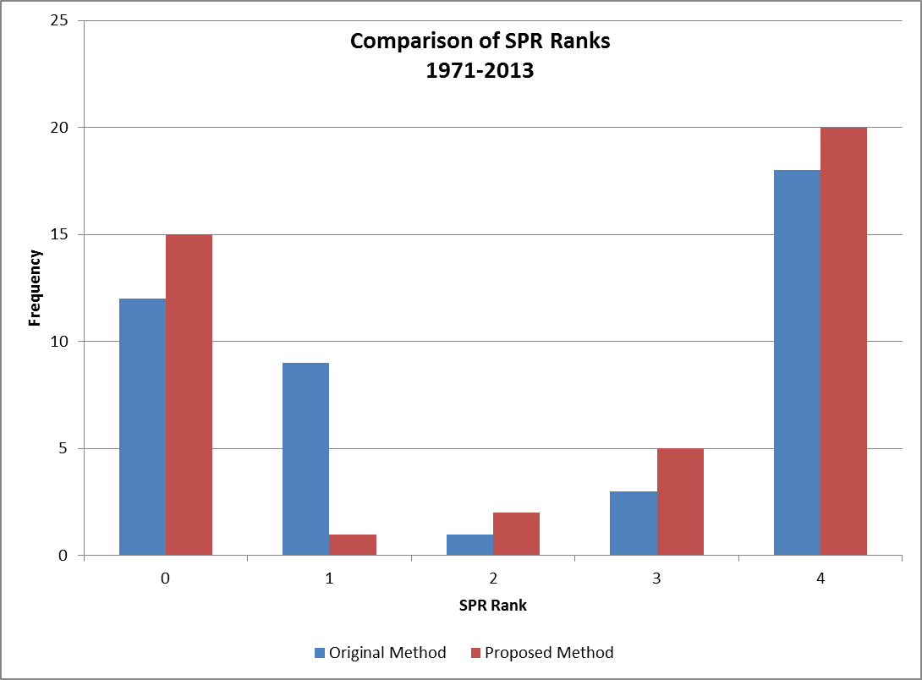

Slide 3
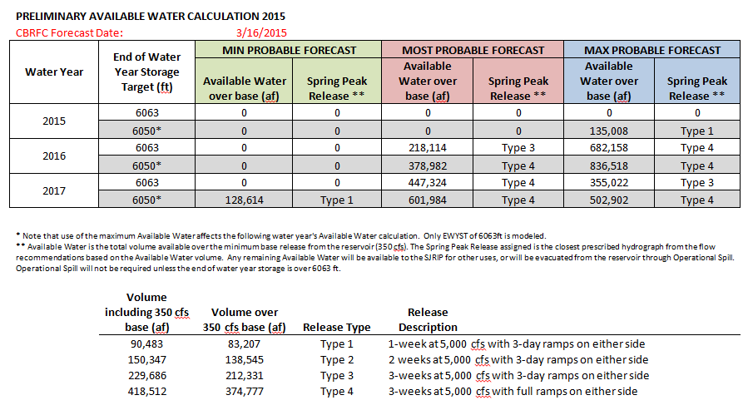

Slide 4
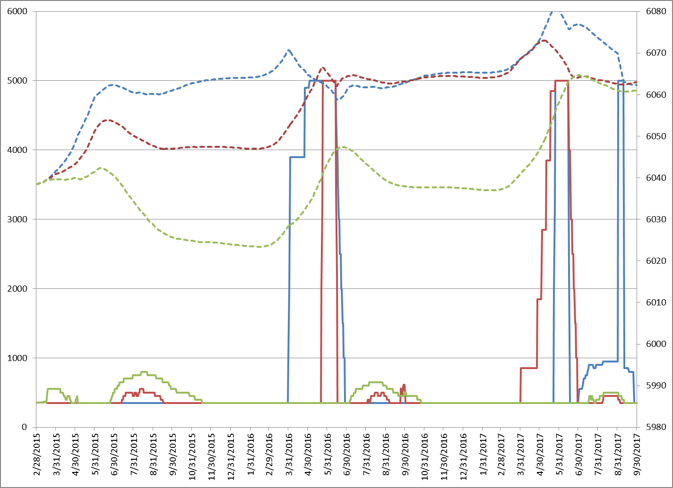
Navajo

Slide 5
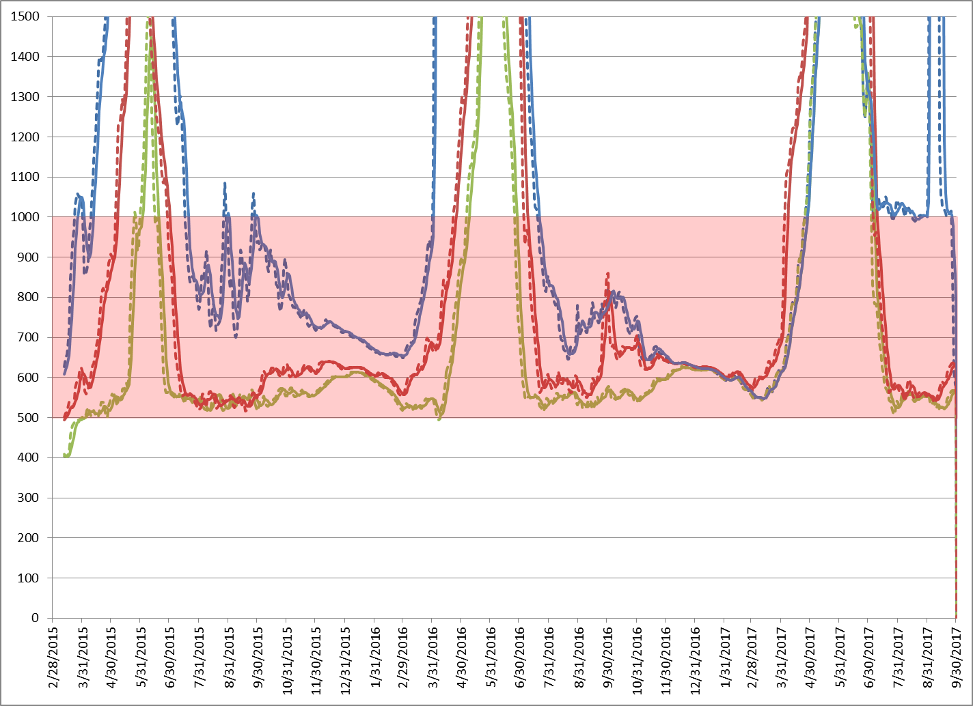
Navajo Target Baseflow

