Slide 1
Evaluating Utah Energy Balance Snowmelt Model in Operational Forecasting
John A Koudelka
David Tarboton
Utah State University
3/26/2015

Slide 2
Bio
MS in Remote Sensing & GIS - University of Wisconsin, 2006
Research Scientist at the Idaho National Laboratory - GIS applications and Spatial Databases
PhD student with Dr David Tarboton at Utah State University

Slide 3
Overview
Purpose
Utah Energy Balance (UEB) Snowmelt Model
Preliminary Study
Next Steps

Slide 4
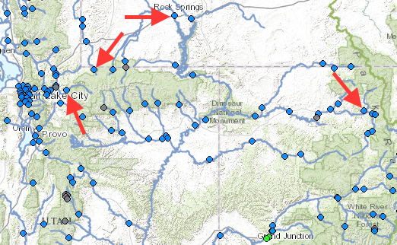
Motivation
CBRFC models were not able to duplicate streamflow peaks in the 2010 Spring runoff.
Believed to be due to incorrect simulation of snowpack
Gage | Historic Peak¹ | Average Peak¹ | Flood Flow¹ | Forecasted Exceedence Probability¹ |  |  |  |  | Normal Time of Peak¹ | Issue Date¹ | 2010 Mean Daily² | 2010 Mean Date² | 2010 Peak Flow³ | 2010 Peak Date³
 |  |  |  | 90% | 75% | 50% | 25% | 10%
Weber (OAWU1) | 4170 | 1625 | 2790 | 1250 | 1350 | 1500 | 1650 | 1750 | 5/24 - 6/16 | 5/19 | 2600 | 6/7 | 3530 | 6/10
Bear (BERU1) | 2980 | 1610 | 4390 | 1050 | 1150 | 1300 | 1500 | 1700 | 5/22 - 6/14 | 5/19 | 2390 | 6/8 | 3240 | 6/8
Blacks Fork (LTAW4) | 6970 | 2440 | 5500 | 860 | 1020 | 1150 | 1450 | 2100 | 5/2 - 6/27 | 5/19 | 4070 | 6/14 | 4280 | 6/14
Elk Nr Milner (ENMC2) | 6290 | 4160 | 4200 | 2750 | 3000 | 3450 | 3850 | 4200 | 5/19 - 6/12 | 5/19 | 6100 | 6/8 | 6970 | 6/8
1. CBRFC mean daily forecasts for June, 2010. http://www.cbrfc.noaa.gov/wsup/pub2/peak/peak.php?year=2010&month=c
2. Mean Daily Peaks. http://waterdata.usgs.gov/
3. Yearly peaks. http://www.cbrfc.noaa.gov/gmap/info/info.php?type=peaks&idcol=id&station=OAWU1
*all values in cfs

Slide 5
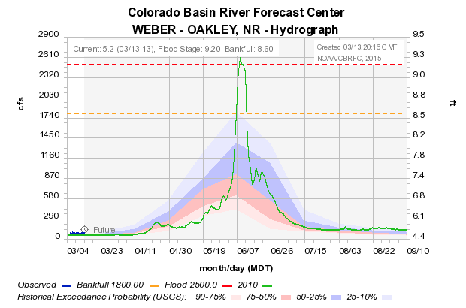
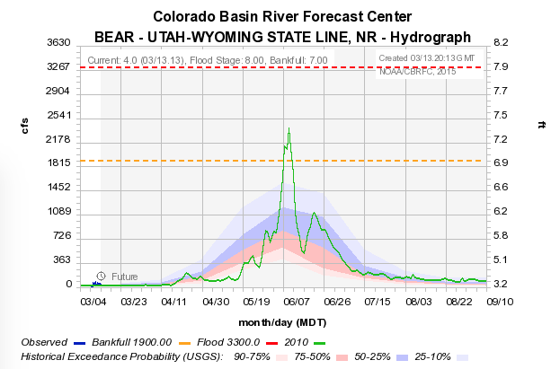
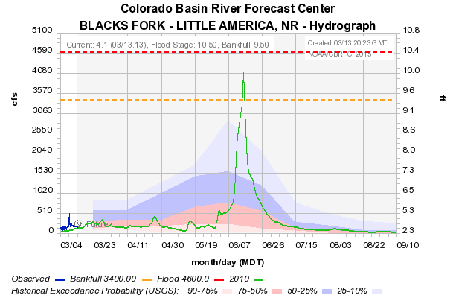
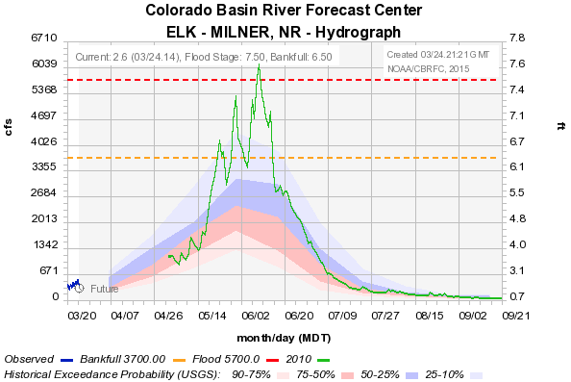
2010 Daily Mean Streamflow Observations

Slide 6
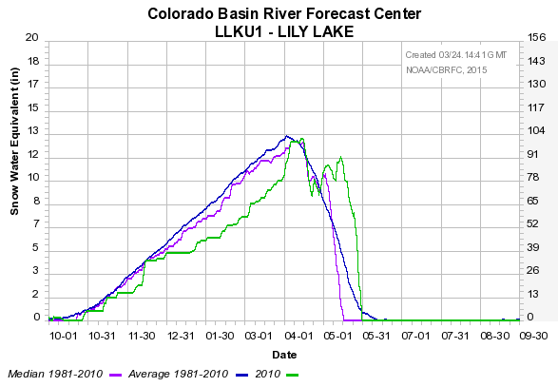
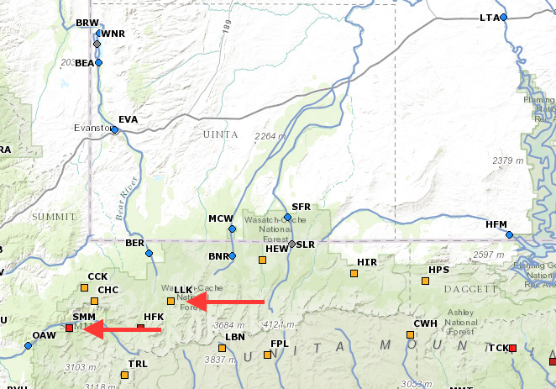
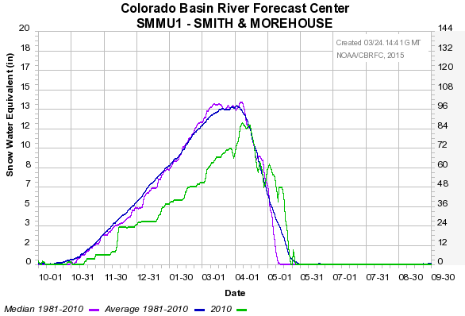
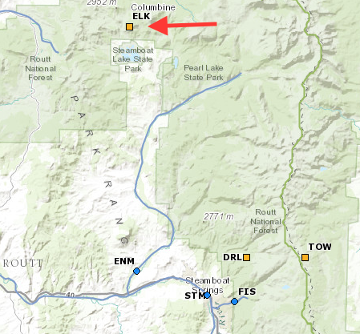
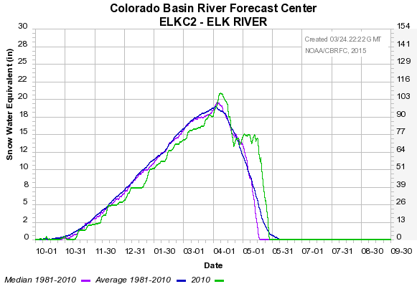
2010 Snotel Observations

Slide 7
Questions
Can operational streamflow forecasts be improved by using a distributed, physically-based snowmelt model instead of a temperature index model?
Is a UEB capable of improving CBRFC streamflow predictions using NWS forecast data?
SNOW17 uses temperature melt factors
UEB uses a physical energy balance driven by radiation, temperature, wind, and humidity
Can UEB run in the FEWS/CHPS application?

Slide 8
Approach
Select forecast period (0.5 - 3 months) and define an error metric/forecast skill score
Quantify skill using forecast data and SNOW17
Quantify skill using best retrospective data and SNOW17
Quantify skill using best retrospective and UEB
→ 2 vs 3 indicates uncertainty due to precip forecast uncertainty
→ 3 vs 4 indicates potential improvement due to UEB
Evaluation must be performed in FEWS so that inputs and underlying hydrologic model (SAC) is identical across comparisons.

Slide 9
Utah Energy Balance Model Overview
Physically based calculation of snow energy balance.
Predictive capability in changed settings
Strives to get sensitivities to changes right
Simplicity. Small number of state variables and adjustable parameters.
Avoid assumptions and parameterizations that make no difference
Transportable. Applicable with little calibration at different locations.
Match diurnal cycle of melt outflow rates
Match overall accumulation and ablation for water balance.
Distributed by application over a spatial grid.
Effects of vegetation on interception, radiation, wind fields

Slide 10
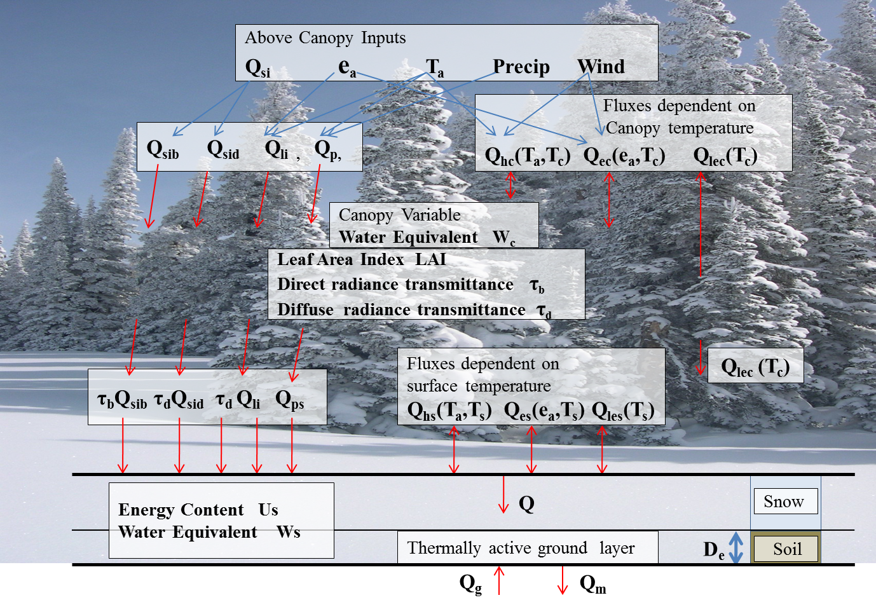
Utah Energy Balance Snowmelt Model
e.g. Mahat, V. and D. G. Tarboton, (2012), "Canopy radiation transmission for an energy balance snowmelt model," Water Resour. Res., 48: W01534, http://dx.doi.org/10.1029/2011WR010438.
Notes:
Physically based calculation of snow energy balance.
Predictive capability in changed settings
Strives to get sensitivities to changes right
Simplicity. Small number of state variables and adjustable parameters.
Transportable. Applicable with little calibration at different locations.
Match diurnal cycle of melt outflow rates
Effects of vegetation on interception, radiation, wind fields

Slide 11
UEB Model Structure
State Variables
Surface snow water equivalent, W_{s}
Internal energy of the surface snowpack, U_{s}
Canopy snow water equivalent, W_{c}
State Equations
Surface mass and energy balance (beneath the canopy)
Canopy mass and energy balance

Slide 12
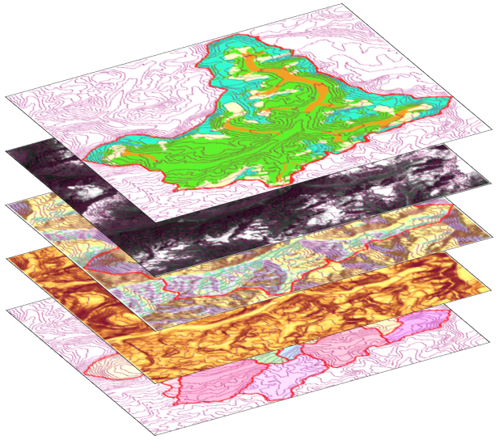
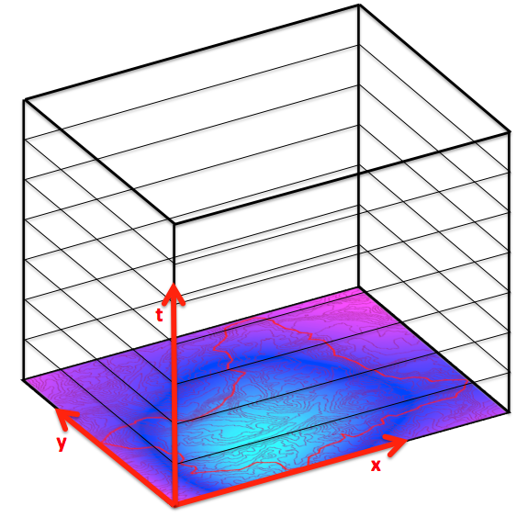
UEB Data Requirements
Parameters
thermal conductivities, emissivity, scattering coefficients, etc.
Initial Conditions
SWE, Snow Age, energy content, atmospheric pressure, etc.
Spatially Varying, Time Constant (SVTC)
Slope, Aspect, LAI, CCAN, HCAN, Watershed(s)
Spatially Varying, Time Varying (SVTV)
Temperature, Precipitation, Wind Speed, Humidity, Radiation

Slide 13
File-Based Input-output System
Overall control file
Input Files
Output Files
Watershed file
Parameter file
Site Initial file
Input Control file
Output Control file
Provides site and initial condition values, or points to 2-D NetCDF files where these are spatially variable
Provides start, end and time step, and info. on time varying inputs as either from text file for domain, from 3-D NetCDF file where spatially variable, or constant for all time
Indicates which variables are to be output and the file names to write outputs.
Provides watershed ID for each grid from the NetCDF file
Provides parameter Values
Point detail text file
3-D NetCDF files
Aggregated Output Control
Holds all output variables for all time steps for a single grid point
Holds a single output variable for all time steps and for entire grid.
Holds list of variables for which aggregated output is required
2-D NetCDF files
Time series text file
3-D NetCDF files
Provides spatially variable site and initial condition values
provides input variables for each time step and assumes a constant value for all the grid points
Provides input variables for each time step and each grid point
Aggregated Output text file
Holds aggregated output

Slide 14
UEB Outputs
Precip in the form of rain
Precip in the form of snow
SWE
Surface Sensible Heat Flux
Surface Latent Heat Flux
Surface Sublimation
Average Snow Temperature
Snow Surface Temperature
Energy Content
Total outflow (Rain and Snow)
Canopy interception capacity
Canopy SWE
Canopy Latent and Sensible heat fluxes
Melt from Canopy
etc.

Slide 15
Preliminary Study
Do we lose important information about the terrain at low resolution?
NWS gridded data at 800m
How does UEB perform with observed data?
Run UEB using observed data from TWDEF
How does UEB perform with best available data?
Run UEB using a mix of Forecast data and best retrospective radiation, rh, and wind data available at TWDEF location
What if radiation data is not available as a forecast product?
Run UEB using a mix of Forecast data, radiation from Bristow-Campbell calculations, and rest from best available retrospective.

Slide 16
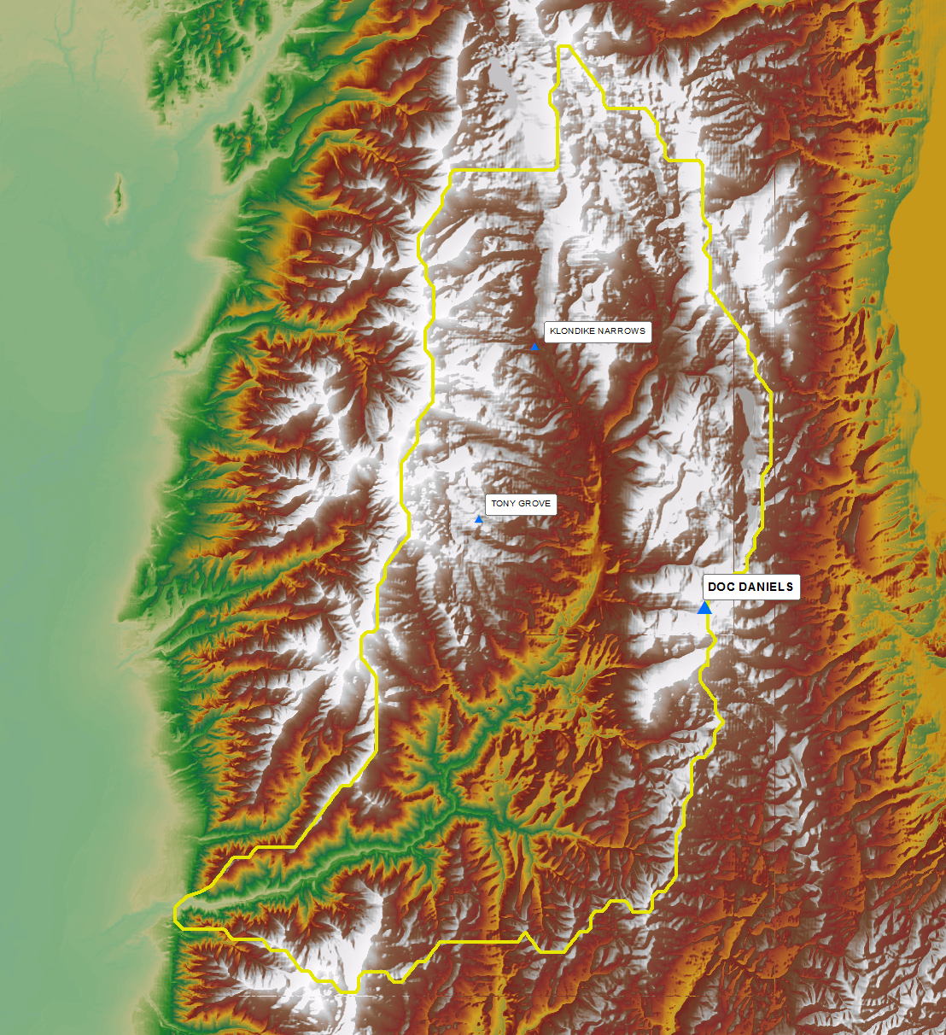
Study Location

Slide 17
SVTC Inputs - Resolution
Slope, Aspect, NLCD (LAI, HCAN, CCAN)
800m
30m

Slide 18
Resolution Comparisons

Slide 19
Inputs
Observed data (TWDEF)
Temperature and Precipitation from SNOTEL.
Precip smoothing
Avanzi, Francesco, et al. "A processing–modeling routine to use SNOTEL hourly data in snowpack dynamic models." Advances in Water Resources 73 (2014): 16-29.
Wind, RH, SW, LW from TWDEF sensors
Forecast Data (NLDAS)
800m Temperature and Precipitation from CBRFC.
SW, LW, Wind, RH generated from NASA Land Data Assimilation (NLDAS) Forcing2 datasets, regridded to 800m.
Forecast Data with Bristow Campbell (Bristow)
800m Temperature and Precipitation from CBRFC
Wind, RH generated from NLDAS
Model run in BC mode

Slide 20
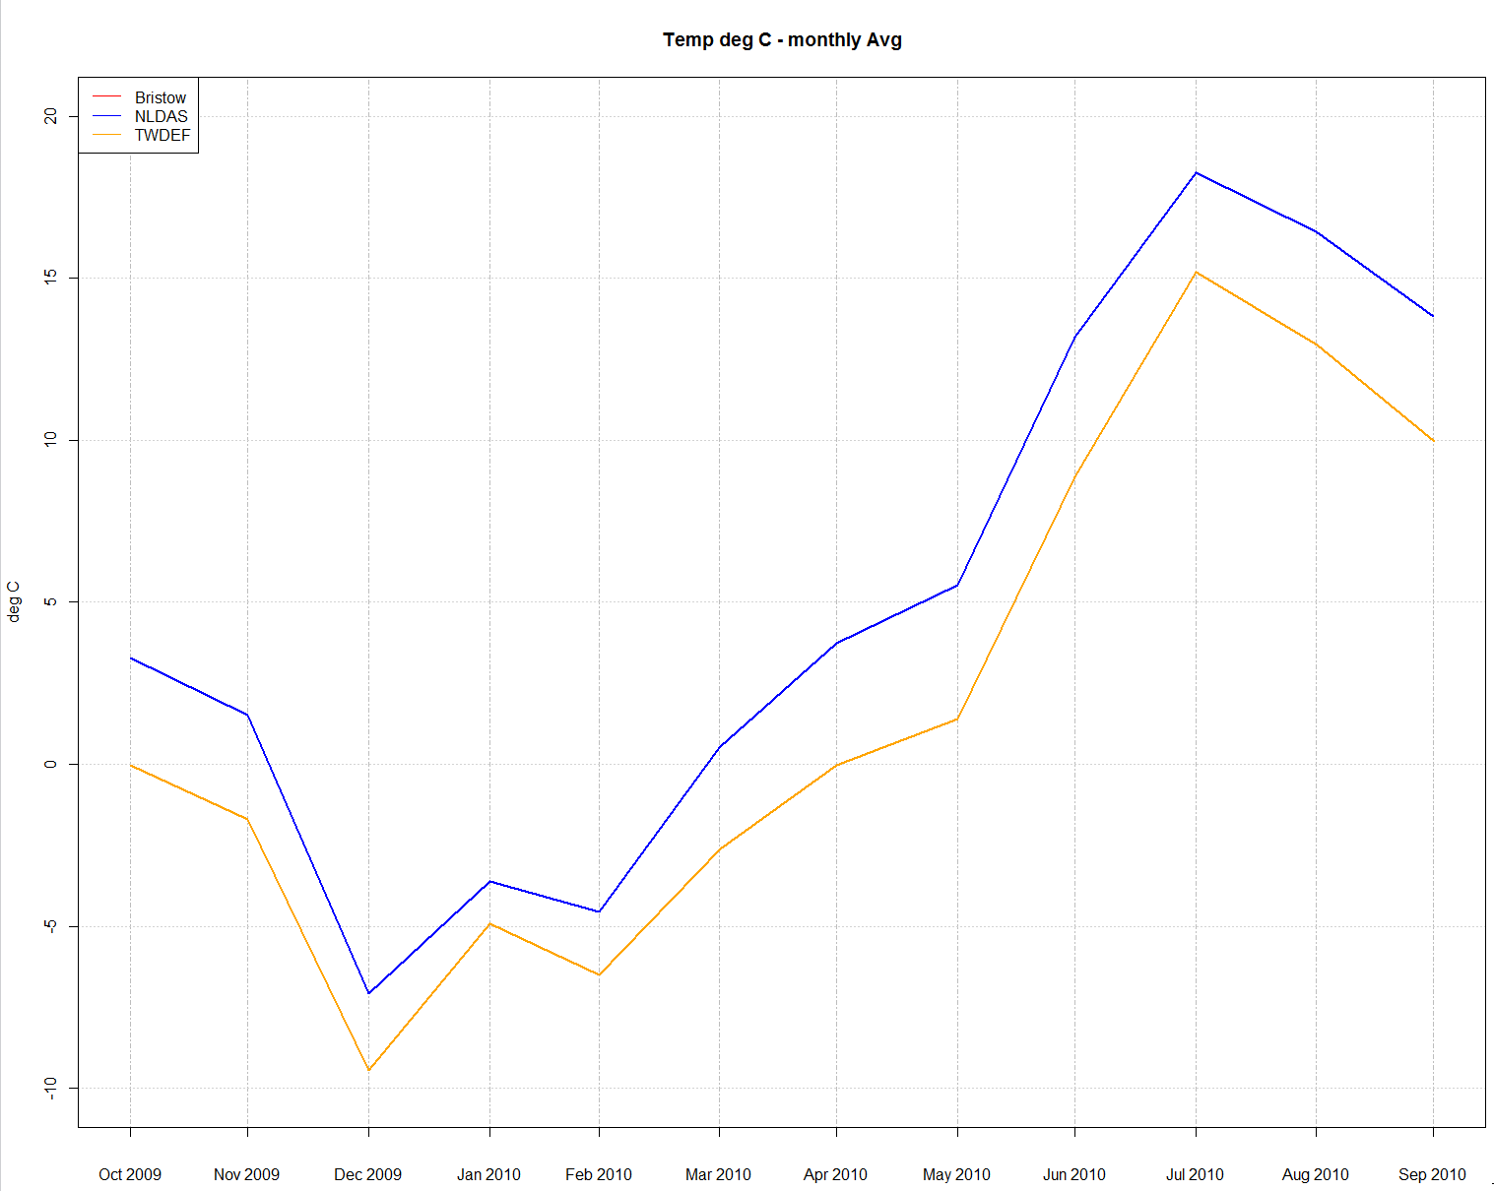
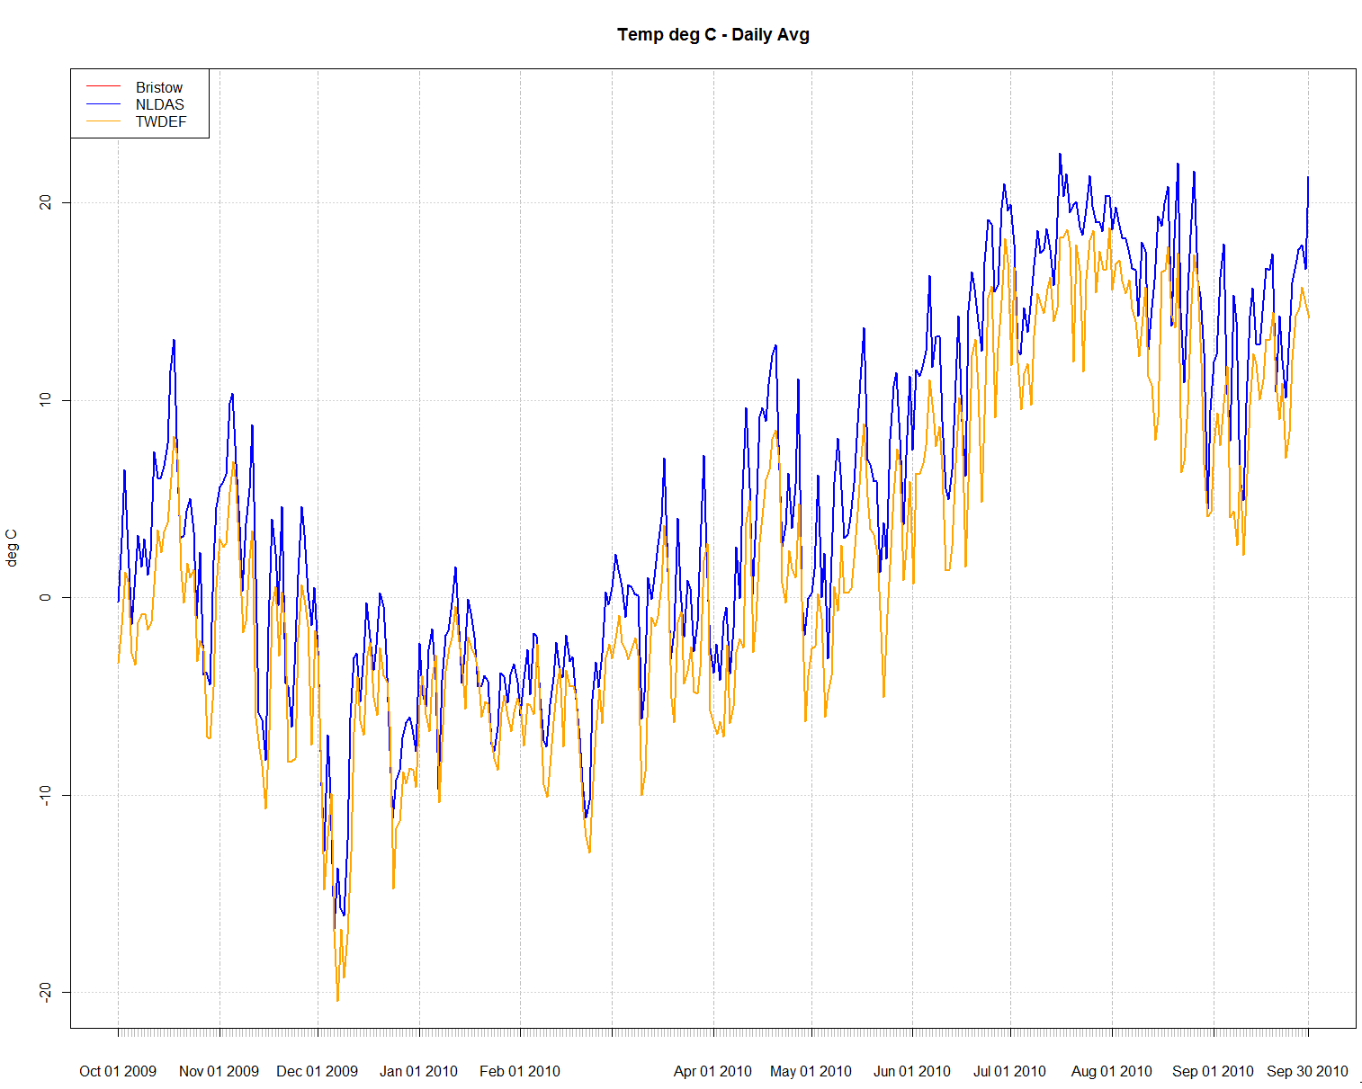
Input Comparisons
Temperature – Monthly Avg
Temperature – Daily Avg
20
20
10
0
0
-10
-20
Deg C

Slide 21
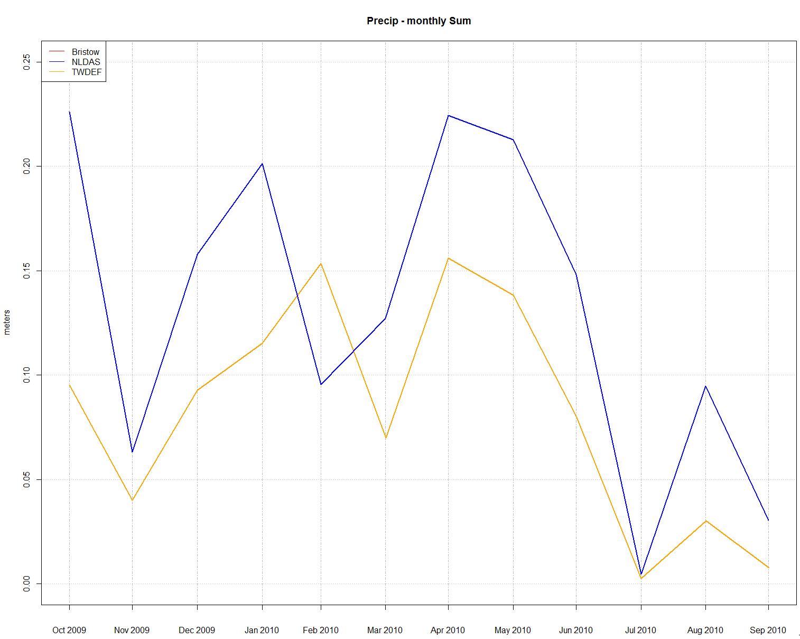
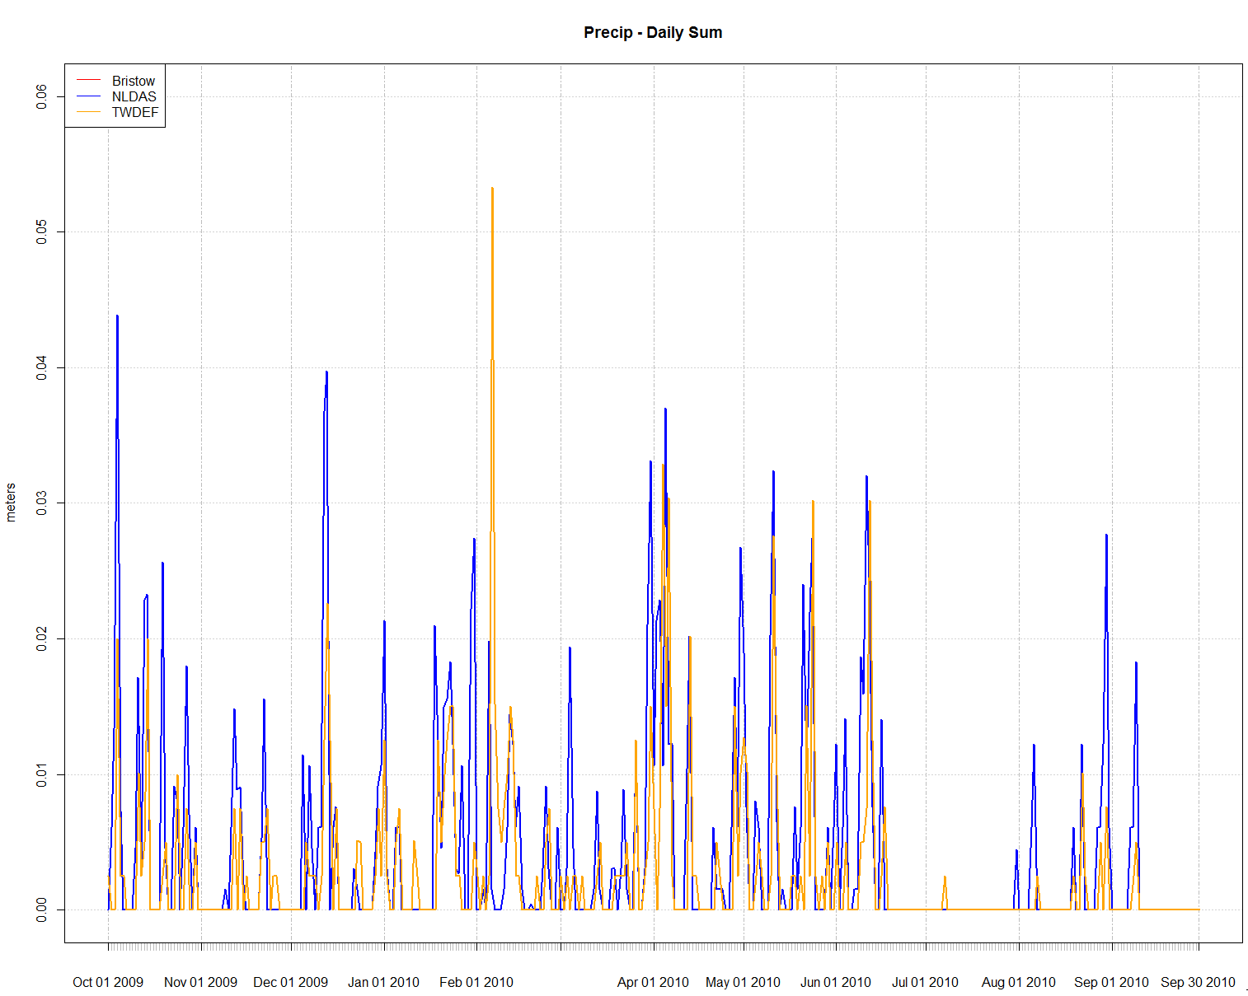
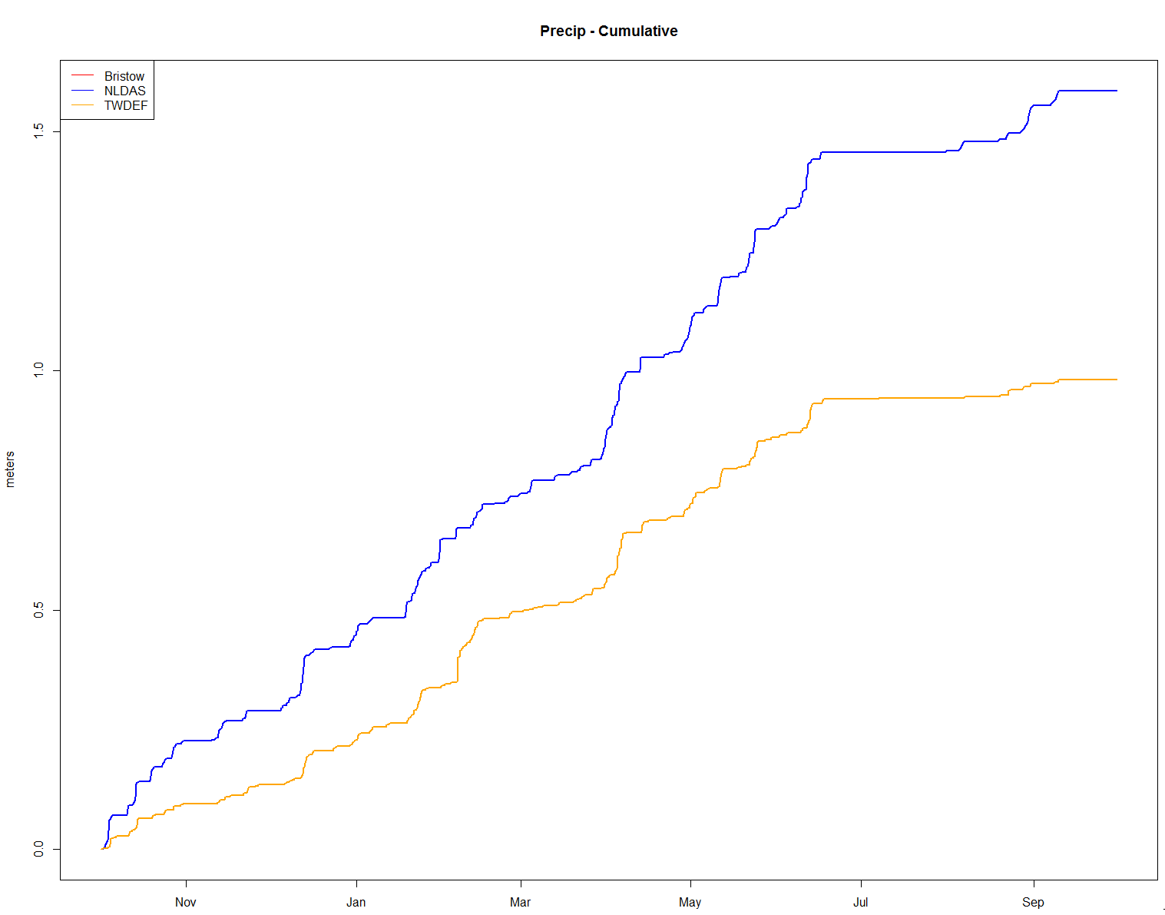
Input Comparisons
Precipitation – Monthly Sum
Precipitation – Daily Sum
0.06
0.2
0.03
0.1
meters
0.0
0.00
Precipitation Cumulative
1.5
1.0
meters
0.5
0.0

Slide 22
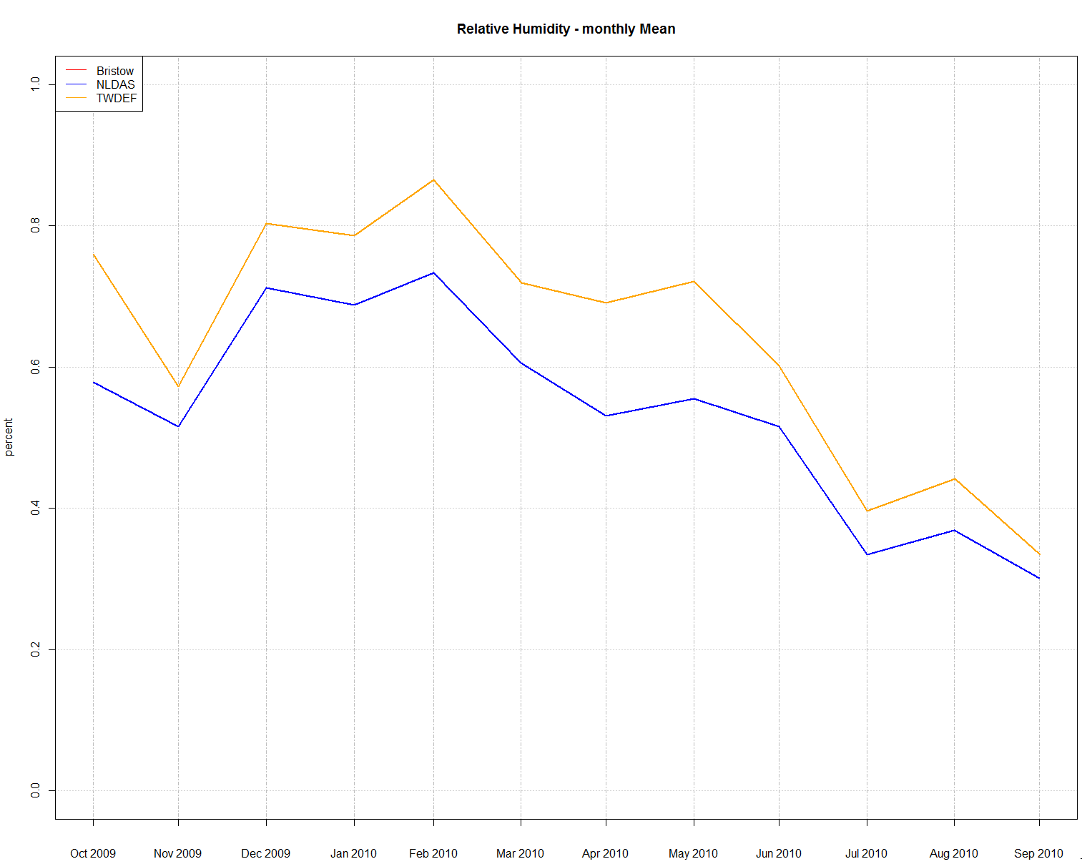
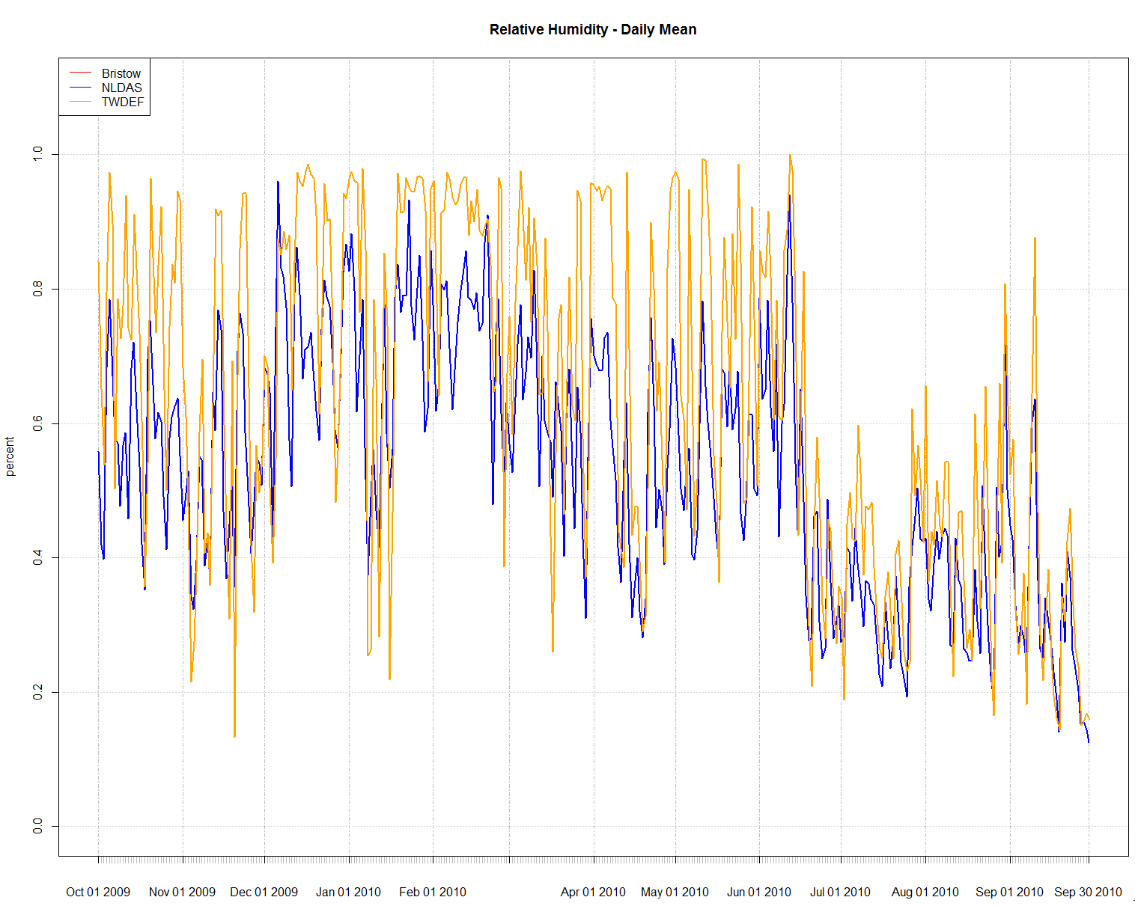
Input Comparisons
Relative Humidity – Monthly Average
Relative Humidity – Daily Average
1.0
1.0
0.6
0.6
0.0
0.0

Slide 23
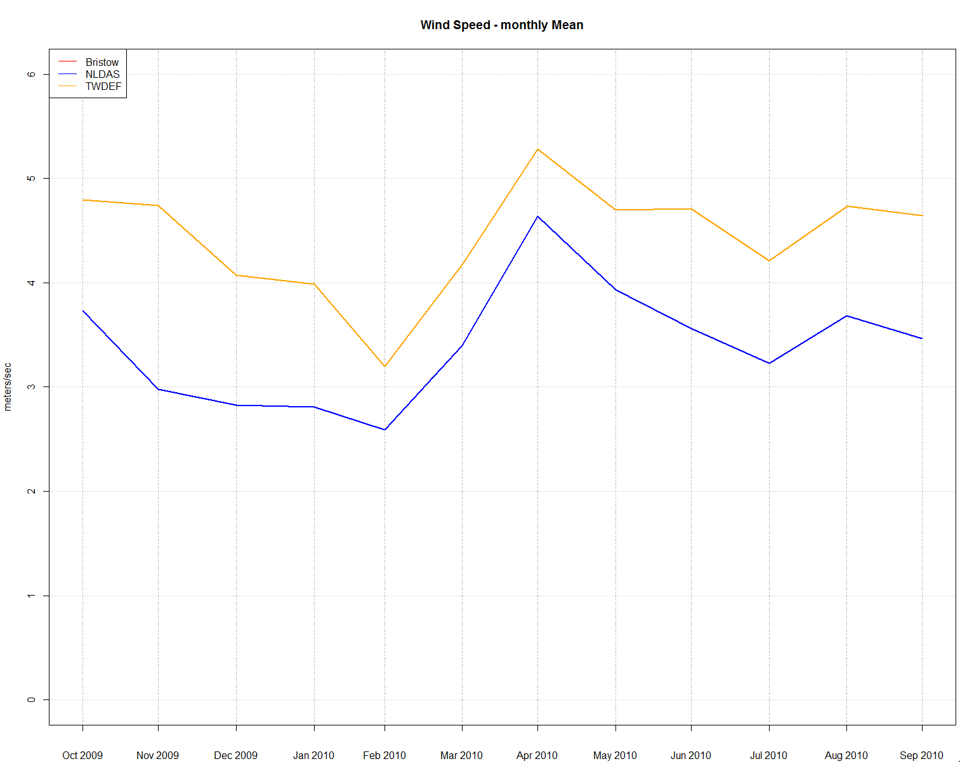
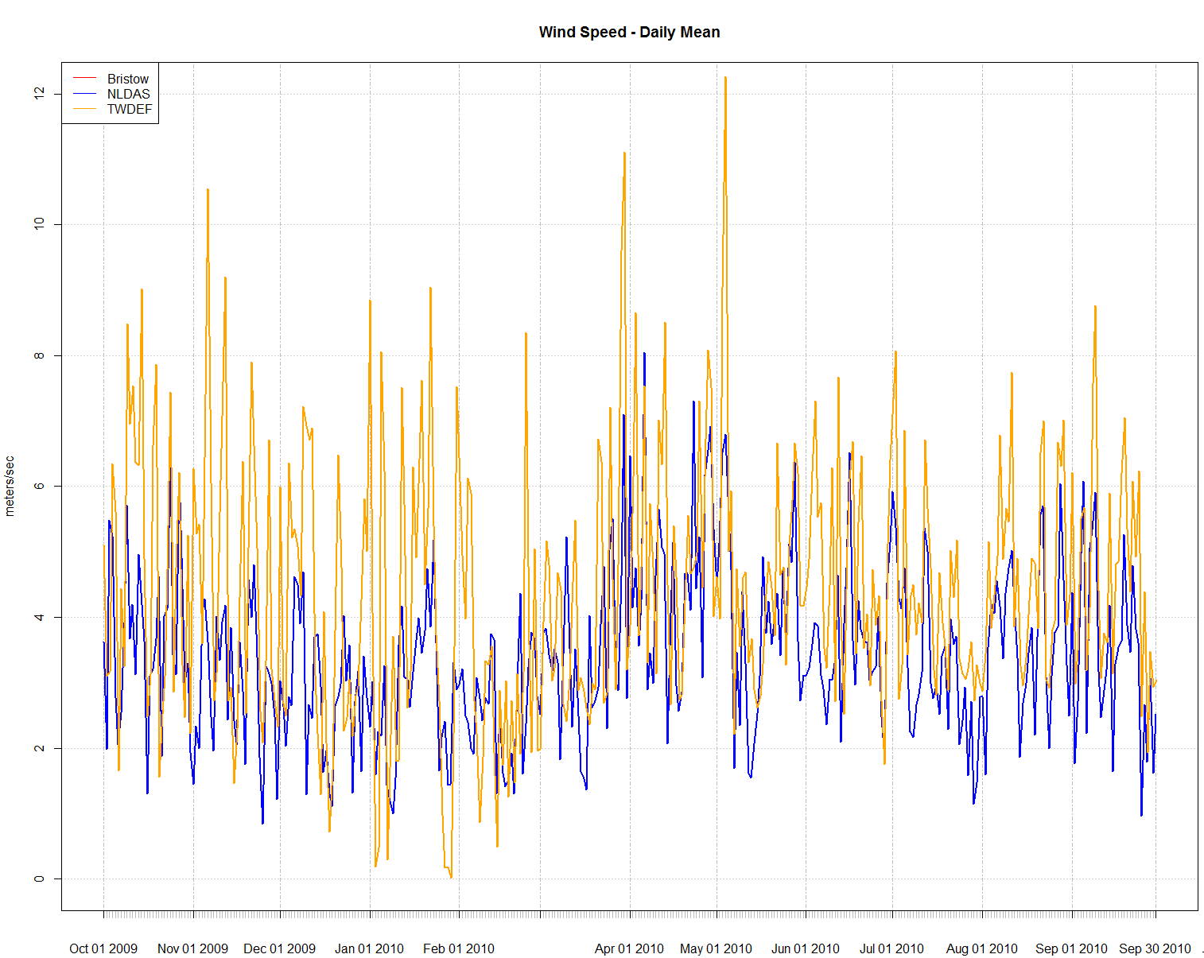
Input Comparisons
Wind Speed – Monthly Average
Wind Speed – Daily Average
6
12
3
6
0
0
Meters/second

Slide 24
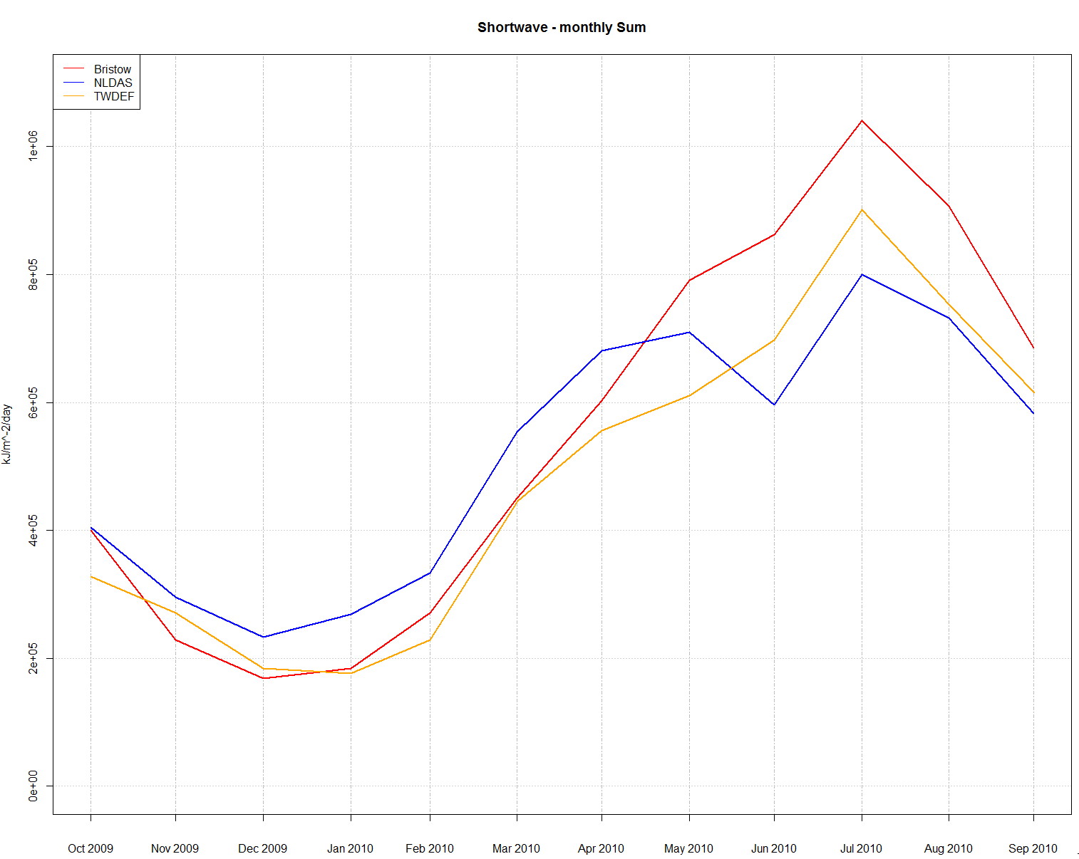
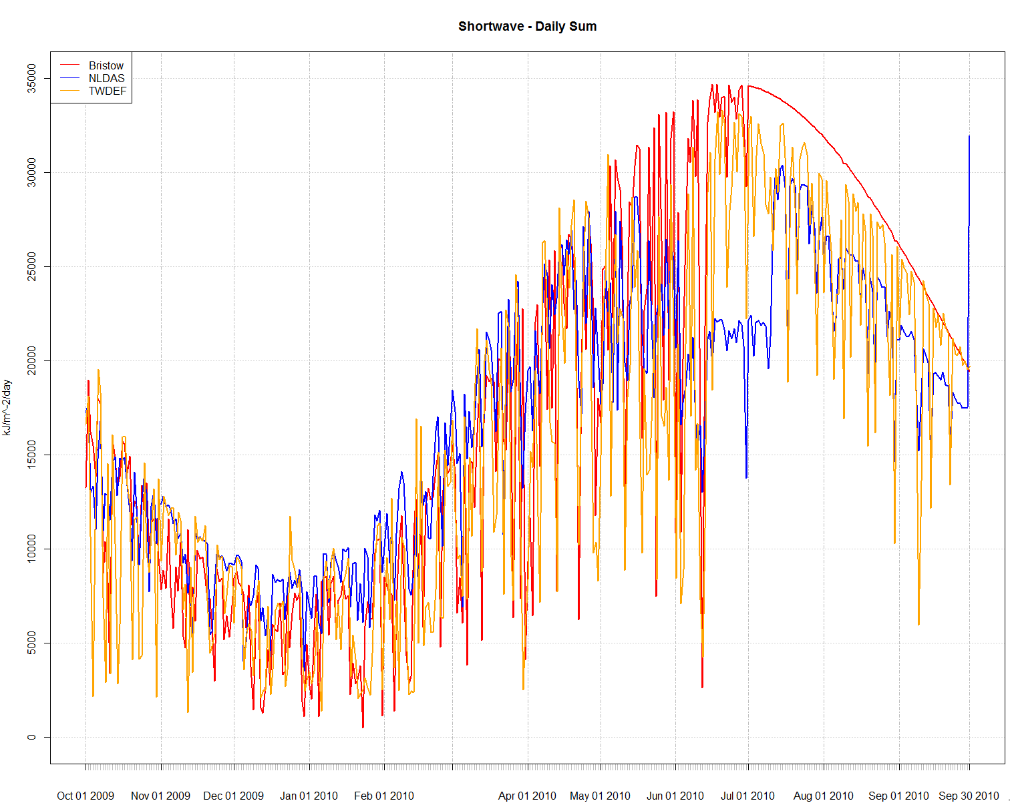
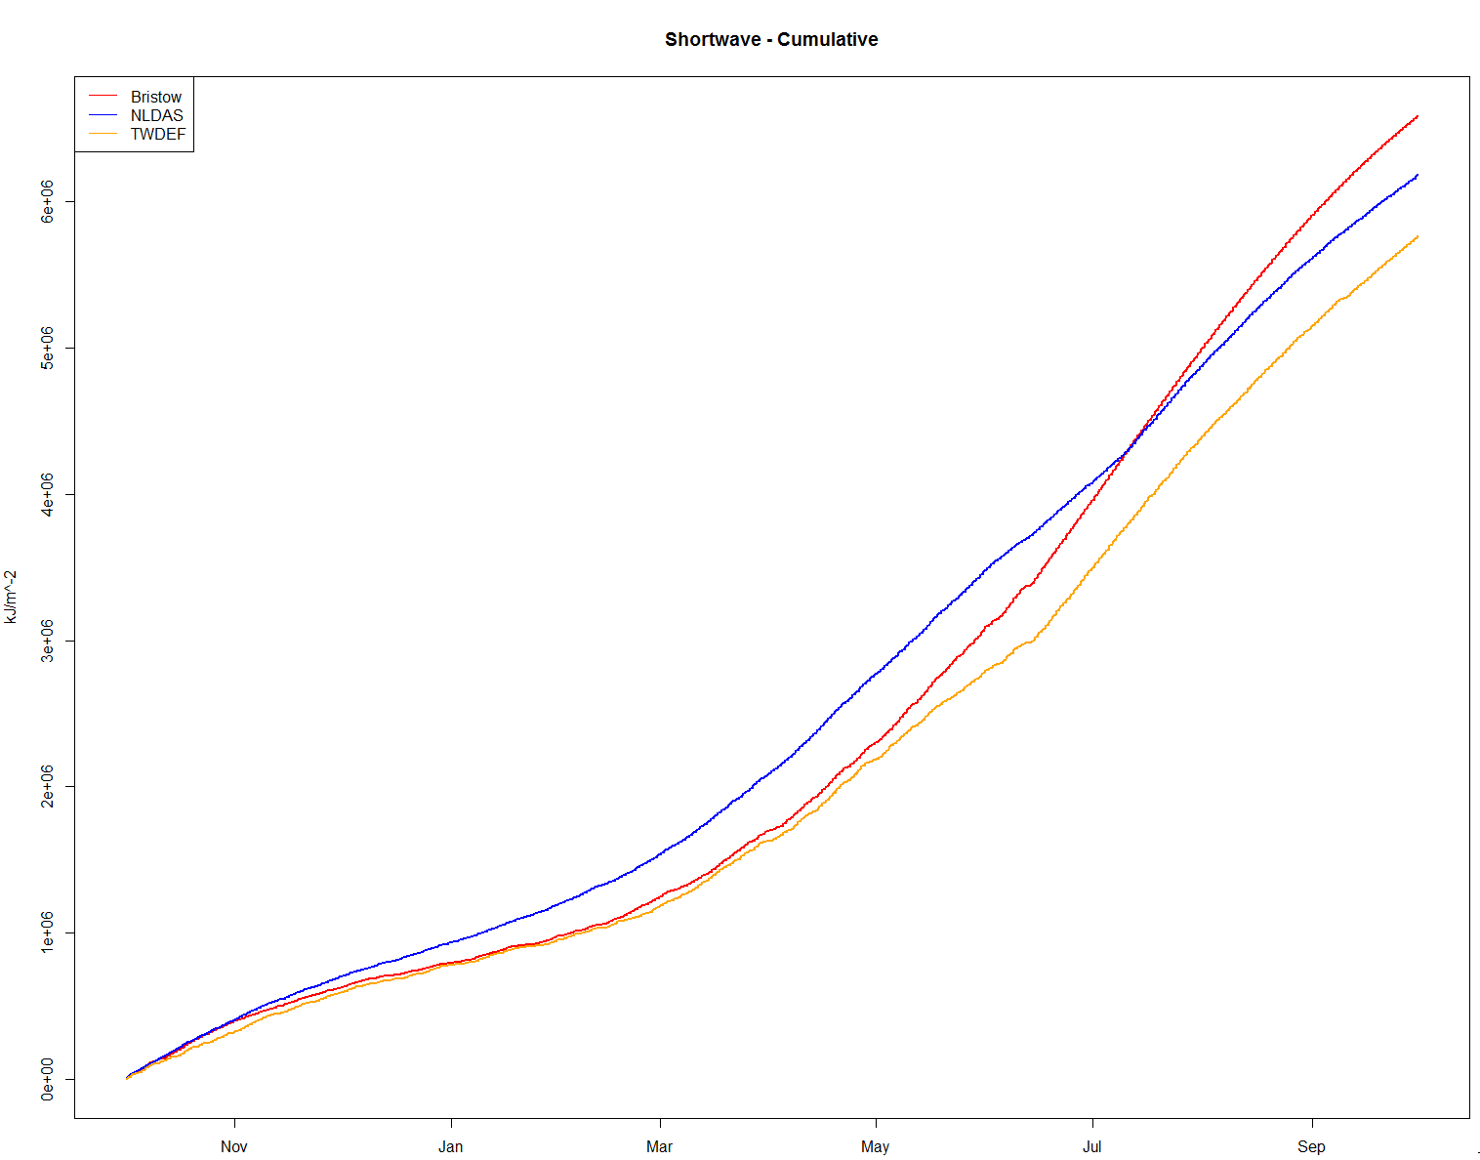
Input Comparisons
Shortwave – Monthly Sum
Shortwave – Daily Sum
1e+06
35000
25000
6e+06
15000
2e+06
5000
0
Shortwave – Cumulative
6e+06
kJ/m²
4e+06
0

Slide 25
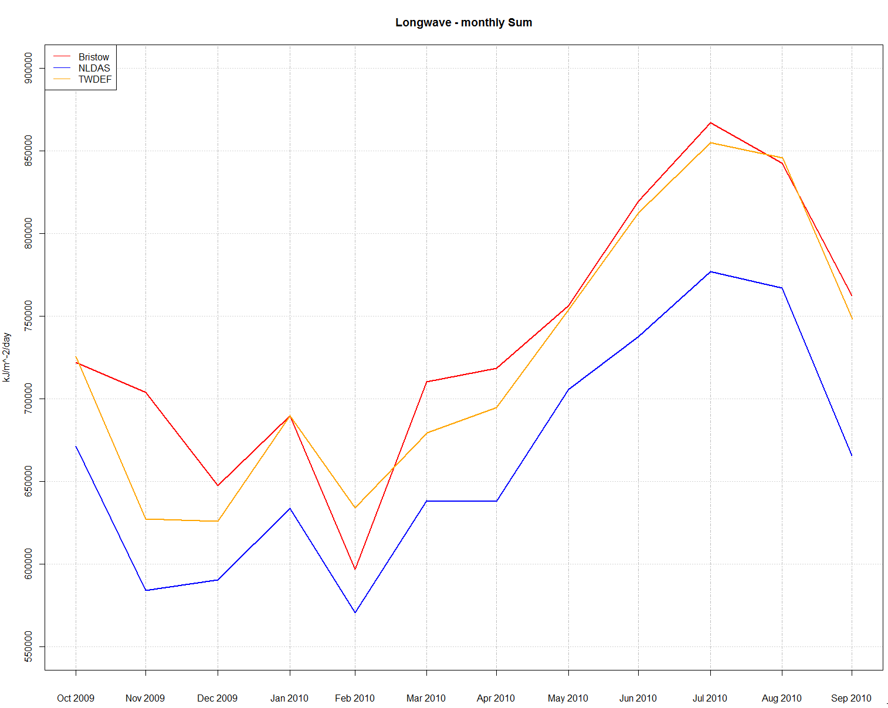
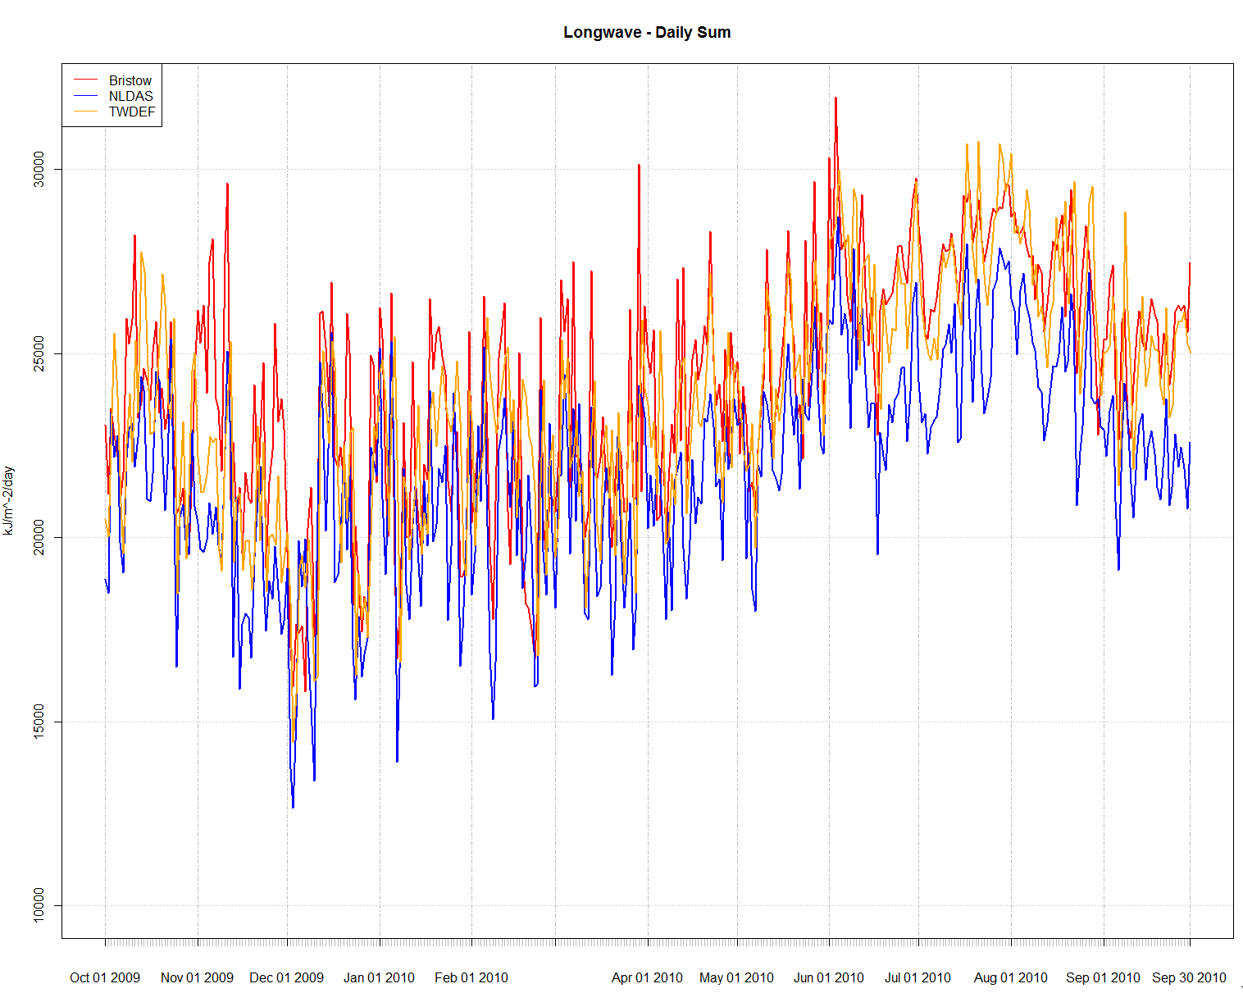
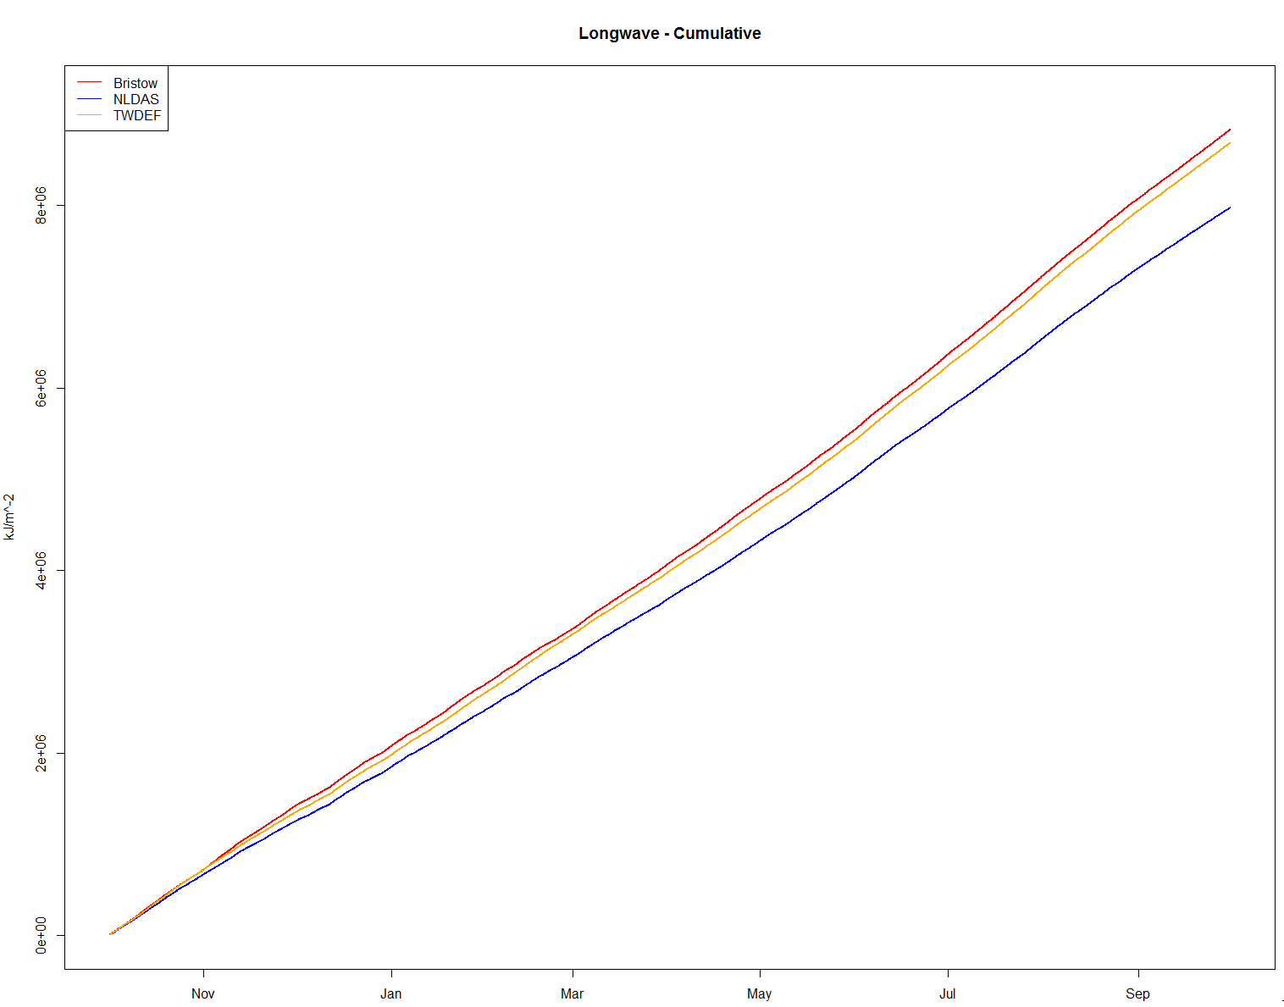
Input Comparisons
Longwave – Monthly Sum
Longwave – Daily Sum
900000
30000
20000
700000
Longwave – Cumulative
550000
8e+06
4e+06
kJ/m²
0

Slide 26
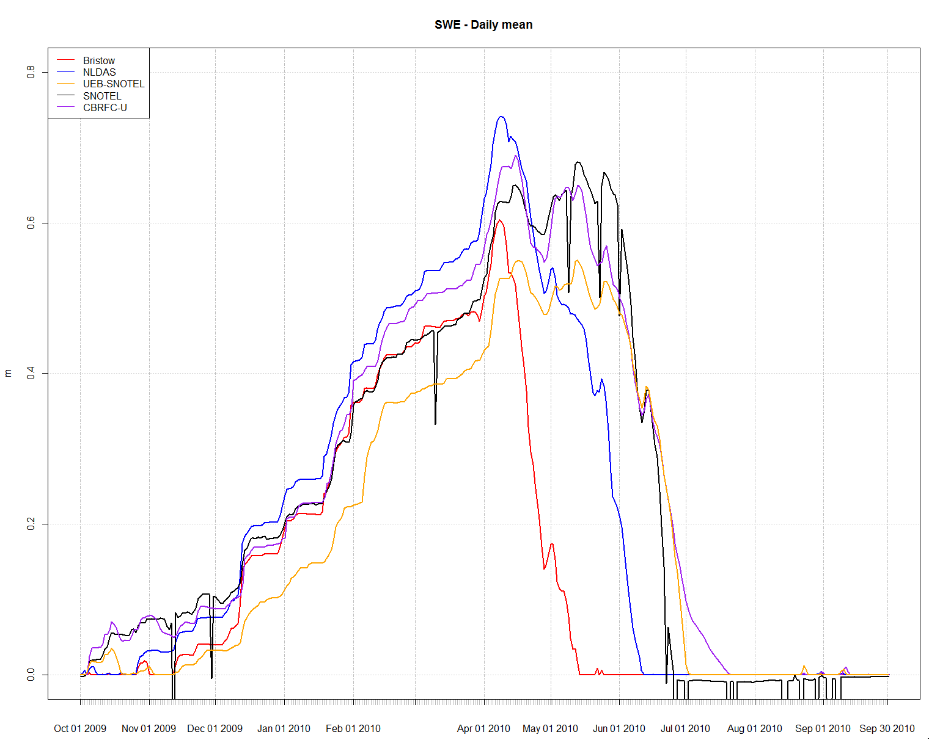
Outputs
0.8
0.4
meters
0.0

Slide 27
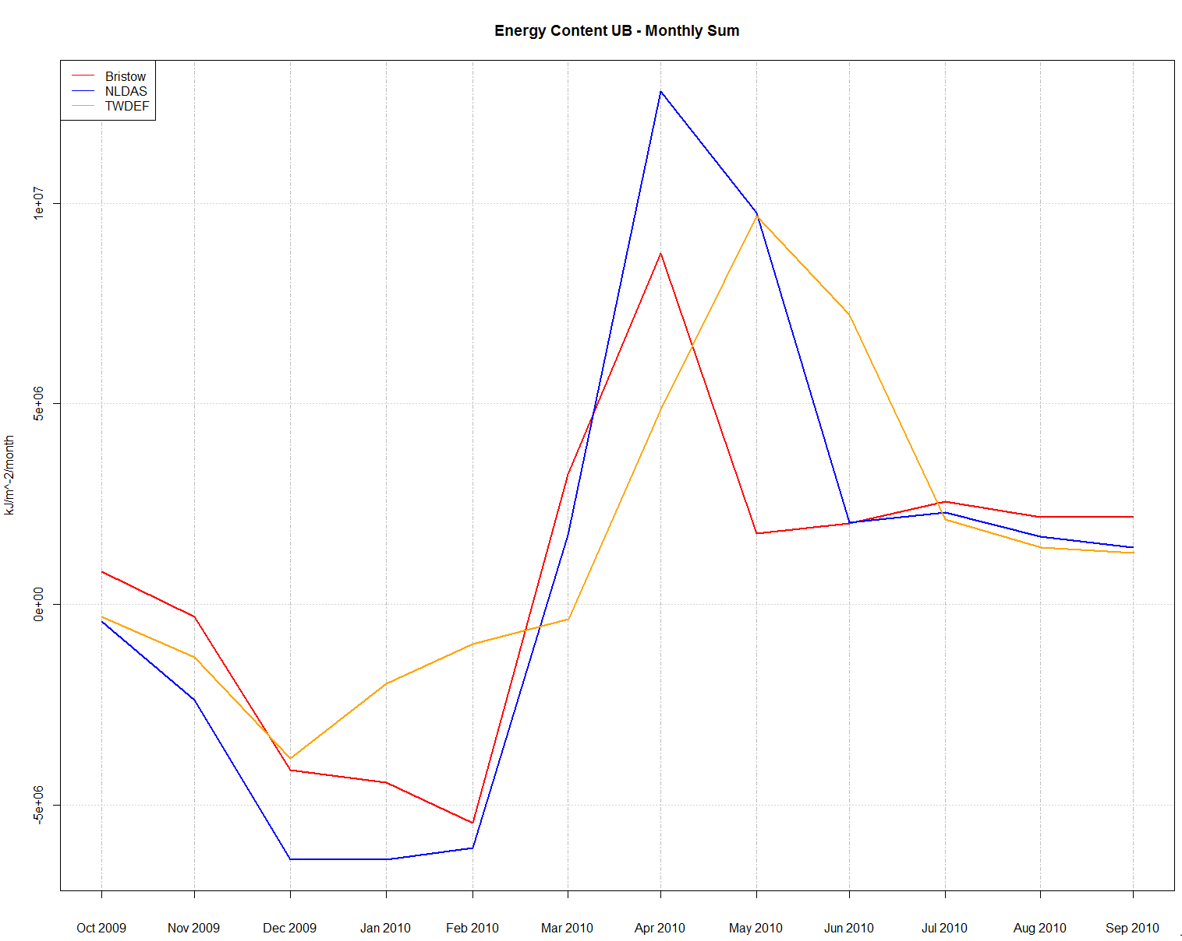
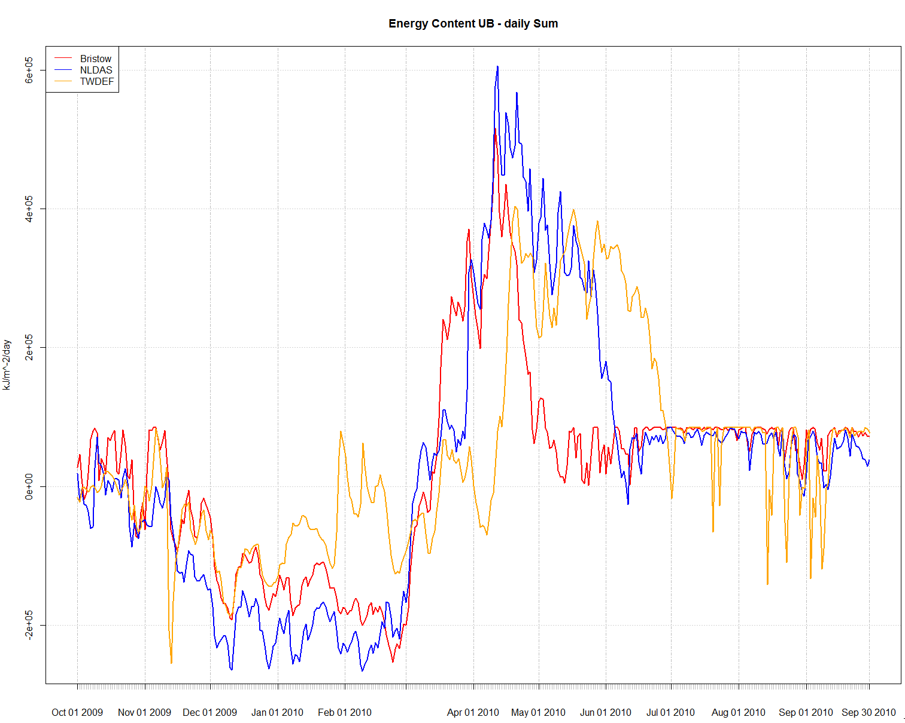
Outputs
Energy Content – Monthly Sum
Energy Content – Daily Sum
6e+05
1e+07
0
0
-5e+06
-2e+05
kJ/m²

Slide 28
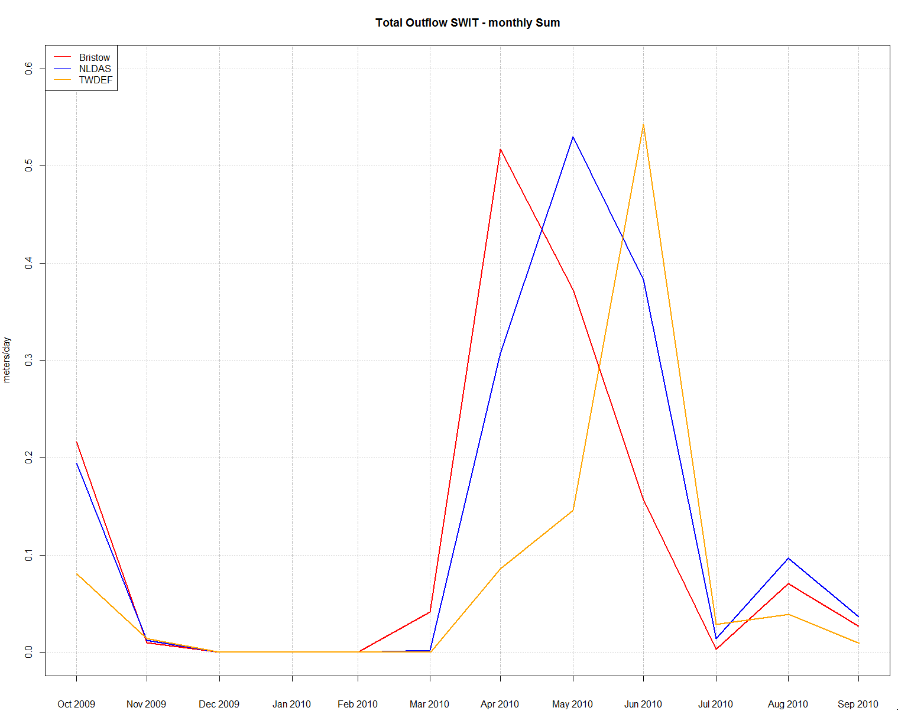
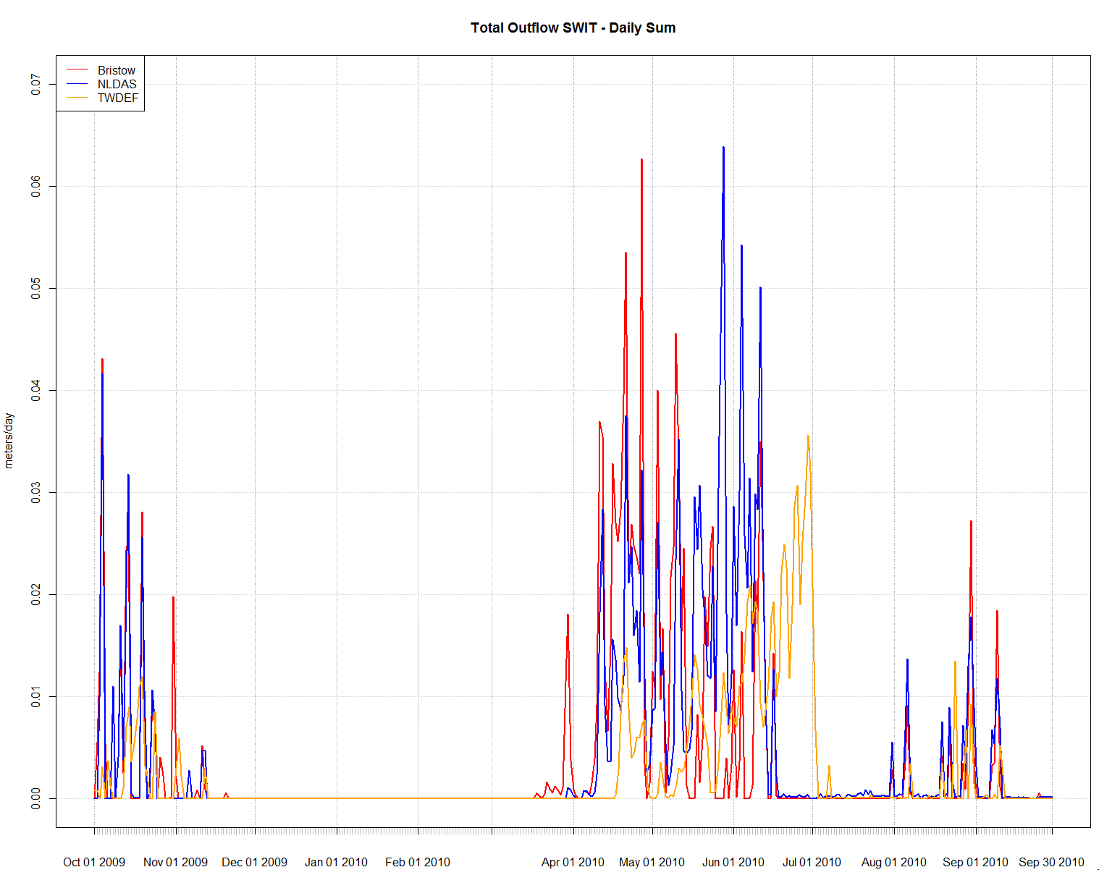
Outputs
Total Outflow – Monthly Sum
Total Outflow – Daily Sum
0.6
0.07
0.3
0.03
0.0
0.00
meters

Slide 29
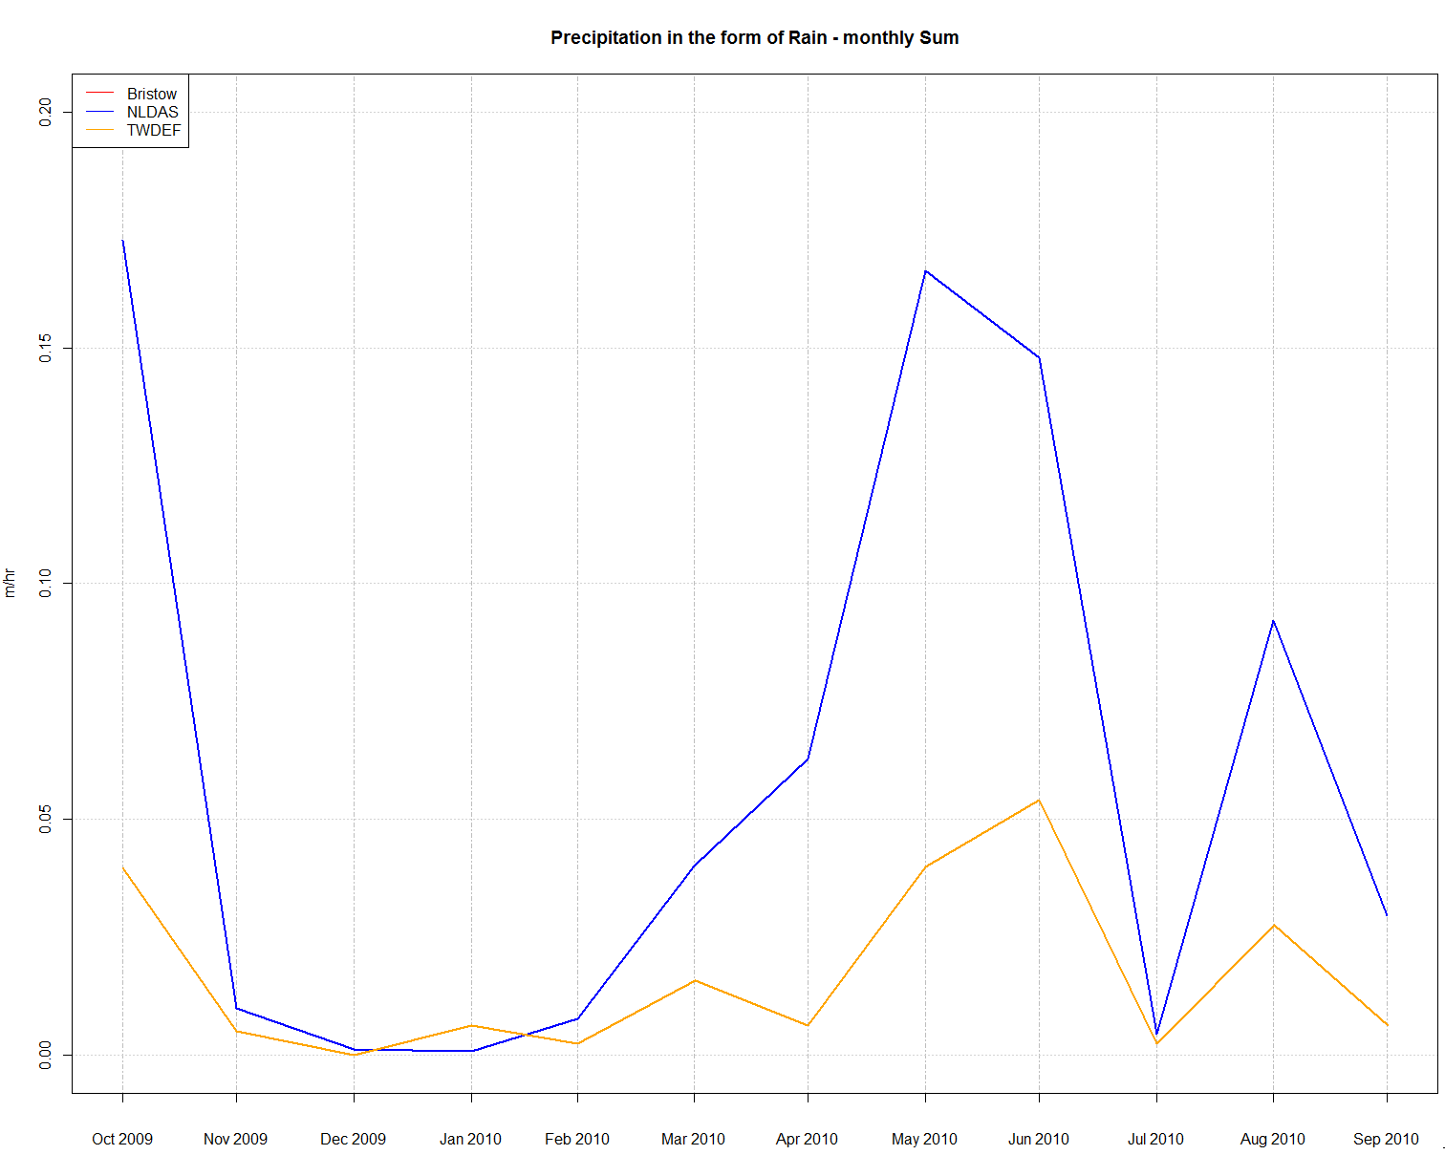
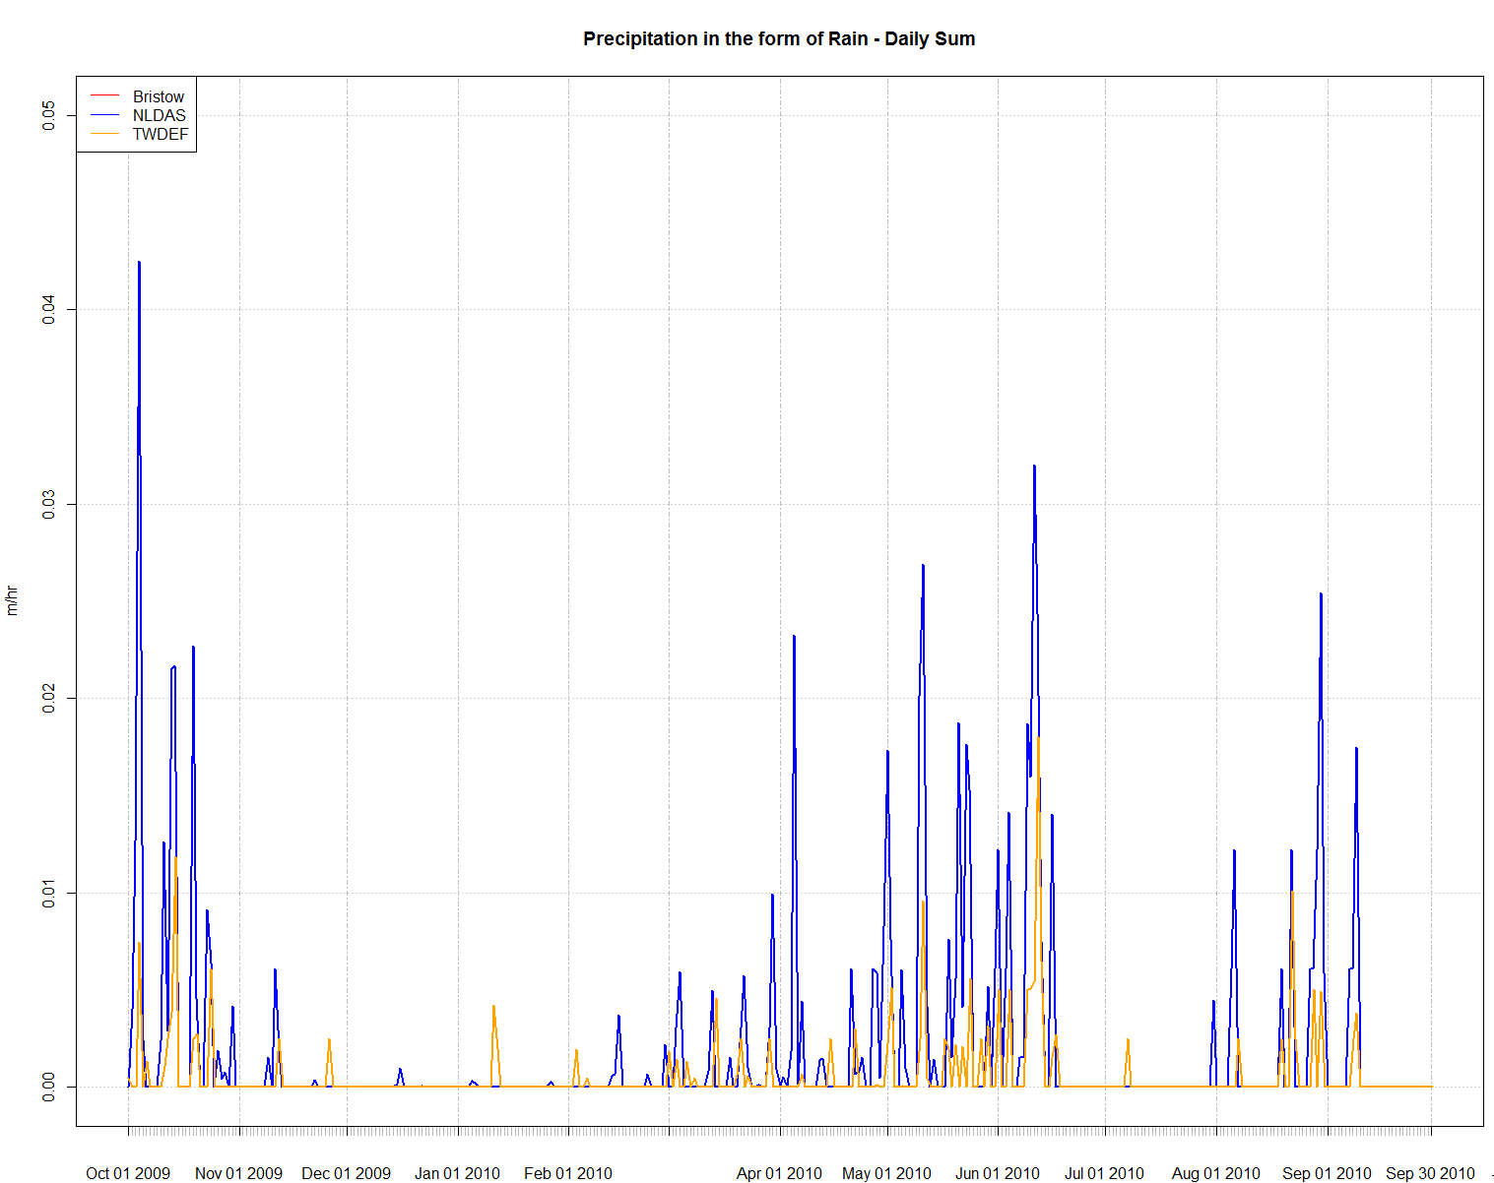
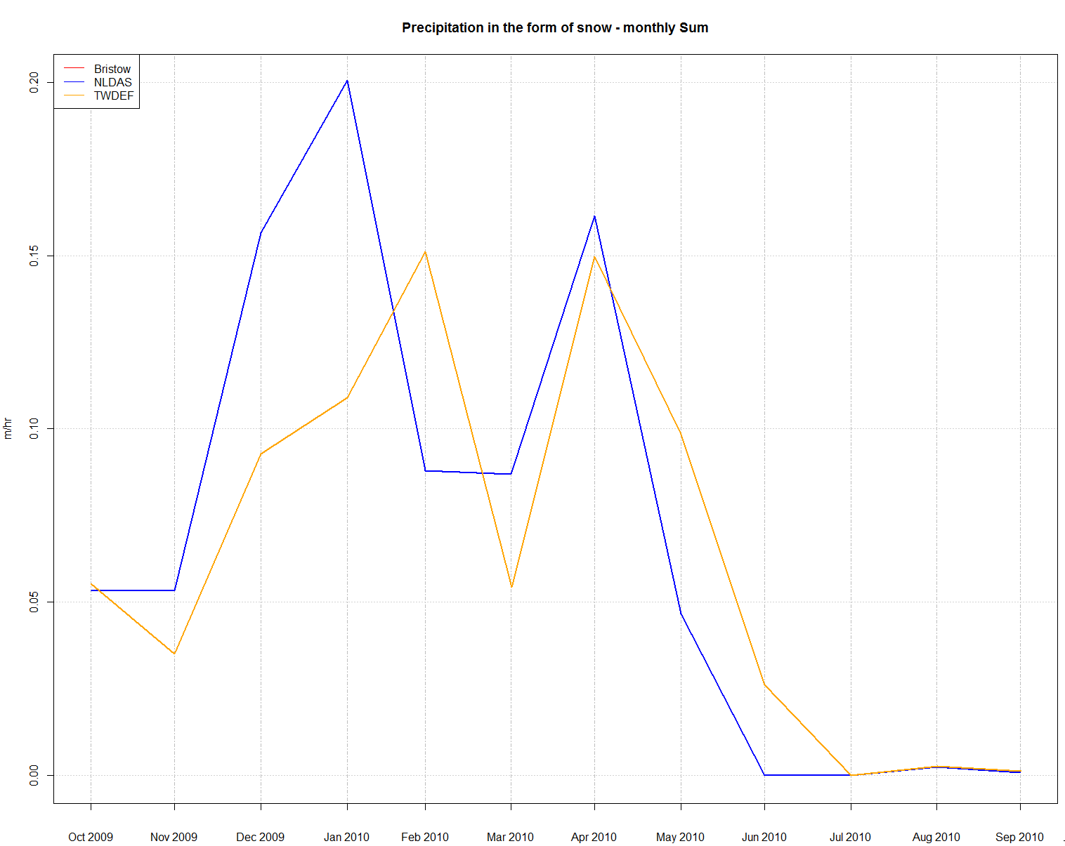
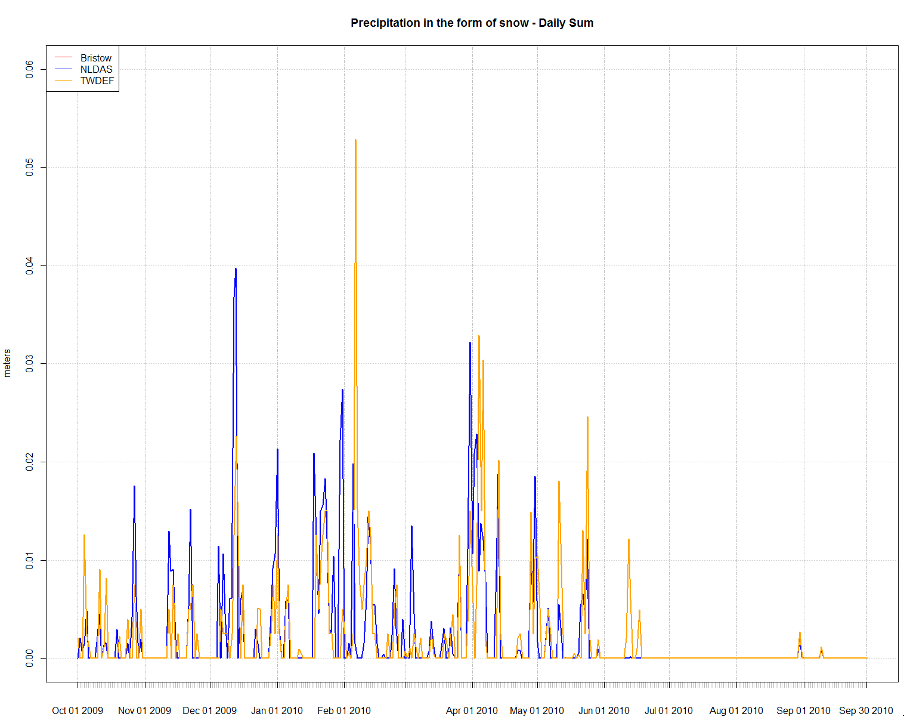
Outputs
Precipitation in the form of Rain – Monthly Sum
Precipitation in the form of Rain – Daily Sum
0.2
0.05
0.1
meters
0.02
0.0
0.00
Precipitation in the form of Snow – Monthly Sum
Precipitation in the form of Snow – Daily Sum
0.2
0.06
0.1
0.03
meters
0.0
0.00

Slide 30
Next Steps
Fully integrate UEB into FEWS/CHPS
Understand GFE products that can be used to run UEB
Evaluate UEB performance for Spring 2010 Runoff event in the Bear and Weber Basins.
NSE, RMSE, Percent Bias for streamflow outputs compared against SNOW17 and UEB.
Fix problems in UEB to improve performance

Slide 31
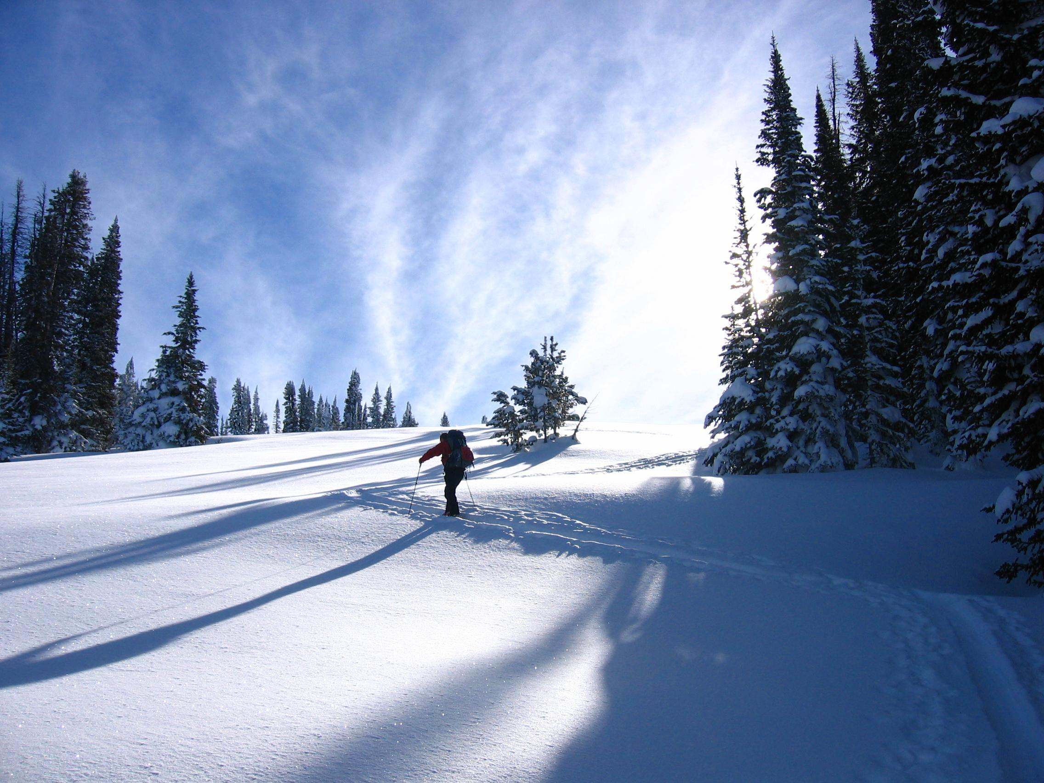
QUESTIONS?
The End
john.koudelka@gmail.com
dtarb@usu.edu

