Slide 1

CRFS Technical Committee
Spring Meeting
LC Operations Update
March 15, 2016

Slide 2
Topics
LC Current Conditions Update
LC Operations Update
SECURE Reservoir Operations Pilot Update

Slide 3
Current Conditions

Slide 4
Colorado River Basin Storage
(as of March 13, 2016)
Reservoir | Percent Full | Storage (maf) | Elevation (feet)
Lake Powell | 46% | 11.16 | 3,593.7
Lake Mead | 39% | 10.25 | 1,082.8
Lake Mohave | 92% | 1.67 | 641.8
Lake Havasu | 93% | 0.58 | 447.9
Total System Storage* | 49% | 29.05 | NA
*Total system storage was 29.09 maf or 49% this time last year
Notes:
4
In handout, include conditions this time at the beginning of year

Slide 5
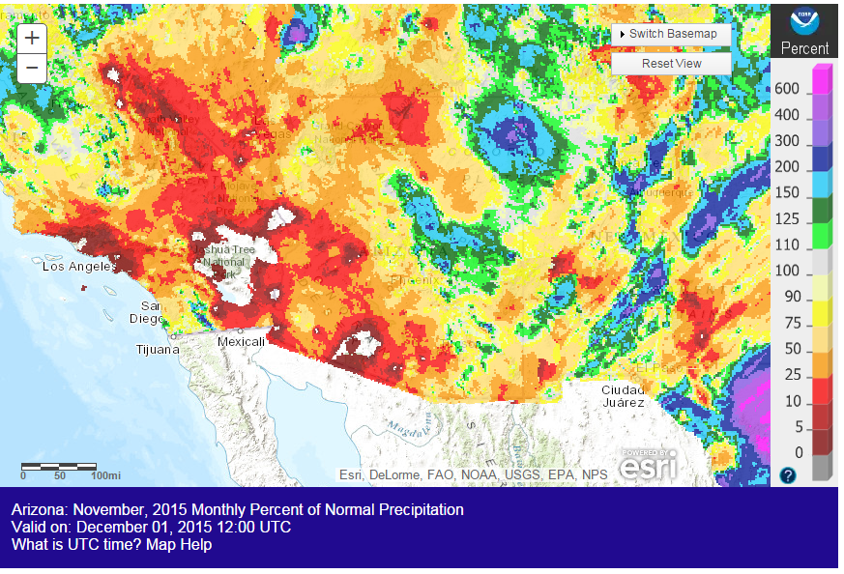
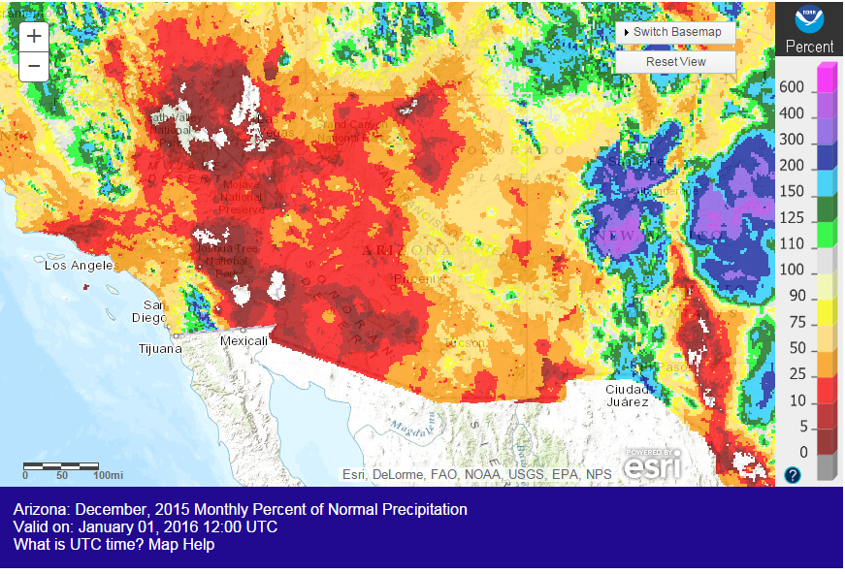
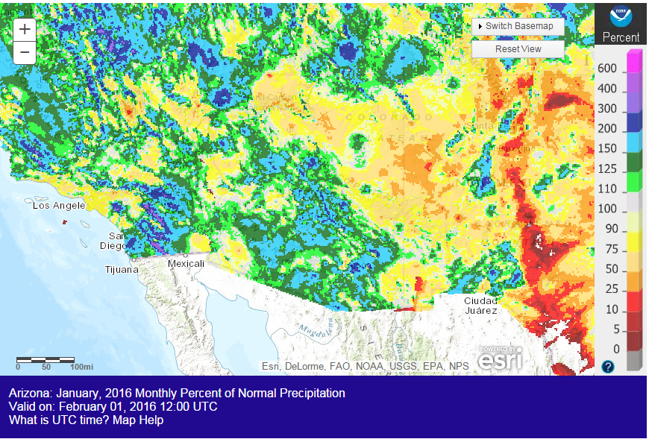
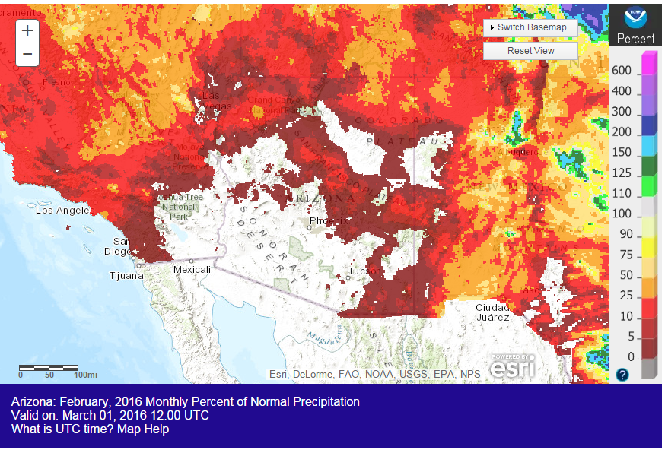
Observed Precipitation
Source: http://water.weather.gov/precip/
Notes:
-Discuss dry summer conditions and wet October.

Slide 6
Lower Basin Side Inflows – WY/CY 2016^{1,2}
Intervening Flow from Glen Canyon to Hoover Dam
Month in WY/CY 2015 |  | 5-Year Average Intervening Flow (KAF) | Observed Intervening Flow (KAF) | Observed Intervening Flow (% of Average) | Difference From 5-Year Average (KAF)
HISTORICAL | October 2015 | 69 | 118 | 171% | 49
 | November 2015 | 56 | 41 | 73% | -15
 | December 2015 | 54 | 43 | 79% | -12
 | January 2016 | 62 | 90 | 145% | 28
 | February 2016 | 73 | 81 | 111% | 8
FUTURE | March 2016 | 55
 | April 2016 | 53
 | May 2016 | 37
 | June 2016 | 21
 | July 2016 | 78
 | August 2016 | 124
 | September 2016 | 112
 | October 2016 | 69
 | November 2016 | 56
 | December 2016 | 54
WY 2016 Totals |  | 795 | 853 | 107% | 58
CY 2016 Totals |  | 795 | 831 | 105% | 36
¹ Values were computed with the LC’s gain-loss model for the most recent 24-month study.
² Percents of average are based on the 5-year mean from 2011-2015.

Slide 7
Parker Dam Releases
Notes:
-Despite dry conditions in the basin, Parker Dam releases were lower than the past 15 year average beginning in April and continued through October. (drought conservation?)

Slide 8
Parker Dam Releases
Notes:
-Despite dry conditions in the basin, Parker Dam releases were lower than the past 15 year average beginning in April and continued through October. (drought conservation?)

Slide 9
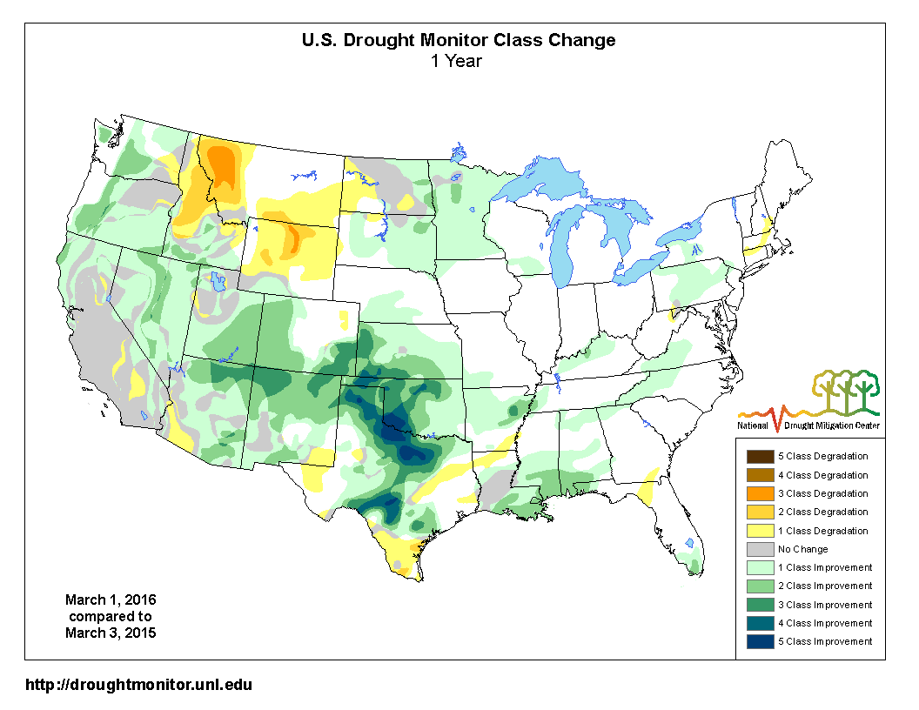
Drought Conditions
Notes:
-Reinforces that there hasn’t been much change in drought conditions in CA since beginning of year. Slight improvement in AZ

Slide 10
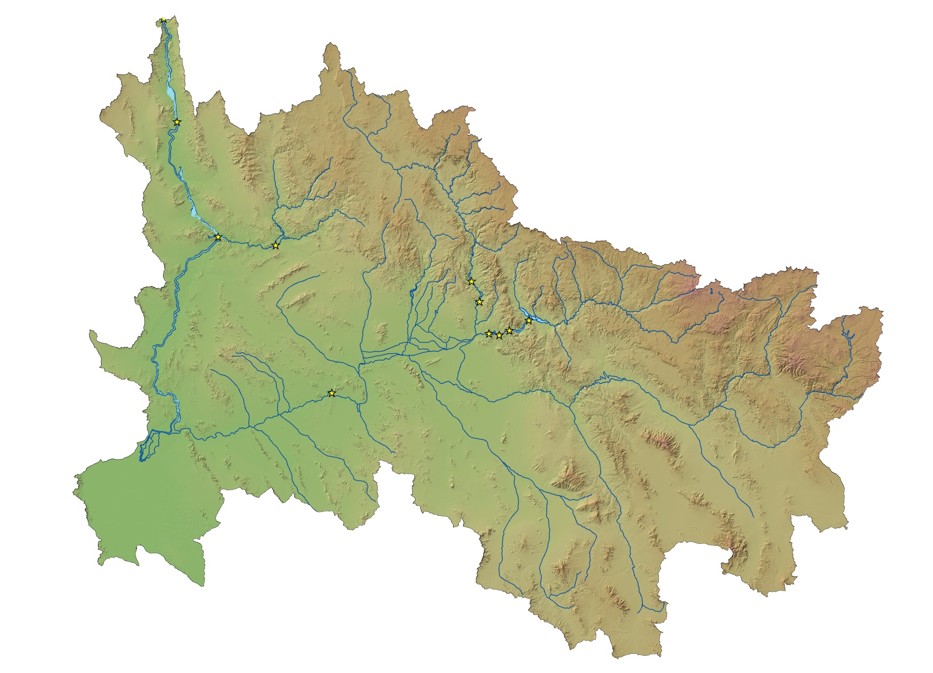

Hoover Dam
STATUS OF OTHER LOWER BASIN RESERVOIRS
as of March 14, 2015
Alamo Dam
Elevation: 1,087.5 feet
Capacity: 5%
Content: 51 kaf
Inflow: 5 cfs
Outflow: 25 cfs
Davis Dam
Salt River Project
Capacity: 58%
Content: 1.33 maf
Alamo Dam
Bill Williams
River
Agua Fria River
Verde River
Parker Dam
Horseshoe Dam
Bartlett Dam
Salt River
Colorado River
Roosevelt Dam
Painted Rock Dam
Stewart Mtn. Dam
Gila River
Mormon Flat Dam
Horse Mesa Dam
Santa Cruz River
San Pedro River
Painted Rock Dam
Elevation: 535.0 feet
Capacity: 0%
Inflow: 0 cfs
Outflow: 0 cfs

Slide 11
Lower Basin Operations
Calendar Year 2016
Lake Mead Operating Conditions
Operating under the Normal/ICS Surplus Condition
  Lower Basin projected water use of 7.5 maf +/- ICS created or delivered
  Mexico projected to take delivery of 1.5 maf +/- any water deferred or delivered

Slide 12
End of Water Year 2016 Projections
March 2016 24-Month Study Most Probable Inflow Scenario¹
Projected Unregulated Inflow into Powell¹ = 9.02 maf (83% of average)
Lake Mead
Lake Powell
1,219.6
26.120 maf
24.322 maf
3,700
17.3 maf
3,651
1,145
16.2 maf
1,105
12.2 maf
9.5 maf
3,606.5 feet
12.38 maf in storage
51% of capacity
3,575
1,075
9.6 maf
1,072.8 feet
9.42 maf in storage
36% of capacity
5.9 maf
3,525
1,025
6.0 maf
9.00 maf
0.0 maf
3,370
895
0.0 maf
Dead Storage
1.9 maf
2.5 maf
Dead Storage
Not to Scale
¹ WY 2016 unregulated inflow into Lake Powell is based on the CBRFC forecast dated 3/2/16.

Slide 13
End of Calendar Year 2016 Projections
March 2016 24-Month Study Most Probable Inflow Scenario¹
Based on a 9.00 maf release pattern from Lake Powell in Water Year 2017
Lake Mead
Lake Powell
1,219.6
26.120 maf
24.322 maf
3,700
17.3 maf
3,651
1,145
16.2 maf
1,105
12.2 maf
9.5 maf
3,599.5 feet
11.70 maf in storage
48% of capacity
3,575
1,075
9.6 maf
1,077.3 feet
9.79 maf in storage
37% of capacity
5.9 maf
3,525
1,025
6.0 maf
0.0 maf
3,370
895
0.0 maf
Dead Storage
1.9 maf
2.5 maf
Dead Storage
Not to Scale
¹ WY 2016 unregulated inflow into Lake Powell is based on the CBRFC forecast dated 3/2/16.

Slide 14
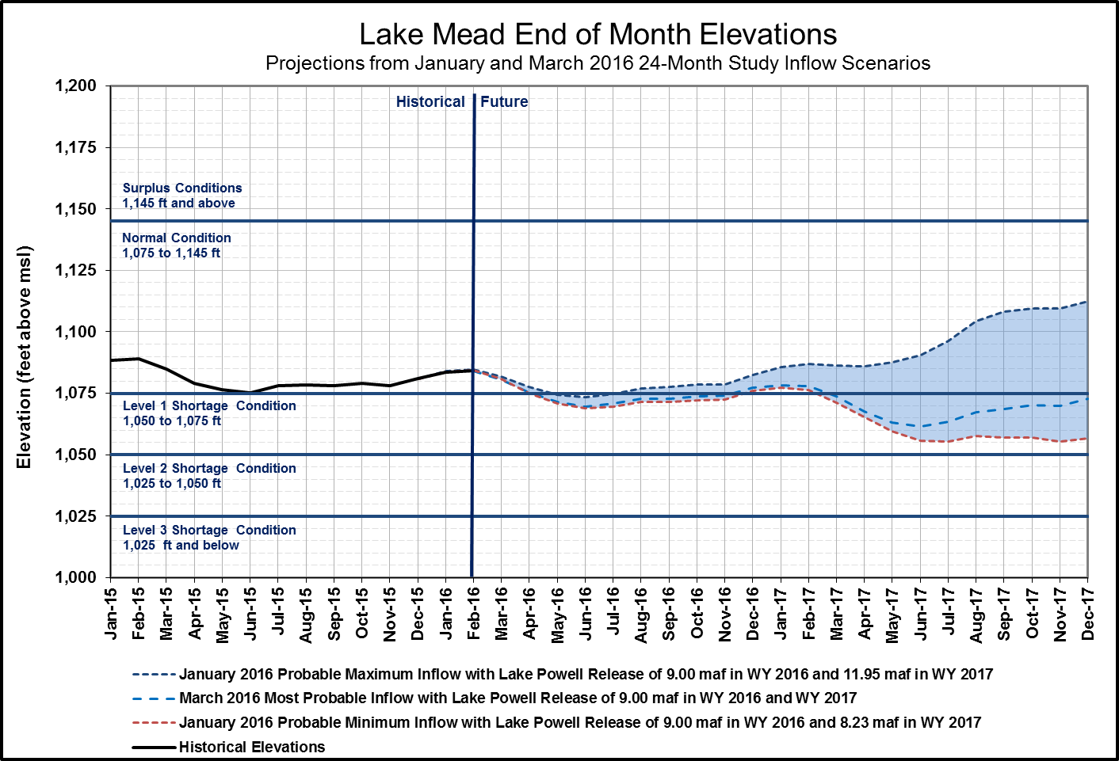
End of CY 2016 Projection: 1,077.3 feet (37% full)
(Range 1,076 to 1,082 feet)
End of CY 2017 Projection:
1,072.7 feet (36% full)
(Range 1,057 to 1,112 feet)

Slide 15
Percent of Traces with Event or System Condition
Results from January 2016 MTOM/CRSS^{1,2,3} (values in percent)
 | Event or System Condition | 2016 | 2017 | 2018 | 2019 | 2020
Upper Basin – Lake Powell | Equalization Tier | 7/6 | 22 | 21 | 29 | 30
 | Equalization – annual release > 8.23 maf | 7/6 | 22 | 21 | 29 | 29
 | Equalization – annual release = 8.23 maf | 0 | 0 | 0 | 0 | 1
 | Upper Elevation Balancing Tier | 93/94 | 52 | 56 | 51 | 45
 | Upper Elevation Balancing – annual release > 8.23 maf | 87/89 | 46 | 43 | 39 | 34
 | Upper Elevation Balancing – annual release = 8.23 maf | 6/5 | 6 | 12 | 10 | 11
 | Upper Elevation Balancing – annual release < 8.23 maf | 0 | 0 | 1 | 2 | 0
 | Mid-Elevation Release Tier | 0 | 26 | 20 | 11 | 18
 | Mid-Elevation Release – annual release = 8.23 maf | 0 | 0 | 0 | 1 | 1
 | Mid-Elevation Release – annual release = 7.48 maf | 0 | 26 | 20 | 10 | 17
 | Lower Elevation Balancing Tier | 0 | 0 | 3 | 9 | 7
Lower Basin – Lake Mead | Shortage Condition – any amount (Mead ≤ 1,075 ft) | 0 | 17/37 | 59 | 60 | 59
 | Shortage – 1st level (Mead ≤ 1,075 and ≥ 1,050 ft) | 0 | 17/37 | 49 | 41 | 35
 | Shortage – 2nd level (Mead < 1,050 and ≥ 1,025 ft) | 0 | 0 | 10 | 16 | 18
 | Shortage – 3rd level (Mead < 1,025 ft) | 0 | 0 | 0 | 3 | 6
 | Surplus Condition – any amount (Mead ≥ 1,145 ft) | 0 | 0 | 5 | 7 | 14
 | Surplus – Flood Control | 0 | 0 | 0 | 1 | 2
 | Normal or ICS Surplus Condition | 100 | 83/63 | 36 | 33 | 27
¹ To address future hydrologic uncertainty CRSS uses 107 hydrologic inflow sequences derived by resampling the observed natural flow record from 1906-2012. MTOM uses a 30-member ensemble unregulated inflow forecast provided by the Colorado Basin River Forecast Center. Results from both models are provided in 2016 and 2017 due to the hydrologic uncertainty that exists this early in the year.
² Reservoir initial conditions based on actual December 31, 2015 conditions.
³ Percentages shown may not be representative of the full range of future
possibilities that could occur with different modeling assumptions.

Slide 16
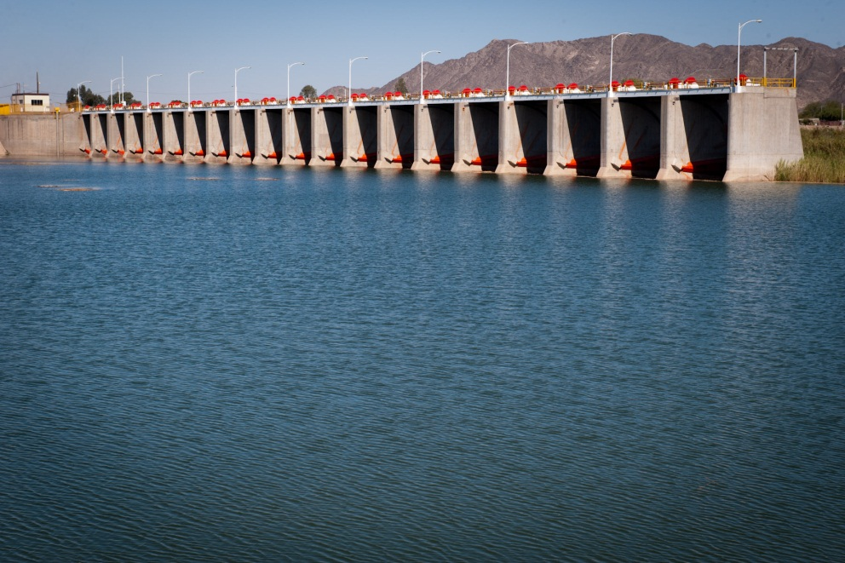
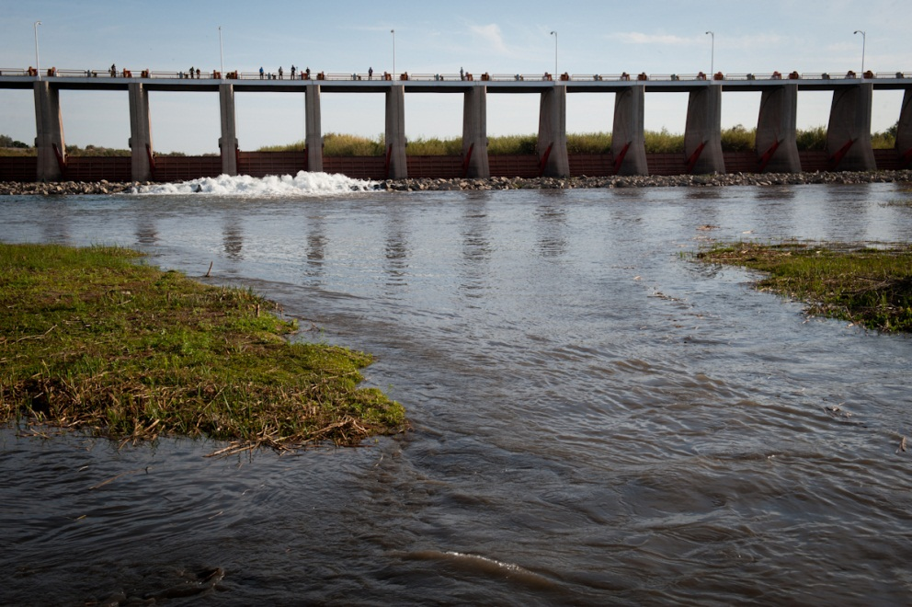
Additional Operational Data
(provisional year-to-date values)
Mexico Excess Flows (af) | Brock Reservoir Stored (af) | Senator Wash Stored (af)
525 | 32,740 | 12,710
Through 3/13/16 | Through 3/10/16 | Through 3/10/16
Morelos Dam Pictured Above – April 2014
Alexander Stephens (USBR)

Slide 17

Lower Colorado River
Operations
For further information: http://www.usbr.gov/lc/region
Email at:
bcoowaterops@usbr.gov

Slide 18
Parker Dam Releases
Notes:
-Despite dry conditions in the basin, Parker Dam releases were lower than the past 15 year average beginning in April and continued through October. (drought conservation?)

Slide 19
Parker Dam Releases
Notes:
-Despite dry conditions in the basin, Parker Dam releases were lower than the past 15 year average beginning in April and continued through October. (drought conservation?)

