Slide 1
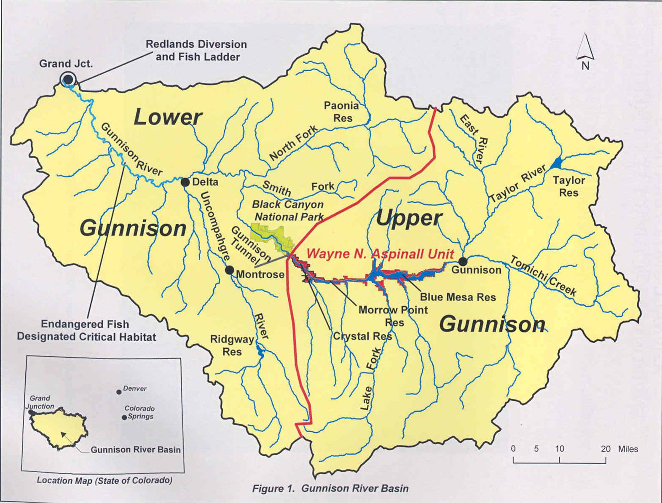
Notes:
The Gunnison River Basin is approximately 8,000 sq miles. The river originates where the East and Taylor Rivers join. From that point, the flows 25 miles to Blue Mesa Reservoir and on through Morrow Point and Crystal Reservoirs.
From Crystal Reservoir, it flows approximately 2 miles to the Gunnison Tunnel. From the tunnel, the river flows 29 miles through the spectactular Gunnison Canyon until it meets with the North Fork confluence. It then travels 75 miles to its confluence with the Colorado River at Grand Junction, Colorado.
About 40 percent of the annual flow of the Colorado River at the Colorado-Utah state lines comes from the Gunnison River.
The watershed above Crystal Dam is approximately 4,000 square miles.
Historical annual gaged flows below the Gunnison Tunnel have ranged from a few days of no flows to 19,000 cfs, both before the Unit reservoirs were constructed.

Slide 2
Aspinall Unit Seasonal Operation Goals
Fill Blue Mesa Reservoir before end of runoff.
Operate to the 2012 Aspinall ROD at the Whitewater Gage.
Meet the NPS Black Canyon water right peak flow.
Meet all state water right needs on the river downstream.
Maximize hydropower production.
Meet Blue Mesa Reservoir End of December ice target of 7490.0 ft
Meet flood control needs of storing water in Blue Mesa Reservoir and to avoid flooding down river in the town of Delta.
Adjust river flows for diversion needs through the Gunnison Diversion Tunnel.
Adjust flows for trout spawning needs in the fall and spring months.

Slide 3
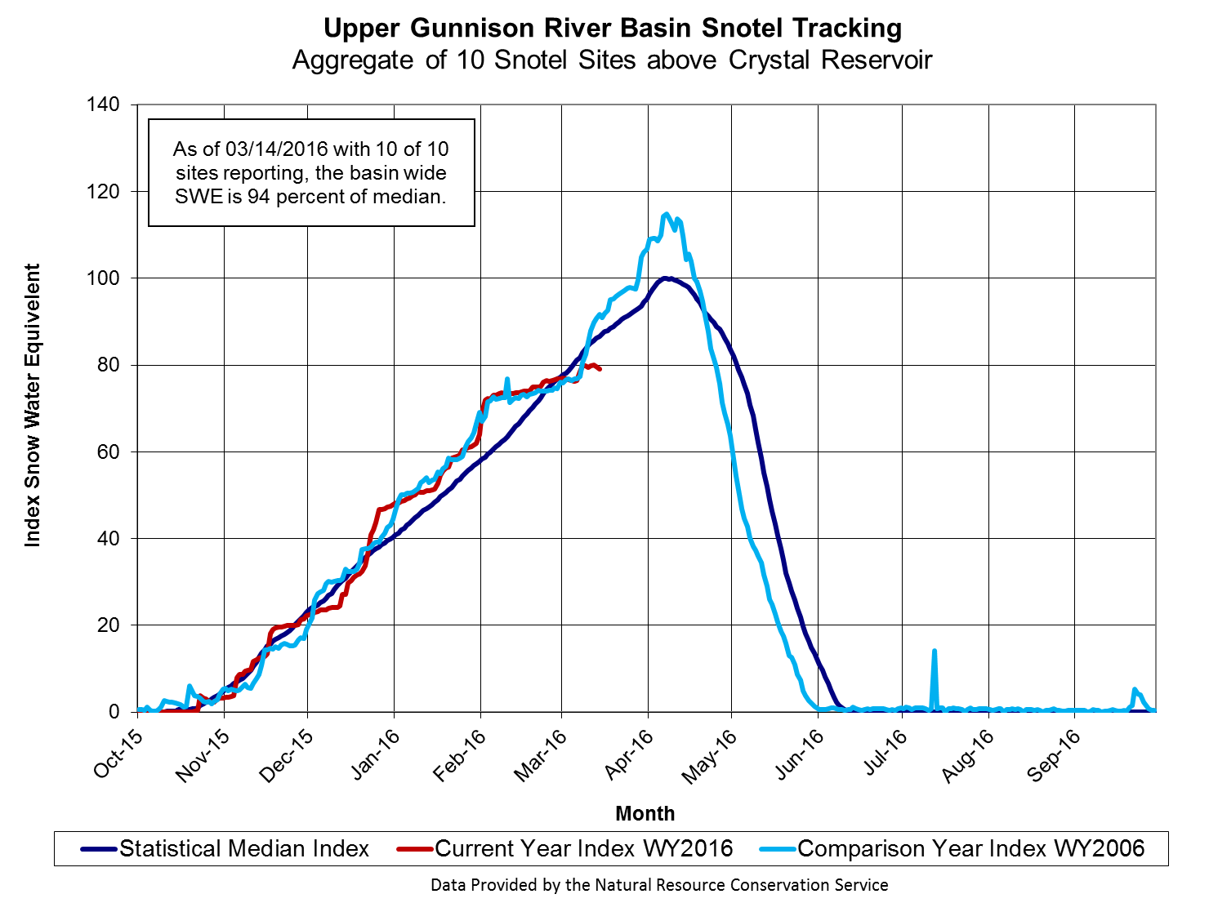

Slide 4
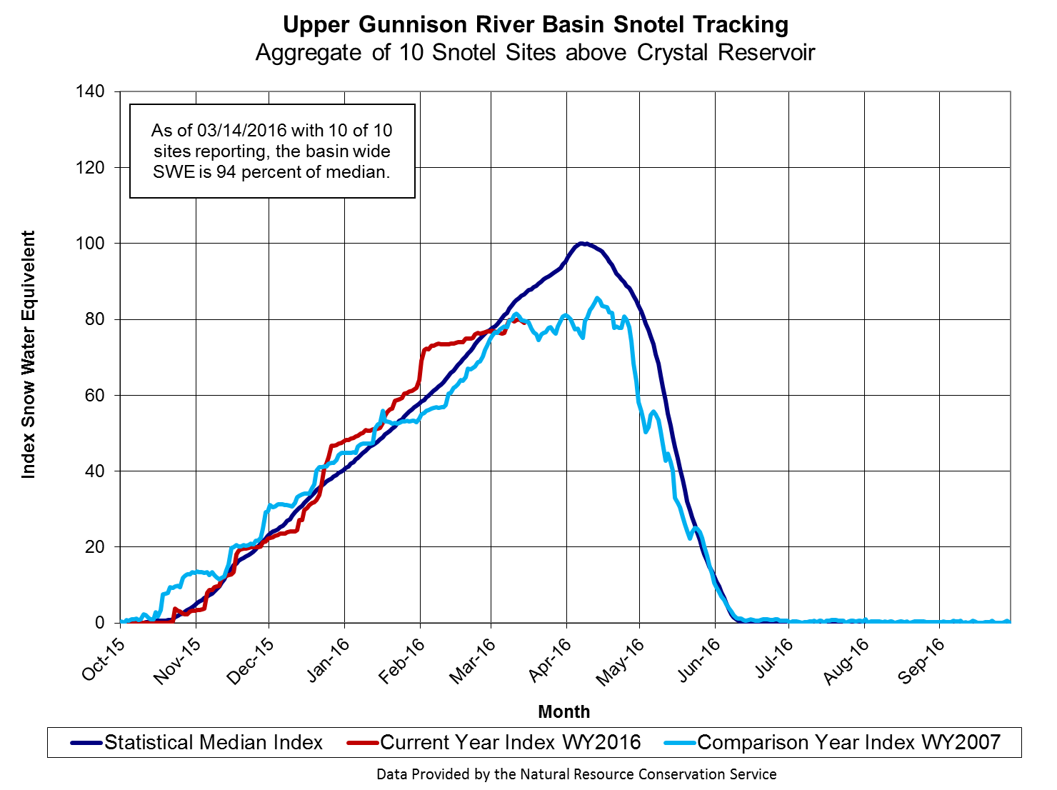

Slide 5
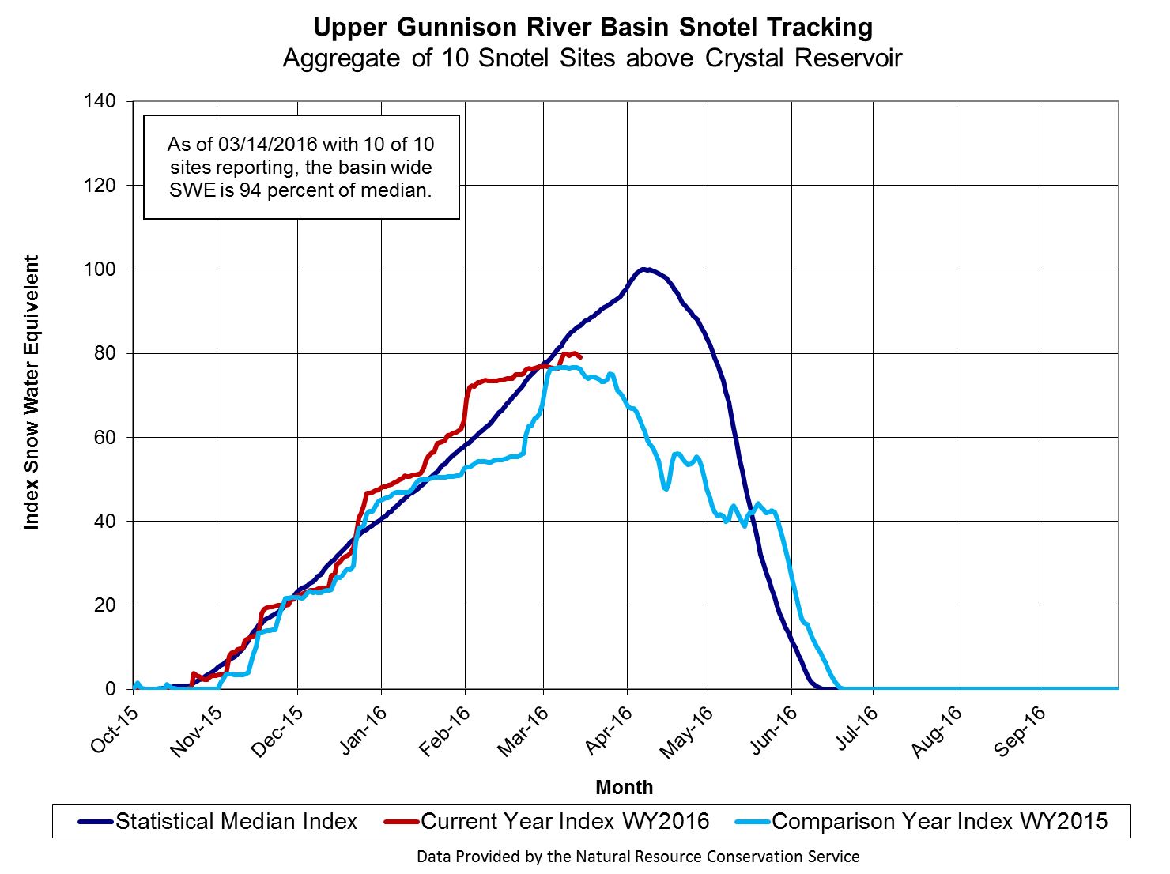

Slide 7
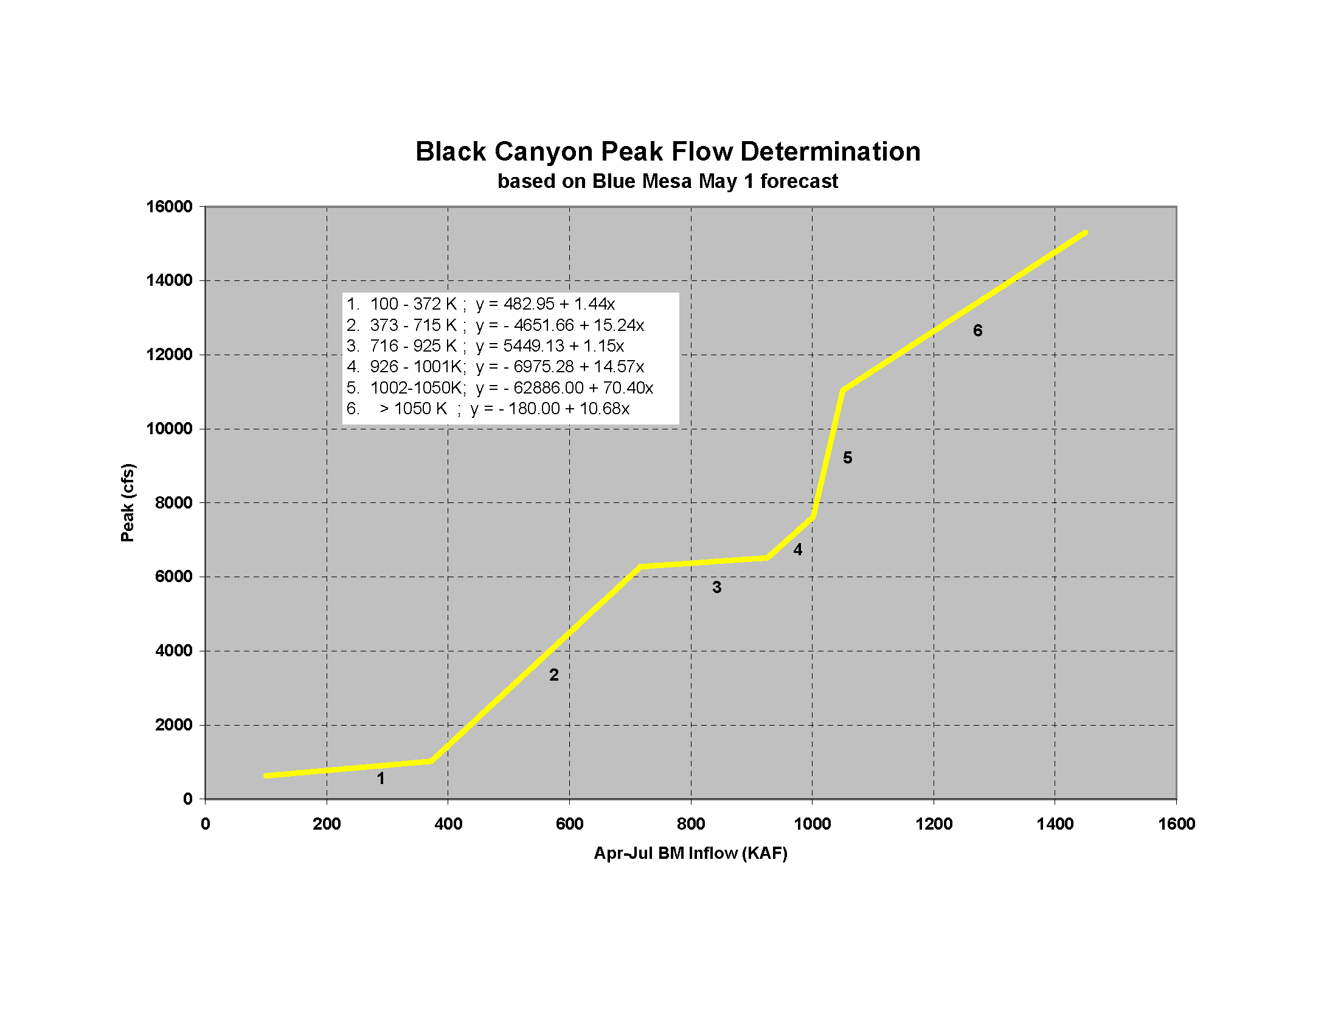
March 15 Forecast
580 KAF
4190 cfs
2006
2007
2015

Slide 8
2006
2007
2015

