Slide 1
USBR Updates:
Green River
CRFS Meeting March 15, 2016

Slide 2
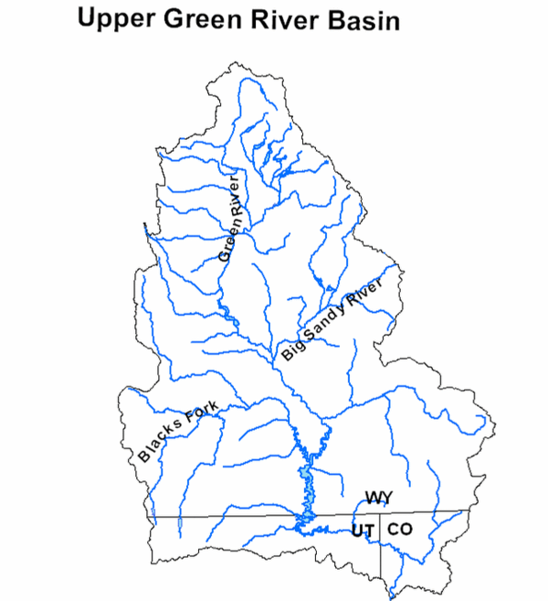
Green River Operations
Fontenelle
Flaming Gorge

Slide 3
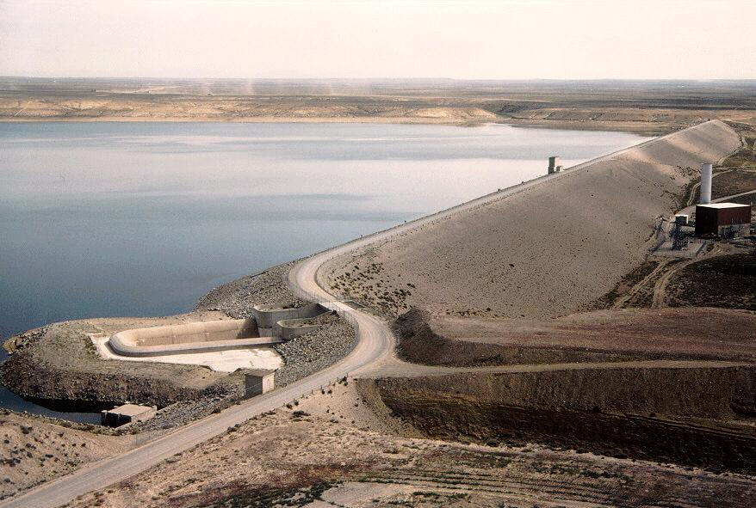
Fontenelle Operations

Slide 4
Fontenelle
Storage
Live Capacity 345,000 AF
Capacity on 3/14/16 144,780 AF
(42% full) typical for March
Pool Elevation
Reservoir Elev. (Min) 6463.00 feet
Elevation on 3/14/16 6475.80 feet
Elevation above (Min) 12.80 feet
Inflow and Release
Average Inflow 850 cfs
Average Release 950 cfs

Slide 5
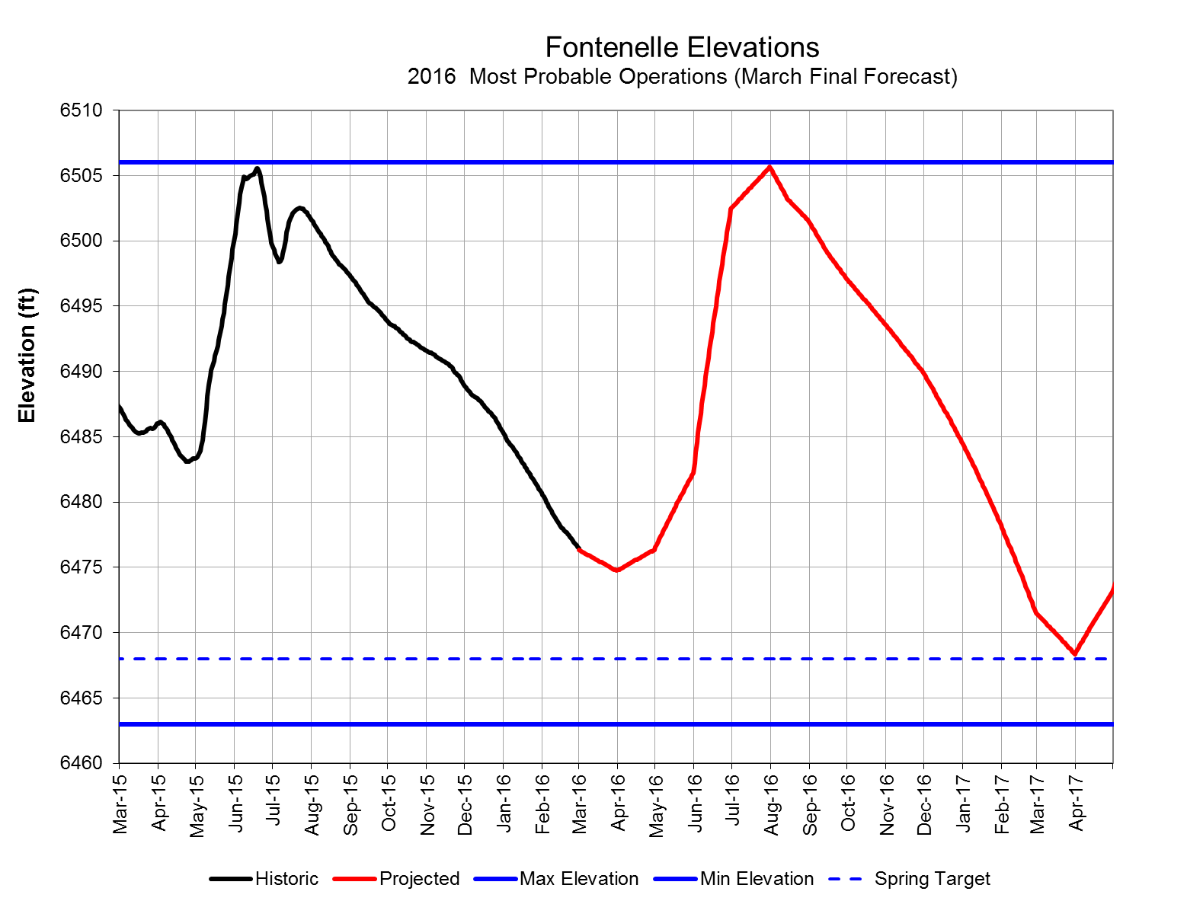
Fontenelle Reservoir Elevation
Notes:
Go to P:\FontenelleOps\FontenelleDailyOps.xls to get most recent plot

Slide 6
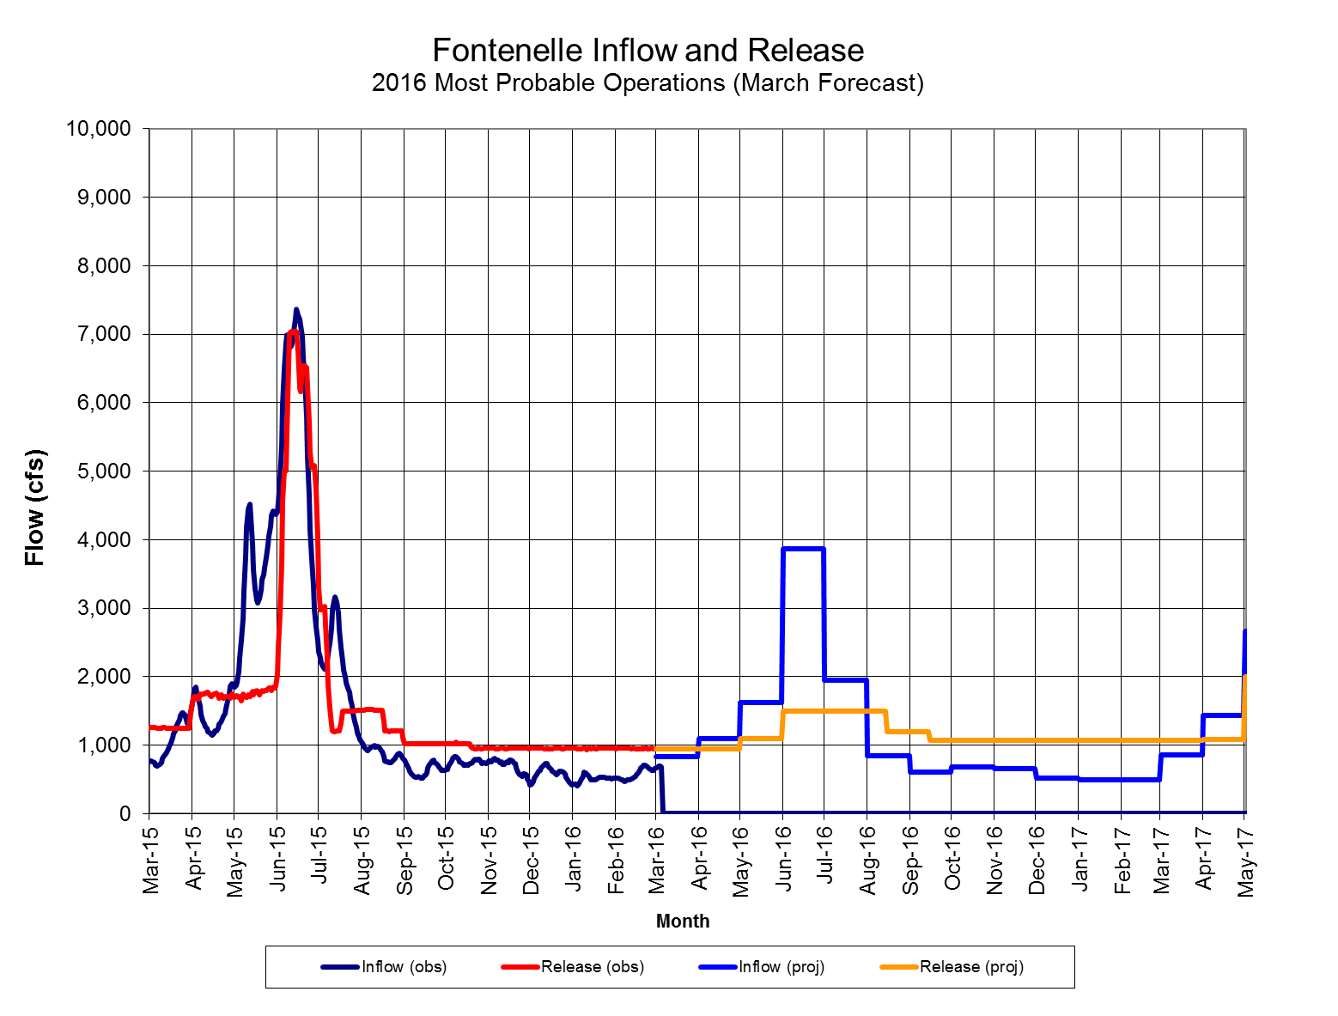
Fontenelle Inflow and Release
2015 Apr – Jul Inflow
768 KAF (106%)
2016 Apr – Jul Inflow
515 KAF (71%)
2016 Projected releases between 900-1,500 cfs over summer
Notes:
Go to P:\FontenelleOps\FontenelleDailyOps.xls to get most recent plot

Slide 7
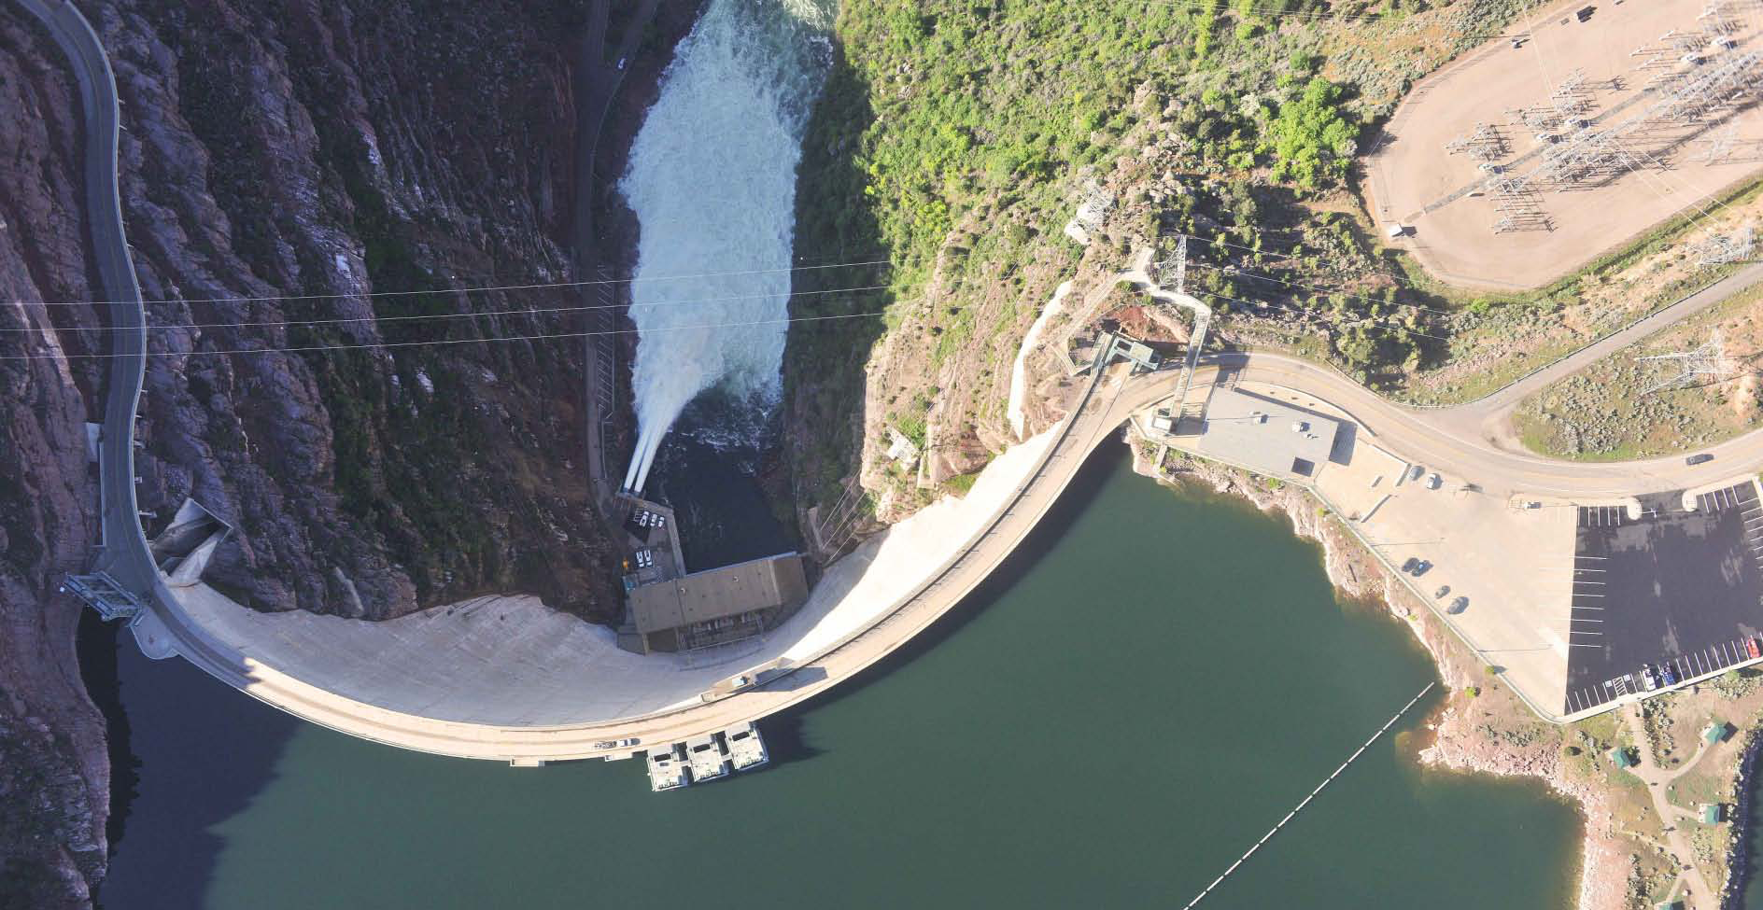
Flaming Gorge Operations

Slide 8
Flaming Gorge
Live Capacity 3.752 MAF
Capacity on 3/14/16 3.140 MAF
Available Space .612 MAF
(84% full)
Reservoir Elev. 6040.00 feet
Elevation on 3/14/16 6024.65 feet
Elevation below (Full) 15.35 feet
Average Inflow 1,470 cfs
Average Release 815 cfs

Slide 9
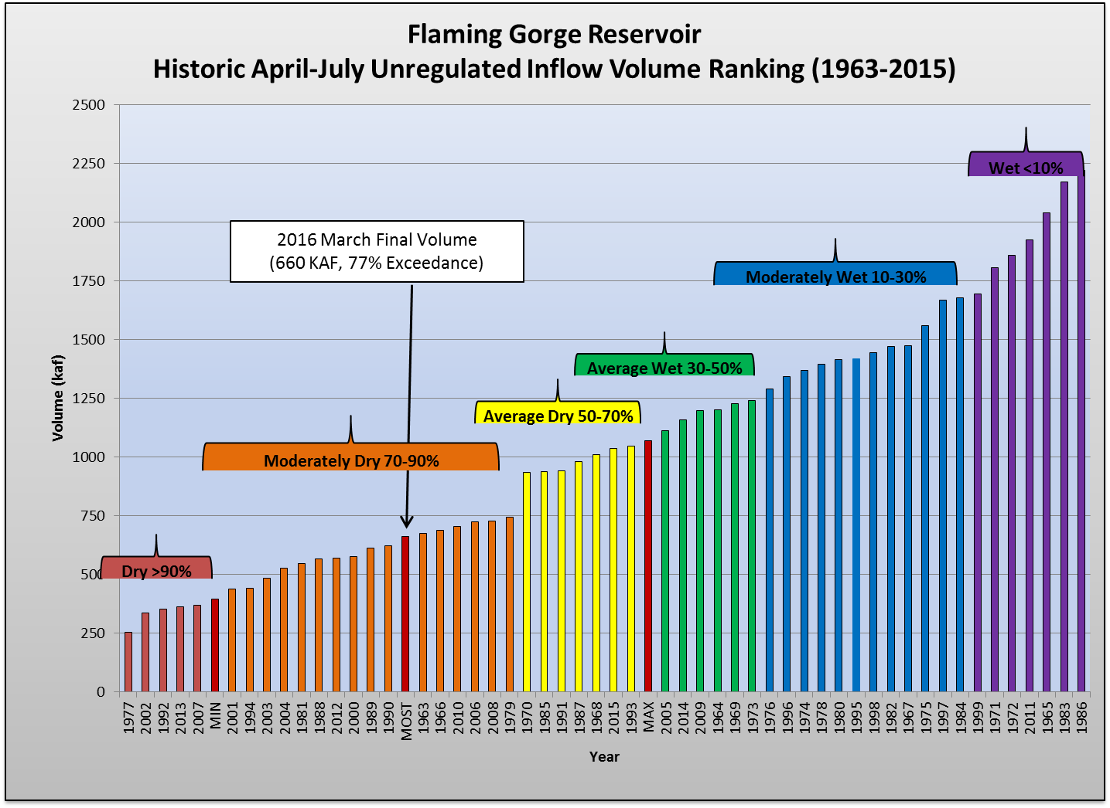
Upper Green Classifications

Slide 10
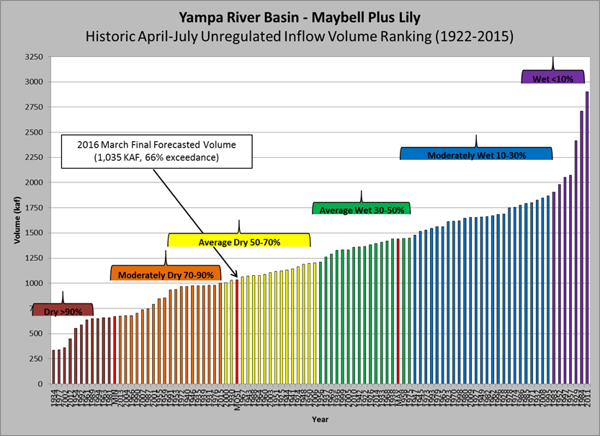
Yampa River Classifications

Slide 11
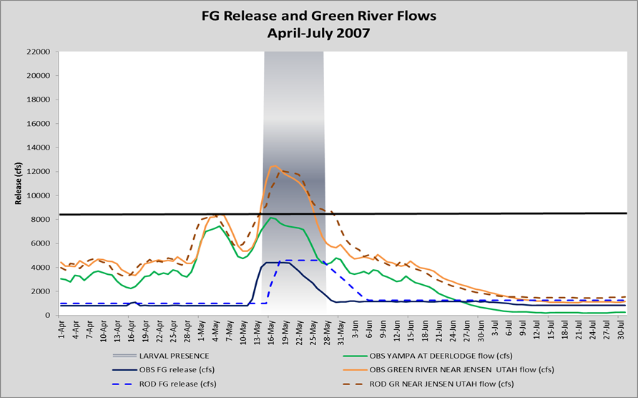
Spring 2016 Analog Hydrograph

