Slide 1
Navajo Operations 2016
No more decision tree
Navajo operated to meet storage target by the end of each water year (with all users and TBF met).
Available Water for Spring Peak Release now calculated with end of water year target 6050 ft.
SPR is maximum number of 5,000 cfs days with 3-day ramp up and 2-week ramp down. Min 21 days, max 60 days.
Operational spill used to end water year at 6063 ft.
In dry years, reservoir may come short of EWYST.
Risk of shortage is greatly reduced in modeling.

Slide 2
Navajo Reservoir Available Water for Spring Peak Release 2016

Slide 3
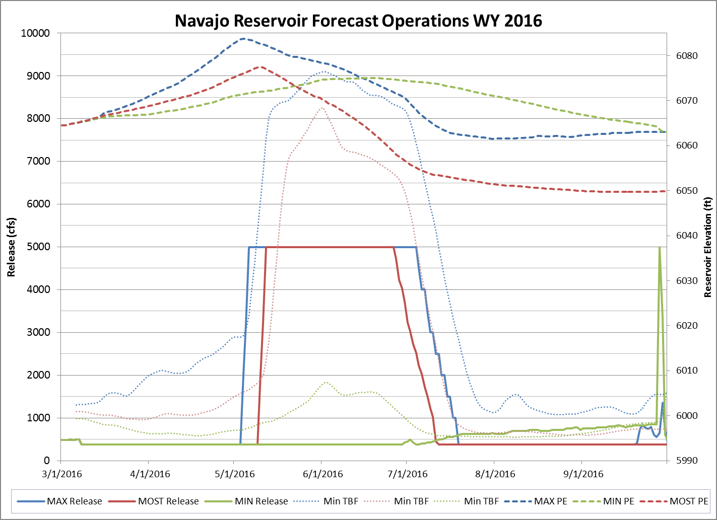
TBF 500 cfs – 1000 cfs

Slide 4
