Slide 1
The Hydrologic Ensemble Forecast Service (HEFS)

Slide 2
Meteorological Forecasts in ESP
Ensemble Post-Processor (EnsPost)
= forcing unc.
= hydro. unc.
= users
WPC/RFC
forecasts
(1-5 days)
Flow bias / uncertainty accounting
Correct flow bias
Add spread to account for hydro. model uncertainty
GEFS
forecasts
(1-15 days)
Meteorological Ensemble Forecast Processor (MEFP)
Hydrologic
models (CHPS)
Bias-corrected ensemble flow forecasts
Correct forcing bias
Merge in time
Downscale (basin)
CFSv2
forecasts
(16-270 days)
Climatology
(271+ days)
NWS and external user applications
(MEFP forcing also available to users)

Slide 3
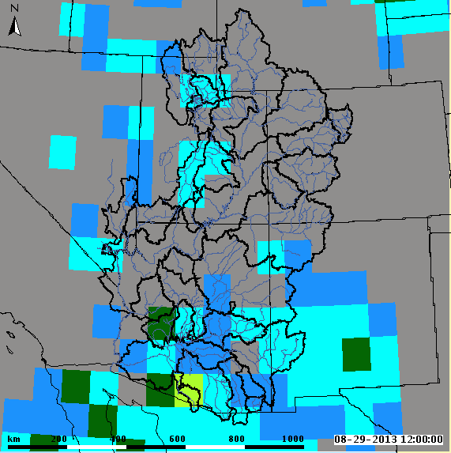
Global Ensemble Forecast System (GEFS)
short term forecast 15 days out
precipitation and temperature max/min
comes as gridded product
1 degree resolution
use the average of the GEFS 20 traces
reforecasts available for 1985-2010
http://www.emc.ncep.noaa.gov/GEFS/faq.php

Slide 4
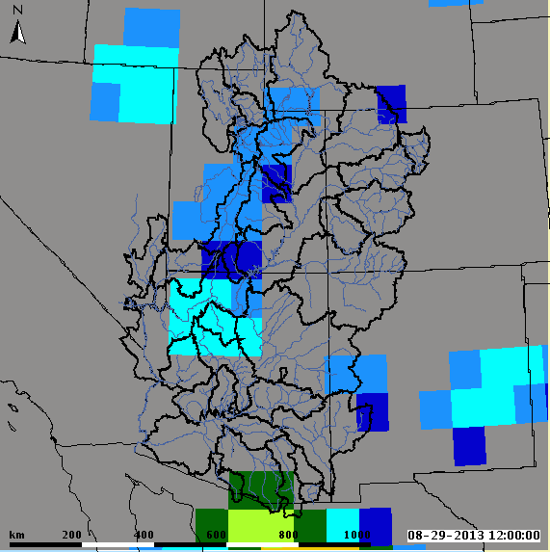
Climate Forecast System (CFSv2)
long term forecast out 9 months (270 days)
precipitation and temperature max/min
comes as gridded product
1 degree resolution
use the lagged ensemble mean
reforecasts available for 1982-2011
http://cfs.ncep.noaa.gov/cfsv2.info

Slide 5
GEFS and CFSv2 Processing
Meteorological Ensemble Forecast Processor Parameter Estimator (MEFPPE)
Historical Observations, precipitation and max/min temperature, are statically related to GEFS and CFSv2 hindcasts to develop a bivariate relationship
Parameters used in forecast process
One time process
Tries to preserve space time relationships
Joint distribution
1
Y
Model Space
Ensemble members for that particular time step
x₁
Probability
…
NQT⁻¹
Observed
x_{n}
x_{fcst}
X
0
Forecast
x₁
x_{i}
x_{n}
Ensemble forecast
http://www.nws.noaa.gov/oh/hrl/general/HEFS_doc/Aug_2014_Seminar/Seminar_D_MEFP_Theory.pdf

Slide 6
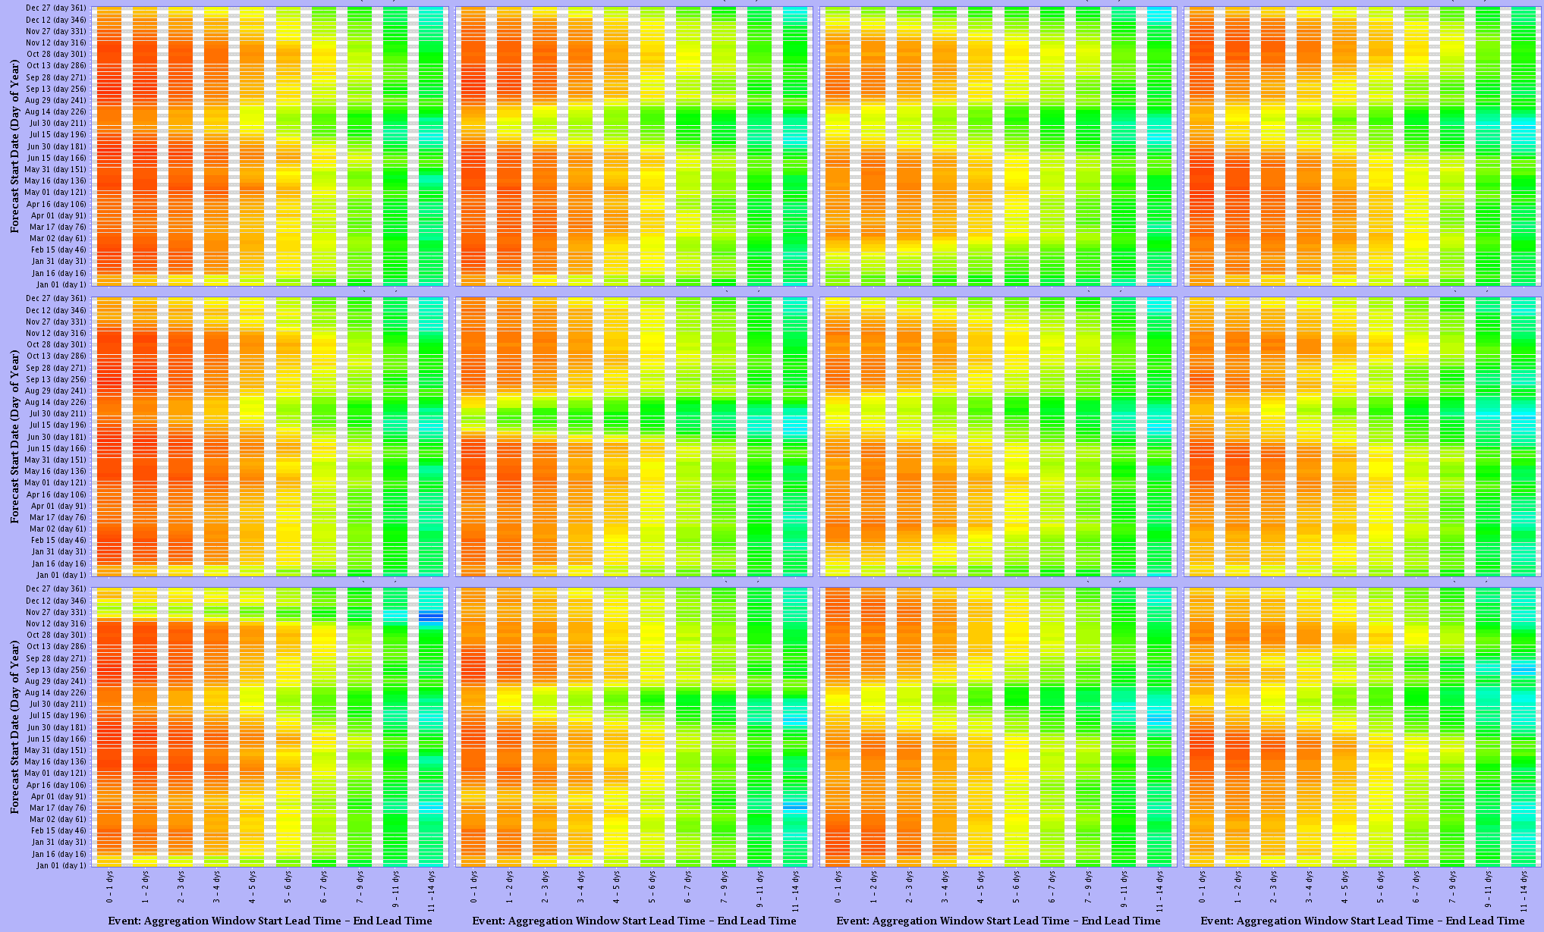
GEFS Temperature MAX Skill
Green: Warren Bridge
Elk: Milner
East: Almont
Animas: Durango
Lower
Mid
Upper

Slide 7
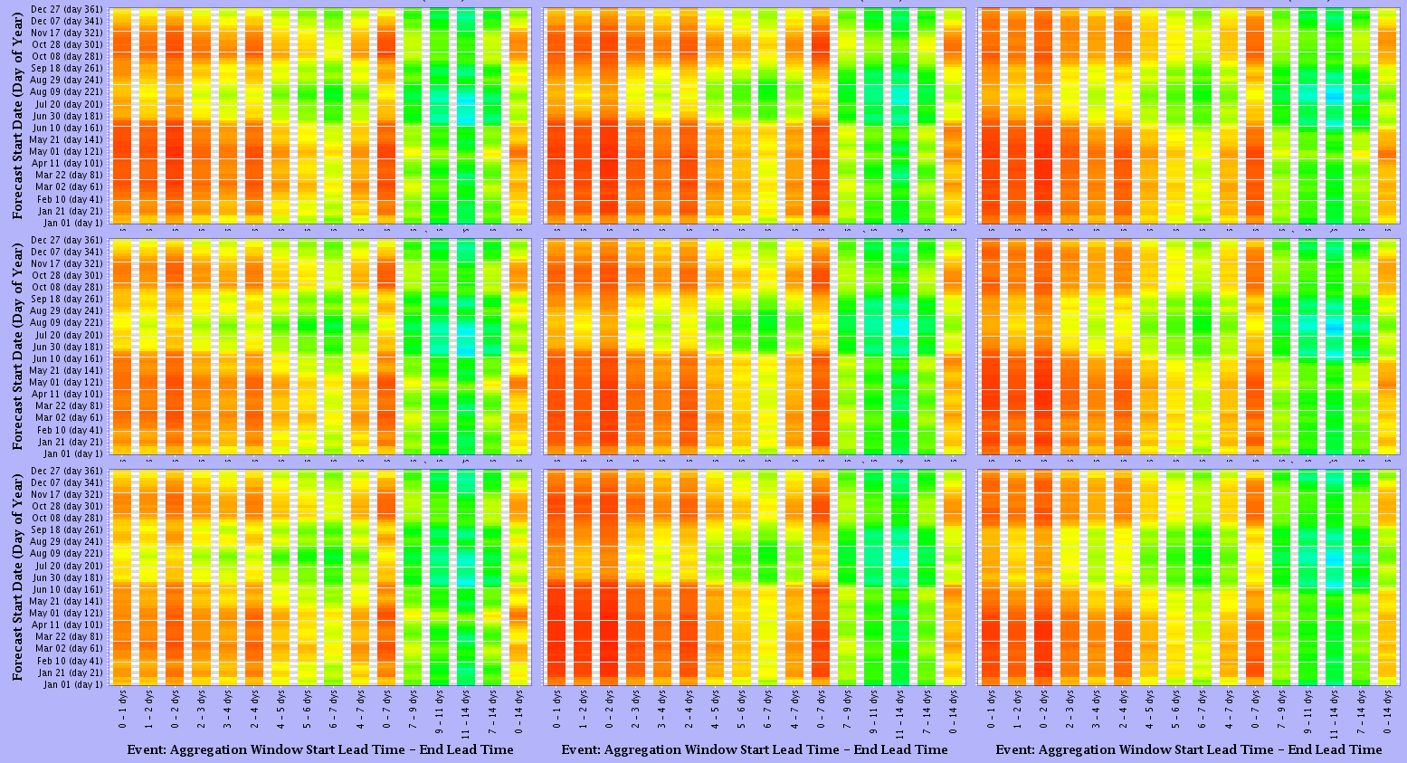
GEFS Temperature MAX Skill
Zuni: Black Rock
Tonto: Roosevelt
Gila: Gila
Lower
Mid
Upper

Slide 8
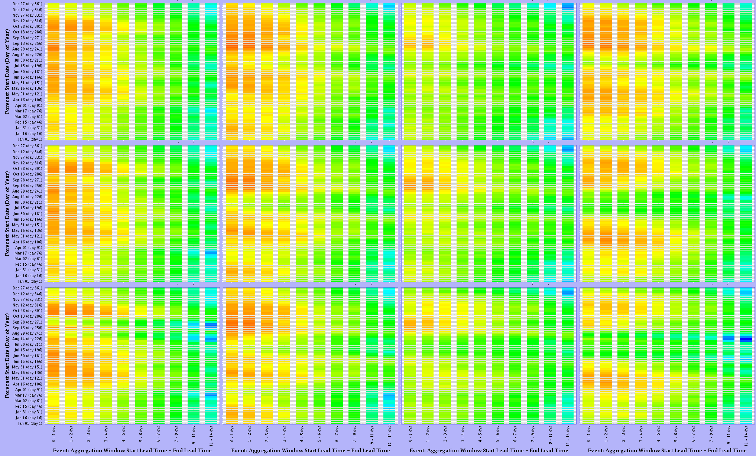
GEFS Temperature MIN Skill
Green: Warren Bridge
Elk: Milner
East: Almont
Animas: Durango
Lower
Mid
Upper

Slide 9
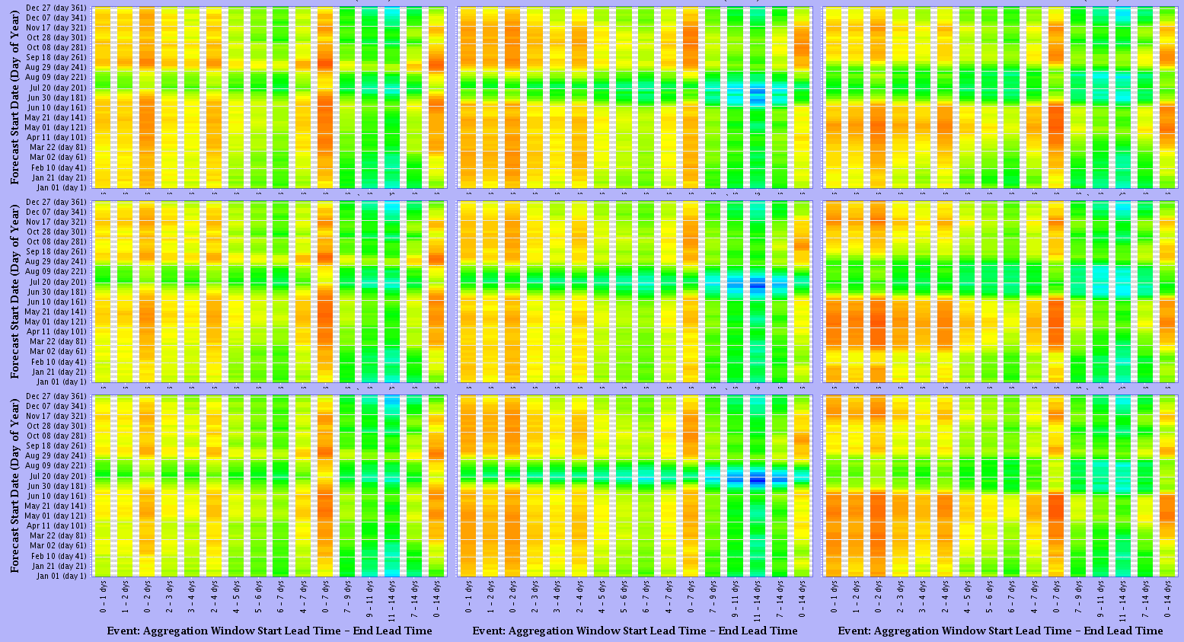
GEFS Temperature MIN Skill
Zuni: Black Rock
Tonto: Roosevelt
Gila: Gila
Lower
Mid
Upper

Slide 10
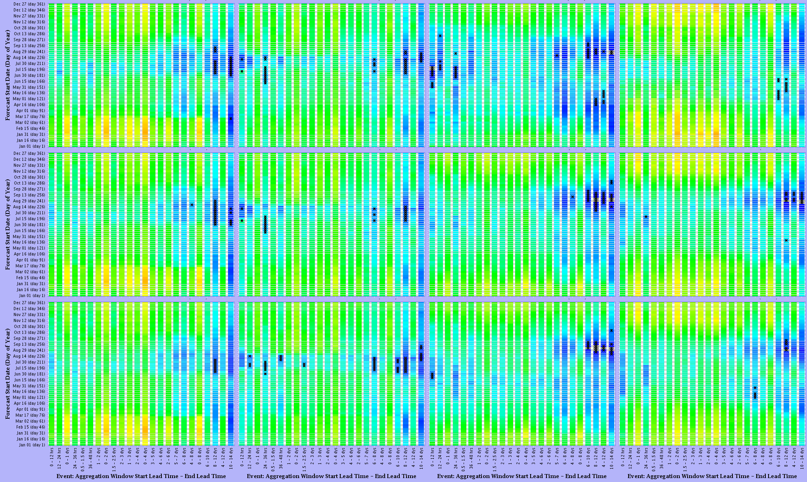
GEFS Precipitation Skill
Green: Warren Bridge
Elk: Milner
East: Almont
Animas: Durango
Lower
Mid
Upper

Slide 11
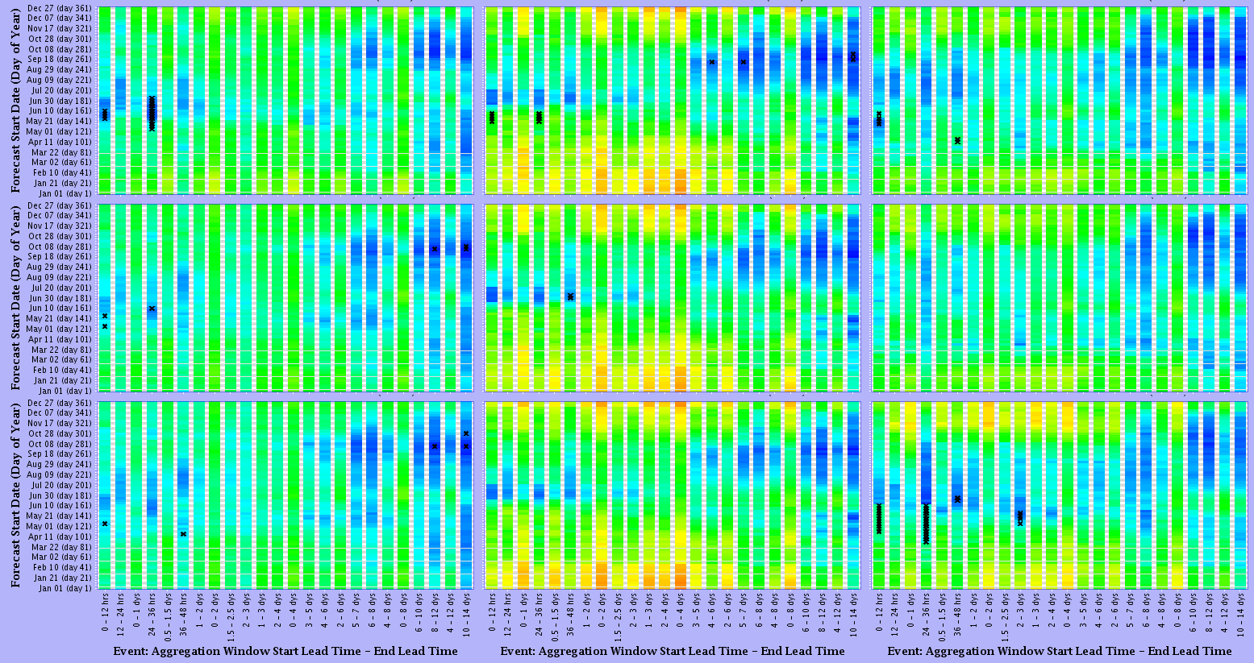
GEFS Precipitation Skill
Zuni: Black Rock
Tonto: Roosevelt
Gila: Gila
Lower
Mid
Upper

Slide 12
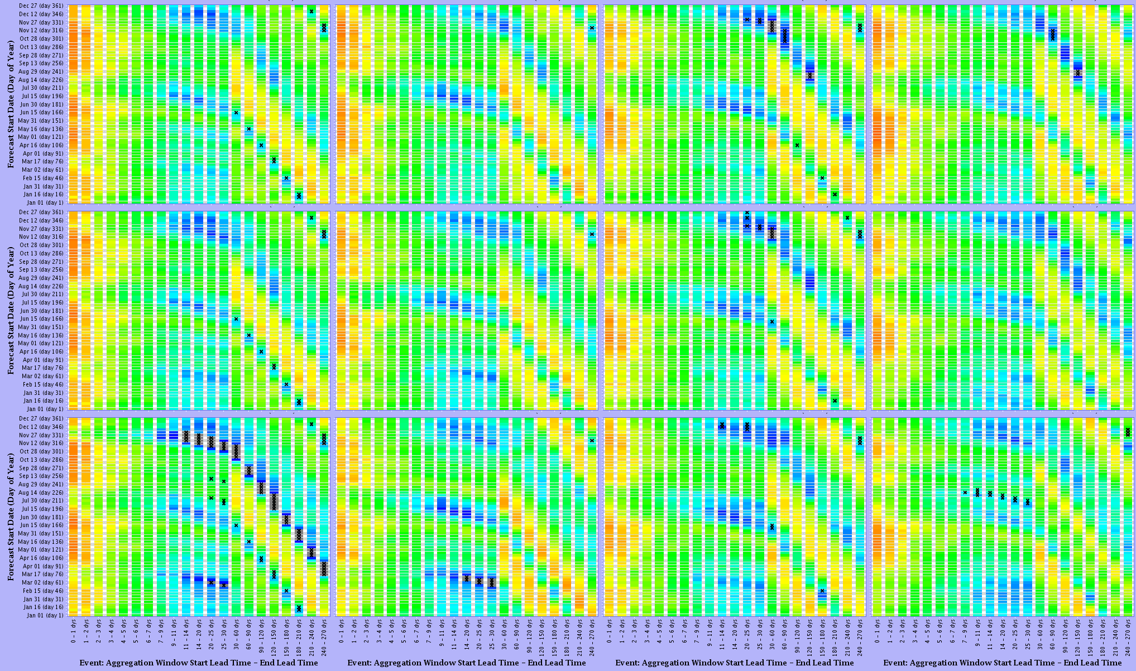
CFSv2 Temperature MAX Skill
Green: Warren Bridge
Elk: Milner
East: Almont
Animas: Durango
Lower
Mid
Upper

Slide 13
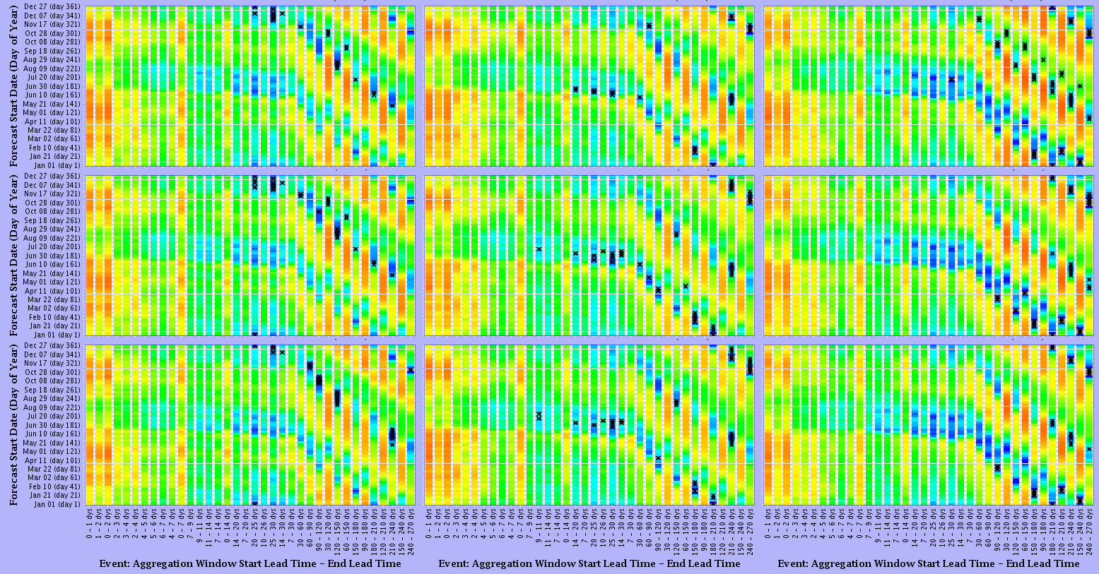
CFS Temperature MAX Skill
Zuni: Black Rock
Tonto: Roosevelt
Gila: Gila
Lower
Mid
Upper

Slide 14
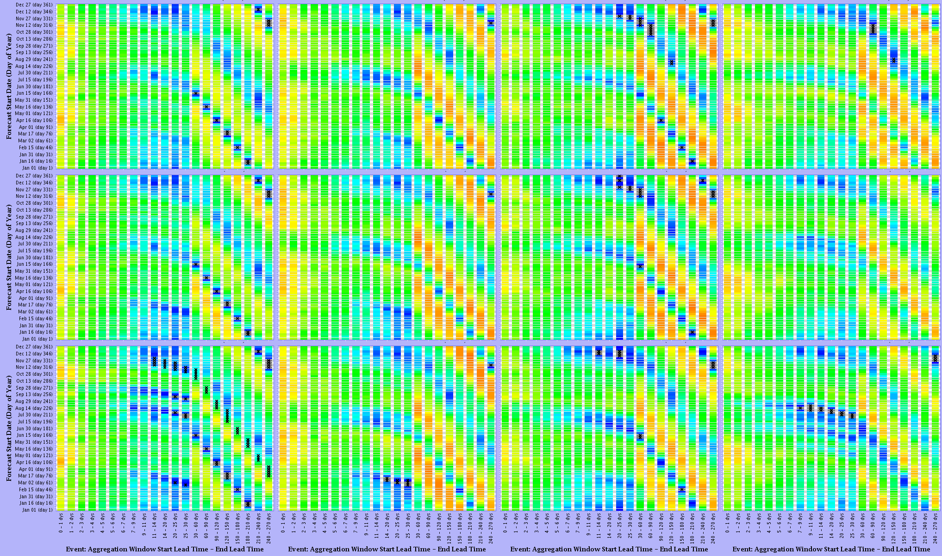
CFSv2 Temperature MIN Skill
Green: Warren Bridge
Elk: Milner
East: Almont
Animas: Durango
Lower
Mid
Upper

Slide 15
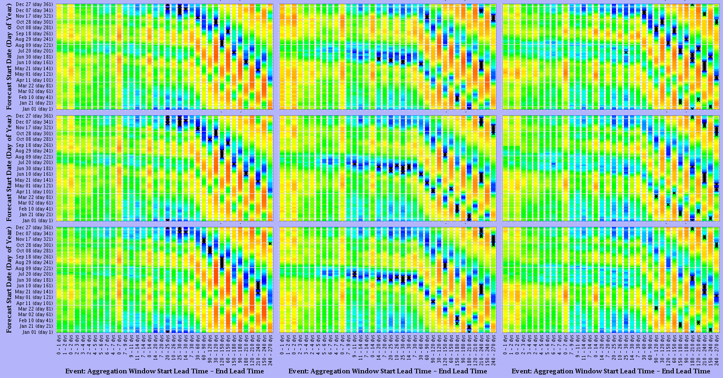
CFS Temperature MIN Skill
Zuni: Black Rock
Tonto: Roosevelt
Gila: Gila
Lower
Mid
Upper

Slide 16
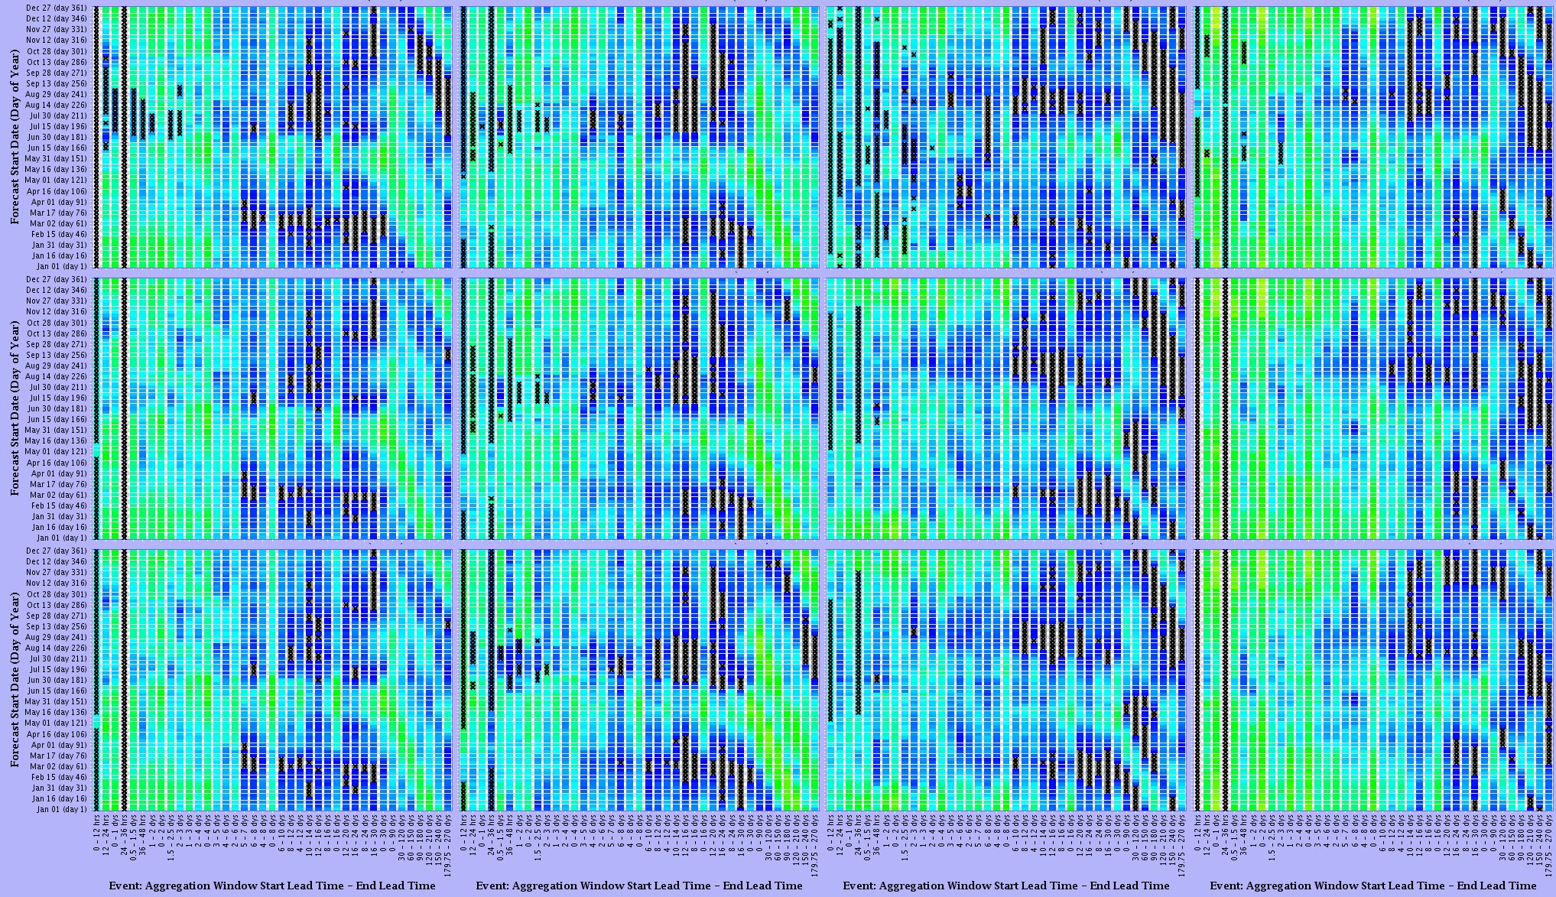
CFSv2 Precipitation Skill
Green: Warren Bridge
Elk: Milner
East: Almont
Animas: Durango
Lower
Mid
Upper

Slide 17
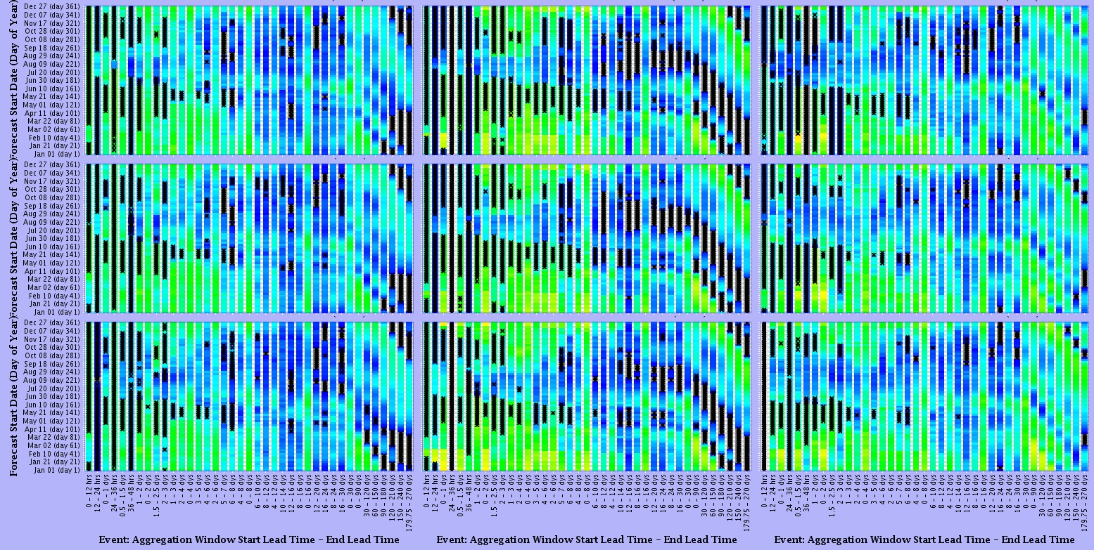
CFS Precipitation Skill
Zuni: Black Rock
Tonto: Roosevelt
Gila: Gila
Lower
Mid
Upper

Slide 18
GEFS and CFSv2 in Stream Forecast
Forcings created by MEFP are used in ESP
Output is a standard mean daily flow
This is the Hydrologic Ensemble Forecast Service (HEFS)

Slide 19
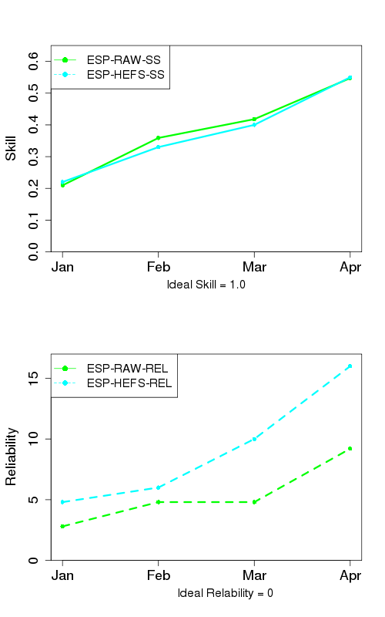
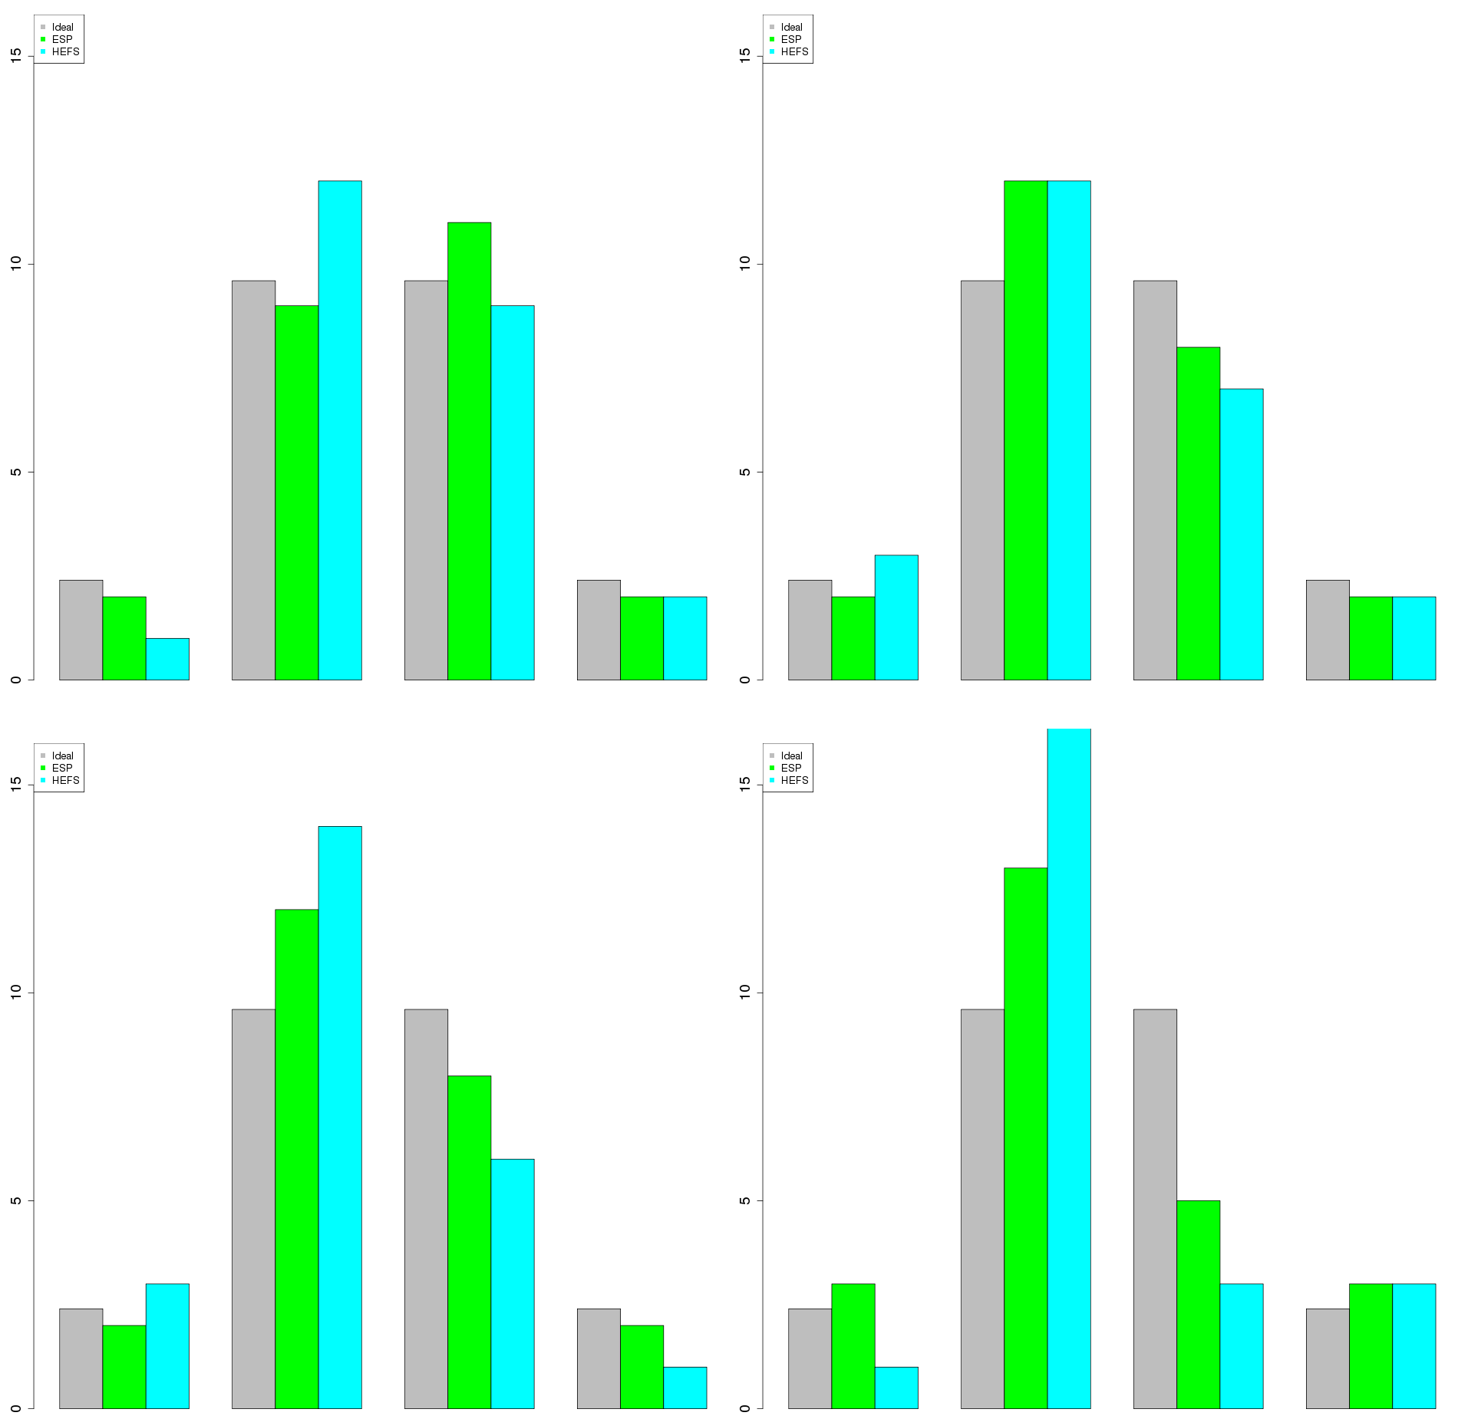
April - July Volume HEFS Skill
Green Warren Bridge
January
February
number of observations
March
April
number of observations
<90%
90-50%
50-10%
>10%
<90%
90-50%
50-10%
>10%

Slide 20
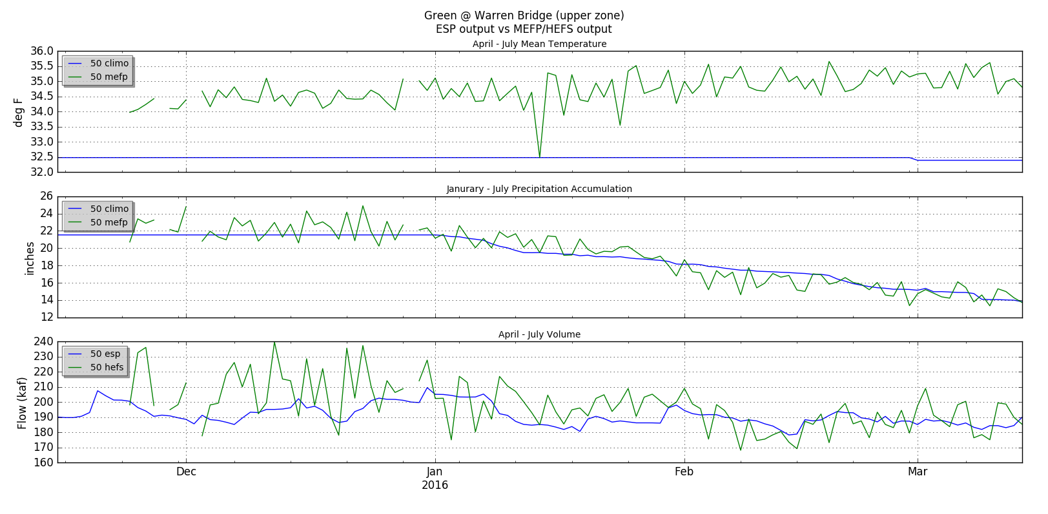
ESP Evolution Climatology vs CFSv2

Slide 21
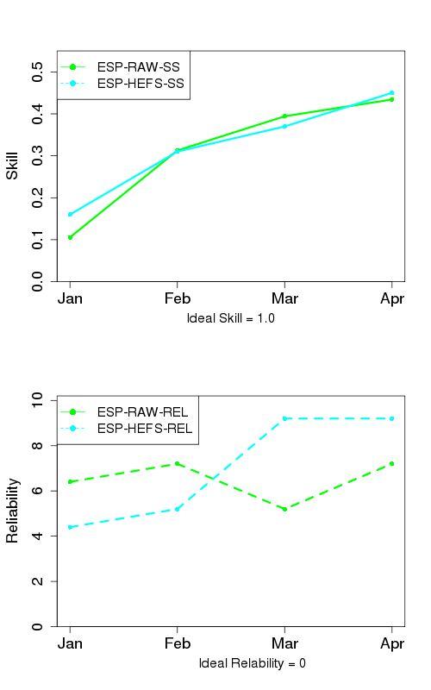
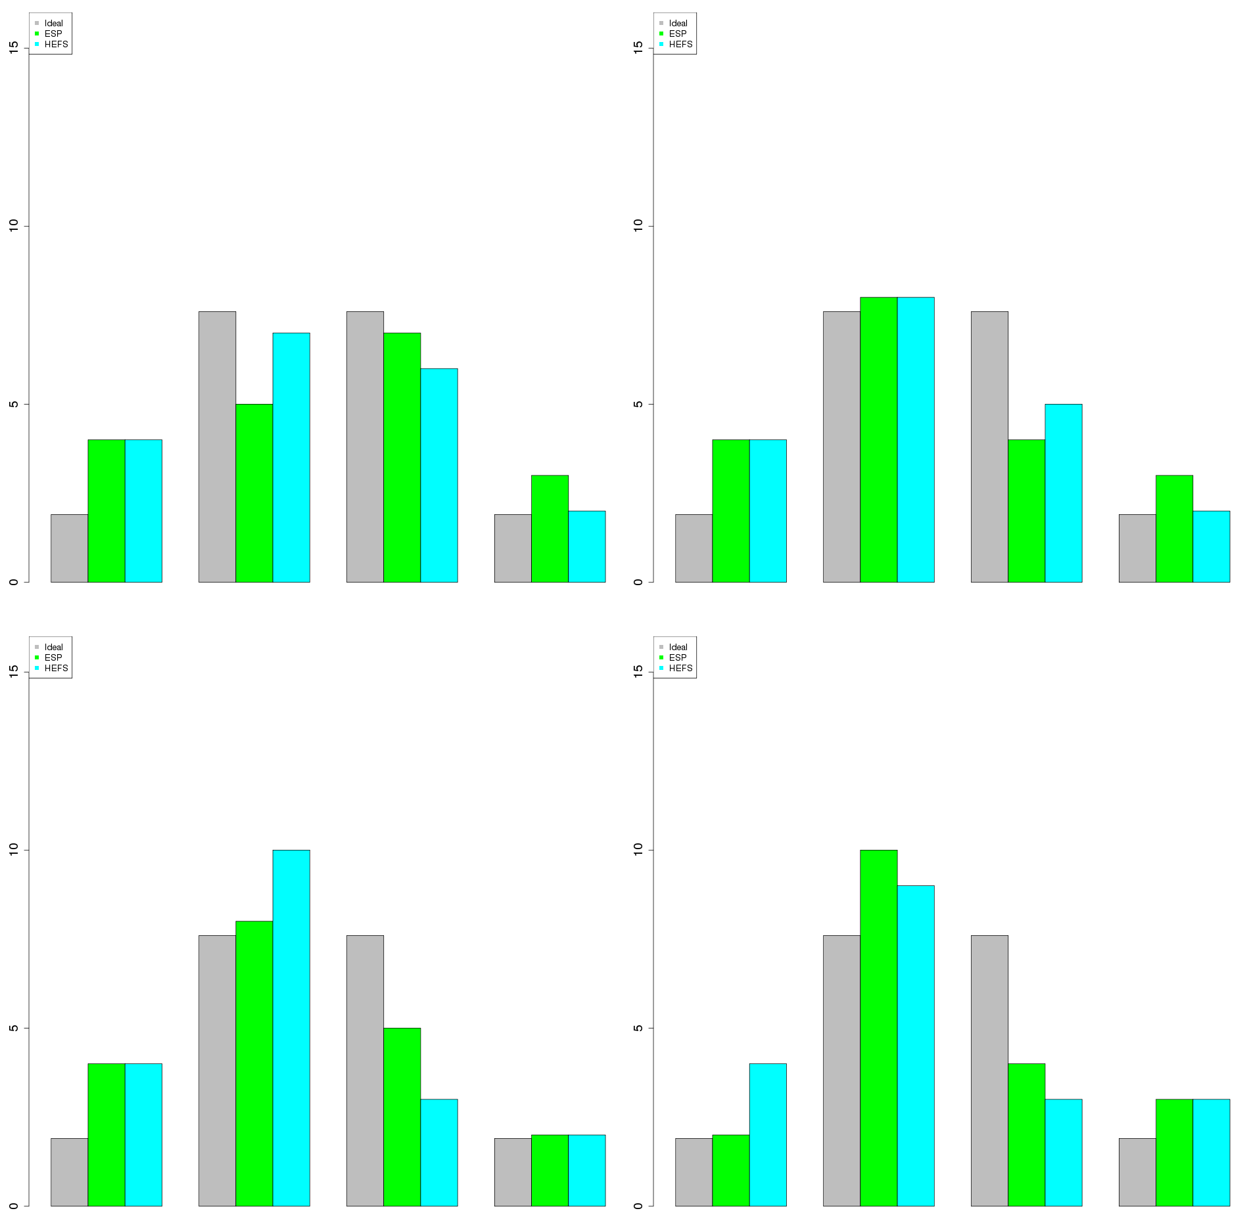
April - July Volume HEFS Skill
Elk - Milner
January
February
number of observations
March
April
number of observations
<90%
90-50%
50-10%
>10%
<90%
90-50%
50-10%
>10%

Slide 22
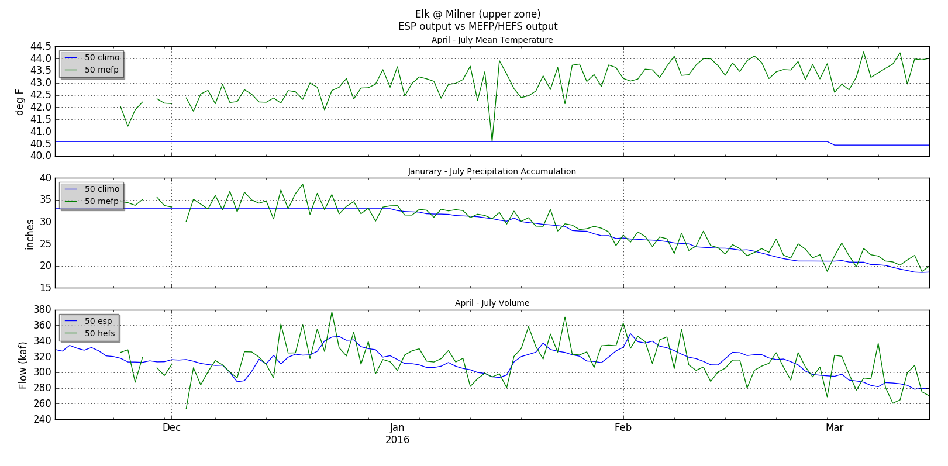
ESP Evolution Climatology vs CFSv2

Slide 23
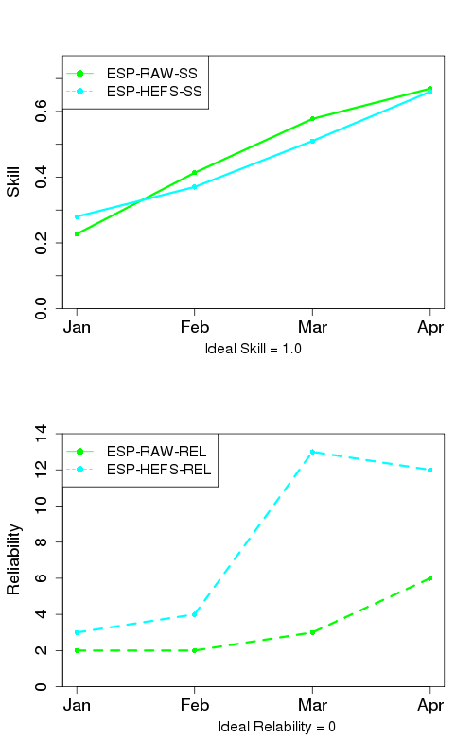
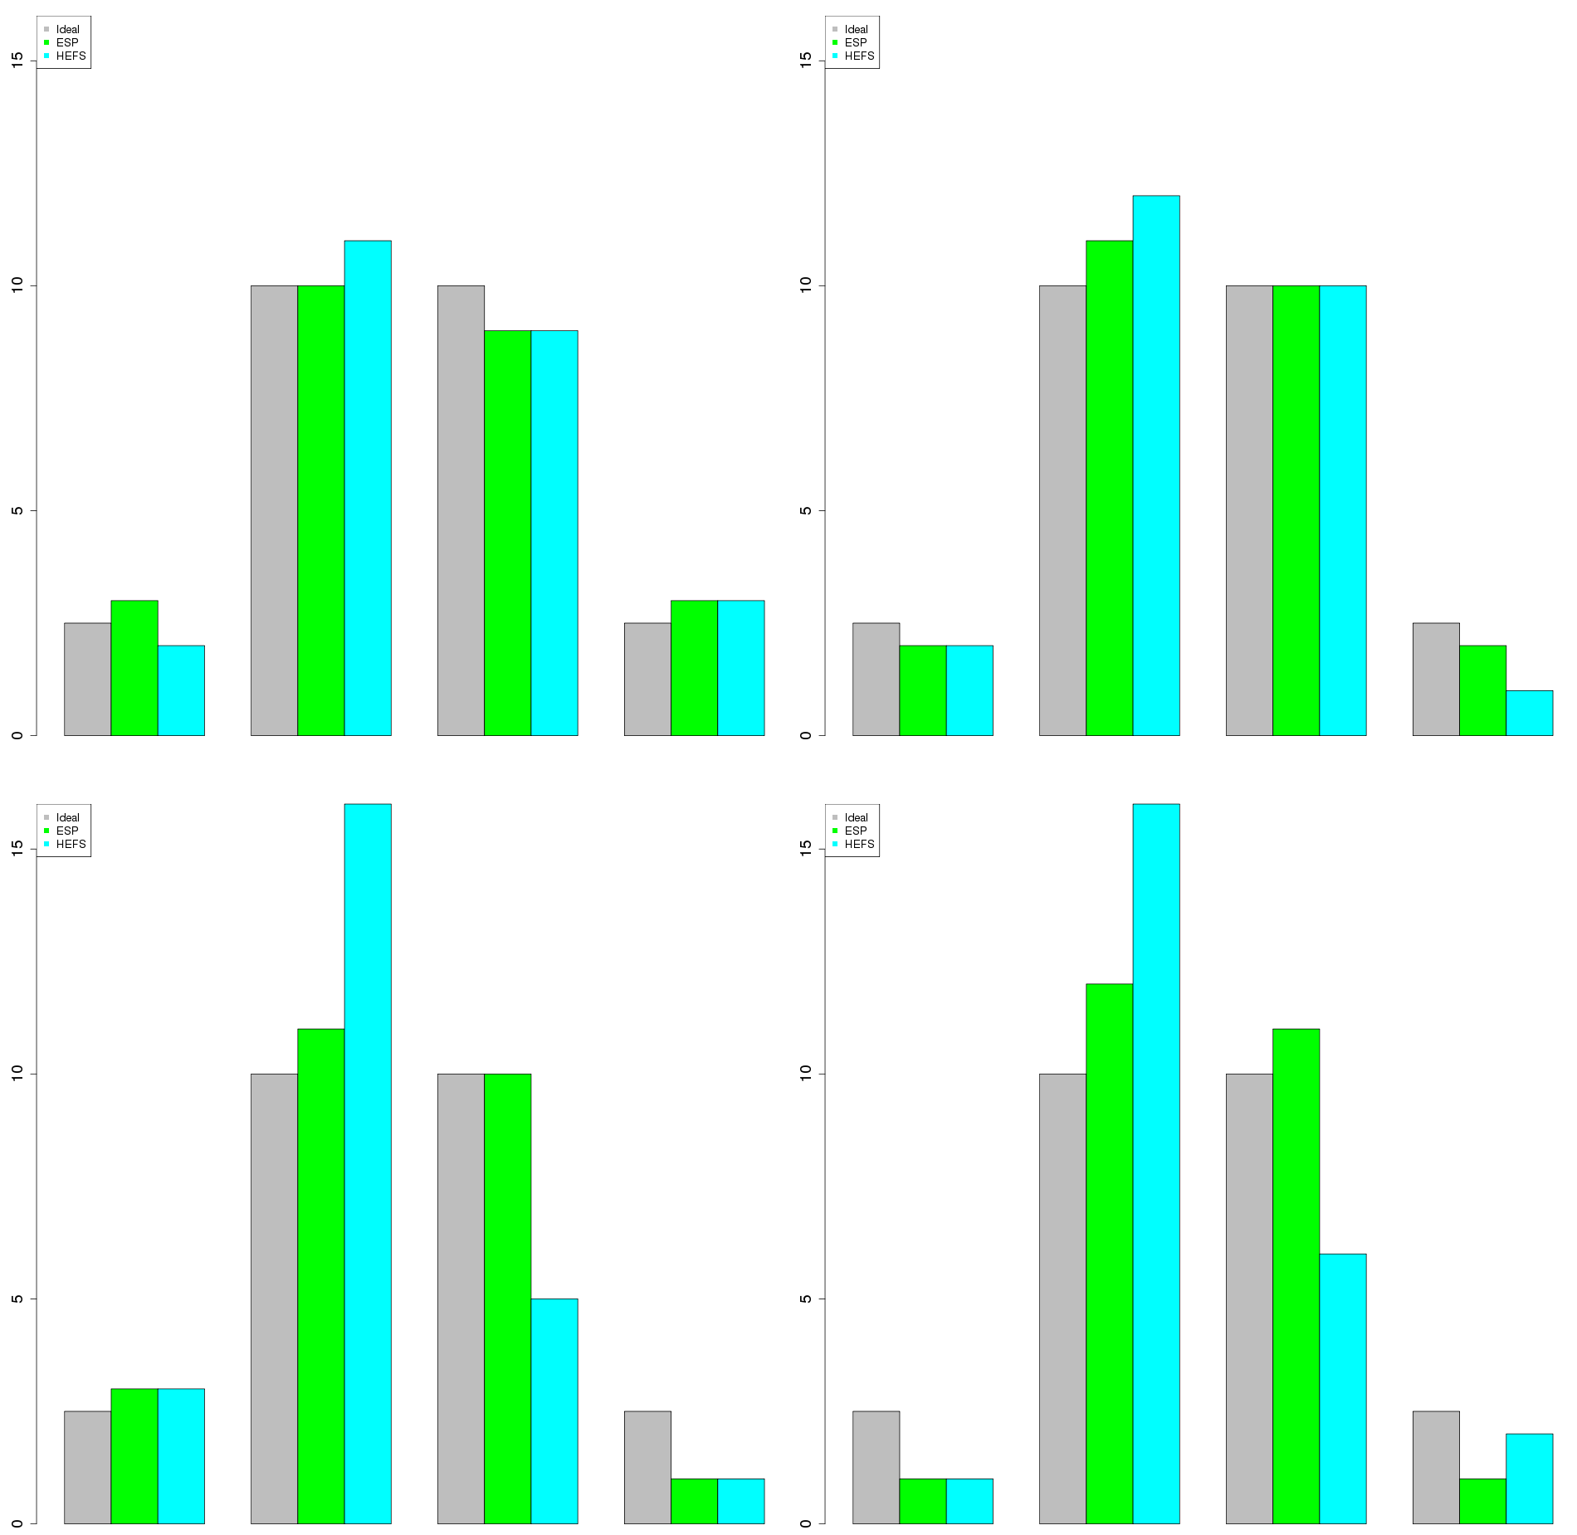
April - July Volume HEFS Skill
East - Almont
January
February
number of observations
March
April
number of observations
<90%
90-50%
50-10%
>10%
<90%
90-50%
50-10%
>10%

Slide 24
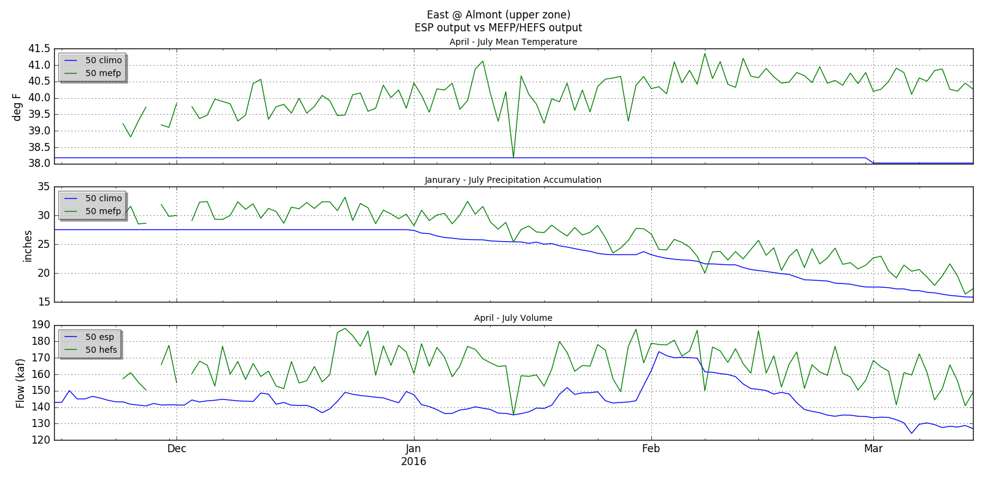
ESP Evolution Climatology vs CFSv2

Slide 25
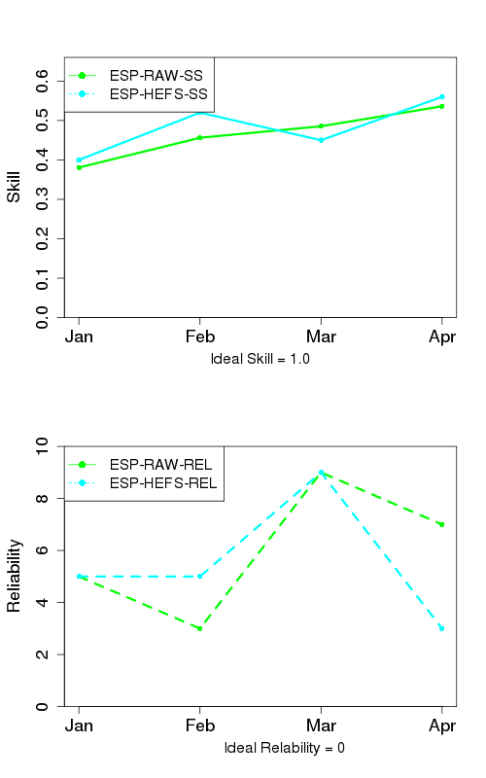
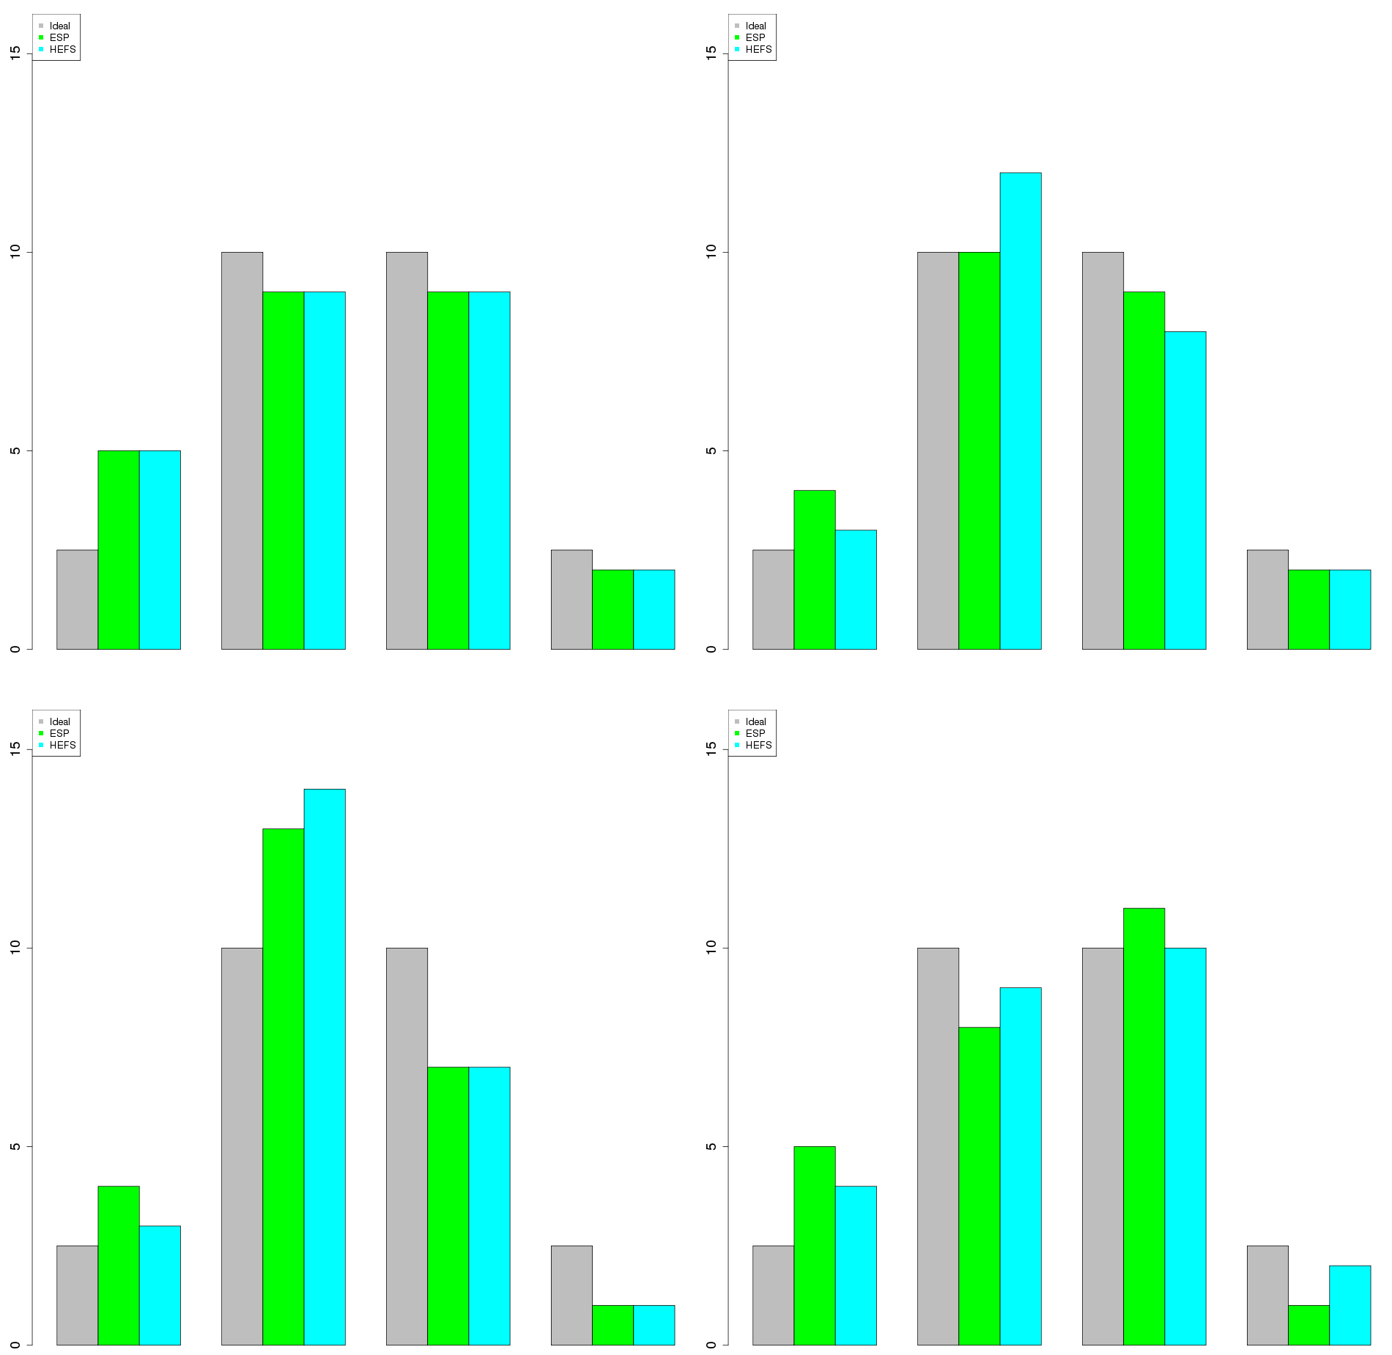
April - July Volume HEFS Skill
Animas - Durango
January
February
number of observations
March
April
number of observations
<90%
90-50%
50-10%
>10%
<90%
90-50%
50-10%
>10%

Slide 26
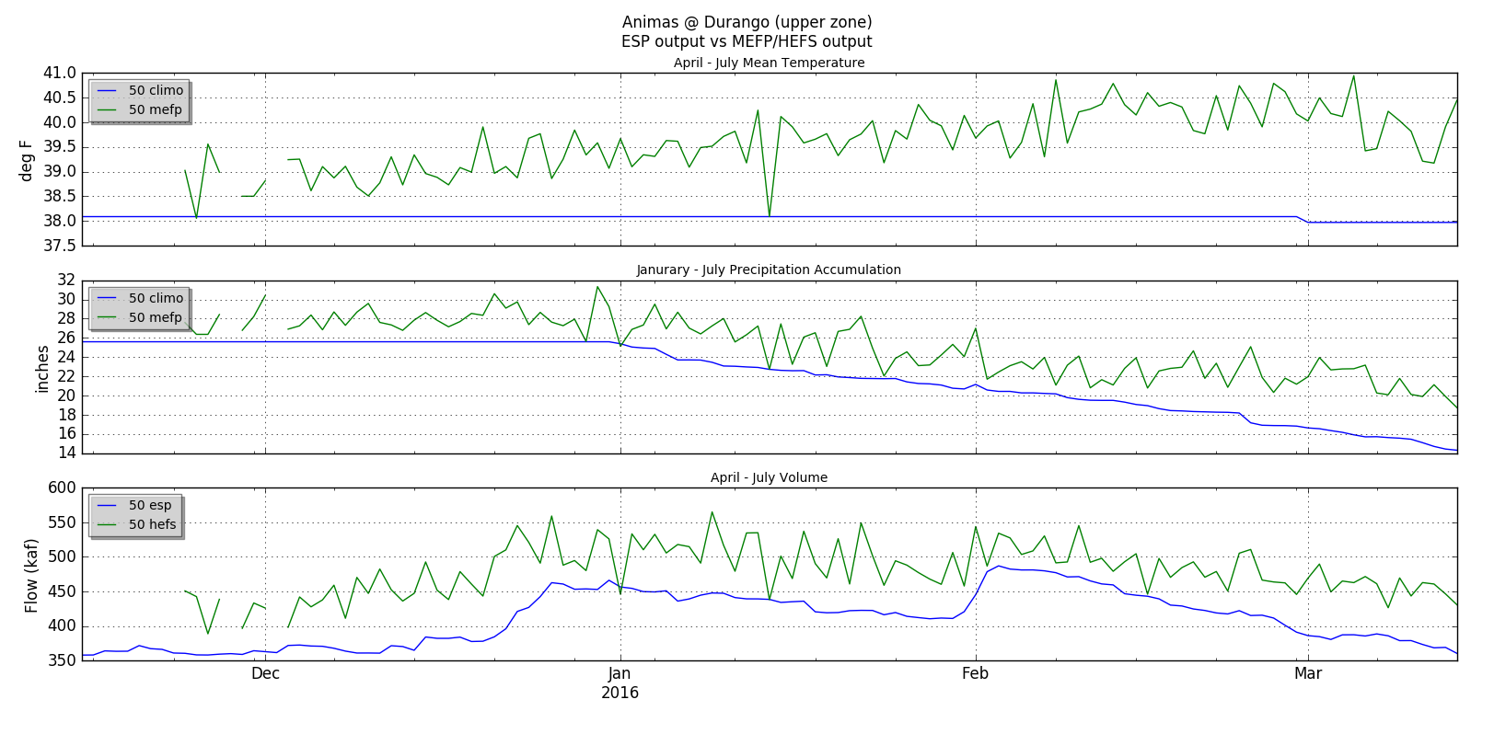
ESP Evolution Climatology vs CFSv2

Slide 27
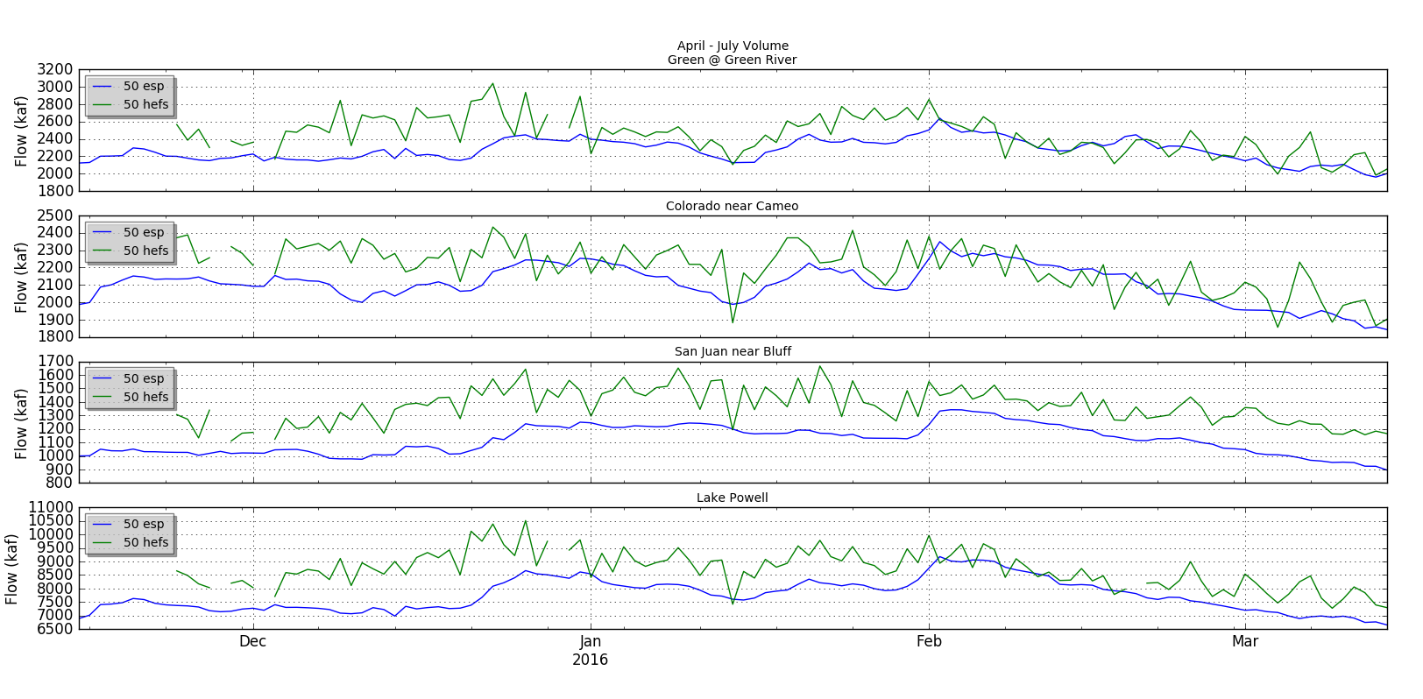
ESP Evolution Climatology vs CFSv2

Slide 28
Initial Conclusions / More Questions
Little, if any, skill added with GEFS/CFS forecast
not unexpected given not much skill in CFSv2
need to develop better CFSv2 forecast smoothing
Need to do more analysis on a monthly scale
Similar results in Lower Basin when adding GEFS/CFS
still need to run hindcasts
How does CFS forecast fare when looking at ENSO signal
limited sample size so it will be difficult to draw any conclusions from
In general more skillful long range forecasts are needed to fully utilize HEFS framework.

Slide 29
Questions

Slide 30
Post Adjusting Ensemble Streamflow Forecasts
Evaluating two methods
Ensemble Post-processor (EnsPost)
daily time step
can have different parameters for different times of year
John Schaake method
monthly time step
each month has a separate adjustment factor
Objective
adjust ensemble stream flows to remove bias from calibration in a repeatable way

Slide 31
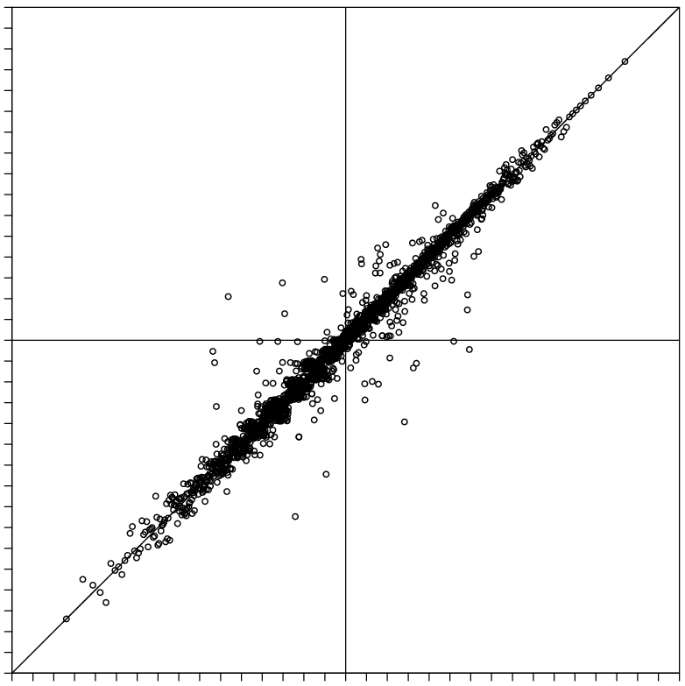
EnsPost
EnsPost (“flow processor”)
Does two things to flow forecast
Adds spread to account for hydrologic model errors
Corrects systematic biases
Uses linear regression between observed flow and historical simulated flow (observed forcing)
Scatter around line of best fit represents the hydrologic error (i.e. no forcing uncertainty)
Prior observation (“persistence”) also included in regression (not shown here)
Observed flow (normalized units), Z_{obs}(t+1)
Simulated flow (normalized units), Z_{mod}(t+1)

Slide 32
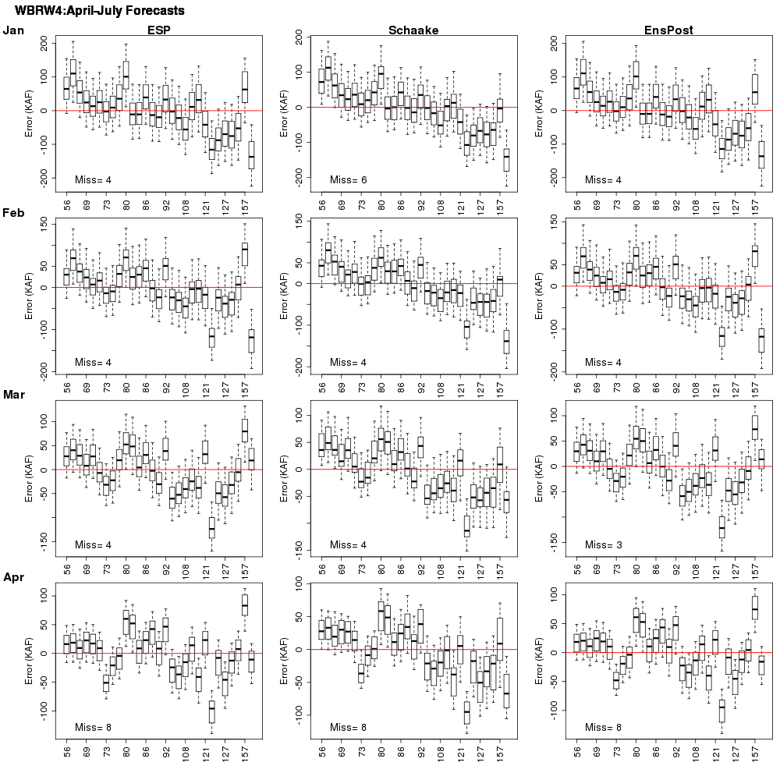
April - July Volume Post Adjustment Skill

Slide 33
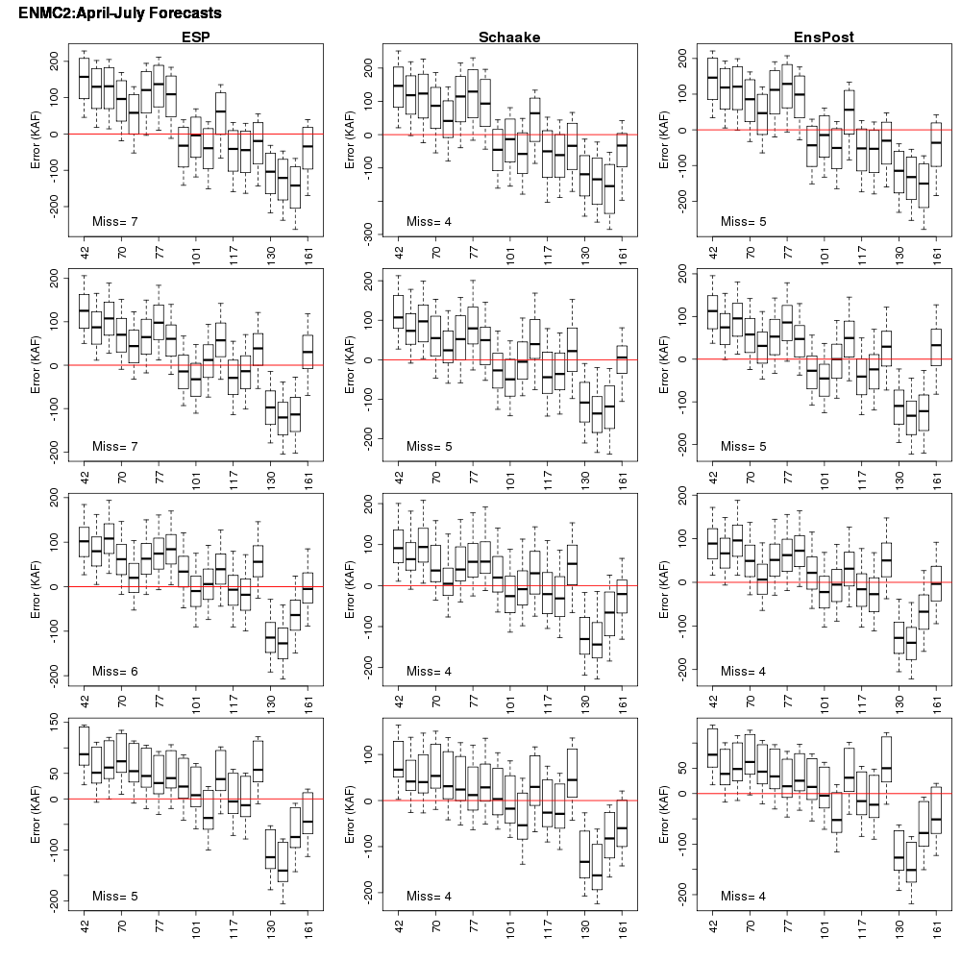
April - July Volume Post Adjustment Skill

Slide 34
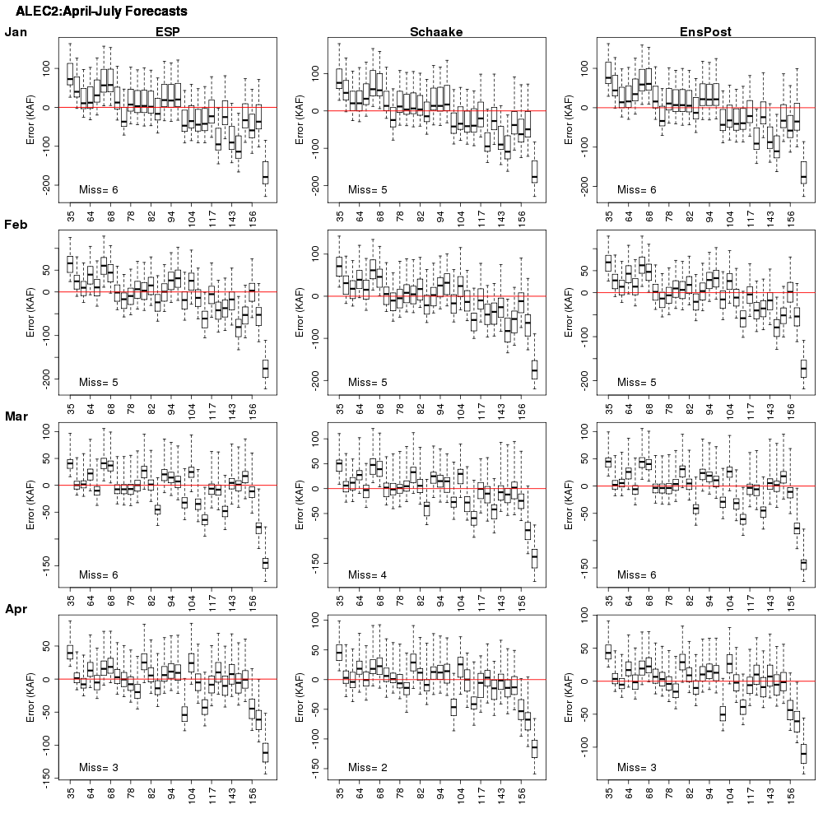
April - July Volume Post Adjustment Skill

Slide 35
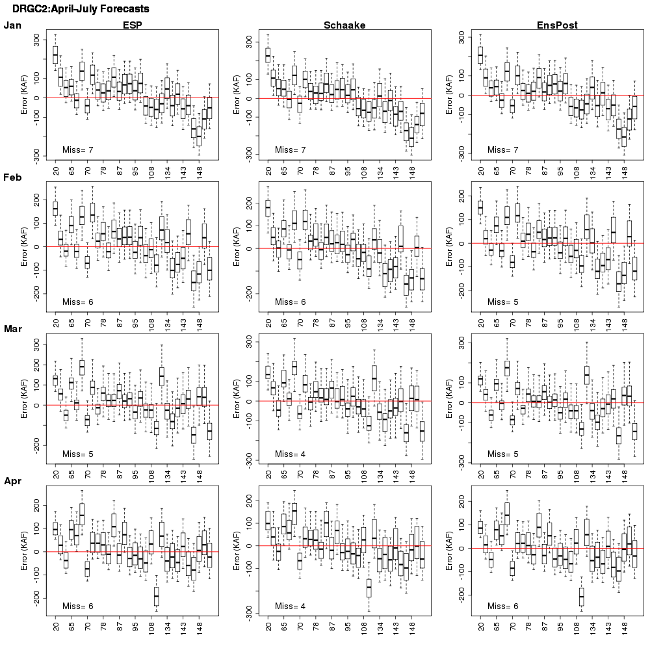
April - July Volume Post Adjustment Skill

