Slide 1
Water Year 2016
Current Conditions and Forecasts
CRFS
March 15, 2016

Slide 2
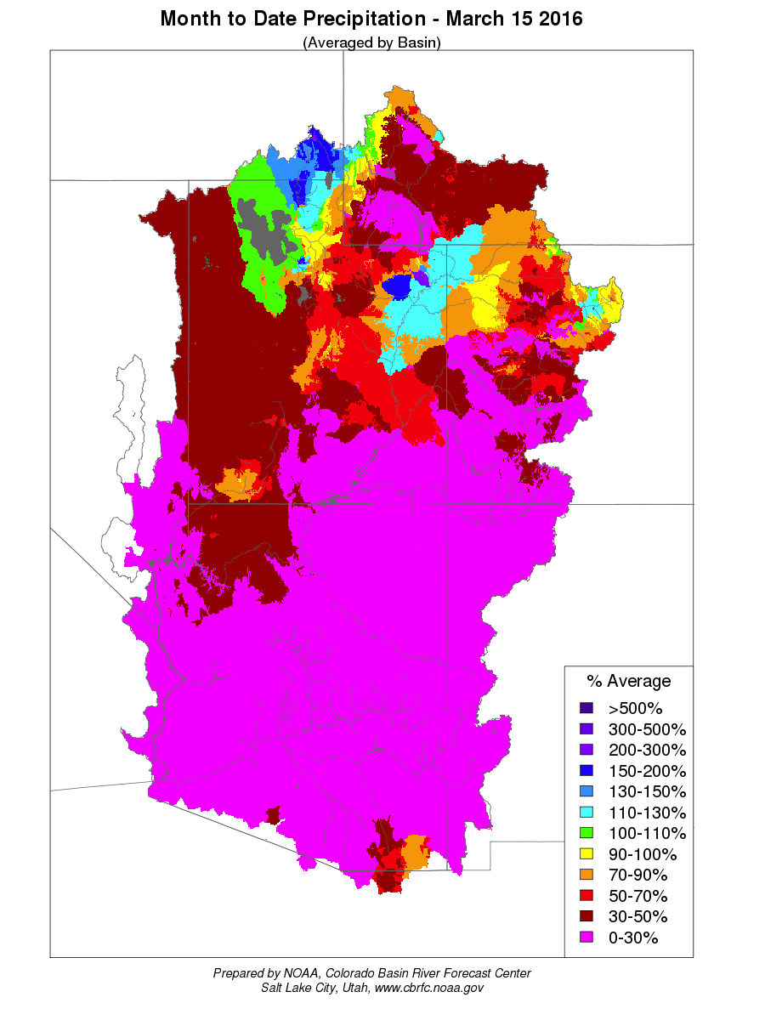
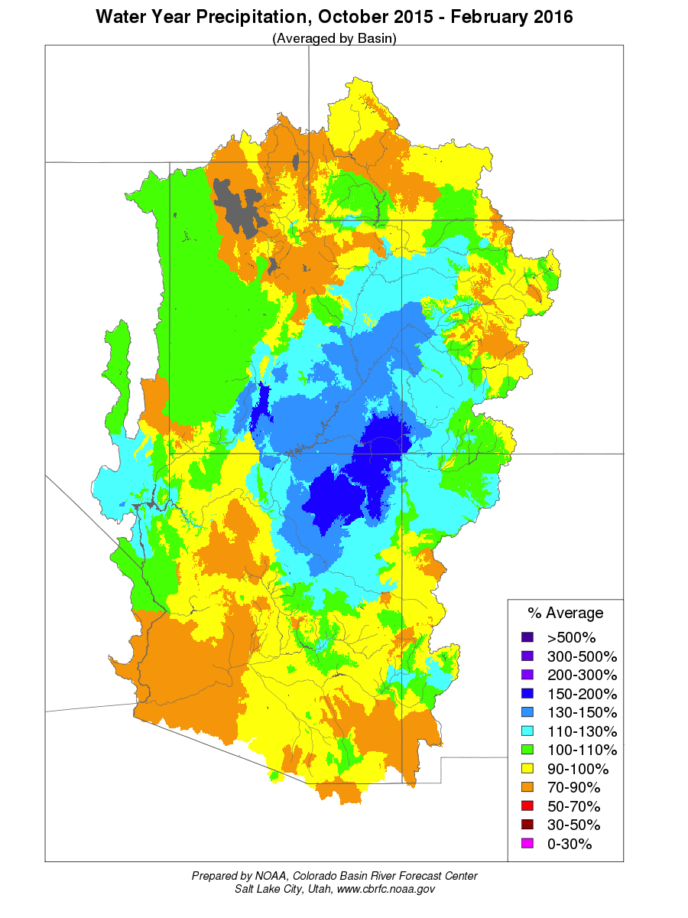
Water Year 2016 Precipitation

Slide 3
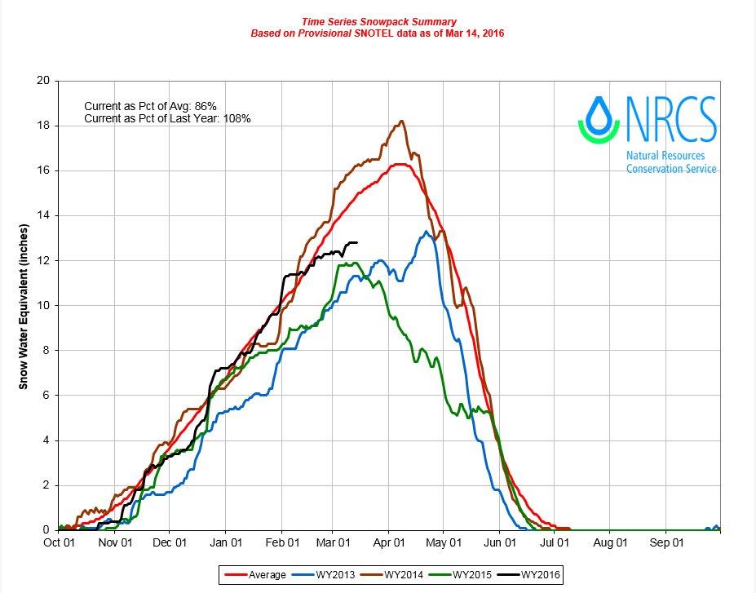
Snow Water Equivalent

Slide 4
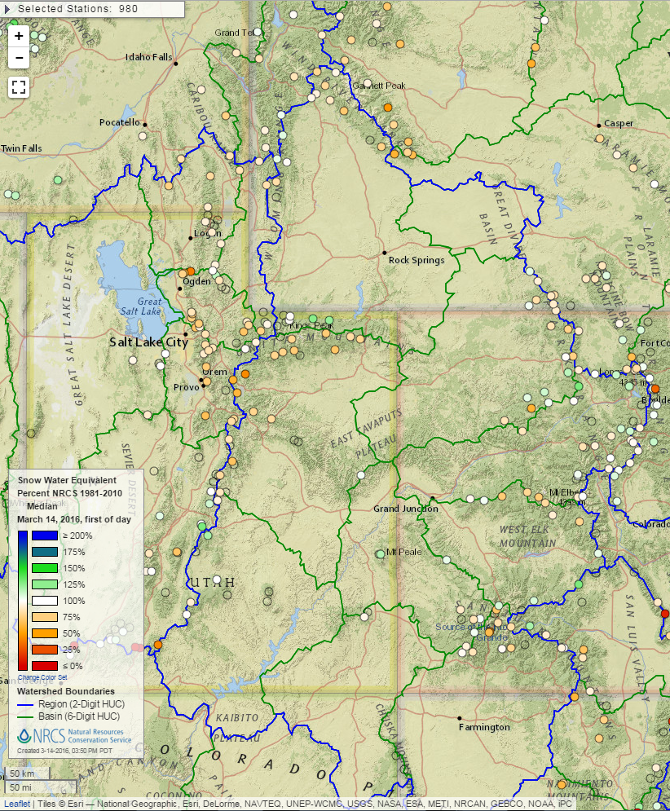
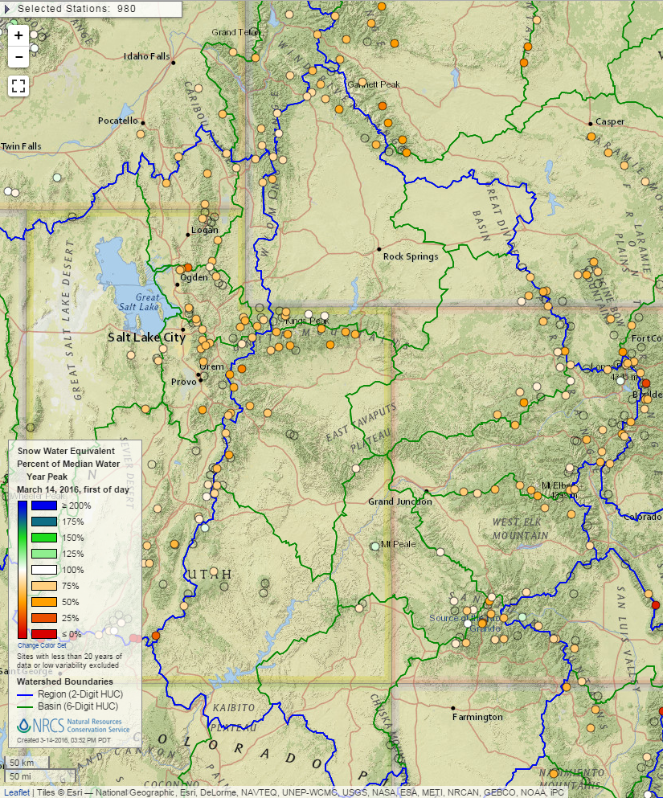
Snow Water Equivalent
Percent of Median
Snow Water Equivalent
Percent of Median Water Year Peak

Slide 5
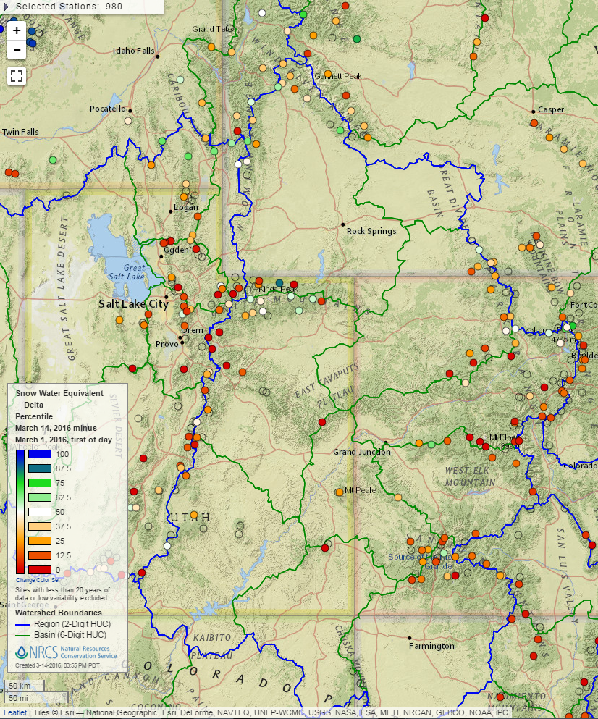
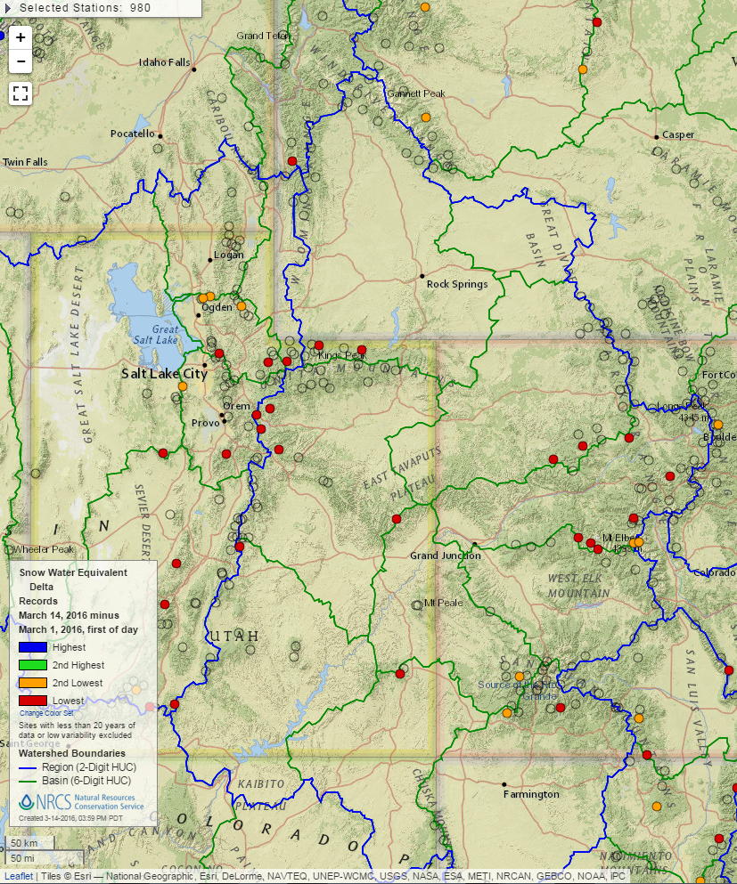
Month-to-Date Snow Water Equivalent Delta, Percentile
Month-to-Date Snow Water Equivalent Delta , Records

Slide 6
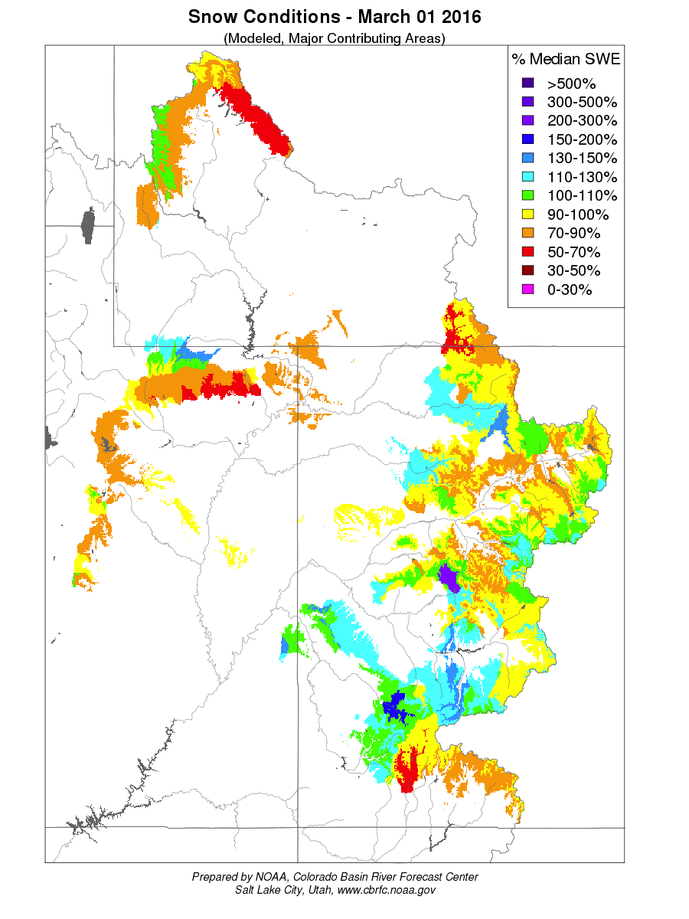
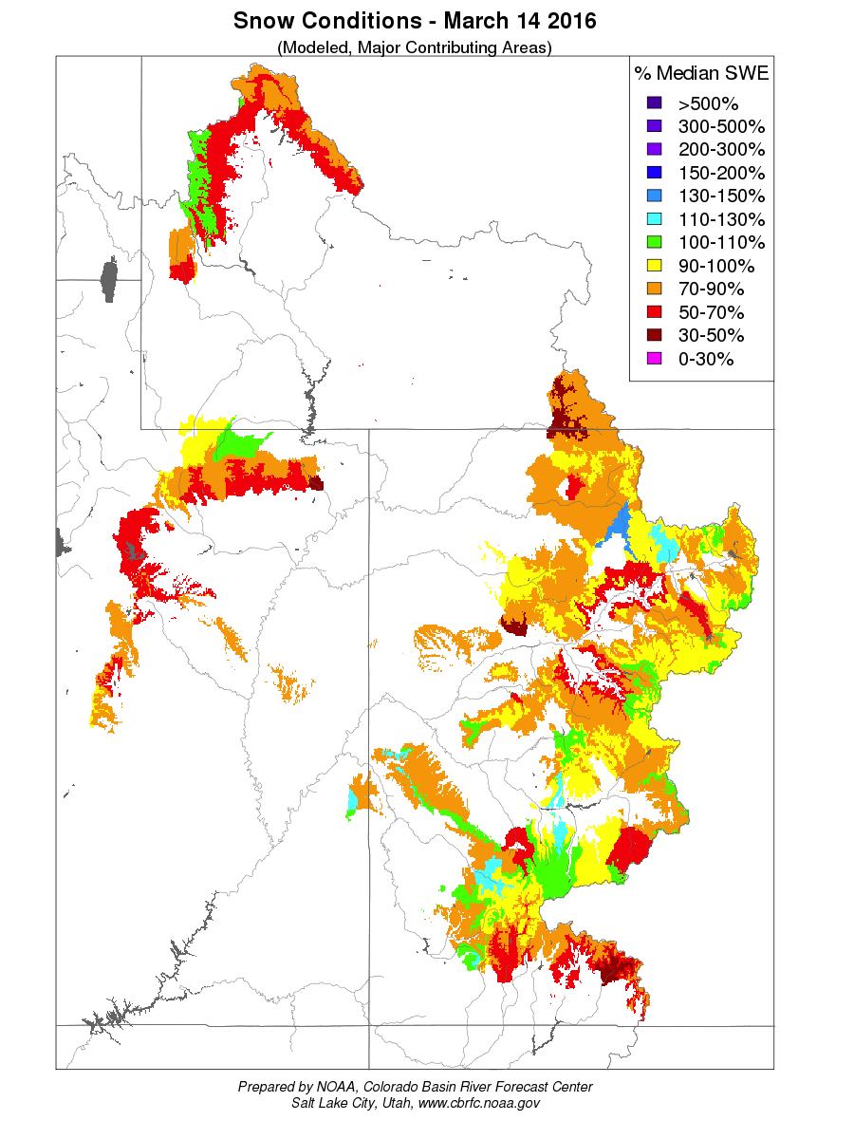
Snow Water Equivalent (model)

Slide 7
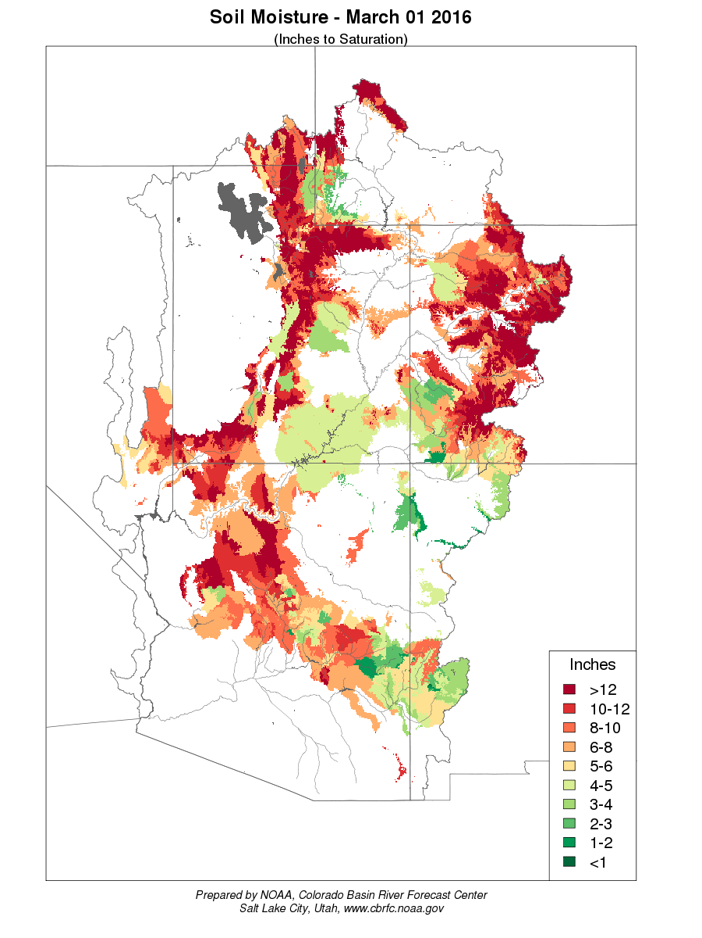
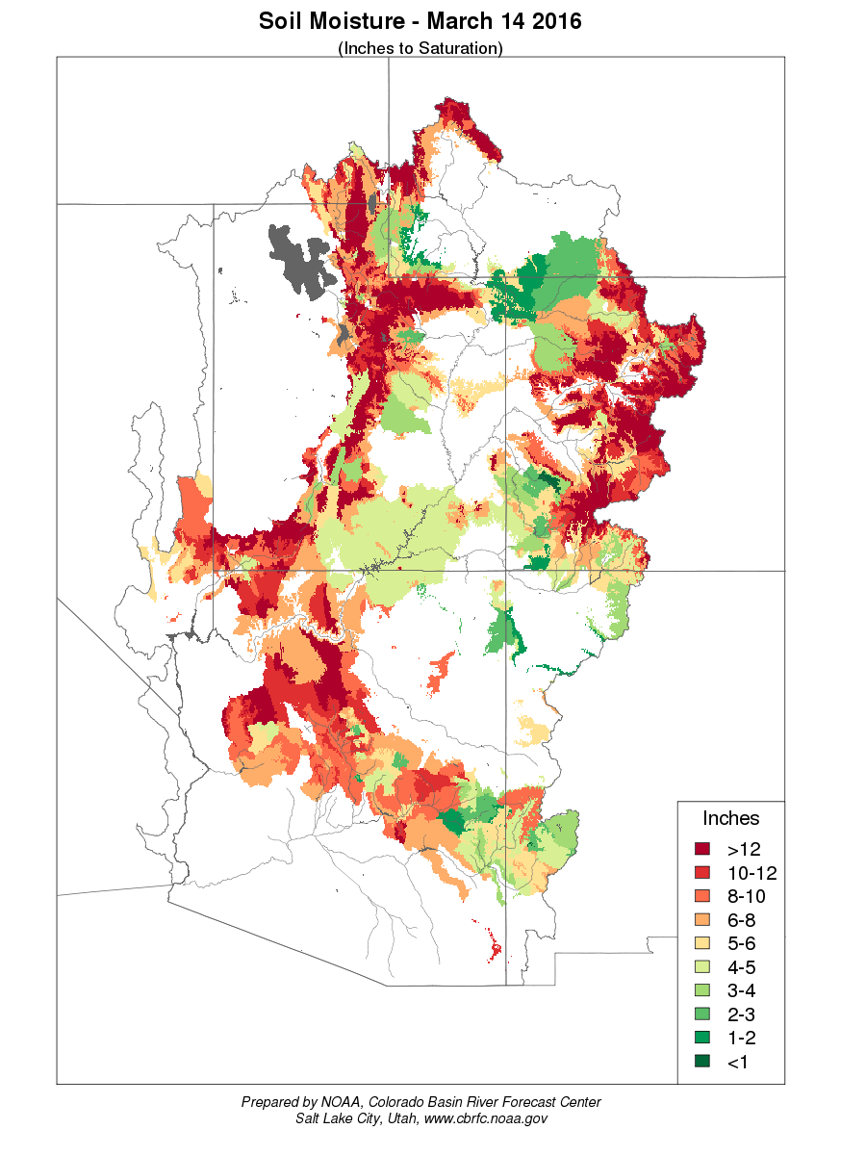
Soil Moisture – Inches to Saturation

Slide 8
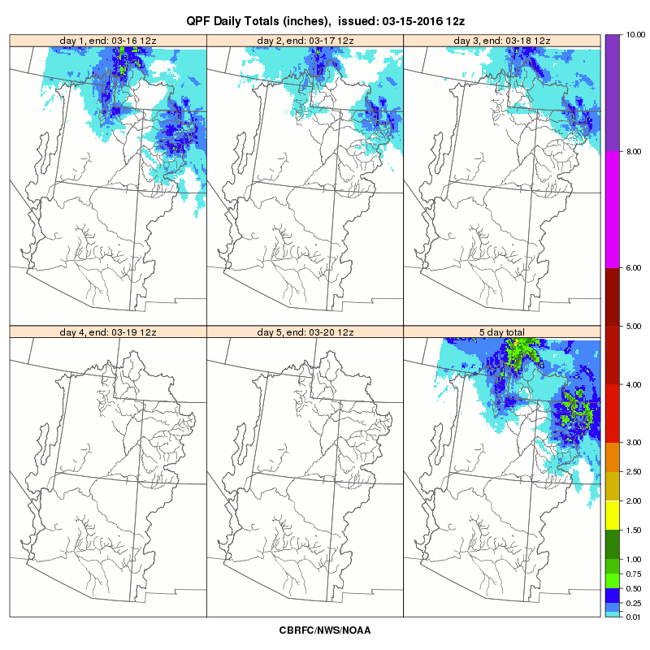
Short Range Weather Forecasts

Slide 9
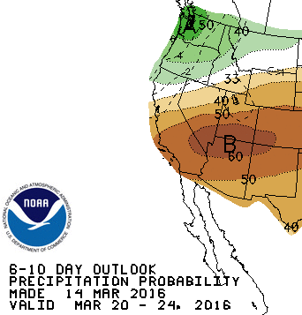
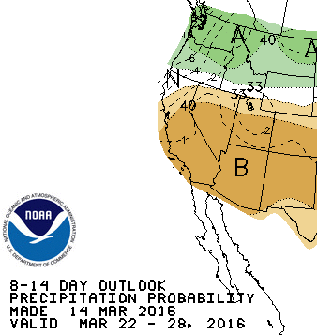
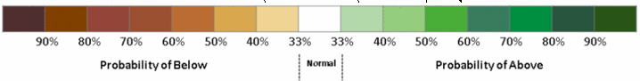
Medium Range Weather Forecasts

Slide 10
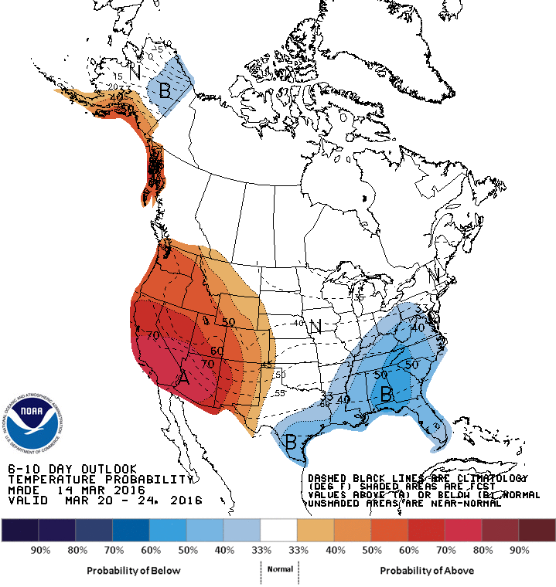
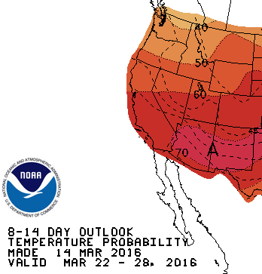
Medium Range Weather Forecasts

Slide 11
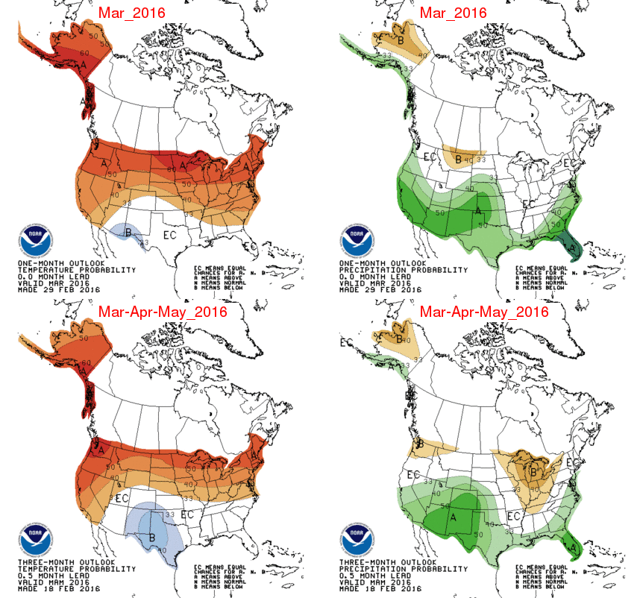
Climate Forecasts

Slide 12
ESP: % Volume Change 3/1 – 3/14
Raw ESP
0 Days QPF
Reservoir | 3/14 ESP (KAF) | 3/1 – 3/14 Change
Fontenelle | 520 / 71%** | +10 / +2%
Flaming Gorge | 625 / 64%** | -35 / -5%
Blue Mesa | 515 / 76% | -45 / -8%
McPhee | 260 / 88% | -30 / -11%
Navajo | 560 / 76% | -100/-15%
Lake Powell | 5050/71% | -500/9%
** ESP with 5 day QPF ~10 kaf higher

Slide 13
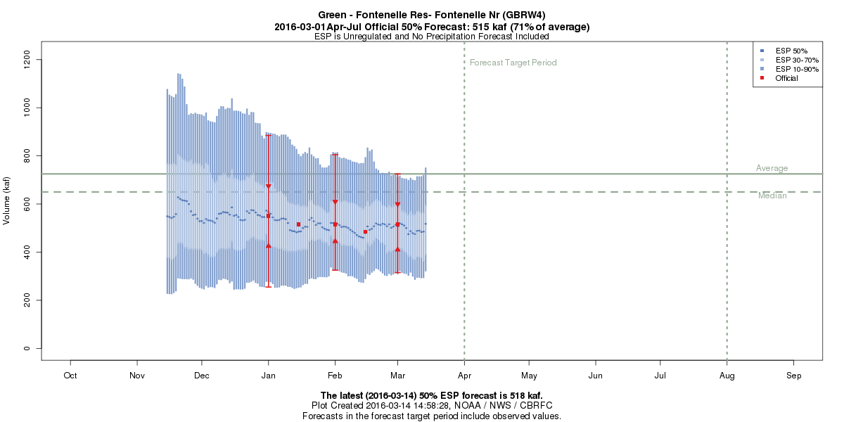
Forecast Evolution Plot
Fontenelle

Slide 14
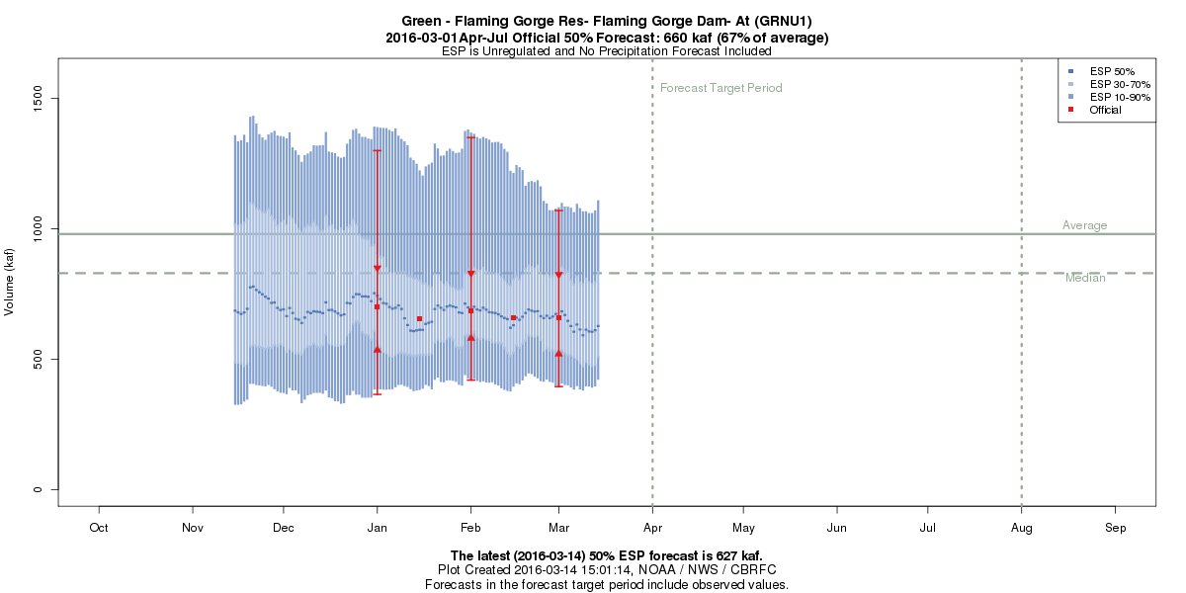
Forecast Evolution Plot
Flaming Gorge

Slide 15
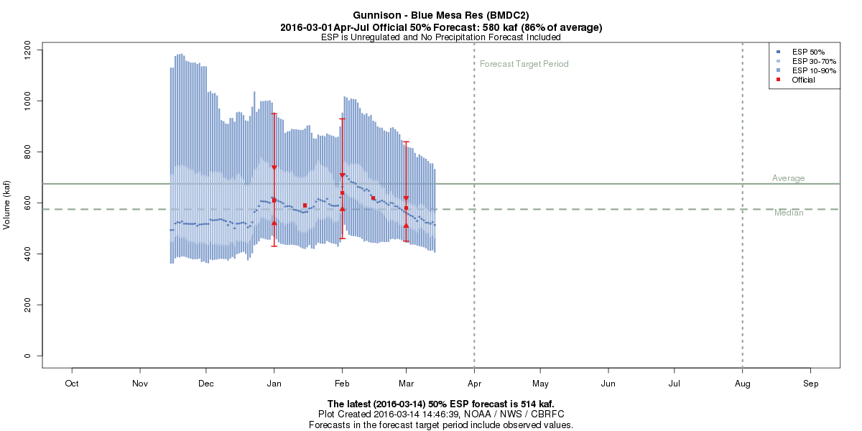
Forecast Evolution Plot
Blue Mesa

Slide 16
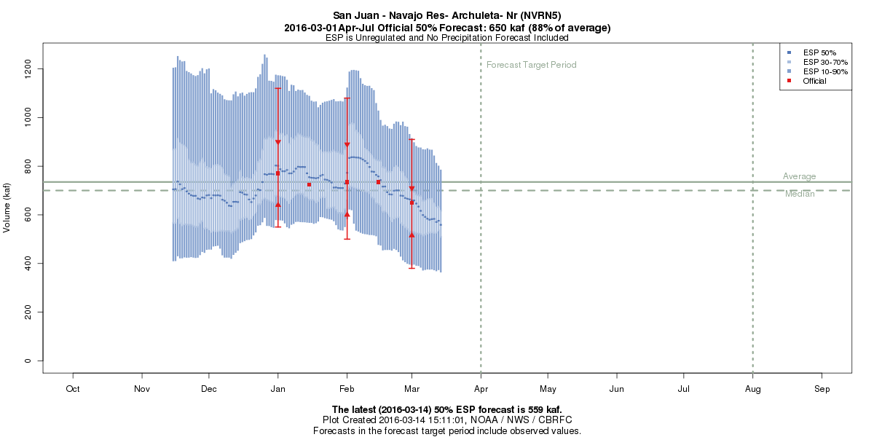
Forecast Evolution Plot
Navajo

Slide 17
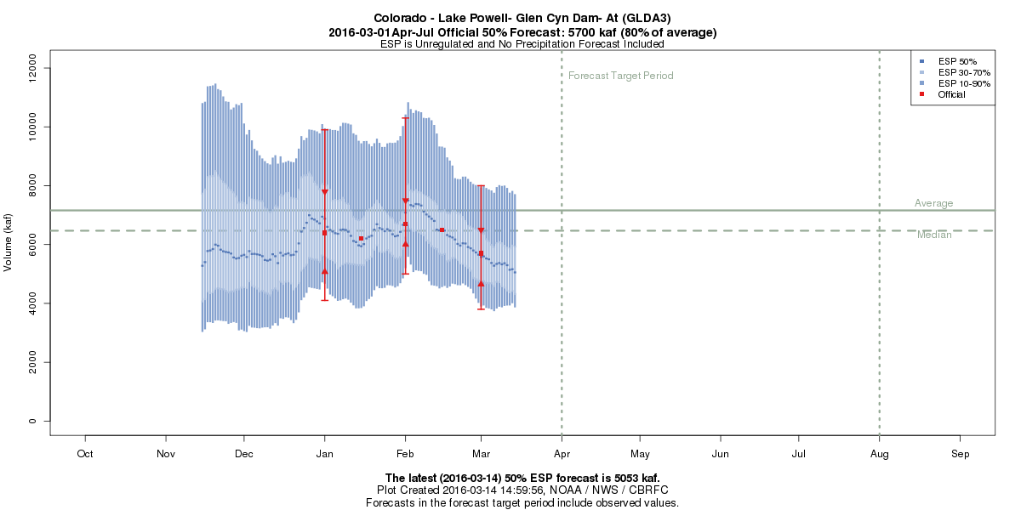
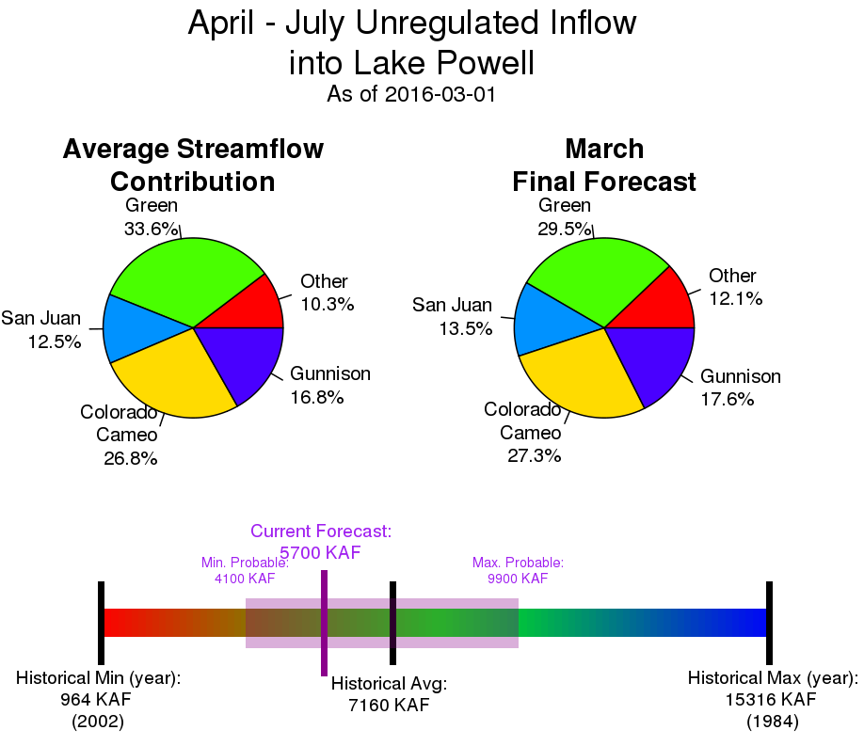
5700 KAF
80%
9019 KAF
83%

Slide 18
http://www.cbrfc.noaa.gov/dash/lp.php

Slide 19
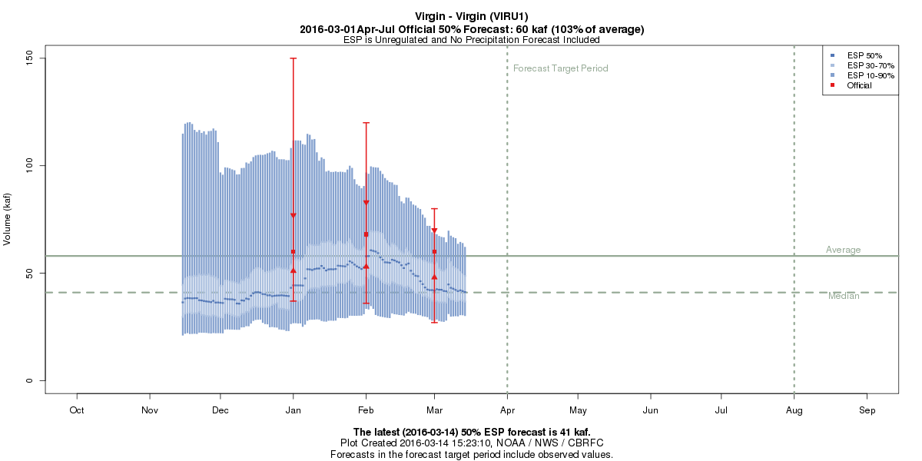
Forecast Evolution Plot
Virgin River
3/1 Forecast: 60 kaf / 103% average
3/14 ESP: 41 kaf / 72%

Slide 20
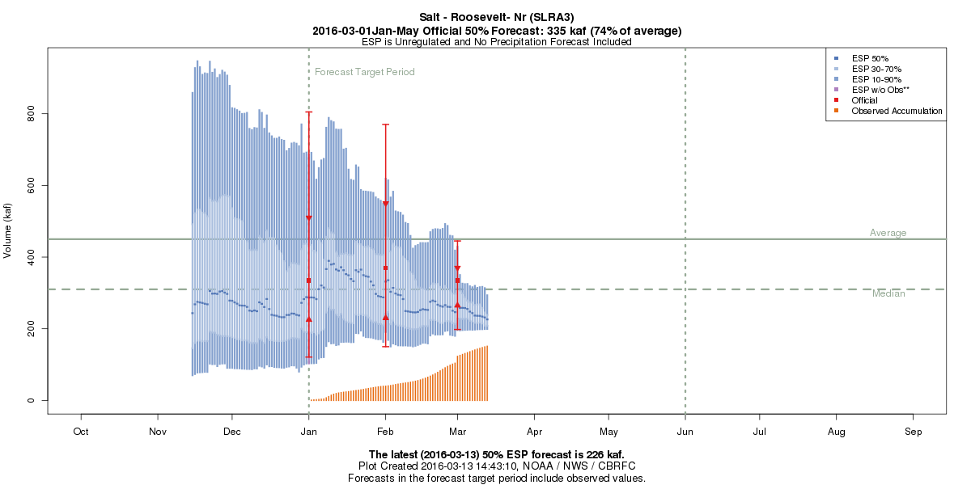
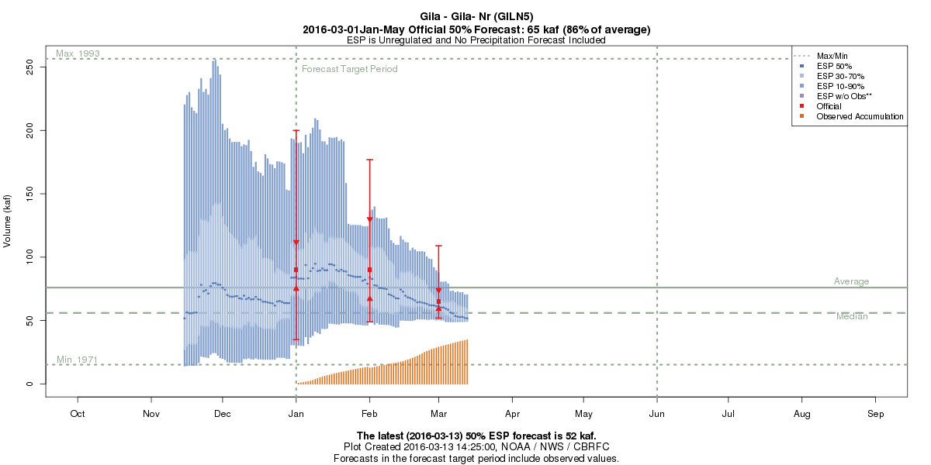
Forecast Evolution Plots – Arizona
3/1 Forecast: 335 kaf / 108% median
3/14 ESP: 226 kaf / 73%
Observed
3/1 Forecast: 65 kaf / 116% median
3/14 ESP: 50 kaf / 89%

Slide 21
Peak Flow Forecasts

Slide 22
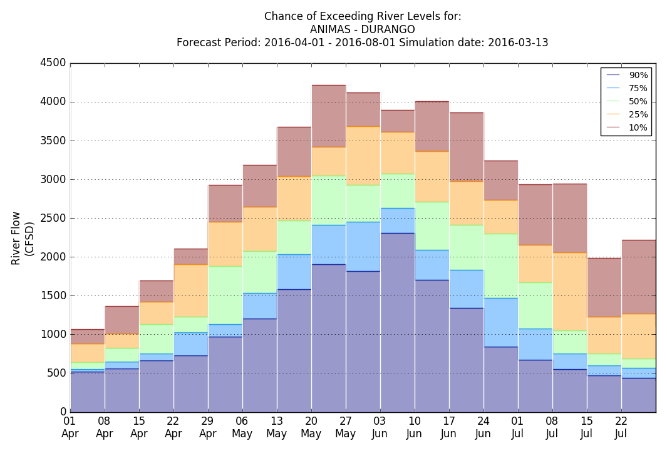
Peak Flow: Animas Durango – Weekly Exceedance Probabilities 2016

Slide 23
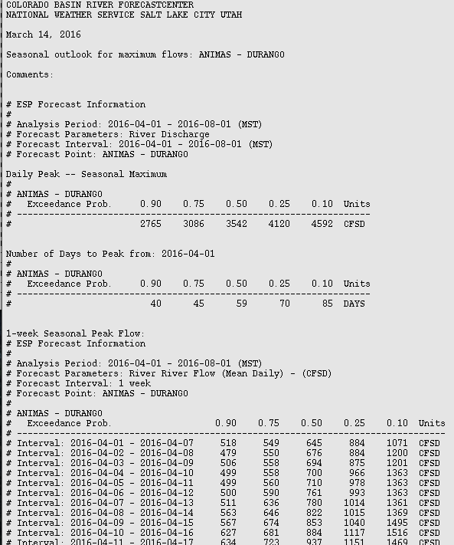
Peak Flow: Animas-Durango
Seasonal & Weekly exceedance probability text Based Product

Slide 24
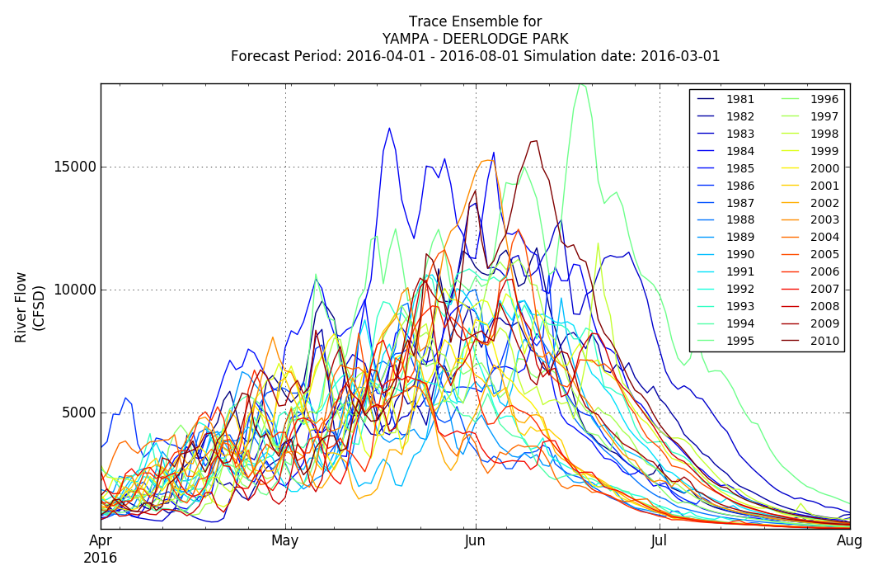
Peak Flow: Yampa-Deerlodge – ESP Trace Ensemble 2016

Slide 25
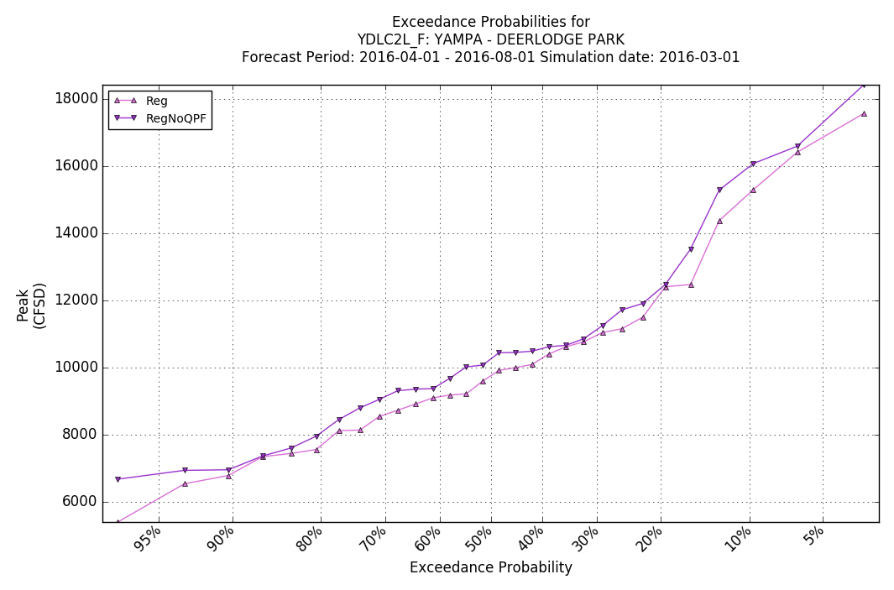
Peak Flow: Yampa-Deerlodge – April-July Exceedance Probabilities 2016

Slide 26
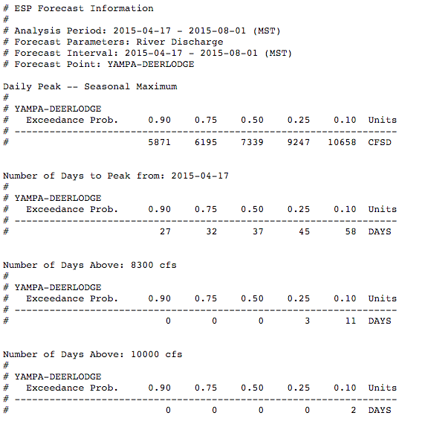
Peak Flow: Yampa-Deerlodge
Seasonal & Weekly exceedance probability text Based Product

Slide 27
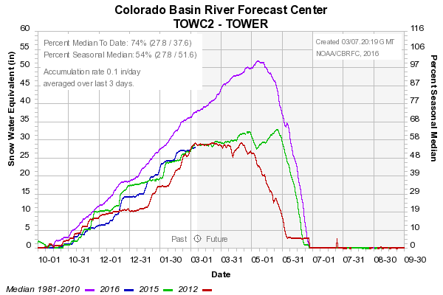
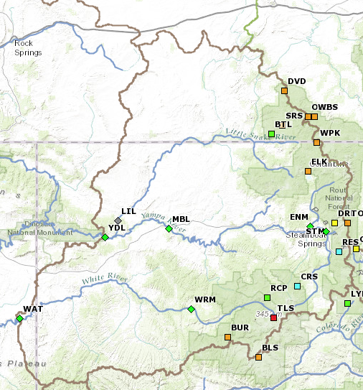
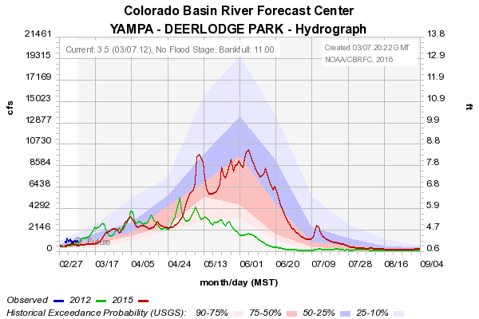
Impacts of Spring Weather
Yampa River Basin
2012
2015
2012: 5360 CFS
2015: 10,100 CFS
March 1 2012 Forecast
90%
7500
75%
8500
50%
10500
25%
13000
10%
15500
March 1 2015 Forecast
90%
7500
75%
8000
50%
10000
25%
11000
10%
15000

Slide 28
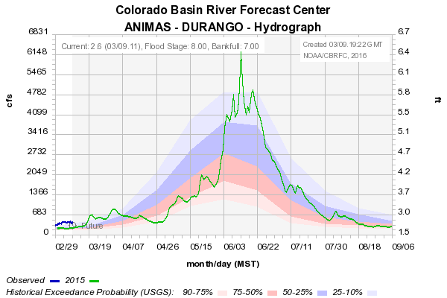
Impacts of Spring Weather
Animas – Durango March 1 2015 Forecast
90%
2200
75%
2700
50%
3200
25%
3700
10%
4100
Normal Peak Period 5/20 – 6/8
2015 Peak: 6210
6/12/2015
2015

Slide 29
CBRFC UPDATE

Slide 30
Calibration Period Extension
Plan to extend the hydrologic model calibration period through Water Year 2015
  Data:
    Add 5 years of data to input precipitation and temperature decks – period will become 1981-2015.
    We will also be collecting the last 5 years of reservoir and river flow data.
    Will not re-calculate averages – will still reference values to 1981-2010 statistics.
  Model calibration:
    Check model parameters, but don’t expect to make many changes.
    Plan to add some diversions in the Upper Green and Duchesne basins where real-time data has become available.
  Will be ready for implementation by December 2016.
    → 35 ESP traces based on 1981-2015

